Slide 1
工作汇报
吴 迪
2019.6.3

Slide 2
CenterNet
data: train 1684 test 800 validation 800
parameters:
“iterator”: 30000 (480000 iterators in the source code),
"learning_rate": 0.00025,
"batch_size": 2,
"decay_rate": 10,
"categories": 48,

Slide 3
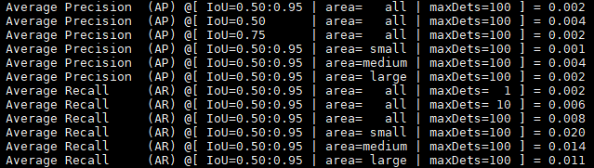
CenterNet
validation

Slide 4
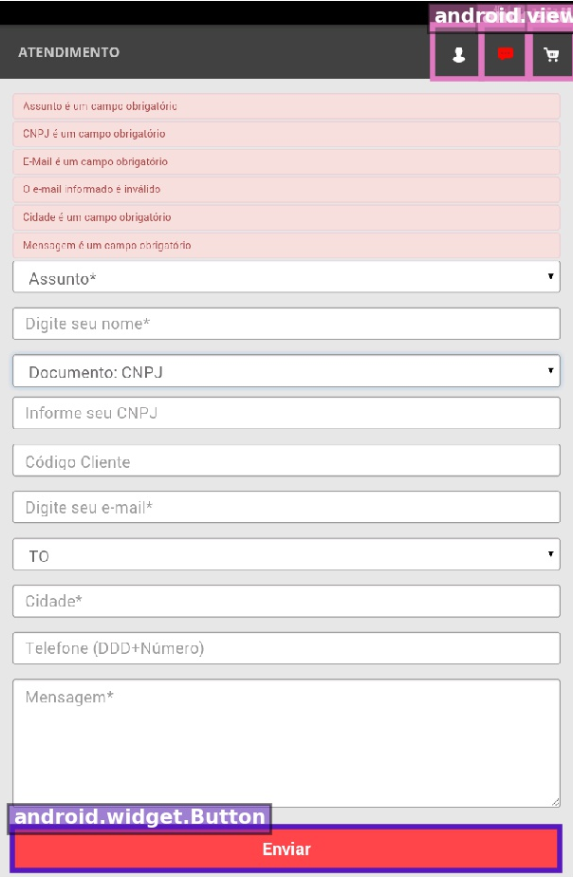
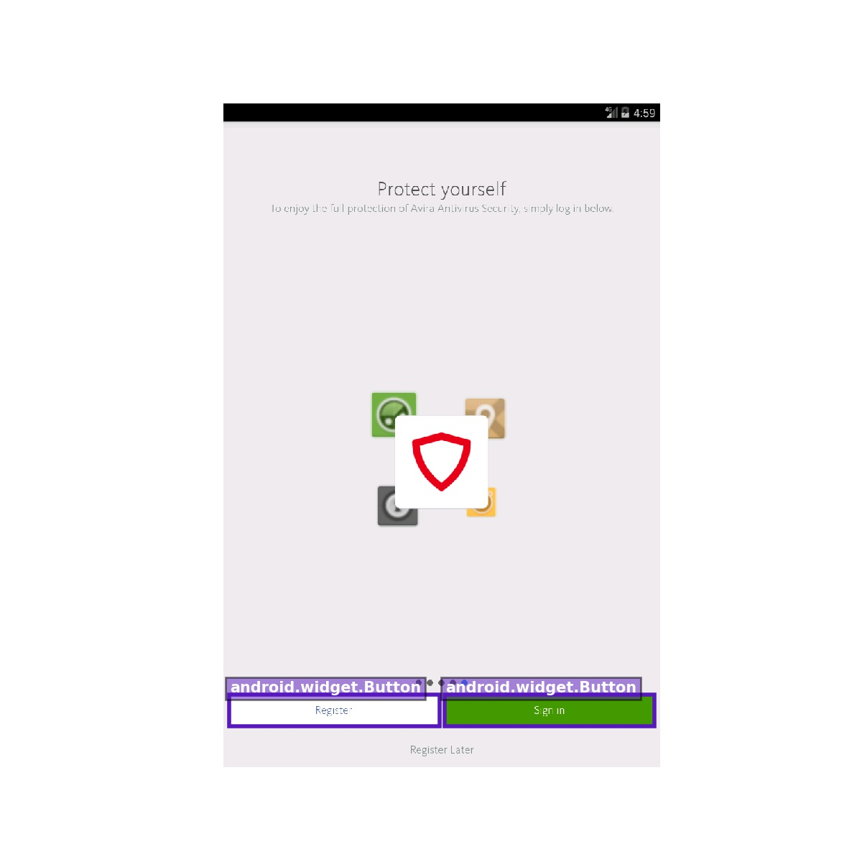

Slide 5
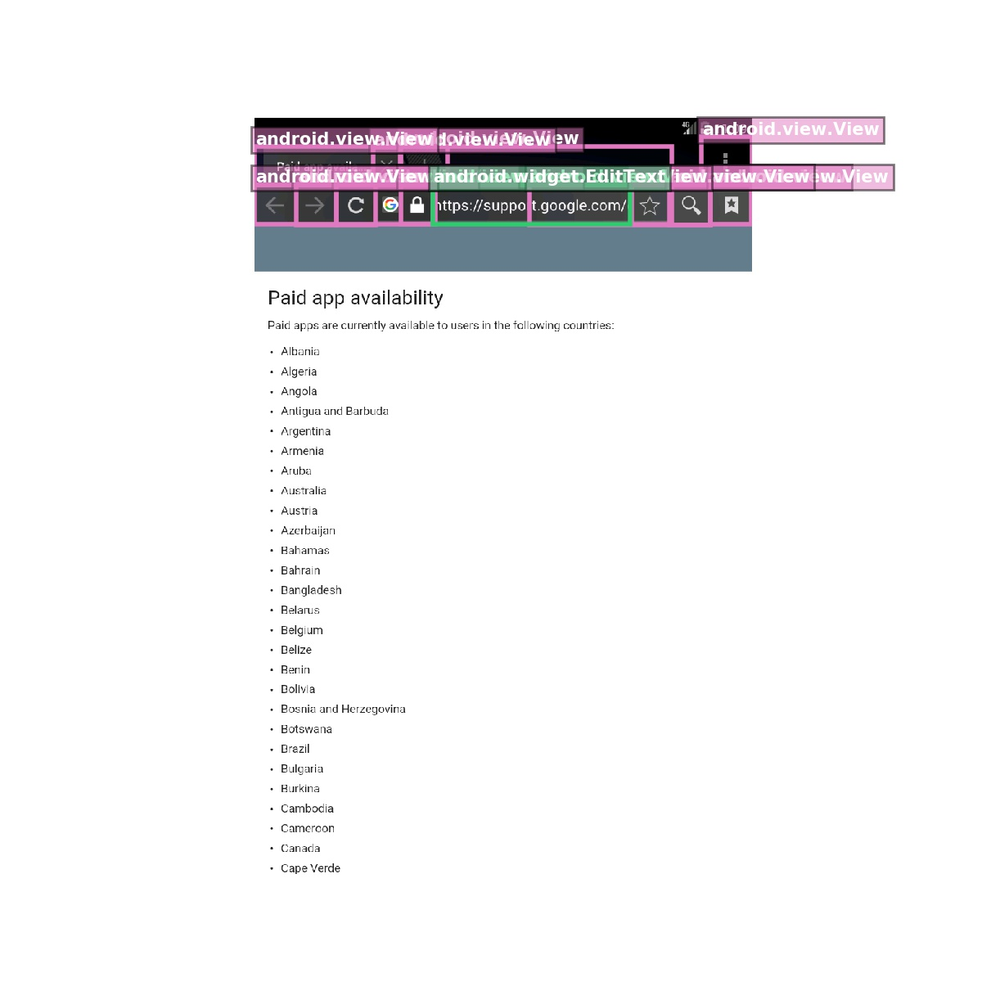
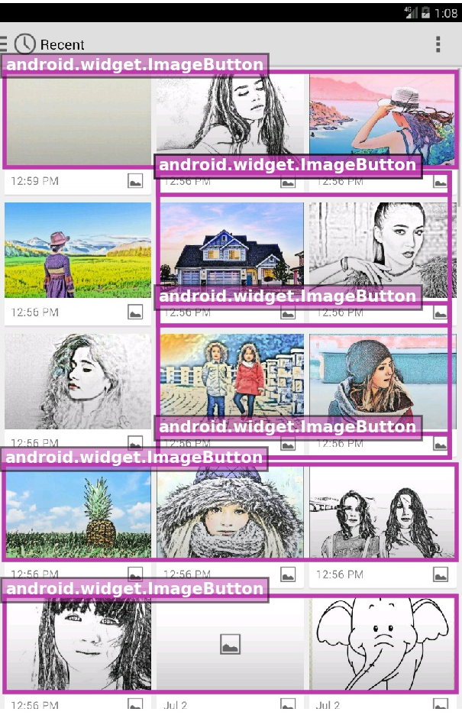

Slide 6
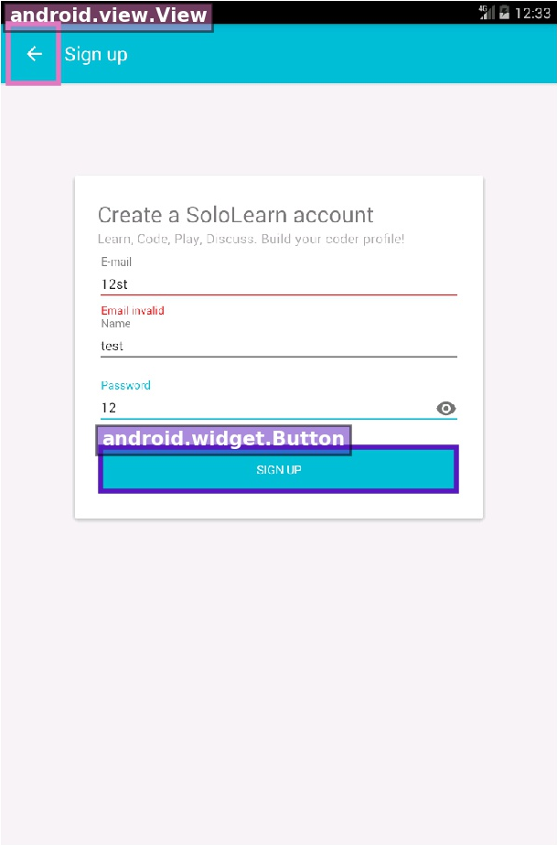

Slide 7
CornerNet-Lite
data: train 1684 test 869 validation 842
parameters:
“iterator”: 80000 (450000 iterators in the source code),
"learning_rate": 0.00025,
"batch_size": 2,
"decay_rate": 10,
"categories": 48,

Slide 8
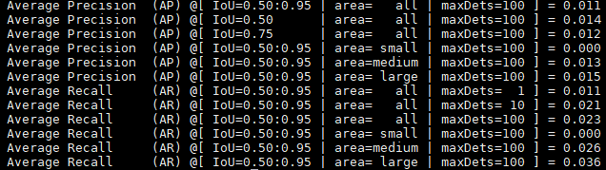
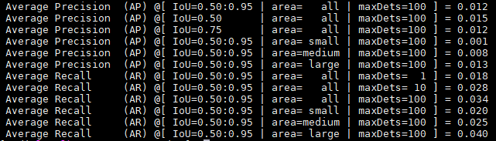
CornerNet-Lite
testing
validation

Slide 9
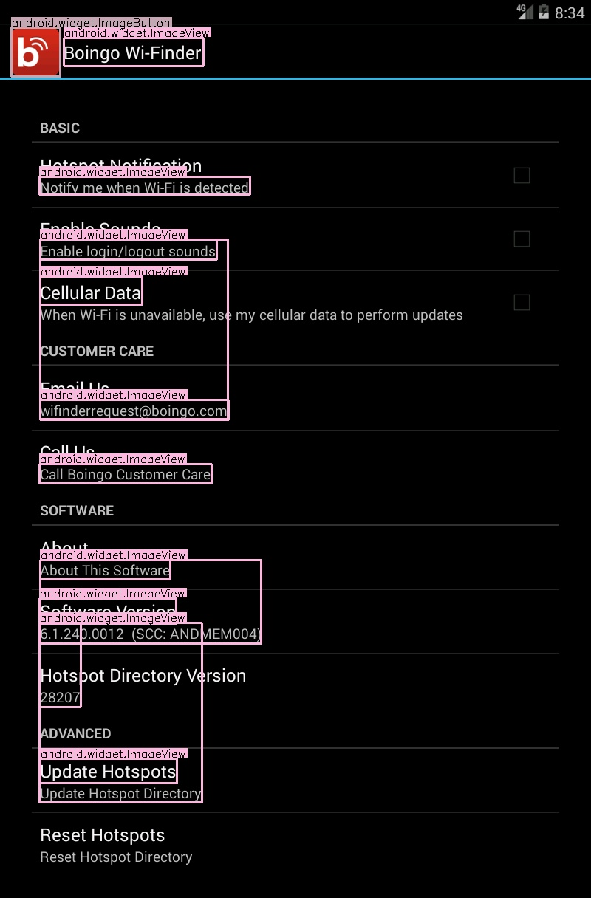
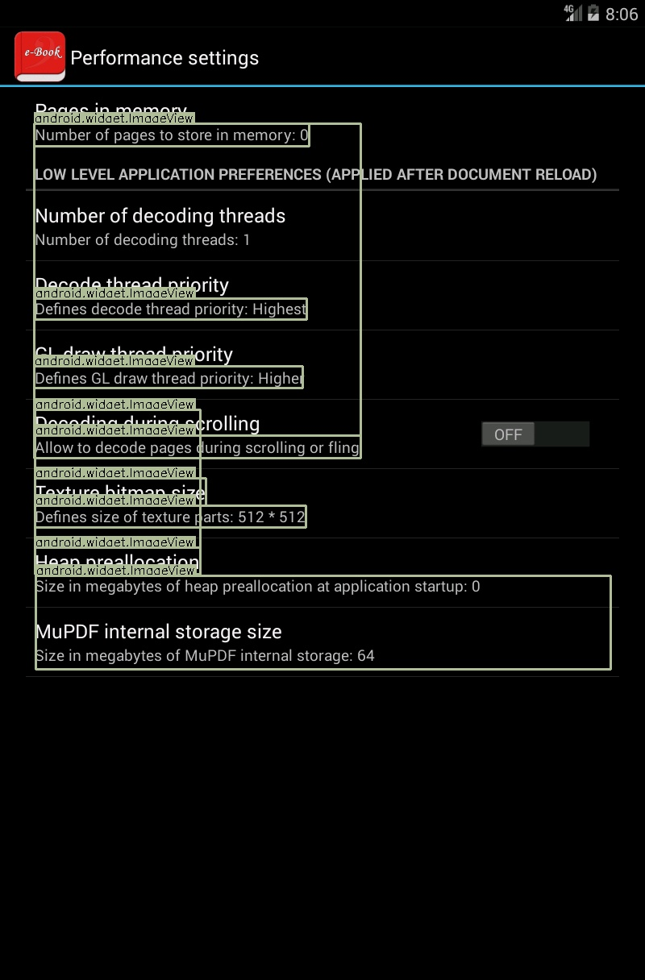

Slide 10
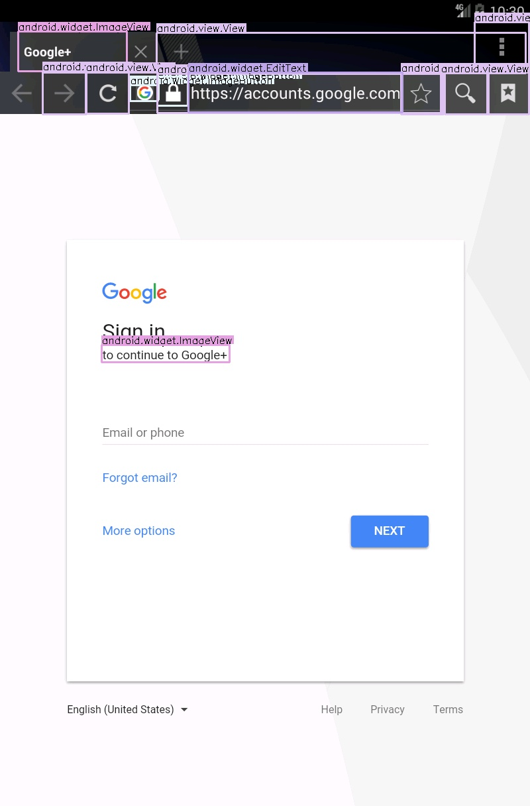
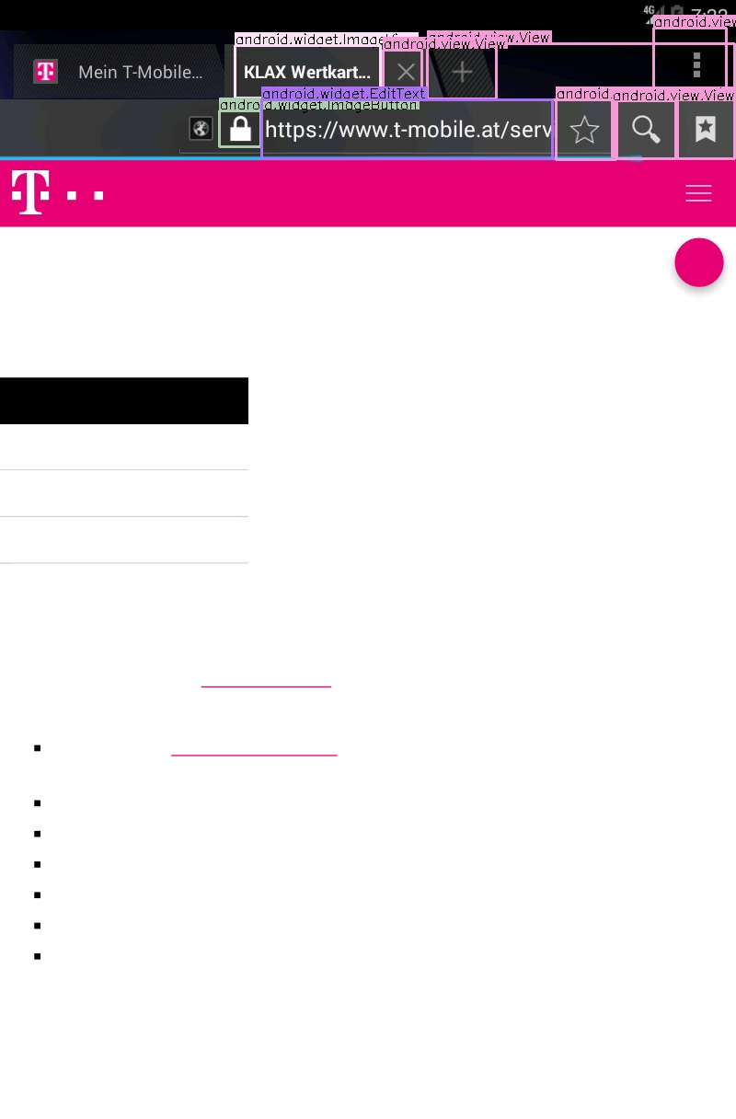

Slide 11
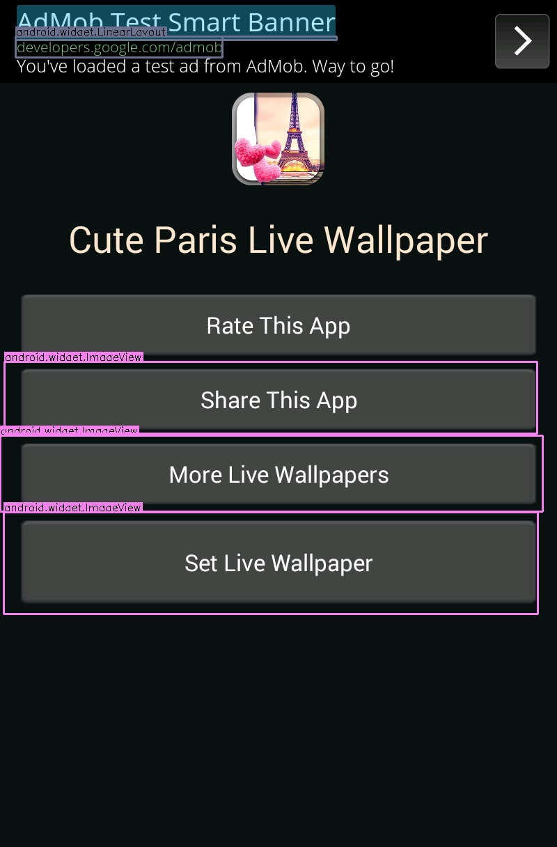
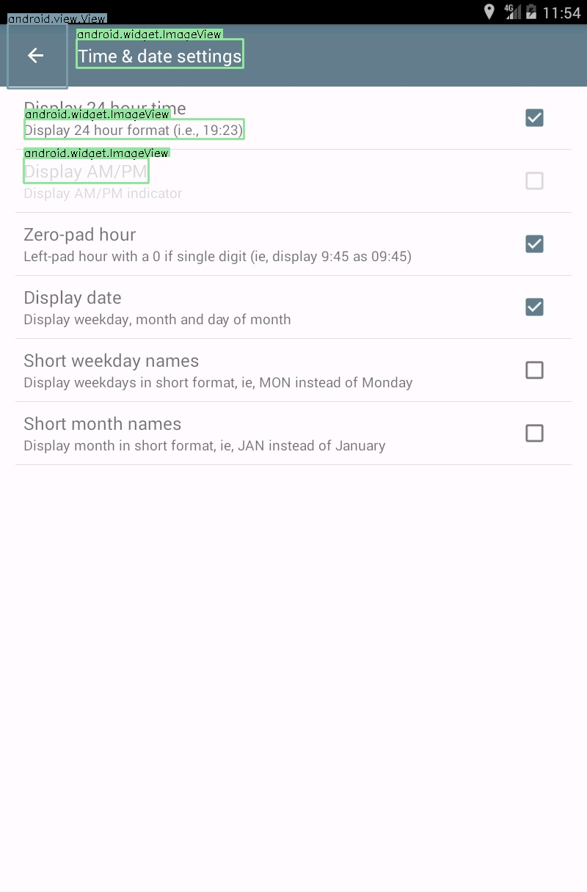

Slide 12



Slide 13
Plugins
XD environment doesn't import base64 code.
The problem in: data in Jimp function cannot be returned to xd, and data in Jimp function can't fill to shape in artboard.

