Slide 1
Weekly work
20190807shencz

Slide 2
CNN
Preprocess with visual samples
Get the weight and output of convolution layers, flatten layer and dense layer.
There are 512 filters with the size of 3, 4, 5, and convolution operation is carried out on the input samples. Get three output array with shape (398,1,512) (397,1,512) (396,1,512),(max-pooling)
Flatten this array and get a array with shape(1536,1), as the input of dense layer.
Get the index of max value on each filter. Each size of filter gets 512 index in total. Connect three matrix and get a 1536 matrix
Get the index in the connected matrix, one word may have many index.
Multiply the corresponding value of flatten layer and the corresponding value of corresponding dimension of the weight matrix of the full connection layer. Operate similar to softmax.
For one word, calculate the average probability. For other word, neutral with 0.5

Slide 3
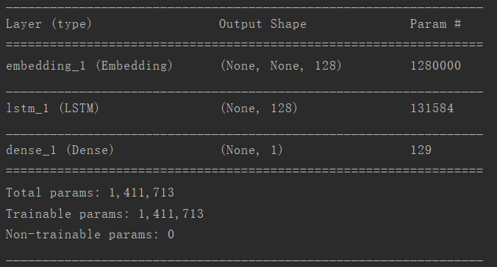
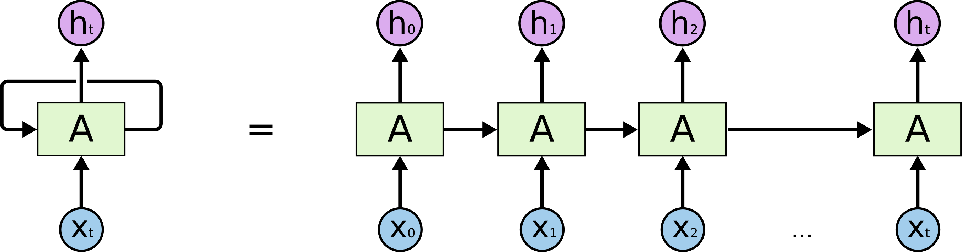

As an input to the full connectivity layer, ht is related to the current input Xt, the output of the previous time node, and the current cell state

