Slide 1
工作汇报
吴 迪
2019.10.21

Slide 2
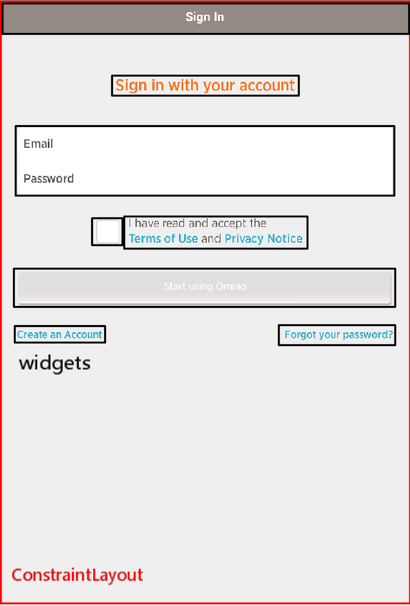
ConstraintLayout
ConstraintLayout: It was created to solve the problem of too much nesting of layout and to position and adjust widgets in a flexible way.
Can we generate a layout structure based
on ConstraintLayout?

Slide 3

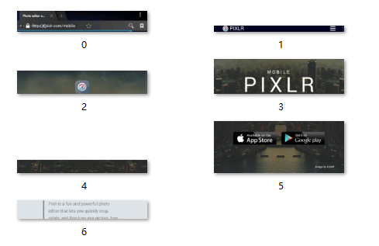
Hierarchy
Cut the image: cut horizontally, the segmentation is not accurate.

Slide 4
Metric
Calculate the similarity of tree structure ?
(It is easier if we use a constrained layout hierarchy.)
Calculate the accuracy of segmented GUI elements ?

