Slide 1
工作汇报
吴 迪
2019.5.20

Slide 2

Plugin：JavaScript Libraries
Cropper.js Glfx.js Filtrr2.js Process.js Grafi.js
These libraries use HTML elements <img> or <canvas>.
They are used in NodeJS and in the browser. And they can not crop image.
Caman.js Jimp.js
They are used in NodeJS and in the browser
XD plugin API environment is not a browser, nor is it Node.js. So the libraryies doesn't work in XD.

Slide 3
Faster-rcnn data processing
Resize images (800,1216,3)->(473,720,3)
Scale down the bounding box coordinates.
Bounding box coordinates in the XML file may negative, zero or over the image boundary, resize the coordinates to 0 or image boundary.
Extract the categories in the XML files.

Slide 4
Partial data
420 UIs
277 for training 143 for testing
Problems: loss = nan
reduce learning rate
reduce batch size
Batch norm

Slide 5
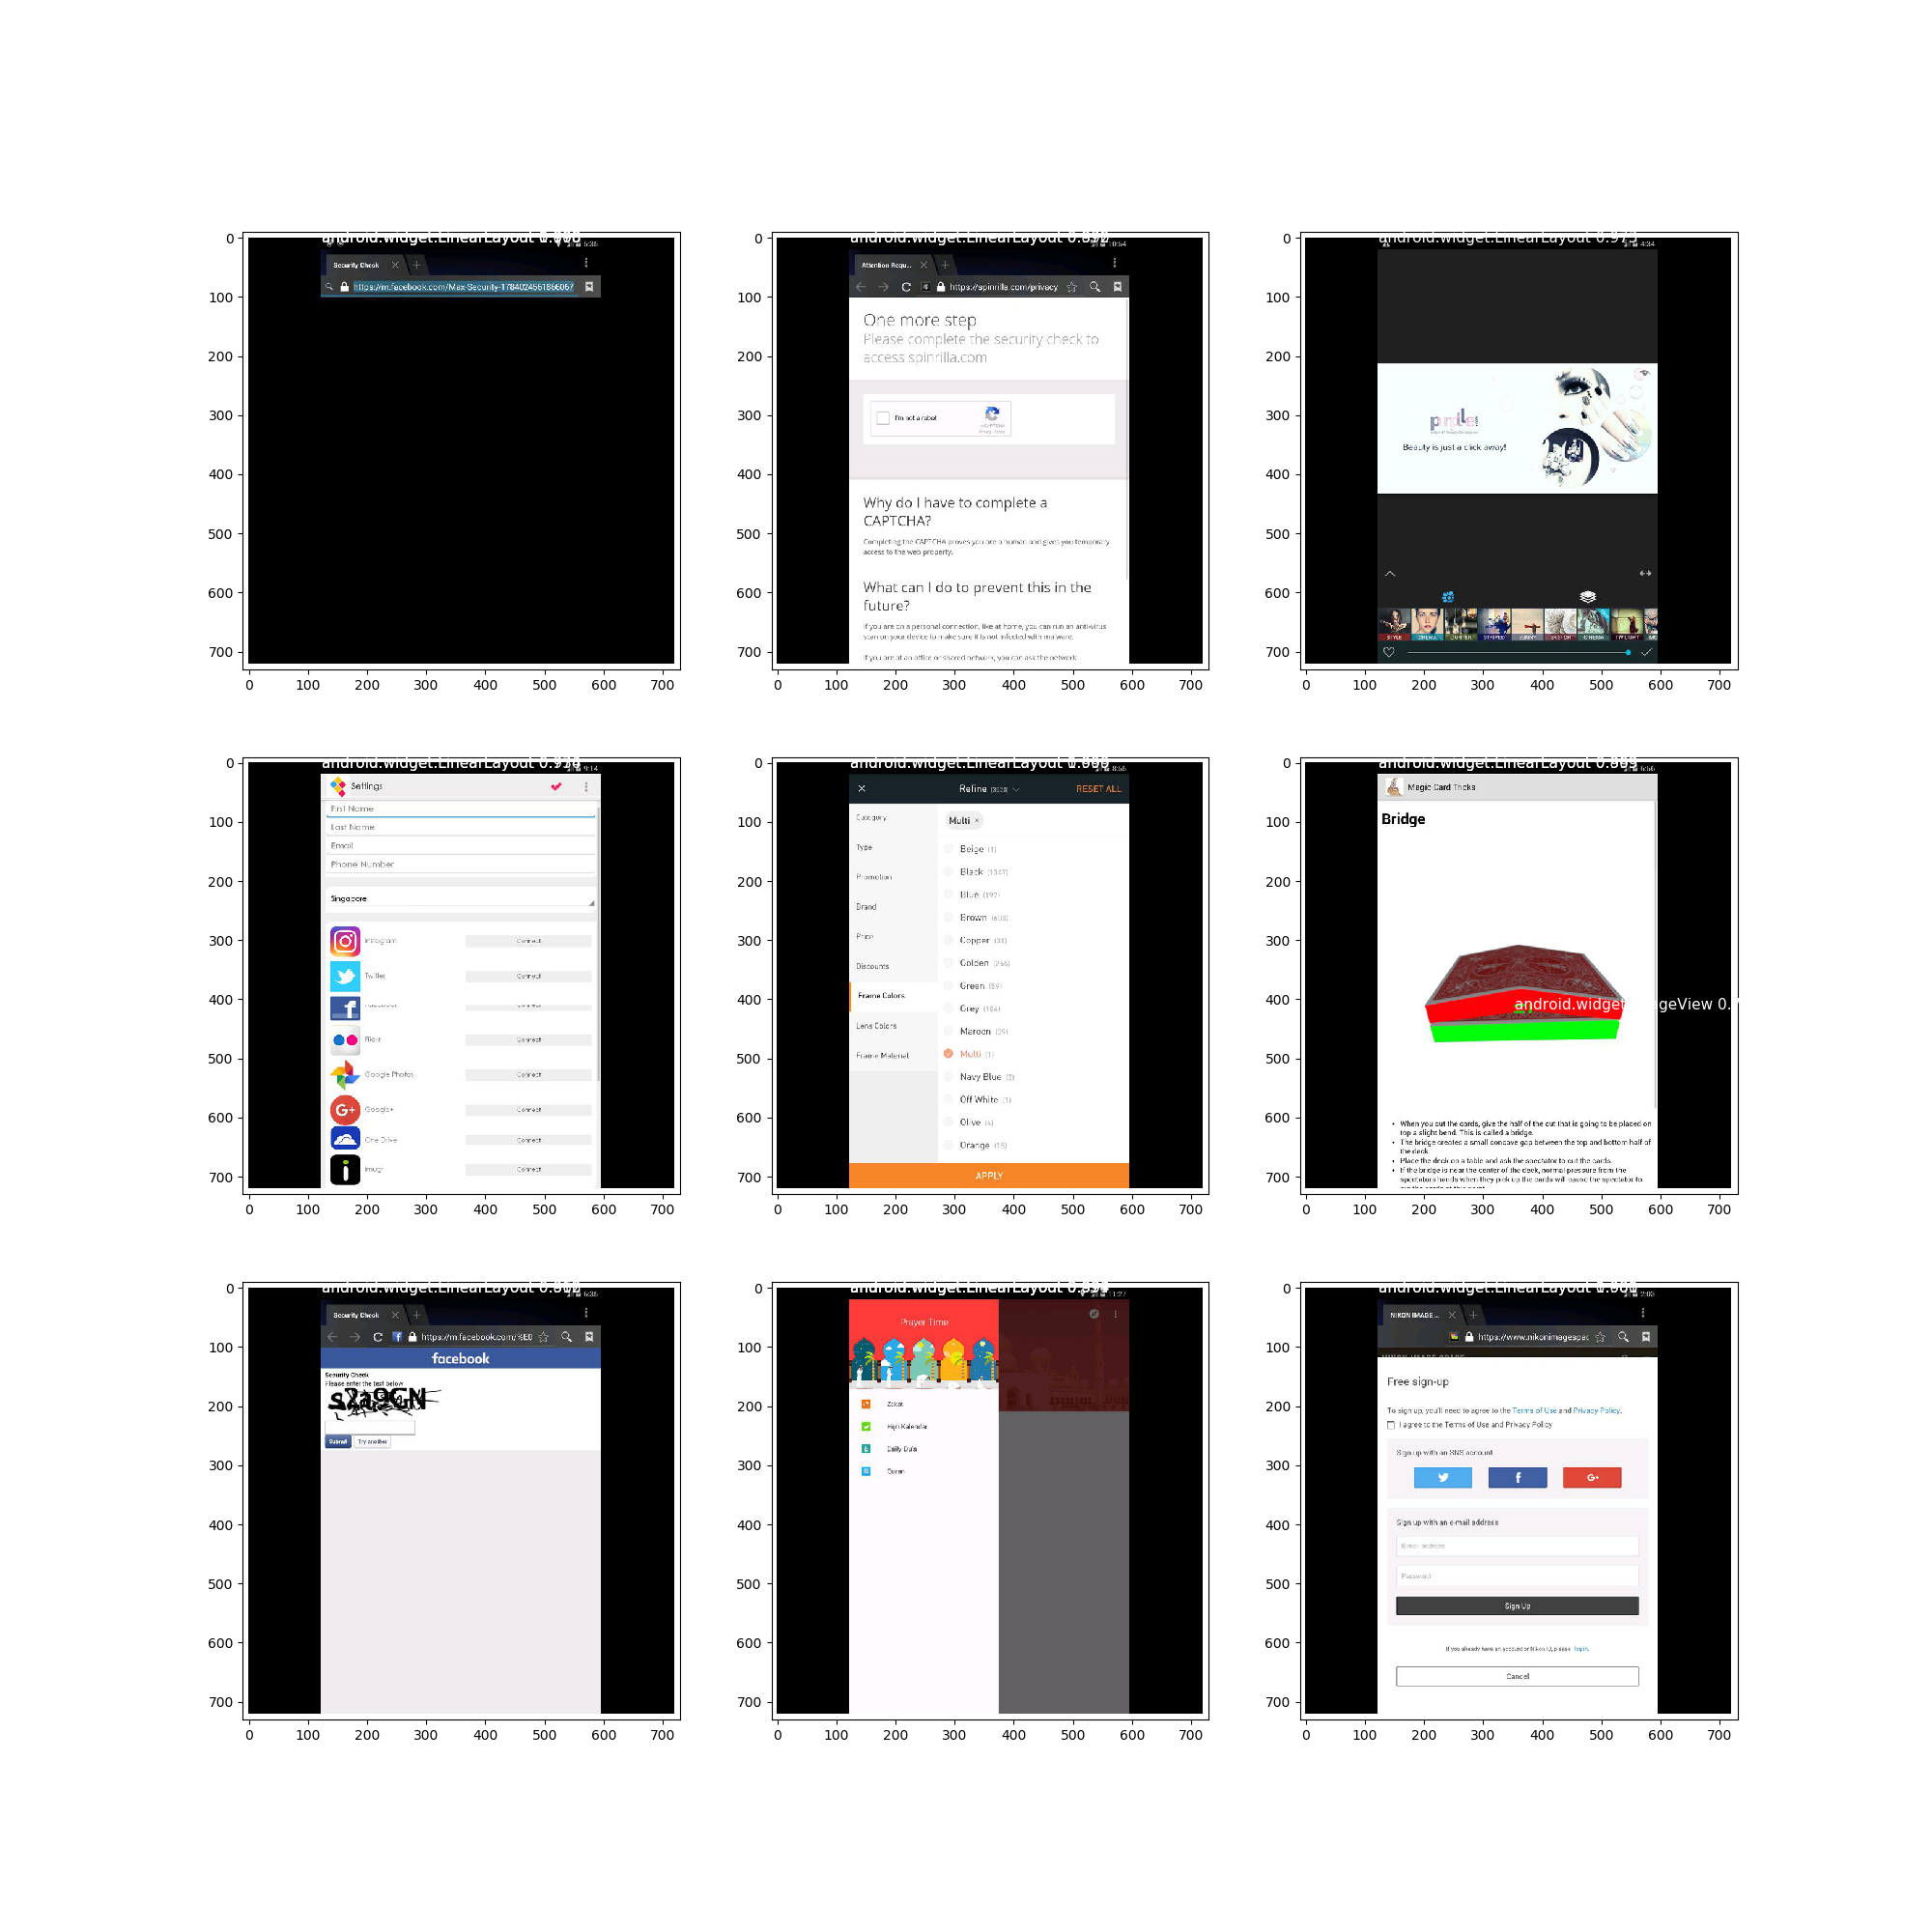

Slide 6
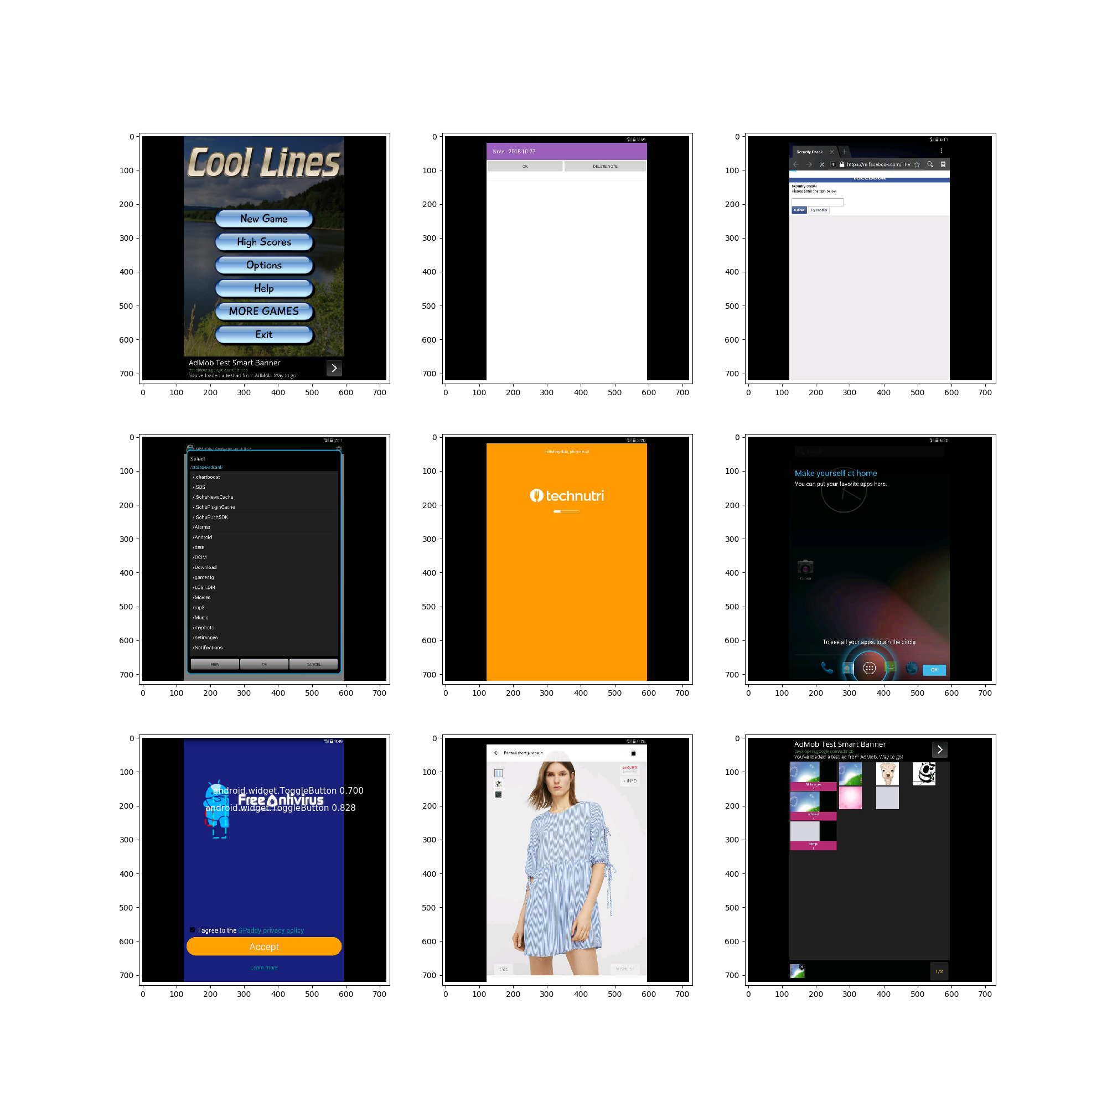

Slide 7
