Slide 1
工作汇报
吴 迪
2019.5.6

Slide 2
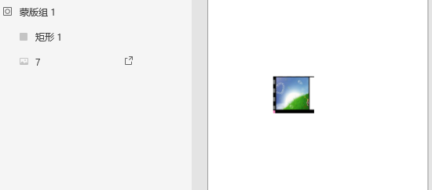
Plugin
Cut image
1. XD JavaScript API - maskgroup
It can cut image, but it exist as picture and shape.

Slide 3
Plugin
Cut image
2. cropper.js JCrop
JavaScript image cropper, It encapsulates the functionality of the front end, which can no longer be processed by the back end.
Notes:
这些方法都是与前端交互，无法再后端直接使用

Slide 4
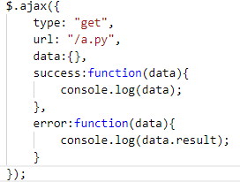
Plugin
Cut image
3. jQuery
Using jquery or ajax load python function, but it return file content not the function.

Slide 5
Faster-RCNN
Network structure:
VGG/ResNet50+RPN(Region Proposal Network)+fast-rcnn
Code from github:
Backbone network: ResNet50
Pascal VOC2007 dataset

Slide 6
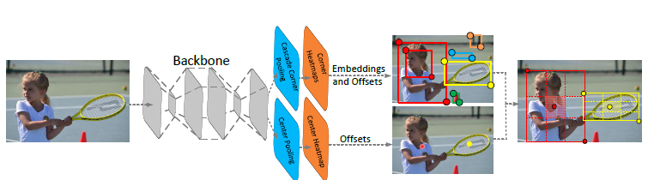
CenterNet
Network structure:
Based on Cornernet: Detecting objects as paired keypoints.

Slide 7
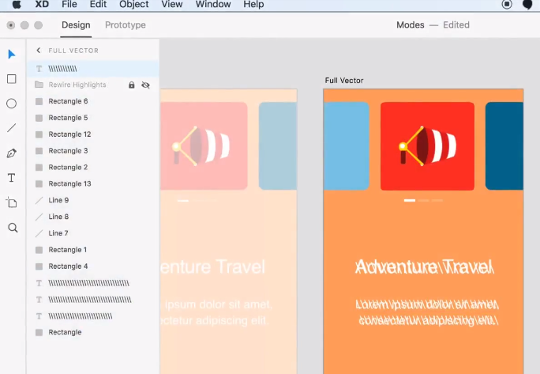
Problems
Image to artboard
What should I do about the model next step?

