Slide 1
工作汇报
吴 迪
2019.4.23

Slide 2
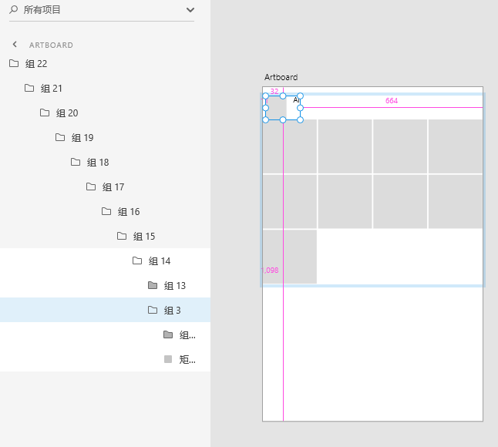
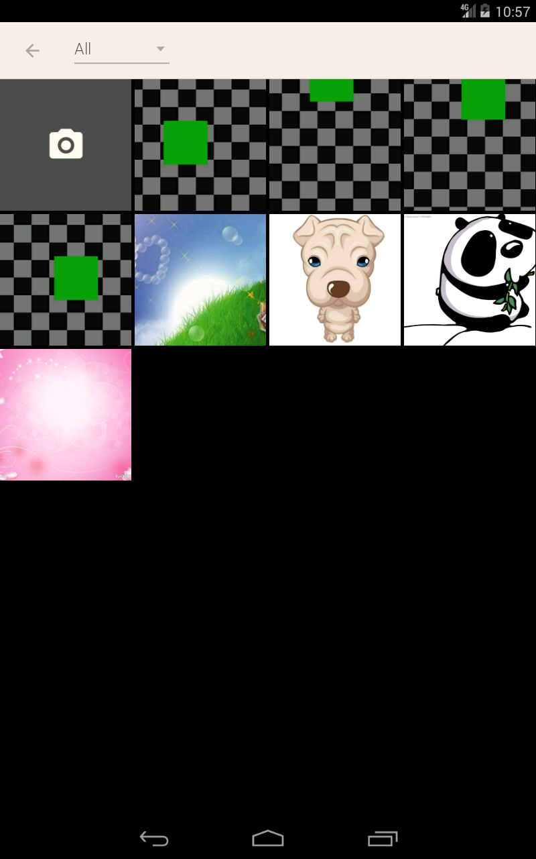
Plugin

Slide 3
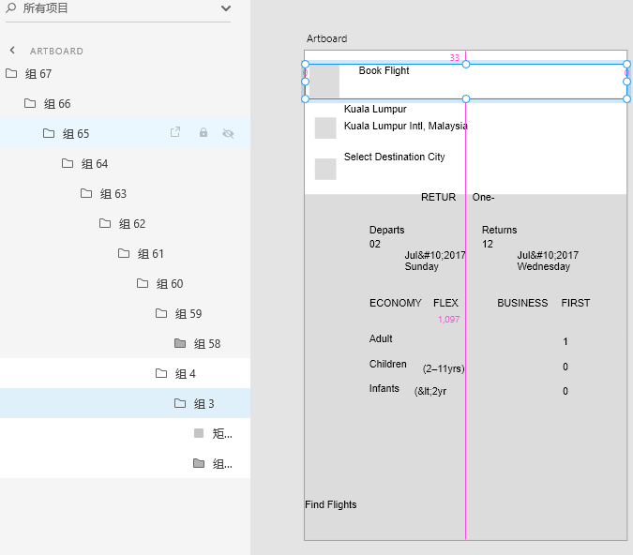
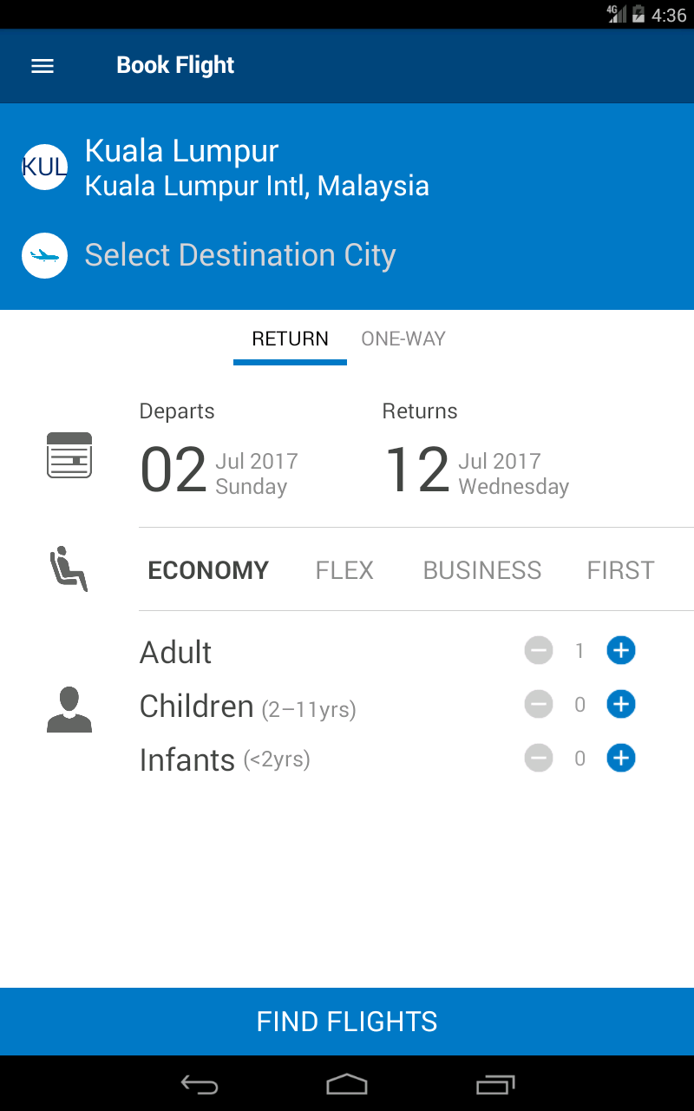
plugin

Slide 4
Dataset
4496 apps
Delete UIs that do not have XML files
apps with non-English fonts
Processing completed
2566 apps

Slide 5
Text precision and Recall
prediction as text ∩ ground truth
1).ground truth text contains predictive text
2).predictive text contains ground truth text:
area_truth/area_predictive_text >= 0.80
3).interset:
area_interset/area_predictive_text >= 0.80
pre_text = len(Text.blocksInALine) precision = pre_truth_text/pre_text
if attribute text has value : text_num recall = pre_truth_text/text_num

Slide 6
Image precision and Recall
prediction as image ∩ ground truth
1).ground truth text contains predictive text
area_truth/area_predictive_text >= 0.80
2).predictive text contains ground truth text:
area_truth/area_predictive_text >= 0.80
3).interset:
iou >= 0.8 (might be better to change it to 0.7)
pre_image = len(Hierarchy.rootView) precision = pre_truth_image/pre_image
if attribute text has value : image_num recall = pre_truth_image/image_num

Slide 7
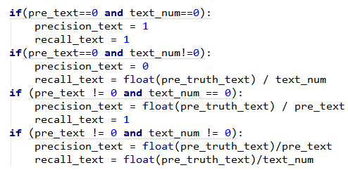
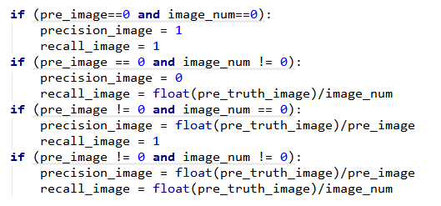
Special case
pre_text (pre_image)=0 or text_num (image_num)=0
text: image:

Slide 8
Result
ramdom_data 2566 UIs

Slide 9
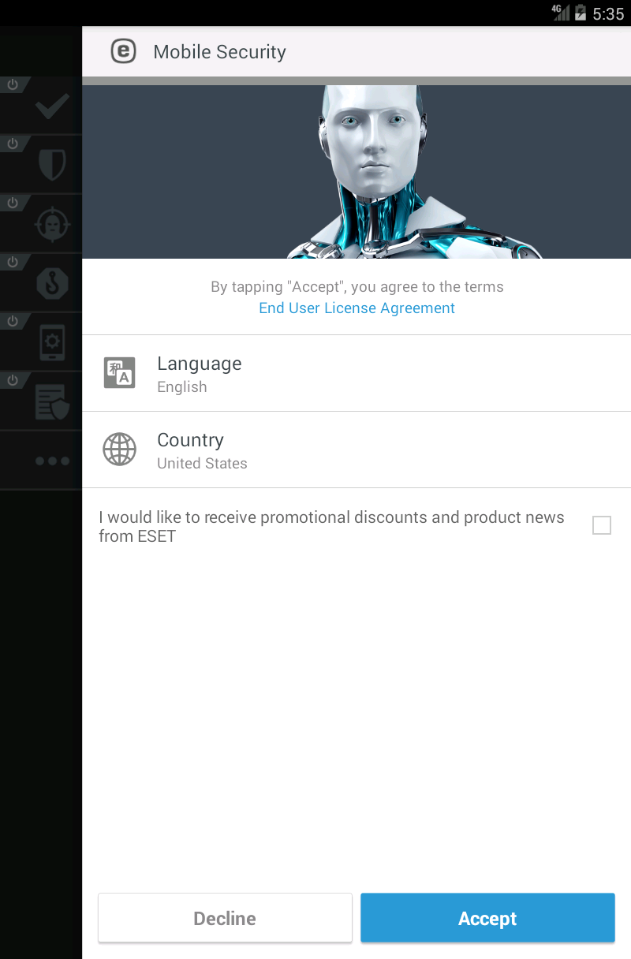
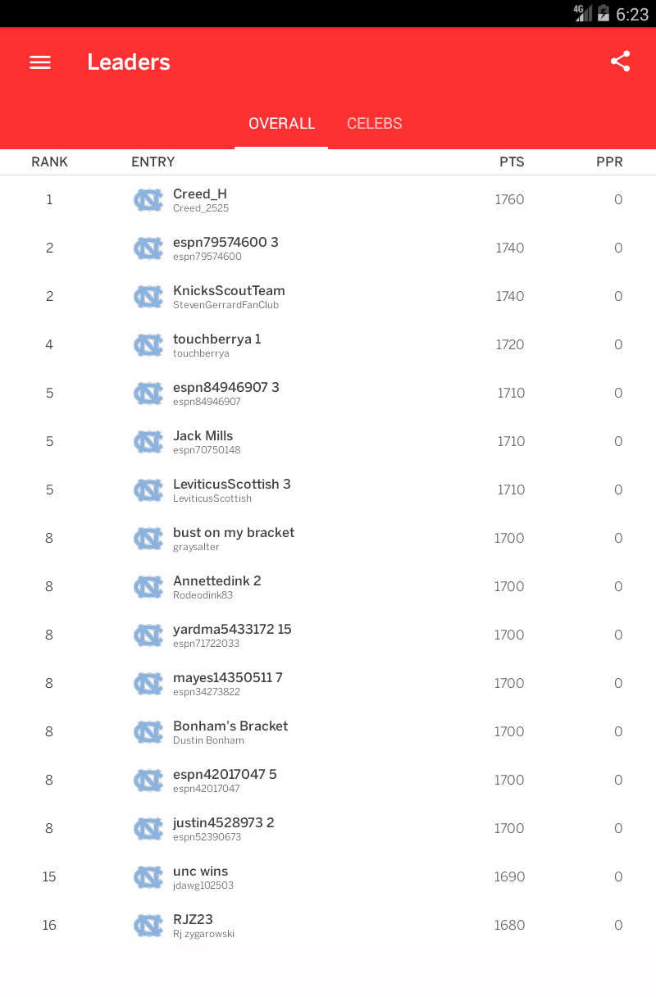


1. 2.

Slide 10
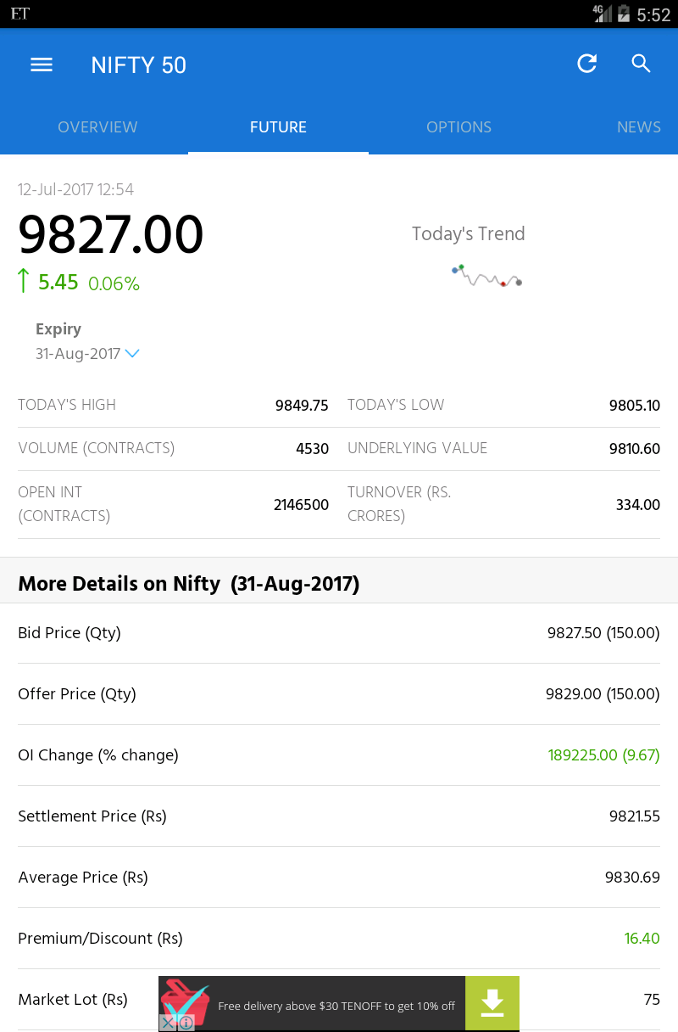
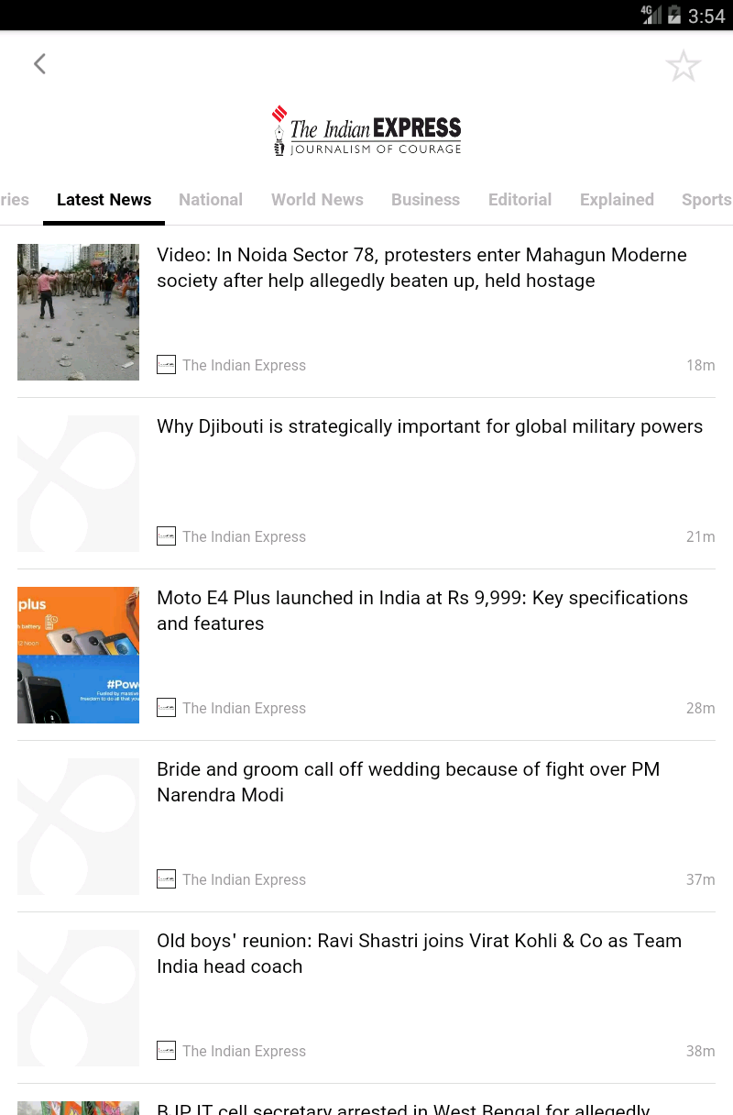


3. 4.

Slide 11
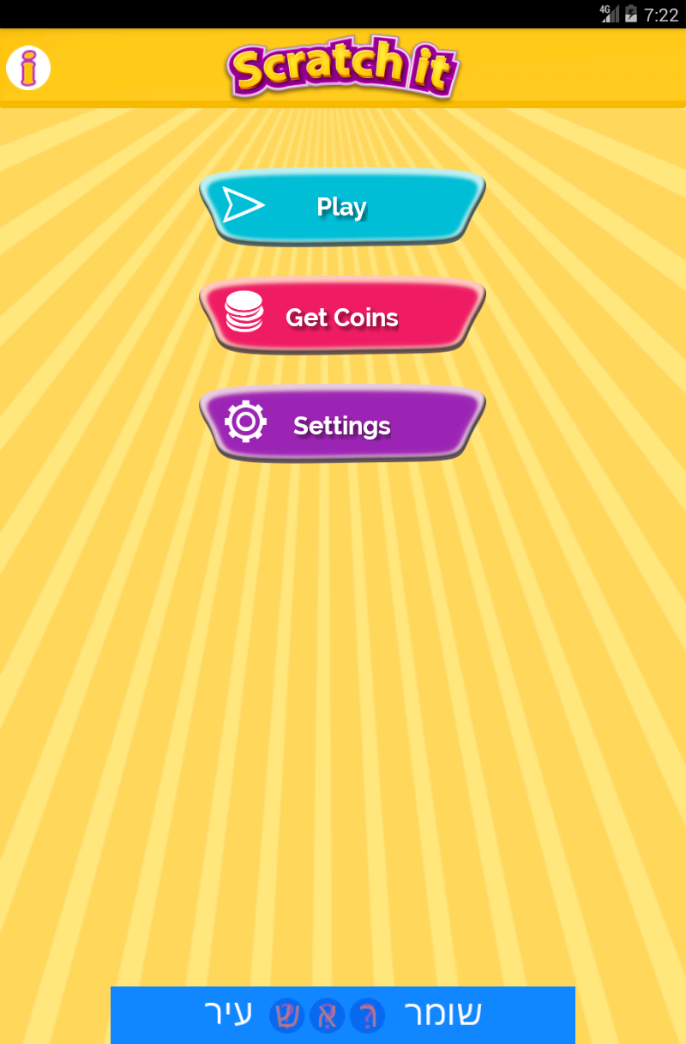
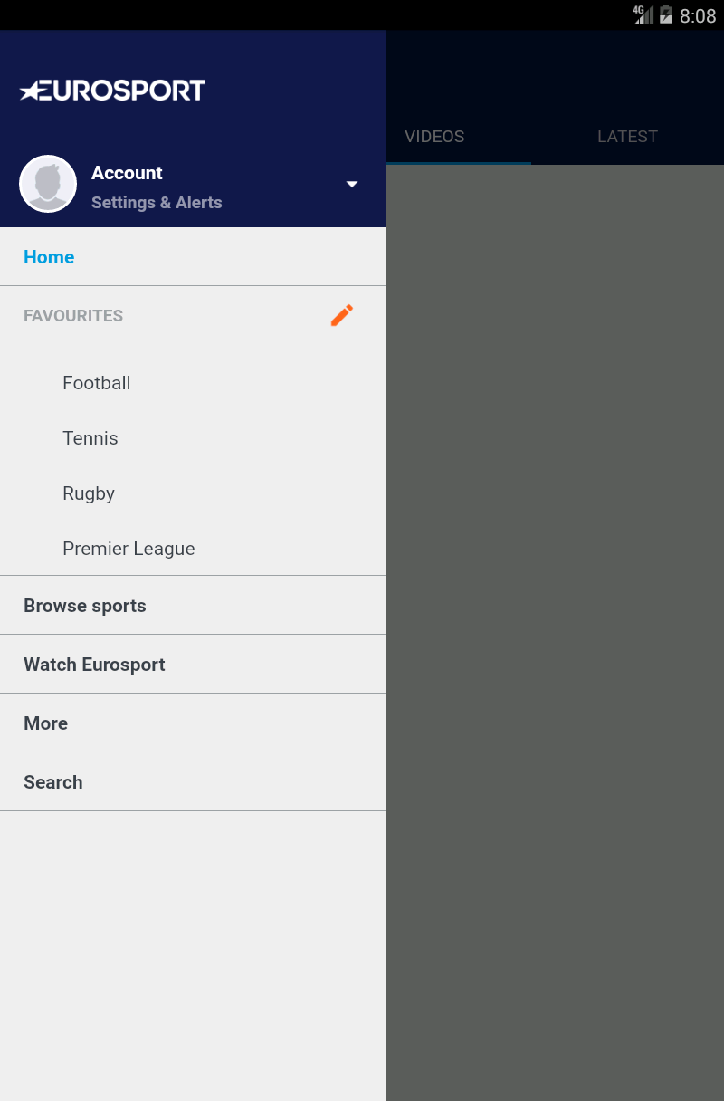


5. 6.

