Slide 1
Weekly work
shencz

Slide 2
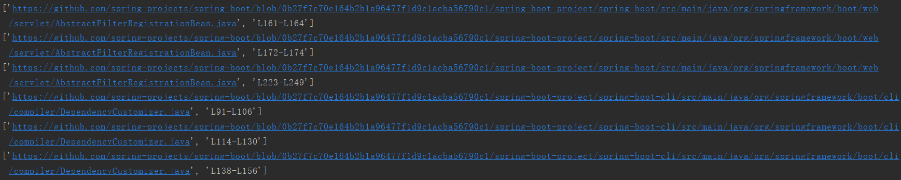
Crawl data
Each json file contains 30,000 pieces of data
Extract the url of data and remove duplicate connections. Get 8381 in total
Crawl 1015 URLs, get jave file

Slide 3
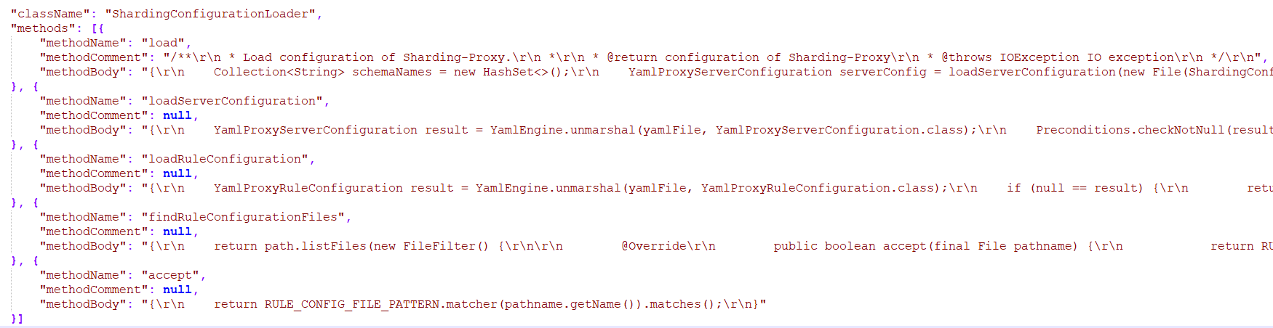
Data cleaning

Slide 4
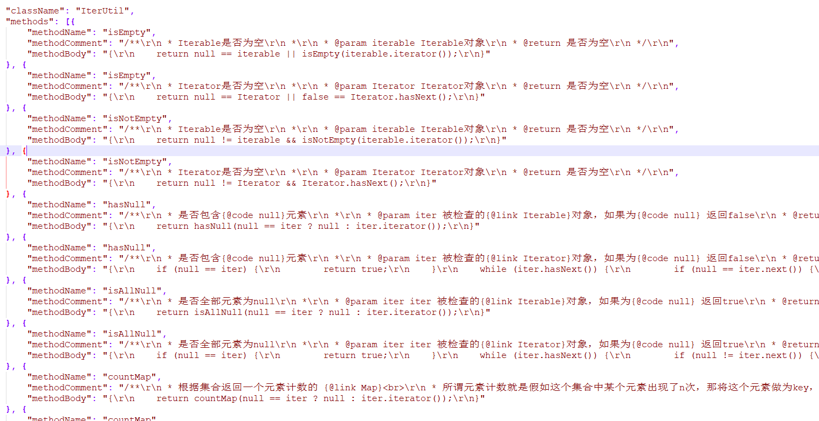
Questions
Model structure
How to combine context comments body
How to get input vector
Attention
Data processing
Parameters list
Chinese and English
Method name

