Slide 1
工作汇报
吴 迪
2019.7.15

Slide 2
Components categories
android.widget.TextView: 292452 51.6172 % 显示字符串的
android.widget.Button: 31865 5.6241 % 按钮
android.widget.ImageView: 159195 28.0976 % 显示图片
android.widget.CheckBox: 7145 1.2611 % 方形复选框
android.widget.ProgressBar: 1906 0.3364 % 进度条
android.widget.SeekBar: 949 0.1675 % 拖动条
android.widget.ImageButton: 45421 8.0167 % 图片按钮
android.widget.EditText: 11493 2.0285 % 用来输入文本的
android.widget.Image: 7172 1.2658 % 图片
android.widget.RadioButton: 2634 0.4649 % 圆形单选框
android.widget.ToggleButton: 952 0.1680 % 状态开关按钮
android.widget.CheckedTextView: 2842 0.5016 % 判断字符串显示
android.widget.Switch: 899 0.1587 % 开关控件

Slide 3
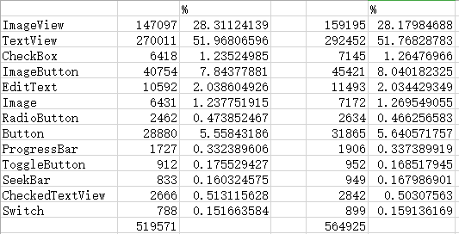
Remove duplicate threshold = 0.94 0.90

Slide 4
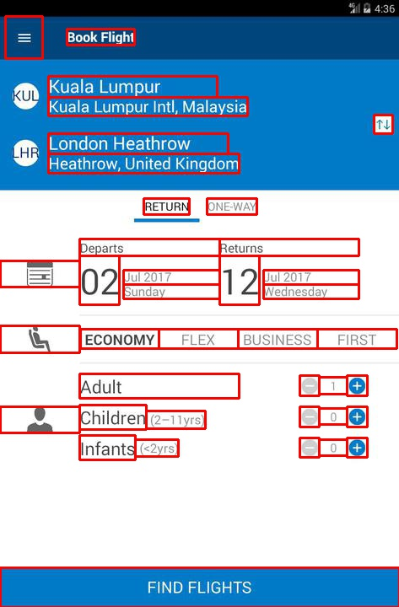
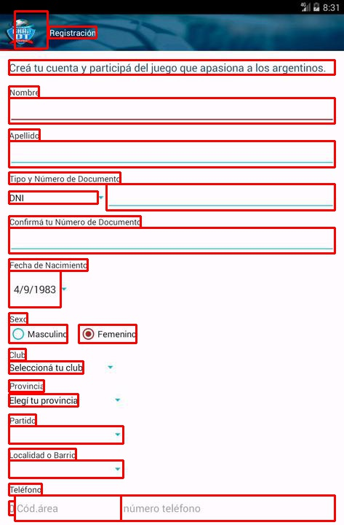
android.widget.RadioButton
Notes:
增加包含少量components的ui

Slide 5
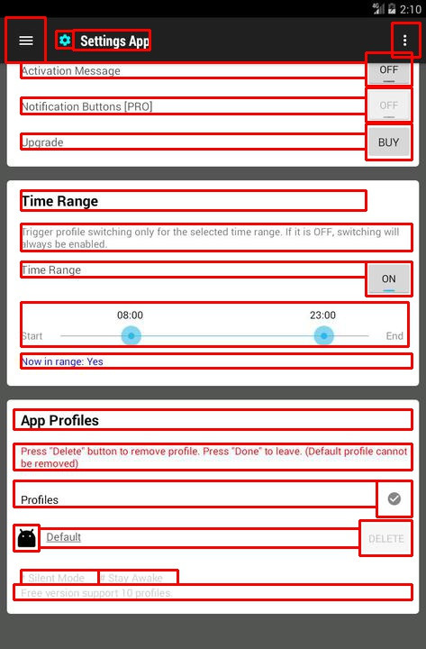
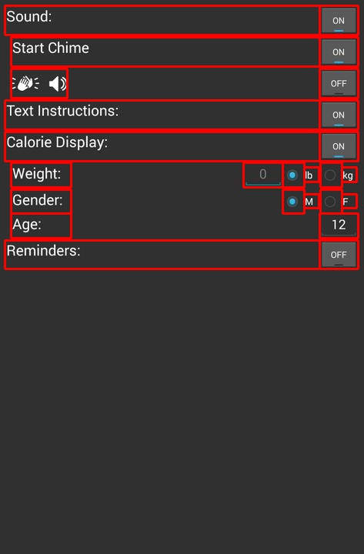
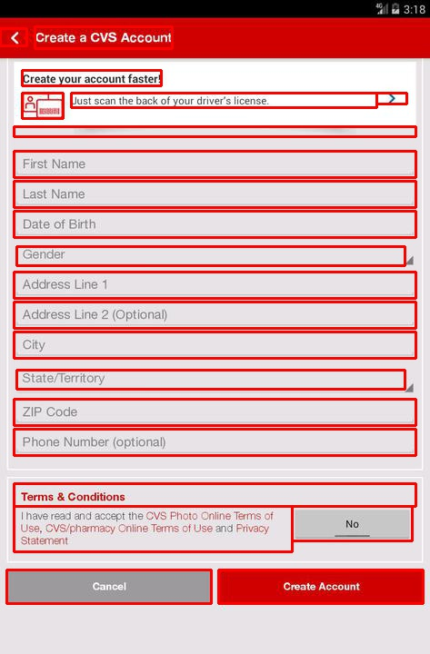
android.widget.ToggleButton

Slide 6
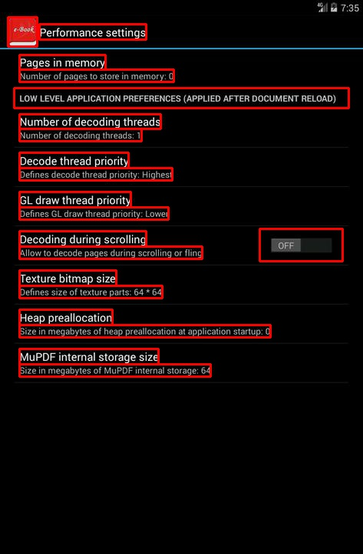
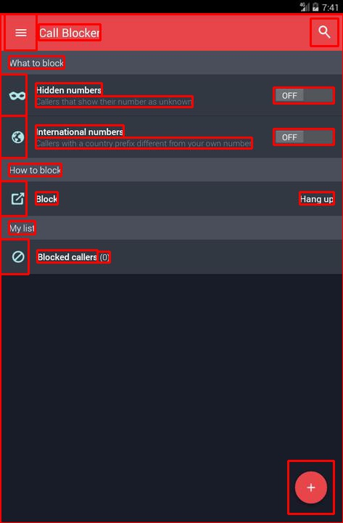
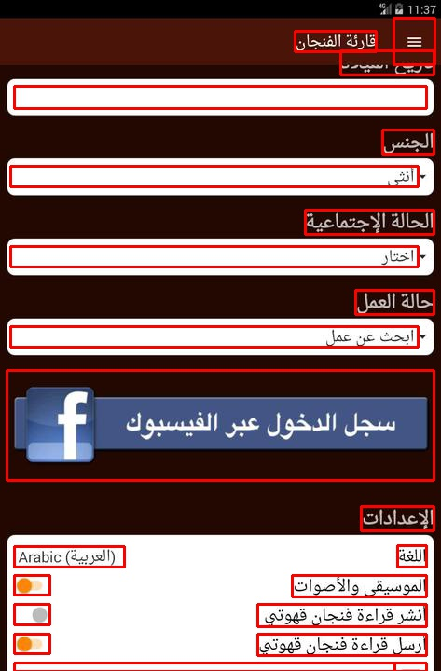
android.widget.Switch

Slide 7
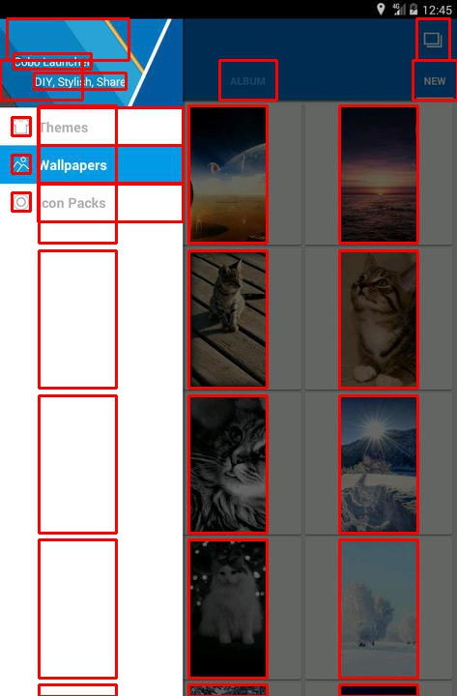
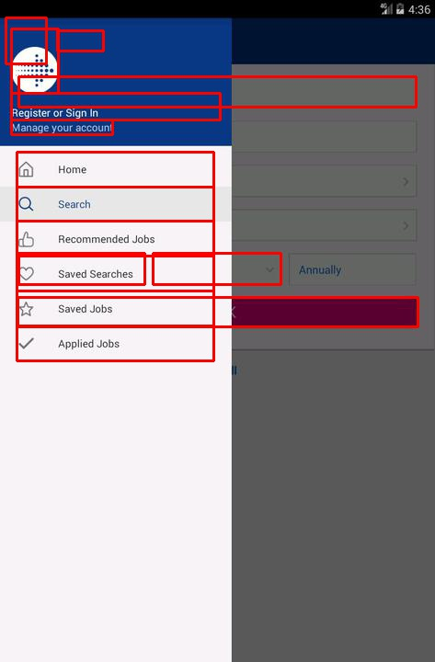
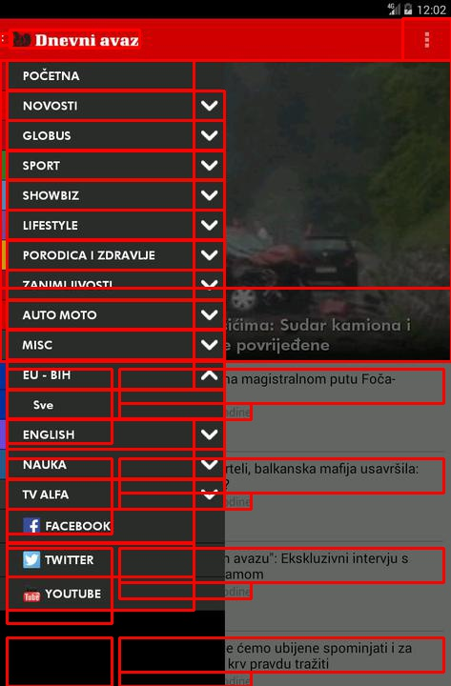
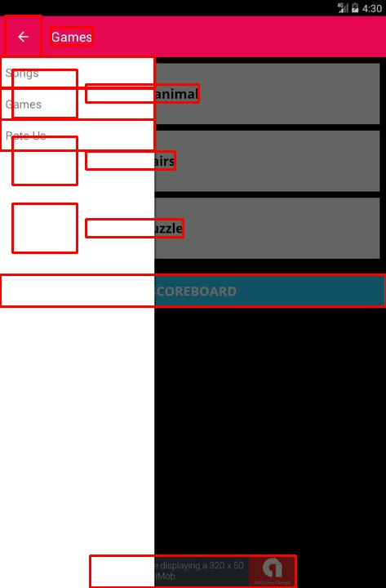
Special UIs

Slide 8
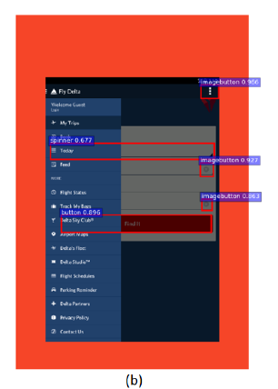
Report
The example of successful detection from the report
Notes:
006820

Slide 9
Data
23622 UIs (80%) for training
2954 UIs (10%) for testing
2952 UIs (10%) for validation
Cut images (800,1216,3)
Fixed the negative coordinates to 0

Slide 10
YOLOv3
"input_size": [416,416],
"batch_size": 8,
"decay”=0.0005,
"learning_rate":0.001,
"epoch": 50,
"categories": 13,

Slide 13
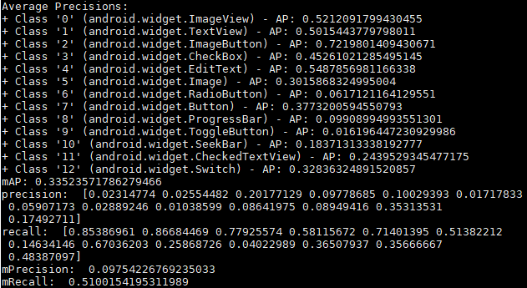
Testing result

Slide 14
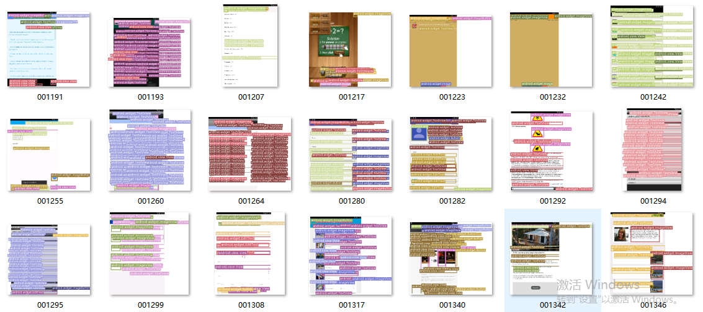

Slide 15
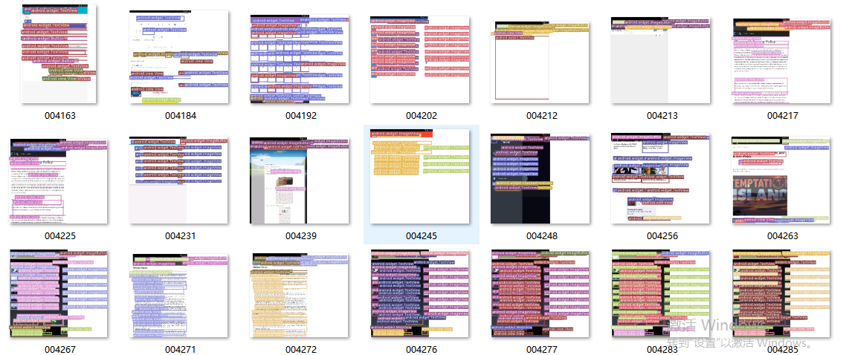

Slide 16
Next
Whether the uneven distribution of categories is a common phenomenon in android ui design？（No relevant information has been found）
Using tf-faster_rcnn and SSD model

