Slide 1
● SDC Hackathon 2026 Grand Final, Domain 1: Future-Ready Workforce
A career GPS
for the AI era.
HalaTuju shows you which of your skills AI is taking over, what to learn next, and a realistic route to your next job, step by step. When the job market changes, your plan changes with it.
Open the app →
Meet the team
Team Dsaise, Universiti Malaya. HalaTuju means “direction” in Malay. Our demo follows Priya, an example worker.

Slide 2



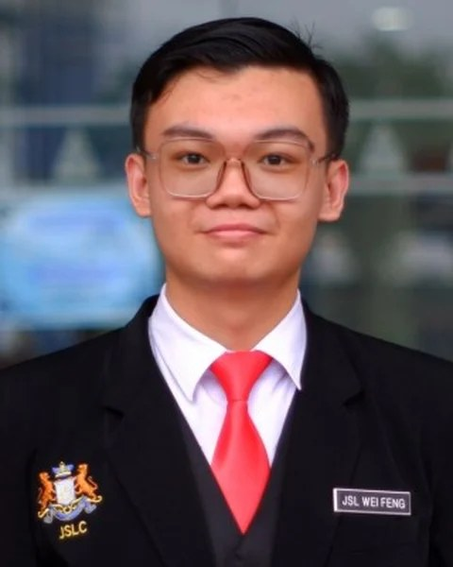


Universiti Malaya, SDC Hackathon 2026 finalists
Team
DSAISE
Five students from Universiti Malaya, Faculty of Computer Science and Information Technology.
Leow Shen En
Choong Zhuo Lin
Tan Wei Feng
Lim Jie Shin
Esther Kong Yuan Er
Team leader
Technical lead
Presenter and documentation
Research and data
UI/UX design

Slide 3
Will AI take my job? How much of it? Which of my skills?
01
01
The problem
Priya has been an accounts payable clerk for 11 years. Next year AI takes over invoice matching. She has six months to move, and nobody can tell her which of her skills still count.
620,000
1 in 4
56%
Malaysian jobs hit hard by AI within 3–5 years.
workers worldwide do a job AI can partly do.
use AI at work, but only 26% are trained for it.
TalentCorp, 2024
ILO, 2025
Hays, 2025
Today’s tools, such as MyMahir, MYFutureJobs and LinkedIn Career Explorer, compare your skills or suggest courses. None of them gives you a dated, step-by-step plan that updates itself when AI changes your work.

Slide 4
Three engines most career tools don’t have.
02
02
What we built
1
OUR OWN MODEL
2
FUTURE SIMULATION
3
AI RESEARCH AGENTS
We trained our own AI-exposure model.
We simulate 1,000 futures per route.
AI agents keep your route up to date.
Shows which of your skills AI can already do.
Shows how often your route holds, and what breaks it.
Three agents vote on each news finding. You decide.
13,939
skills scored, trained on RunPod
1,000
futures per route, plain code, no guessing
74
trusted sites checked daily
✕ Most tools: a job match, no view of your own skills
✕ Most tools: one fixed plan
✕ Most tools: fixed data, updated by hand
For workers, graduates, career switchers, and the HR teams that guide them.

Slide 5
Watch Priya’s route change, live.
03
03
Live demo
Four minutes in the real app: which of her skills AI takes, where she can move, how her plan is tested, and what happens when the news changes.
0:00
1:05
2:25
3:20
Stay
Move
Updated
For everyone
Her CV goes in, her personal details come out. Which of her 10 skills AI puts at risk.
Her best job matches, a UN goal put first, and the route tested in 1,000 futures.
The news changes, three agents vote, and she chooses: keep my route, or switch.
The same app in Bahasa Melayu, and the whole journey from the keyboard.
Open the app →
halatuju.replit.app
Backup video

Slide 6
Measured, not claimed.
04
04
How well it works
We trained our own AI model and tested it on jobs it had never seen, then tested how well the app reads CVs. Where we fixed something, we show the first result too.
OUR AI MODEL AGAINST HUMAN EXPERTS
READING CVS AND QUALITY
0.92
35 of 36
Current job read correctly
36 test CVs, 24 Oct 2026
agreement on 185 jobs it had never seen
1.0 means perfect agreement
154 of 155
Personal details removed first
before any AI reads the CV; 128 of 155 on the first test
95–100%
Right job in the top 3, no CV
from a few questions; finance, sales, IT
543
Automated tests
run on every code update
Scale starts at 0.80. Built on the EU’s list of 3,039 jobs and 13,939 skills. Against the ILO’s separate index of 2,956 jobs, never trained on: 0.79.

Slide 7


How your plan stays up to date when AI changes jobs.
05
05
How plans stay current
Agents read and vote. Fixed formulas, not AI, set every number, so each change can be undone.
1
2
3
4
5
Read
Check
Vote
Decide
You choose
74 trusted sites, daily
quote must be on the page
three agents, two vendors
a fixed rule, not a model
keep my route, or switch
STEP 3 · VOTE
THREE AGENTS, TWO VENDORS
STEP 4 · FIXED RULE
NO MODEL DECIDES
EXAMPLE “Shared-service centres move invoice matching to AI.”
2 or 3 yes
Applied, and can be undone
Evidence checker
GPT-5.5
Is it real, recent and trusted?
YES
EXAMPLE RESULT
Skill matcher
GPT-6-sol
1 yes
A person decides
Is it really about this skill?
YES
Sceptic
DeepSeek-V4-Pro
Is it hype or a sales pitch?
NO
0 yes
Rejected, reasons recorded

Slide 8
Everything the Domain 1 brief asked for
06
06
The six must-haves
All six must-haves run live in one journey. The right column shows where you see each one in the demo.
1
Skills profile intake
CV, LinkedIn, scan or a few questions. Personal details removed first.
✓ Live
Act 1
2
AI-trend signals, with source and date
74 trusted sites. Every quote checked, three agents vote.
✓ Live
Act 3
3
Ranked roles, with the match explained
Match score, gap in weeks, and whether demand is rising.
✓ Live
Act 2
4
A personal pathway, with time and cost
Fastest, Balanced or Safest, fitted to her hours, with RM cost.
✓ Live
Act 2
5
SDG mapping that changes something
Put a UN goal first and the job list re-ranks.
✓ Live
Act 2
6
More than one future, as estimates
Slow or fast AI, 2026 to 2030, 1,000 futures per route.
✓ Live
Acts 2, 3

Slide 9









A UN goal that changes the ranking, not just a label
07
07
UN goals
Decent work
Productivity through innovation
Skills for work
Any goal, by choice
Target 8.5
Target 8.2
Target 4.4
Put a UN goal first
Move workers whose jobs are exposed to AI into new roles, instead of laying them off.
Workers learn the AI skills their own job now needs.
Every route is a skills plan, with hours and courses.
Put the goal you care about first, and the job list re-ranks around it, showing the cost in match points.

Slide 10
A market of 620,000 workers who need this now.
08
08
Impact and feasibility
Sized from the number of Malaysian workers in jobs that AI will change, at RM 300 per worker a year.
TAM
Everyone who could use it
2.42 million Malaysian workers in jobs with high or medium AI impact
RM 726M
SAM
Who needs it most
620,000 workers in highly impacted jobs
RM 186M
SOM
Our target by year three
10,000 seats at RM 300 a year. Break-even at about 1,000 seats
RM 3M
Sources: TalentCorp (2024), GBS Malaysia Mid-Term Report (2025), Department of Statistics Malaysia (DOSM). Prices are pilot assumptions.

Slide 11
Free for workers. Employers pay, because layoffs cost more.
09
09
Business model
MAIN REVENUE
FOR WORKERS
FOR WORKERS
FOR EMPLOYERS
FOR GOVERNMENT
Personal
Personal Plus
Enterprise
Public partners
Free
RM 9.90
RM 25
Licence
a month
per worker a month
a year, per agency or campus
✓ Career map and routes
✓ 1,000-futures test
✓ Private to the worker
✓ Everything in Personal
✓ Certificates
✓ Advisor sessions
✓ HR view of skills at risk
✓ Internal moves before layoffs
✓ Help for leavers
✓ Staff opt in, data stays theirs
✓ PERKESO
✓ TalentCorp
✓ Universities
One layoff avoided (RM 22,800) pays for 76 workers for a year
Builds trust and reach
Small extra income
Reach at national scale
Severance: 20 days’ wages per year of service at the DOSM 2025 clerical median, RM 2,693. Reading a CV costs us RM 0.03 and a news check RM 1.05, measured. Personal data handled under PDPA. Prices are pilot assumptions.

Slide 12
KL first. Break-even in 2027. RM 1.9M a year by 2029.
10
10
Roadmap
Now, Oct 2026
Next 3 months
H1 2027
Oct 2027
2028–29
Live and tested
Ready for employers
Pilot in Greater KL
Break-even
Scale
Any of 3,039 jobs, 1,000-futures test, three-agent vote, 543 tests.
Track all 13,939 skills daily. Import HR data. HRD Corp-claimable courses.
Shared-service centres around KL Sentral, Bangsar South and Cyberjaya. First talks with MDEC and GBS Malaysia.
Monthly profit turns positive in the median of 10,000 simulated futures.
More employers and universities in the Klang Valley, then Penang and Johor. Licensed Malaysian job-ad data. More sectors.
Done
Goal: letter of intent from 1 employer
Goal: 2–3 centres, about 1,500 staff
Funding needed: about RM 150k
Median: 7,400 seats, RM 1.9M a year
OUR ASK Introductions to one pilot employer, and to HRD Corp so our courses can be claimed.

Slide 13
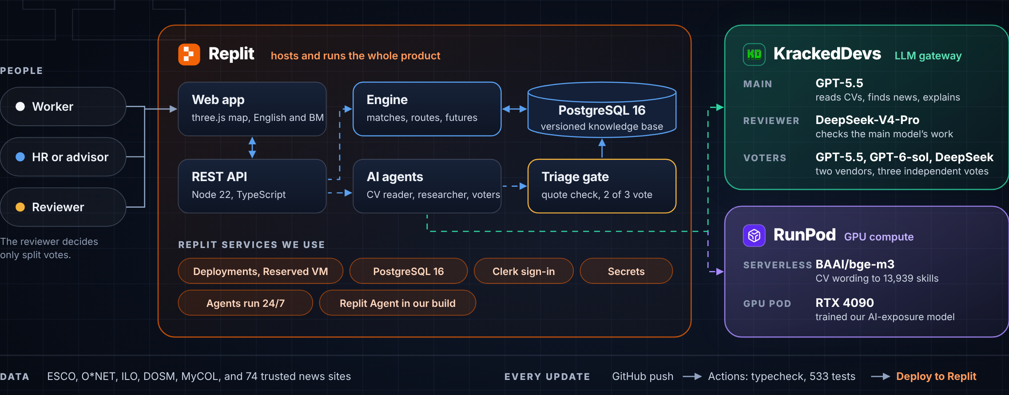
One app on Replit, with KrackedDevs and RunPod plugged in.
11
11
Architecture

Slide 14
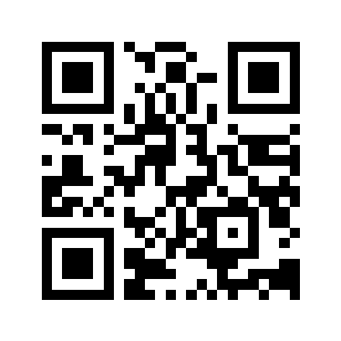
HalaTuju, Team Dsaise, Universiti Malaya
Knowing what is coming is one thing.
Knowing what to do next is another.
Thank you.
Open the app →
Source code
Scan to try it
halatuju.replit.app
Leow Shen En, Choong Zhuo Lin, Tan Wei Feng, Lim Jie Shin, Esther Kong Yuan Er

Slide 15
We ran the business 10,000 times.
A1
A1
Appendix: business stress test
The same stress test we give workers, applied to our own company. Every input is a range, not a single guess.
MONTHLY PROFIT, 2027 TO 2029 (RM)
98%
of futures break even within 18 months
RM 152k
funding needed to get there (1 in 10 futures: RM 244k)
RM 1.9M
yearly revenue by end of 2029 (80% range RM 1.0M–3.2M)
7,358
seats by end of 2029; our 10,000 target is a stretch, reached in 1 of 4 futures
━ Median ━ Middle half of futures ┅ 8 in 10 futures Median break-even: Oct 2027
WHAT MOVES YEAR-THREE PROFIT MOST
Staff per employer
Employers signed a month
Price we actually charge
Employers who leave
RM 2.1M swing
RM 1.6M swing
RM 552k swing
RM 460k swing
Inputs: RM 25 a seat a month, RM 0.50 to serve, RM 24,452 fixed a month; 1 to 4 pilot employers at 30–80% of price; 0.25–0.9 new employers a month of 200–900 staff; 0.5–3% monthly churn; team grows to 5 past 5,000 seats. Seeded, 10,000 runs.

Slide 16
Three tests that could have embarrassed us.
A2
A2
Appendix: how well it works
We ran them anyway, and we show the results as they came out.
01
02
03
Fairness test
Tamper test
Live run, 23 Oct 2026
We gave the same CV six different names, genders, ages, races, religions and marital statuses. The AI received exactly the same text every time, so the skills, matches and routes came out the same.
Text hidden in a web page cannot change what the AI reads from a CV, invent data, or skip our checks. Page text is treated as data, never as instructions.
Our agents read 769 articles in 5.5 minutes and sent 7 findings to a person. Every change is saved as a version and can be undone.
tests/fairness.test.ts
tests/injection.test.ts
Measured on the live server

Slide 17
Change the data. Check a course. Ask why.
A3
A3
Appendix: judges, try to break it
Three things you can test in the app right now, and what you will see.
01
02
03
Change the trend data now
Is this course real?
Why this score, and what would raise it?
Open the agents panel and watch three agents vote on a news finding. The knowledge base moves from version 1 to version 2, every plan is re-scored, and the route visibly changes on the map, with the source attached. Undo puts it back.
30 real course listings with price and hours. Jobs come from the EU’s official list; wages are Malaysian government figures from DOSM. When no course exists, the app says “no course listed yet” instead of making one up.
The breakdown lists each skill the job needs, how much employers want it, and your level. Confirm a skill or finish a step, and the number updates in front of you.
In rehearsal, the route changed in 0.1 seconds
Click any step to open the listing
A fixed formula. No AI in the loop.

Slide 18
What this prototype cannot do yet.
A4
A4
Appendix: what we say openly
Sample data in places
Matching is still rough
Tests still to run
The 16-job catalogue in the demo uses labelled sample data. “Check any job” uses the real official list. Most study times are estimates, and our task evidence comes from US data.
A nurse matches her own job at only about 30%, because the official list has about 60 skills per job and a CV names about 16. The questions reach about 70% accuracy for trade jobs.
We have not yet tested clues such as school name or graduation year. The 1,000 futures test a plan; they do not predict any one person’s future.

