Slide 1
Programming Language/Toolchain for quick IoT Prototyping
Yixiang Wang

Slide 2
Overview
The Internet of Things was first introduced by Kevin Ashton in 1982 in a lecture. The Internet of Things is a development of the Internet (Yang et. al., 2011) , the Internet of Things brings physical objects into the network.
The Internet of Things often involves many areas of technology, such as mechanics, logistics, interaction design, etc., and some of the technicians in these areas are not proficient with programming.
Graphical programming makes it easier for users to create programs (Bak et. al., 2020), so many block programming tools have been designed to make it easier for people with no computer expertise to write programs.
This project will design an innovative and targeted graphical programming tool for the Internet of Things (IoT) that will most importantly improve the efficiency of building IoT.

Slide 3
Background
The arduino IDE is the most commonly used arduino program editor, it is very lightweight but at the same time not very comprehensive, for example it has no workspace and all the code is in a single file.
For non-experienced users, the arduino IDE is difficult to use and has only simple error correction features such as keyword colour change. Beginners often encounter various syntax errors when using it and waste a lot of time doing so. The simple interface also often makes it difficult for non-experts to understand the code.
Graphical programming has been around for a long time and there have been many graphical programming tools produced so far(Lin & Weintrop,2021), The broad types are graphical tools connected by lines, jigsaw-like programming tools, and programming tools close to the text base code.
Graphical programming languages solve almost all the syntax problems encountered in programming. Taking this a step further, Repenning (2017) suggests that graphical programming can also show more advantages in terms of error correction in semantics. It can more easily reveal non-grammatical logical gaps, or some errors that reveal conformity to the syntax but are inconsistent with the actual goal.

Slide 4
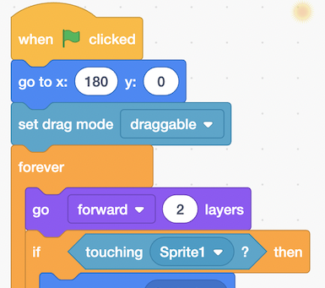
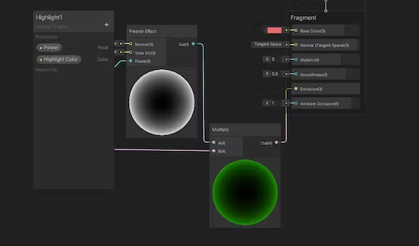
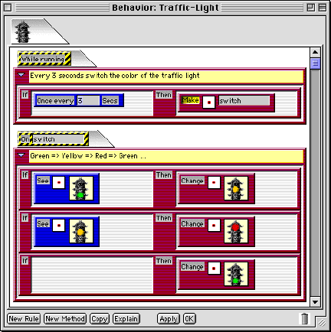
Background
Unity shader graph, Connected graphical programming languag.
Scratch,Programming languages with puzzle features.
AgentSheets (Repenning, 2000)

Slide 5
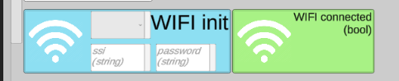
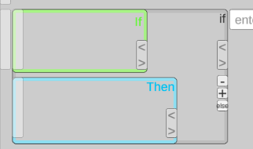
Design
The common mode of operation for entities in the Internet of Things is to acquire environmental data or data about themselves via sensors. The data is then sent to a data processing device for decision making or presentation via some WIFI, Bluetooth or other ways of communication.
For this reason I have designed a block programming language that will have many sensor blocks and communication blocks, and to enhance the presentation of their semantics many of the blocks in this project will be accompanied by icons to show the corresponding device, for example the two below are two methods in the wifi module.
.
Also to enhance the semantic presentation, the condition (bool) is shown in green and the actual action is shown in blue. Therefore the if else statements in this project are also given the corresponding colour

Slide 6
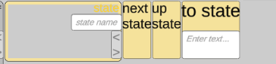
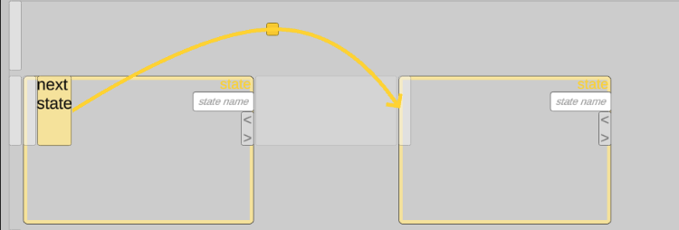
Design
State machines are a common abstraction method used in IoT programming to make programs more readable and less coupled. Writing a state machine from zero can take a lot of time, so for this reason this project includes state blocks and the state related blocks have been given a yellow colour in order to distinguish them from the conditions and the function method.
To enhance the semantic cues between states, the different states are automatically linked by arrows, allowing the user to visualise the transition between states.
In order to distinguish between keywords and method names, the names of structures such as if, else, then state, etc. have been placed on the left-hand side to improve readability.

Slide 7
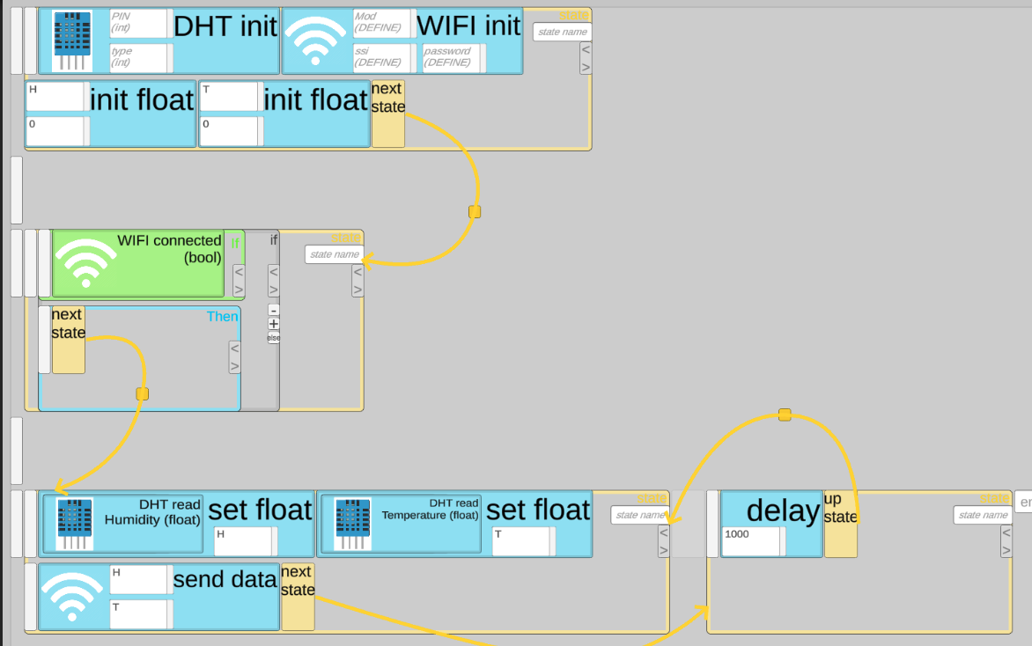
Results
Based on the above design, we can easily build program logic that includes state transitions, reading sensor data, and transferring data to the service, as shown in the following diagram

Slide 8
Results
This editor's blocks are arranged in a regular reading order close to the text, and it is also compatible with many text editors' operating methods or shortcuts when in use.
The structure of these blocks is determined at the time of writing and does not require much syntactic analysis when saving and generating code.
The code can be stored in json format according to the tree structure, and the blocks can be converted into runnable code relatively easily through a mid-order traversal

Slide 9
References
Bak, N., Chang, B. M., & Choi, K. (2020). Smart Block: A visual block language and its programming environment for IoT. Journal of Computer Languages, 60, 100999.
Lin, Y., & Weintrop, D. (2021). The landscape of Block-based programming: Characteristics of block-based environments and how they support the transition to text-based programming. Journal of Computer Languages, 67, 101075.
Repenning, A., Ioannidou, A., & Zola, J. (2000). AgentSheets: End-user programmable simulations. Journal of Artificial Societies and Social Simulation, 3(3), 351-358.
Repenning, A. (2017). Moving Beyond Syntax: Lessons from 20 Years of Blocks Programing in AgentSheets. J. Vis. Lang. Sentient Syst., 3(1), 68-89.
Triantafyllou, A., Sarigiannidis, P., & Lagkas, T. D. (2018). Network protocols, schemes, and mechanisms for internet of things (iot): Features, open challenges, and trends. Wireless communications and mobile computing, 2018.
Yang, Z., Yue, Y., Yang, Y., Peng, Y., Wang, X., & Liu, W. (2011, July). Study and application on the architecture and key technologies for IOT. In 2011 International Conference on Multimedia Technology (pp. 747-751). IEEE.
Any questions?

