Slide 1
HOTEL DATABASE
INFO 6210
FINAL PRESENTATION
Group 22
Beiyi Shen
Minglei Wang
Qiucheng Wang
Yangyang Liu
12/08/2019

Slide 2

CONTENTS
01
Database Description
02
ERD
03
Database Implementation
04
View & Visualization

Slide 3

01 Database Description
Functions & Goals
Check-in & Check-out
Consumption
Employee & Tasks
Income
Track every reservation, and process the check-in and check-out progresses for all customers.
Record all the spending of customers in every amenity. Provide analysis for different departments.
Manage employees from different departments, and assign work tasks for them.
Manage hotel income.
Provide analysis report for this whole property.

Slide 4
Highlights
Hotel managers will be able to track reservation history and analysis trend of reservations.
Reservation Tracking & Management
Room rate will be changed seasonally in case to help hotel to reach highest profit.
Bill of customers will be automatically calculated when they check out.
Bill Automatically calculated
Intelligent Room Rate Managing
All consumptions by customers can be tracked through Check-In ID.
Employees will be easily assigned work tasks through database. Avoid miscommunication that may exist.
Easily Tracked
Clear Working Tasks Management

Slide 5
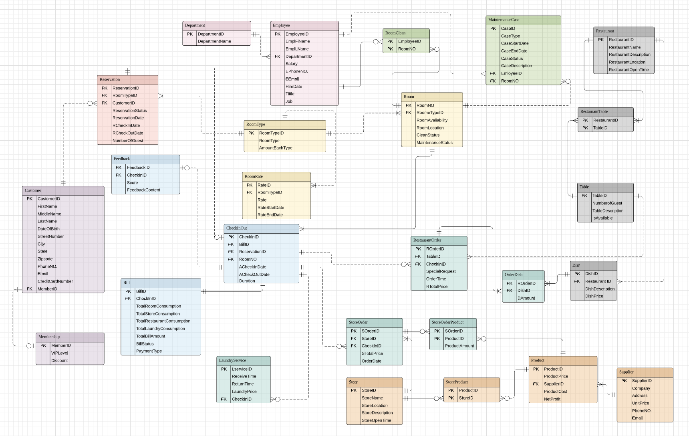
02 ERD
Task
Employee
Reservation
Room
Restaurant
CheckIn
CheckInOrder
Customer
Store

Slide 6
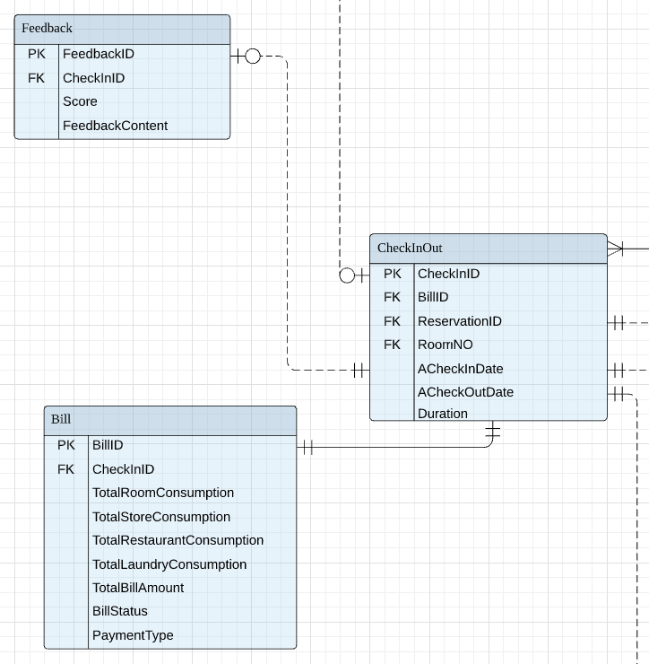
CheckIn

Slide 7
Task
Employee
Reservation
Room
Restaurant
CheckIn
CheckInOrder
Customer
Store

Slide 8
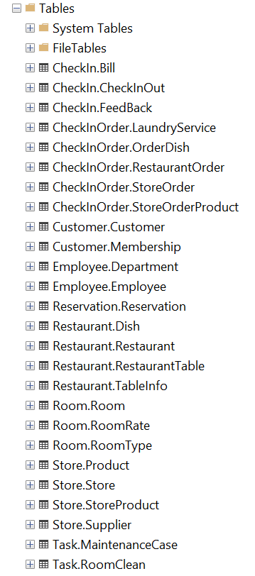
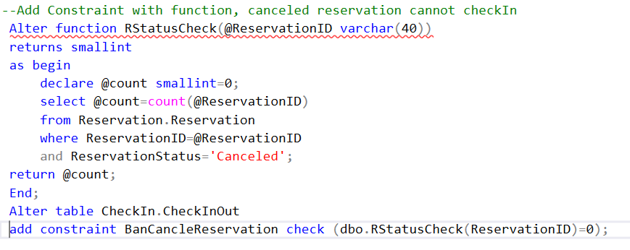
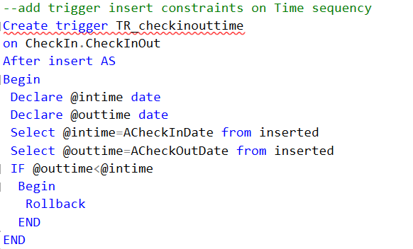
03 Database Implementation
I. Create Table Add Constraint
II. Add Constraint

Slide 9
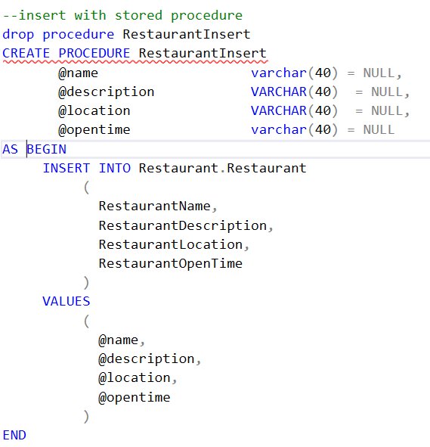
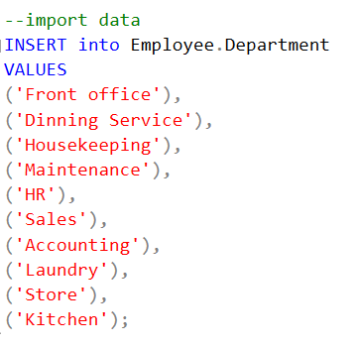
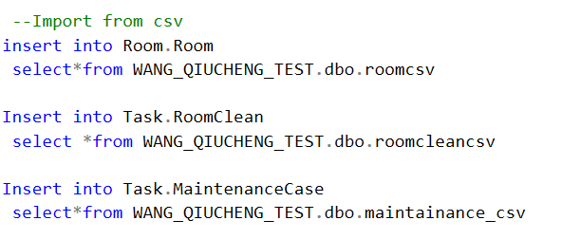
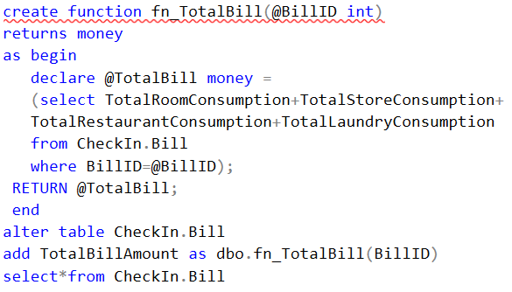
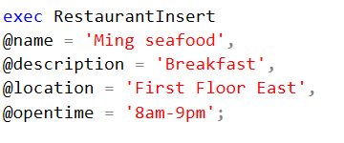
03 Database Implementation
III. Import Data
IV. Calculated Columns
Calculate NetProfit in Store.Product
Calculate CheckInRate in CheckIn.CheckInOut
Calculate Duration in CheckIn.CheckInOut
Calculate order amount in each order table
Calculate TotalBill in CheckIn.Bill

Slide 10
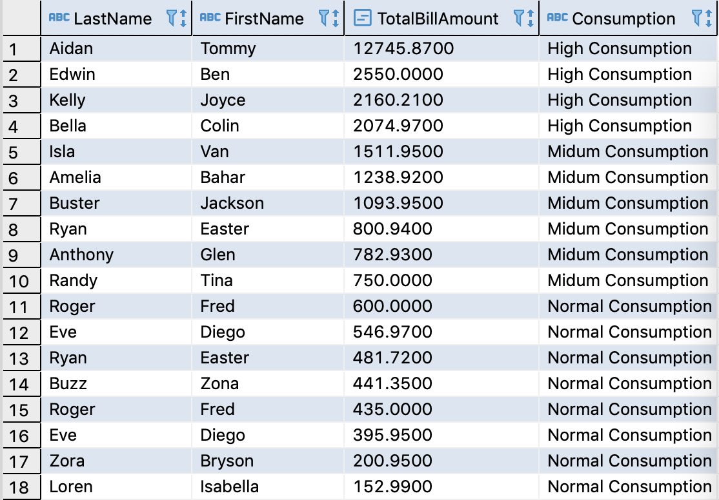
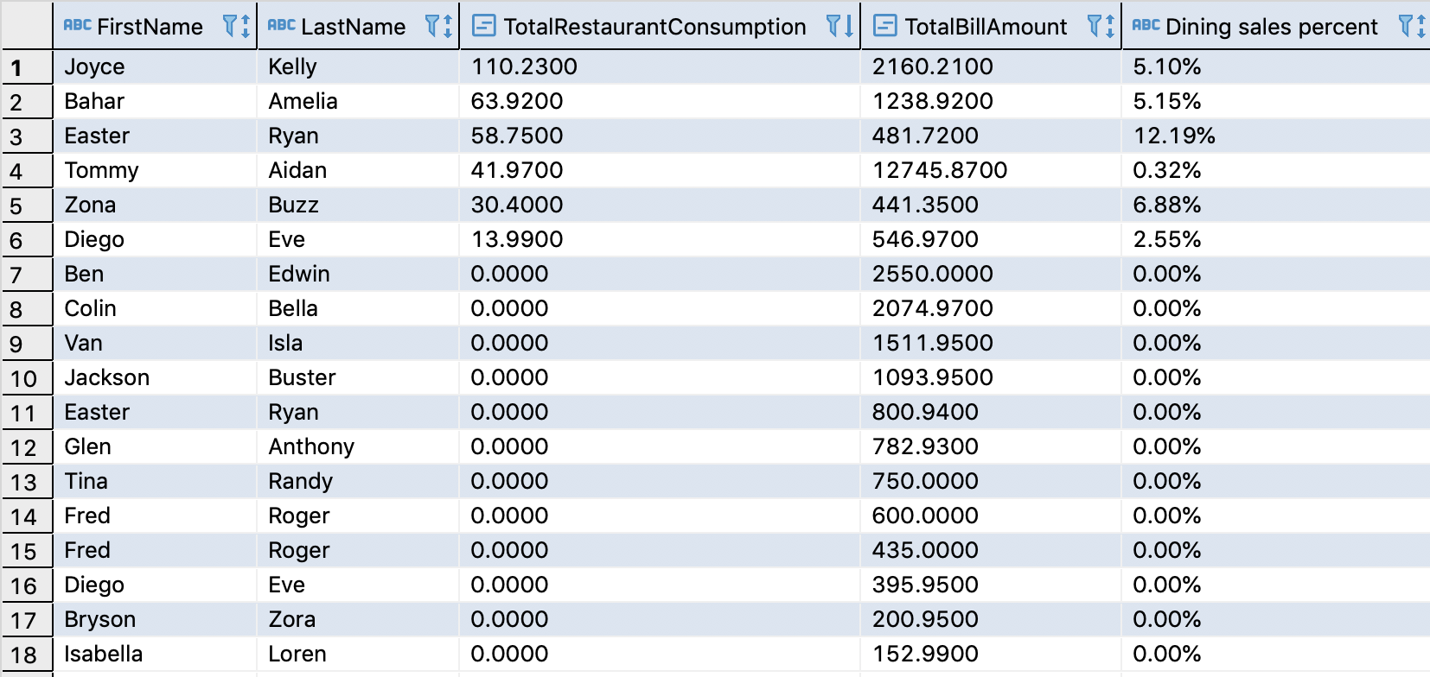
04 View & Visualization
01
02
Customers Consumption
Res Consumption and Its Proportion

Slide 11
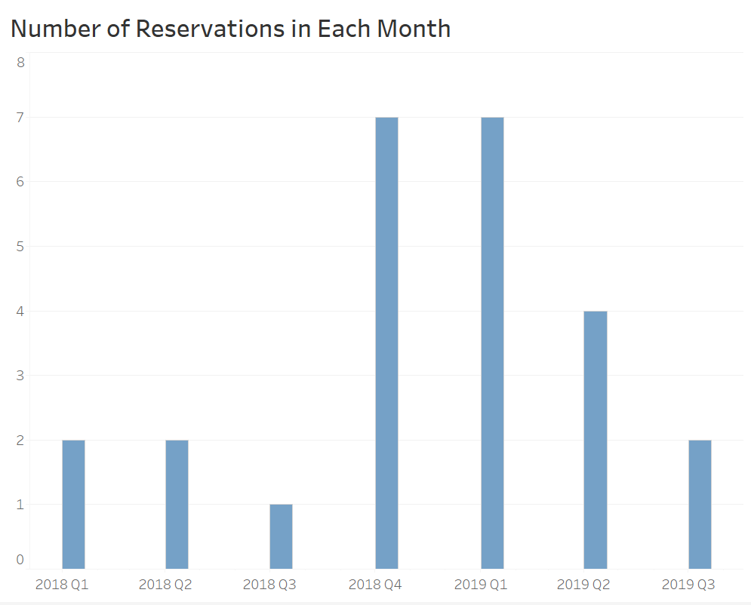
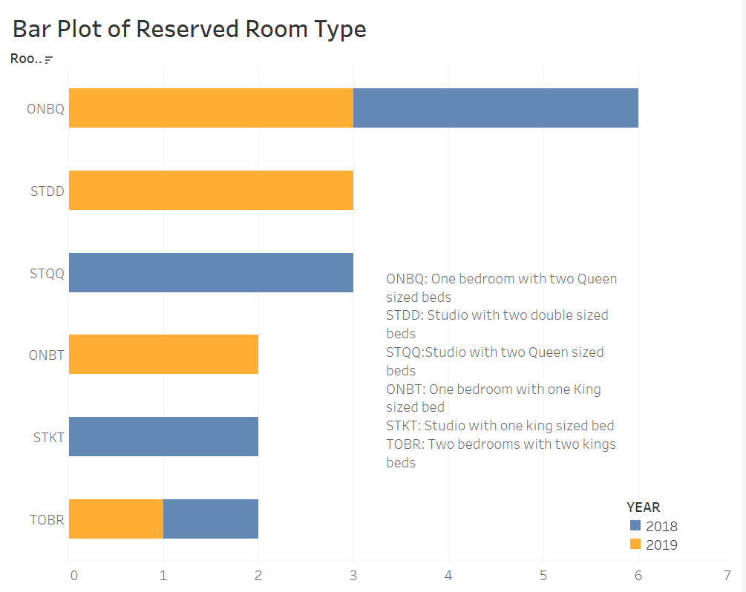
04 View & Visualization

Slide 12
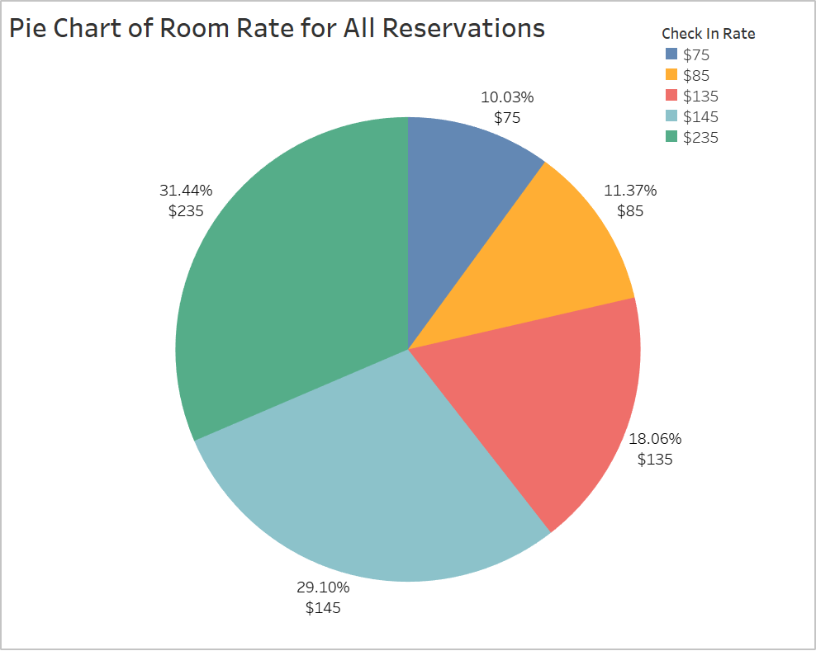
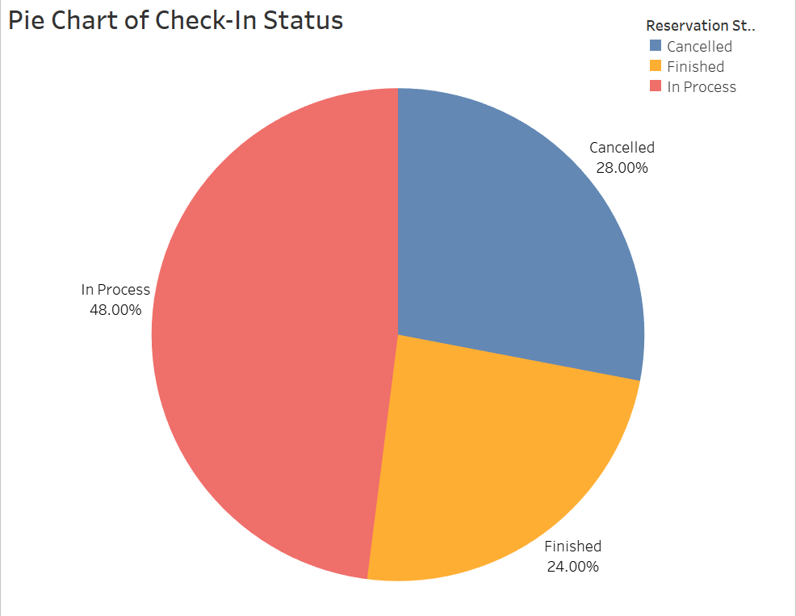
04 View & Visualization

