Slide 1













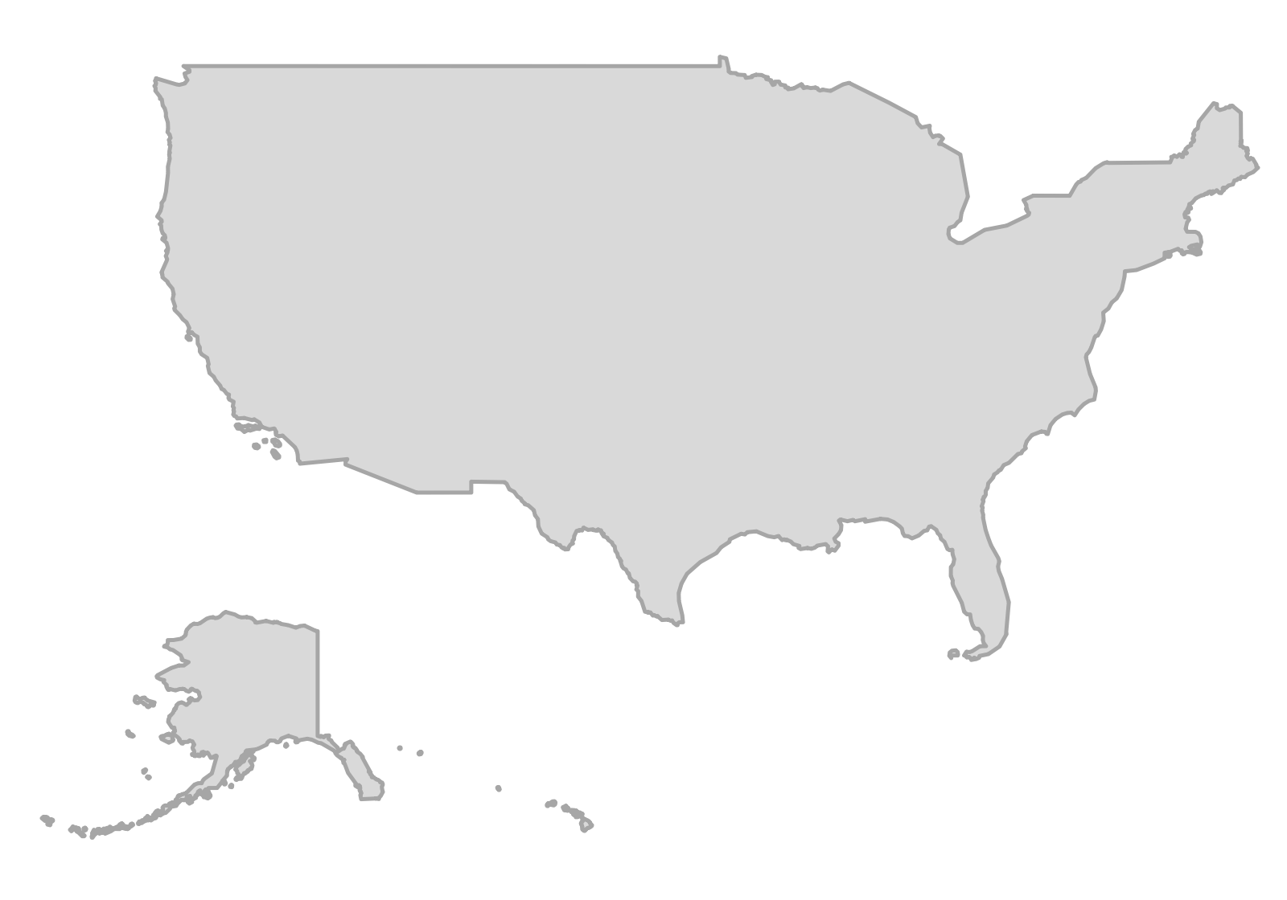


























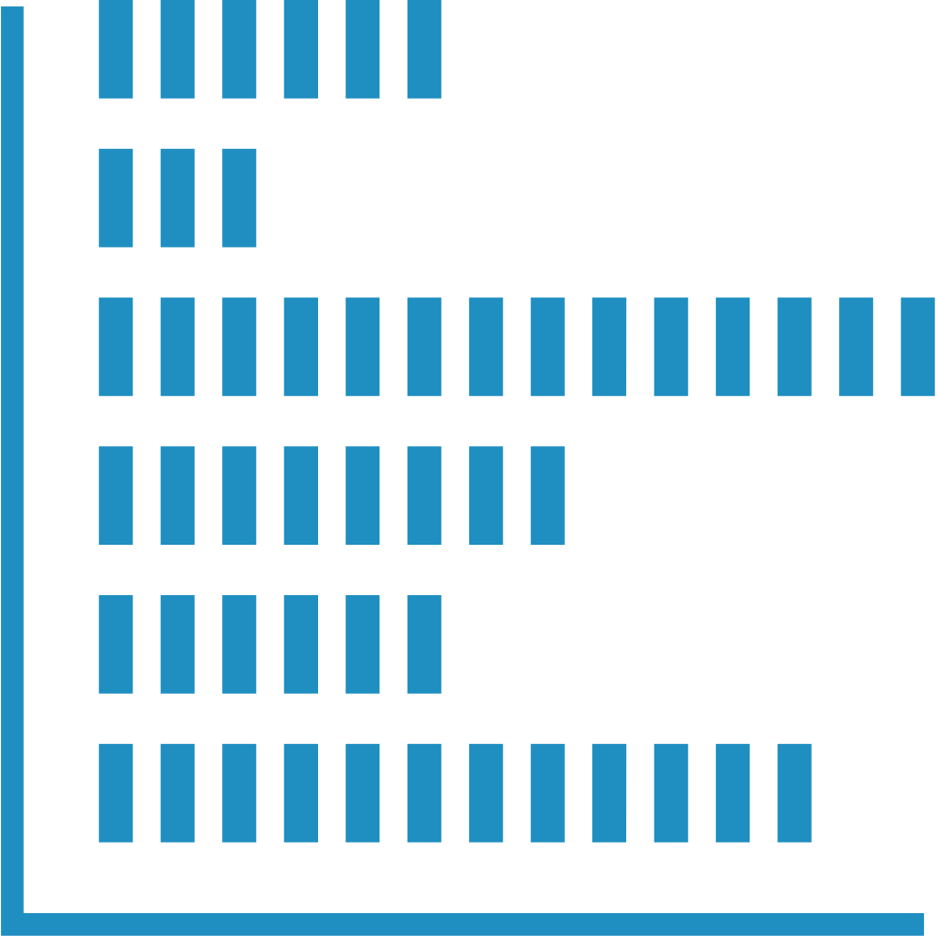










1
Public project data collection
NSF
25,782
Project text fields for coding
candidate records
(2015–2025)
Project title
Retained metadata
NSFC
9,982
Public abstract
candidate records
(2015–2025)
Search window
Paired Chinese–English search lexicon
Batch collection by Python
project records
Available keywords
2015–2025
2
Corpus preprocessing and relevance screening
Inclusion criterion:
Retained corpus
Independent screening audit
Urban sustainability problem, urban system, or urban application as the research focus.
NSF
NSFC
NSF:
NSFC:
Project-ID
deduplication
DeepSeekV4-pro
Field
standardization
6,207 records
2015–2025
5,546 records
2015–2023
Collected
project records
relevance screening
Exclude background-only
and non-urban records
Typical examples of excluded records
Two blinded reviewers
High accuracy
Two blinded reviewers
High accuracy
Background-only
city/SDG mentions
Medicine
Materials
Algorithms
Basic
biology
General
economics
3
Codebook and prompt design
Alignment
Six research-content dimensions
Prompt design (role and rules)
Conservative bilingual coder
Urban sustainability + SDG aware
Codebook
Unified Chinese–English
coding prompt
Urban
needs
Problem
pressures
Urban
systems
Definitions and boundaries
Minimal sufficient coding
12 urban-related SDGs
121 Targets
Hierarchy and selection rules
No external knowledge
Original-language evidence
No agency/country/
language-based inference
SDG Targets framework
Knowledge
tasks
Intervention
types
Research-action
stages
Structured JSON output
Each field judged
independently
Closed code set
4
Small-Sample Iteration and full-corpus coding
a. Pilot refinement
b. Full-corpus coding
Input project records
DeepSeek-V4-pro
Project-wise coding
Outputs
Stratified
pilot coding
Error and
evidence review
Prompt
revision
Iterative refinement (multiple rounds)
Codebook
Coded fields +
original-language
evidence excerpts
Coding
records
Pilot includes NSF and NSFC
High reasoning configuration
Stratified by award year and within-agency text length
Automatic checks
(format and logic)
Finalized codebook and prompt
Fields and
allowed labels
Parent-child
consistency
Source-evidence
matching
Retry or flag
for review
Evidence
records
5
Independent human validation
Original project texts
Independent blinded annotation
Majority-vote
consensus
Comparison and evaluation
LLM-consensus agreement
600 NSF + 600 NSFC
projects
Three independent annotators
Variable-level performance
Corresponding LLM labels
Inter-annotator agreement
Notes:
Reconstructed from the image supplied by the user: E:\可持续发展目标基金\定稿撰写\成图\llm流程图\ChatGPT Image 2026年9月13日 14_25_27.png
All body text and headings have been retyped as editable Times New Roman text. Layout frames, arrows and basic symbols are native editable PowerPoint shapes. Detailed icons and institutional marks are cropped from the supplied source image. Source content and numerical values are retained as provided.

