Slide 1
Simulation of Doppler Cooling of Yb Atom Using Doppler Force Model and RK4 method
Shengbin Yan
May 2, 2025

Slide 2

Introduction to Doppler Cooling
Doppler effect: wave’s frequency increases moving towards it
On incidence with a photon, atom receives a momentum kick, and absorbs the energy (if on resonance)
Spontaneous emission: atom emits a photon in a random direction
Net momentum change due to spontaneous emission will be zero over time
Light preferentially slows down atom with certain detuning and power

Slide 3
Doppler Force Model
One way to simulate a doppler cooling process is to use the Doppler force model, its derivation is shown below.

Slide 4
Doppler Force Model

Slide 5
Doppler Force Model

Slide 6
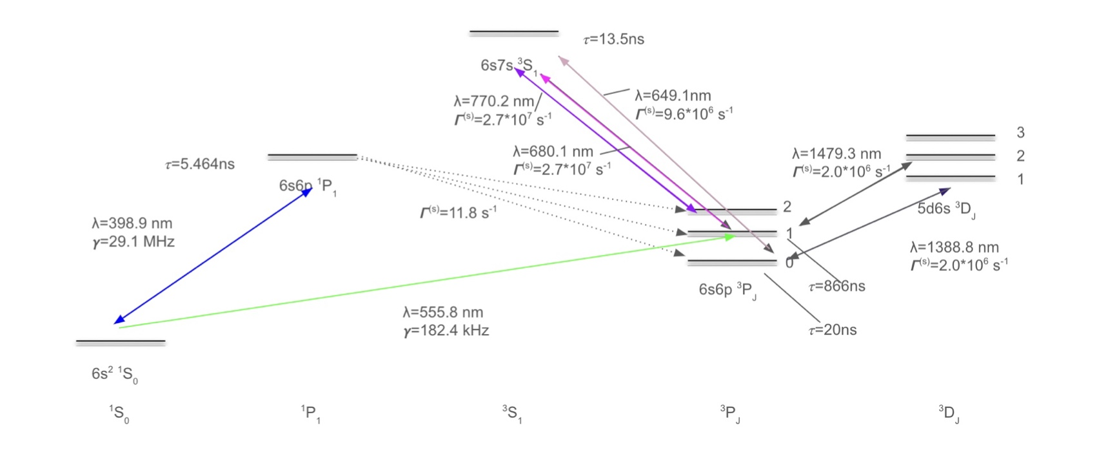
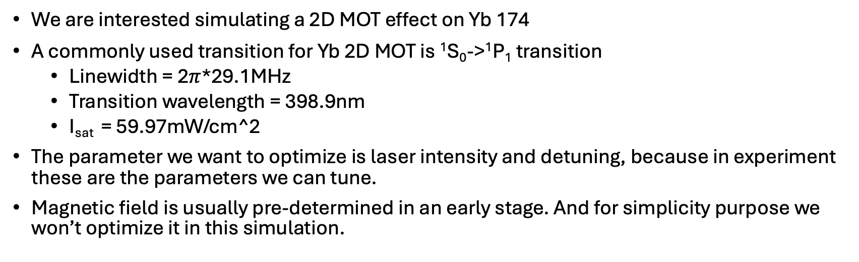
Physical Model
We are interested simulating a 2D MOT effect on Yb 174
A commonly used transition for Yb 2D MOT is ¹S₀->¹P₁ transition
Linewidth = 2$π$*29.1MHz
Transition wavelength = 398.9nm
I_{sat} = 59.97mW/cm^2
The parameter we want to optimize is laser intensity and detuning, because in experiment these are the parameters we can tune.
Magnetic field is usually pre-determined in an early stage. And for simplicity purpose we won’t optimize it in this simulation.

Slide 7
Simulation Method and Process
With the Doppler Force model, we can update the position and momentum of atom over time
RK4 method is used for the simulation
First, we simulate one atom in 1D, under two counter-propagating laser. Optimize parameters
Then, we move onto 2D case with 1 atom, with two pairs of counter-propagating laser
Next, We will add effect of magnetic field
Finally, we start with 1000 atoms initialized with positions and velocities under normal distribution, then obtain final velocity profile after a certain period

Slide 8
Simulation Result: 1D

Slide 9
Simulation Result: Single atom in 2D

Slide 10
Simulation Result: Atom Vapor

Slide 11
Simulation Result: Atom Vapor, magnetic field

Slide 12
Conclusion

Slide 13
Bibliography

