Slide 1



End-to-end Mechanised Proof of an eBPF Virtual Machine for Microcontrollers
Shenghao Yuan¹, Frederic Besson¹, Jean-Pierre Talpin¹,
Samuel Hym², Koen Zandberg¹, and Emmanuel Baccelli^{1,3}
¹ Inria France
²University of Lille, CNRS, CRIStAL, France
³ Freie Universitat Berlin, Germany
Notes:
collobrating with three… ;
riot-fp;

Slide 2
Content
Background
Motivation
Workflow
Evaluation
Conclusion
Next Step

Slide 3
Linux eBPF
eBPF (extended Berkeley Packet Filter)
ISA (instruction set arch…): 64-bit RISC-V like
verifier: reject unsafe BPF programs
interpreter/JIT compiler (binary translation)
Linux kernel
safe extension
eBPF VM
interpreter/ JIT
verifier
eBPF: a small virtual machine in the Linux kernel
Notes:
limited memory resource…
two slides： highlight rBPF (difference)…

Slide 4
RIOT-OS rBPF
RIOT-OS: a tiny OS for tiny IoT (internet of things) micro-controllers
rBPF: an eBPF variant for RIOT-OS focusing on memory footprint and isolation
limited resource:
computation,
memory, etc
less hareware isolations
IoT environment
smaller
faster
RIOT-OS kernel
rBPF VM
interpreter
memory
isolation
verifier

Slide 5
RIOT-OS Community expects …
Functional correctness
rBPF-verifier SHOULD reject all unsafe code.
rBPF-interpreter SHOULD execute all instructions correctly
…
IoT lacks hardware-enforced memory isolation
Can rBPF satisfy memory isolation?
rBPF implementation:
defensive runtime checks
(e.g. check_mem)
Notes:
size -> smaller
efficient -> faster

Slide 6
Contributions
CertrBPF: a verified rBPF interpreter in Coq
Coq implementation
verified C implementation
Evaluation: CertrBPF v.s. original-rBPF + ~ memory footprint and execution time
End-to-end verification workflow: from Coq to C

Slide 7
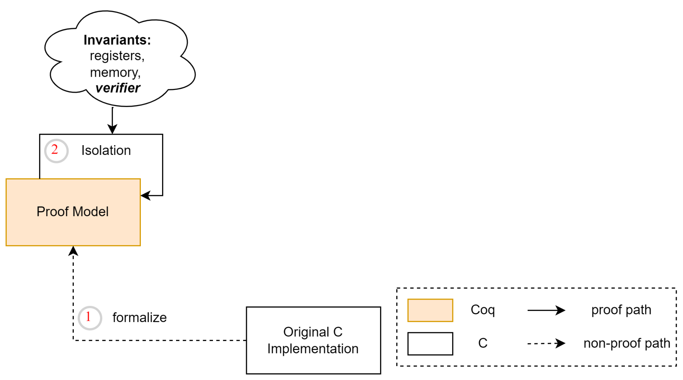

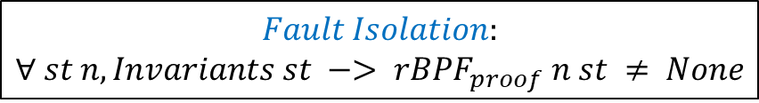
CertrBPF: Formalization
Computation (option-state Monad)
$$M a state: state →option (a ×state)$$
Monad: model side effects in a pure functional language.
Option None captures undefined behaviours
Some (res, st) designates normal computation
$$Fault Isolation:$$
$$∀ st n,Invariants st −> rBPF_{proof} n st ≠ None$$
Notes:
regs -> registers
mem -> memory
-> Invariants

Slide 8
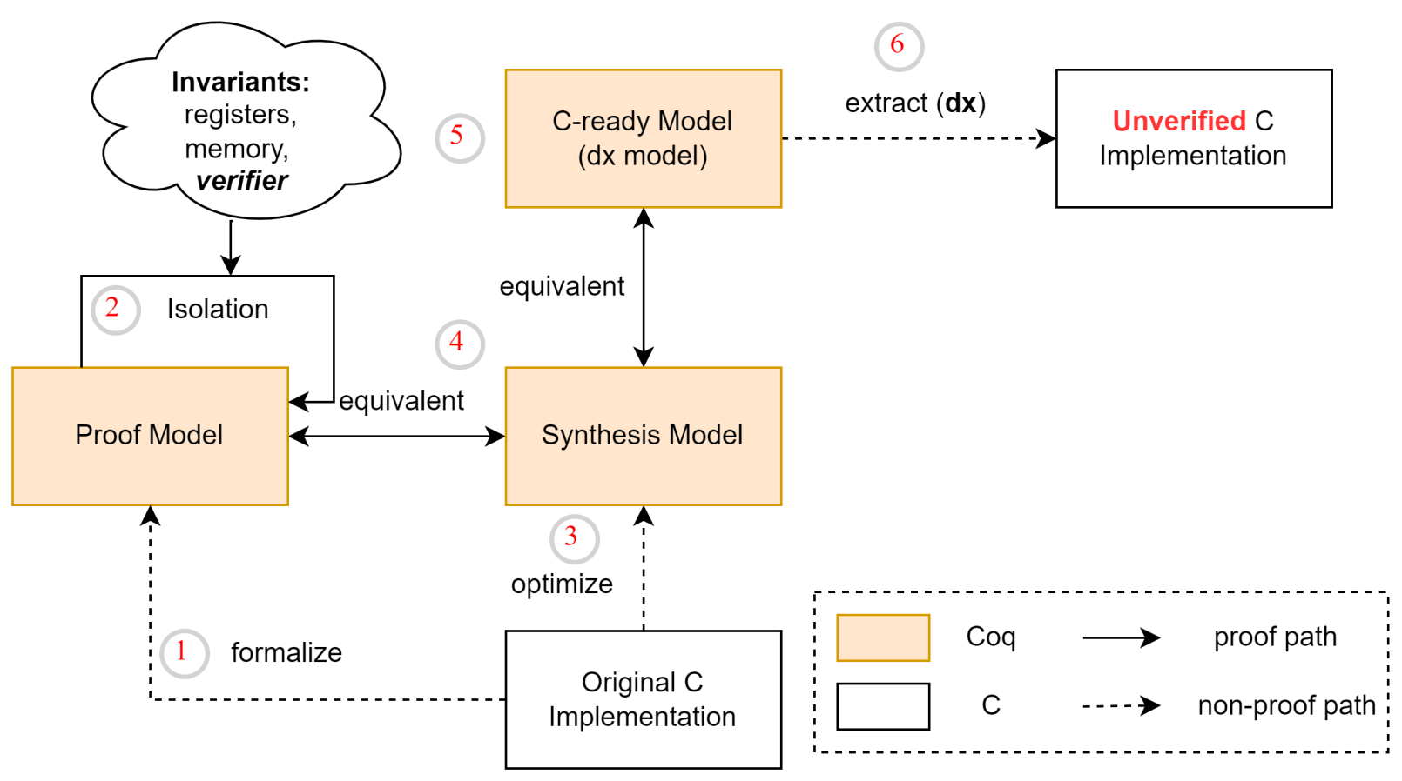
CertrBPF: Synthesis
mapping
info
Automatic extraction
∂x: translates monadic Coq programs to C code
smaller
faster
Notes:
1 -> 2 -> 3…

Slide 9
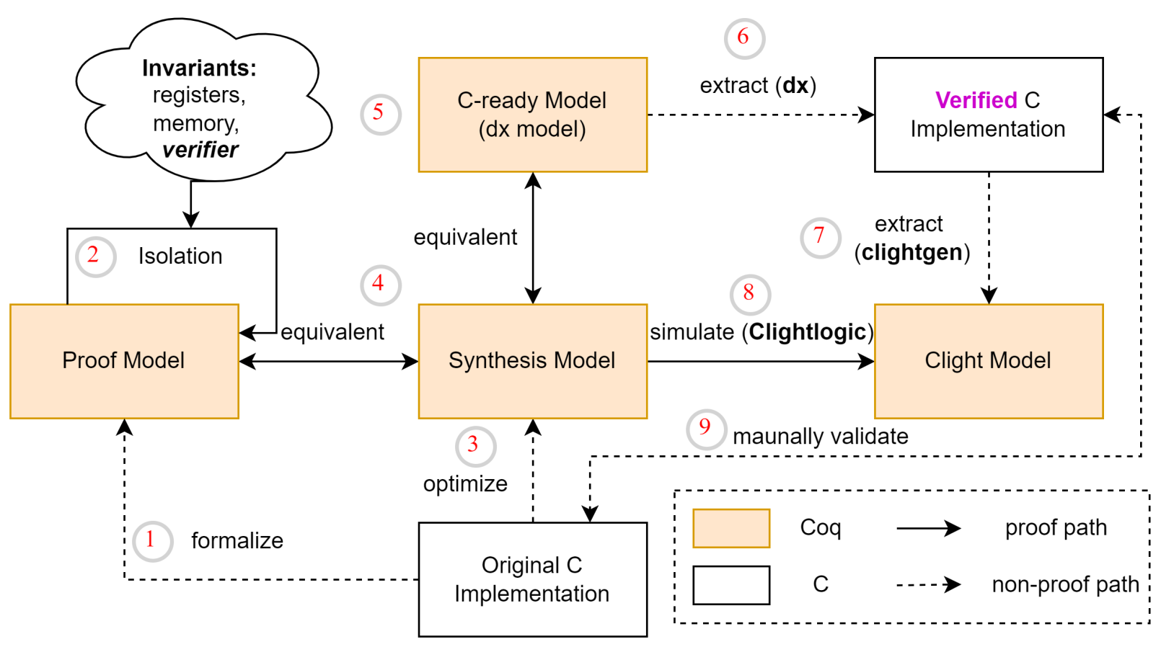
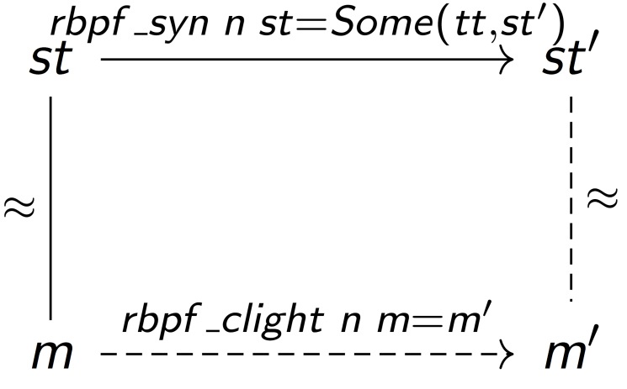

CertrBPF: Simulation
Forward simulation
Clightlogic: a framework for simulation proofs
$$∀ n st m.$$
$st≈m→rbpf_{syn} n st=Some\left(tt,st^{′}\right)→∃ rbpf_{clight} m^{′}.rbpf_{clight} n m=m^{′}∧st^{′}≈m$’

Slide 10
CertrBPF: Evaluation
Safety
CertrBPF
verified implementation;
isolation guarantee.
Original rBPF
issues (58/88: alu+jump+memory…)
verifier: jump out of range;
wrong implementation of instructions;
dynamic checking (align, overflow);
optimization (masking issues);
…
RIOT-OS kernel
rBPF VM
interpreter
verifier

Slide 11
CertrBPF: Evaluation
Safety
fully verified & fault isolation
Footprint
Flash (read-only data)
Stack (stack space)
Context (static RAM)
CertrBPF
Flash: reduces on ESP32 and RISC-V;
Stack: reduces on three platforms;
Context: increases on all platforms
Architecture | ARM | ESP32 | RISC-V
Flash | +6% | -25% | -37%
Stack | -33% | -4% | -22%
Context | 144B-92B | 144B-92B | 144B-92B

Slide 12
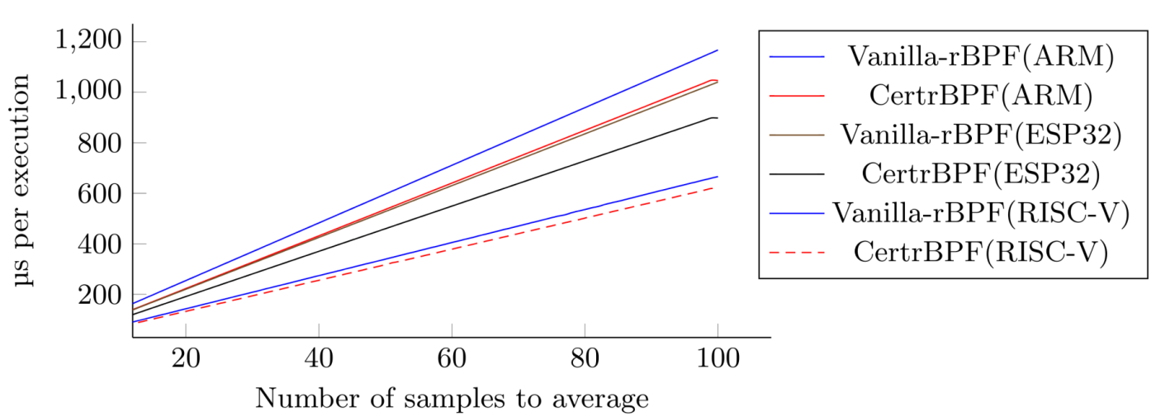
CertrBPF: Evaluation
Safety
fully verified & fault isolation
Footprint
same memory required as original
Performance
better performance
CertrBPF
has better performance
on all platforms

Slide 13
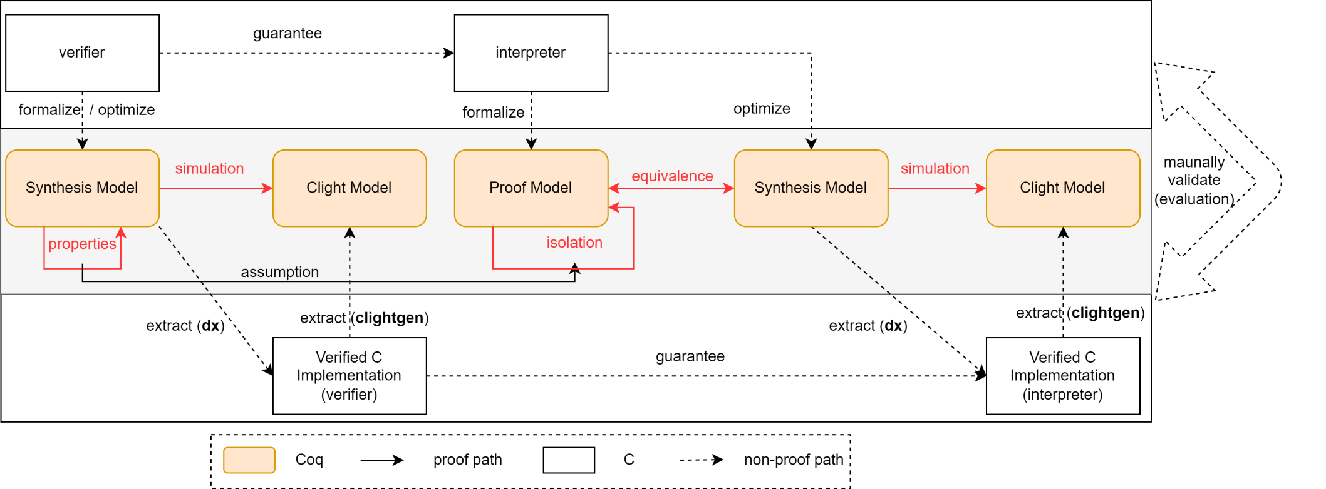
End-to-end Verification Approach
Workflow: Coq models – (dx) – > extracted C
Verifications

Slide 14
Conclusion & Next Step
An end-to-end verification approach from Coq programs to C code
A verified & efficient C implementation
CertrBPF-verifier
CertrBPF-interpreter
We are carrying on
CertrBPF-JIT
A verified rBPF Just-in-Time compiler
that directly translates rBPF binary code into ARM binary code
(https://gitlab.inria.fr/syuan/rbpf-dx/-/tree/jit )
Contact me: https://shenghaoyuan.github.io/

