Slide 1







TECHNOLOGY TREND & STACK OVERFLOW 2019 SURVEY ANALYSIS
Shenghui Susan Su
February 16, 2023

Slide 2



OUTLINE
Executive Summary
Introduction
Methodology
Results
Visualization – Charts
Dashboard
Discussion
Findings & Implications
Conclusion
Appendix

Slide 3

EXECUTIVE SUMMARY
Relevant skills required for developers in the IT and Consulting business are ever changing and evolving. Identify the future skill requirements and trends can be beneficial to help current and aspiring developers, job seekers, students, educators, recruiters, employers, and policy makers to make informed data-driven decisions.
This presentation summarizes key findings from an analysis of data collected as part of the 2019 Stack Overflow Developer Survey. The analysis yielded the following insights :
• Most popular languages, databases, Platforms, and WebFrames technology
• Gender gap among developers and technology divide in countries

Slide 4

INTRODUCTION
The primary objective of the annual Stack Overflow Developer 2019 survey is to gather data regarding technology usage and trends among developer.
In this analysis, a subset of the 2019 dataset was examined (present dataset: N = 11, 398; original dataset N ≈ 90,000).
Audience: Developers (current and aspiring), IT professionals, educators, students, employers, and policy makers

Slide 5

METHODOLOGY
Data Collection (Sources)
Stack overflow developer 2019 survey
GitHub job postings
Programming languages annual salary
Data Wrangling
Data Exploration
Data Cleaning
Data Visualization
Python matplotlib & turtle
IBM Cognos
Presentation

Slide 6
RESULTS
CURRENT TEHNOLOGY TREND
FUTURE TECHNOLOGY TREND
DEMOGRAPHICS FACTORS

Slide 7
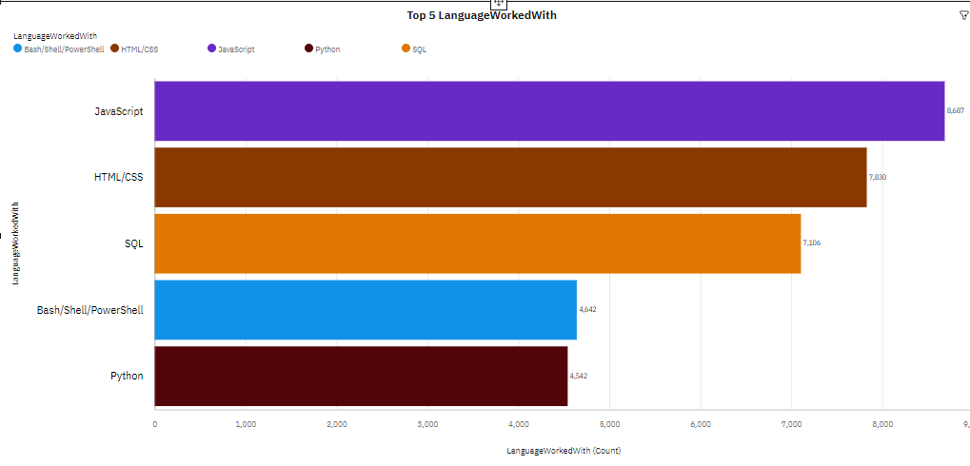
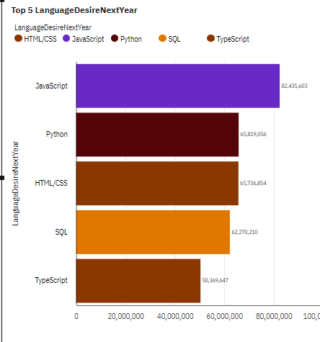
PROGRAMMING LANGUAGE TRENDS
Current Year
Next Year

Slide 8
PROGRAMMING LANGUAGE TRENDS – FINDINGS & IMPLICATIONS
Findings
Javascript, HTML/CSS, and SQL are all time favorites
Modern language such as Python and TypeScript are becoming popular
Decreasing usages in Powershell/Bash and PHP
Implications
Web development is in huge demand and thus any Web API programming language such as Python and TypeScript become as the new trending technology
SQL remains as the leading technology

Slide 9
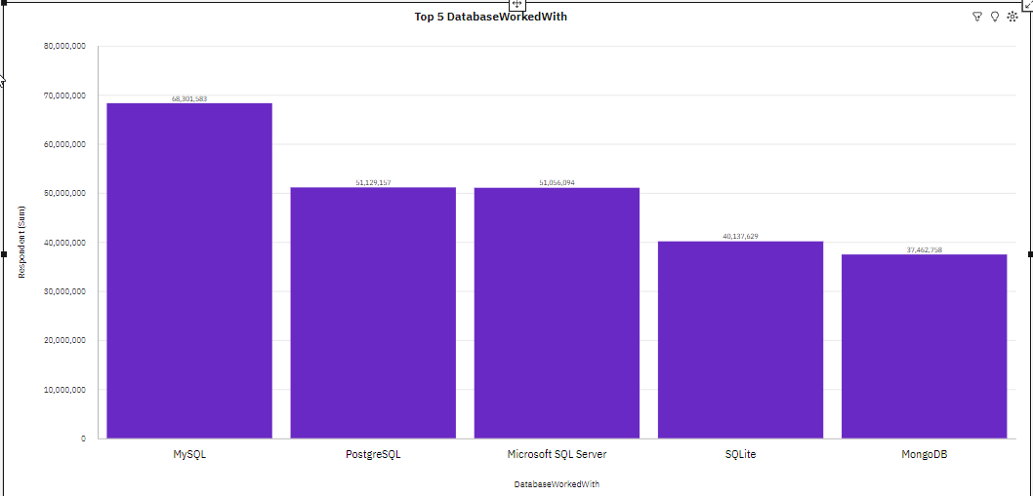
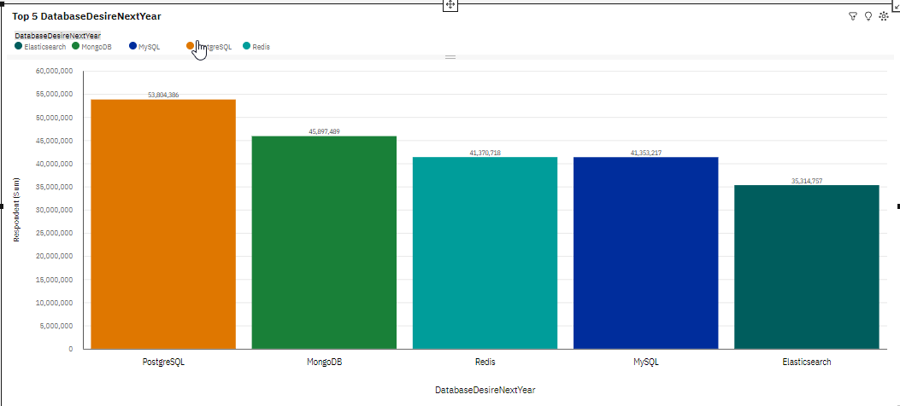
DATABASE TRENDS
Current Year
Next Year

Slide 10
DATABASE TRENDS - FINDINGS & IMPLICATIONS
Findings
MySQL is the most popular database
PostgreSQL is gaining popularity over other SQL database programs
MongoDB was popular and gaining interest
Increasing interest in Elasticsearch.
Implications
Open-source database programs are becoming popular
NoSQL database programs are gaining popularity
Current and aspiring data analysts should develop competence in NoSQL in addition to SQL database programs

Slide 11

DASHBOARD
The following URL shows the image of
the IBM Cognos Dashboard developed to visualize this analysis
(the permanent link is not sharable due to technical issues)
https://github.com/shenghuisusansu/sharing-github/blob/IBM-Data-Analyst-Capstone-Project/IBM%20Cognos%20Dashboard.pdf

Slide 12
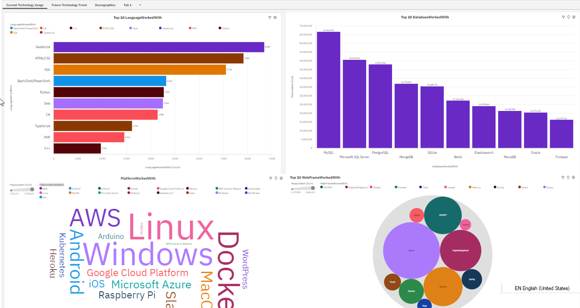
DASHBOARD – Current Technology Trend

Slide 13
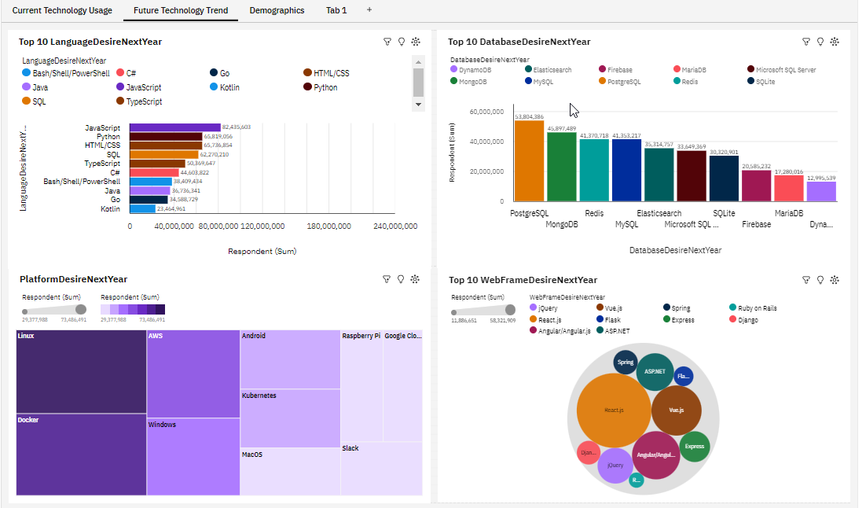
DASHBOARD – Future Technology Trend

Slide 14
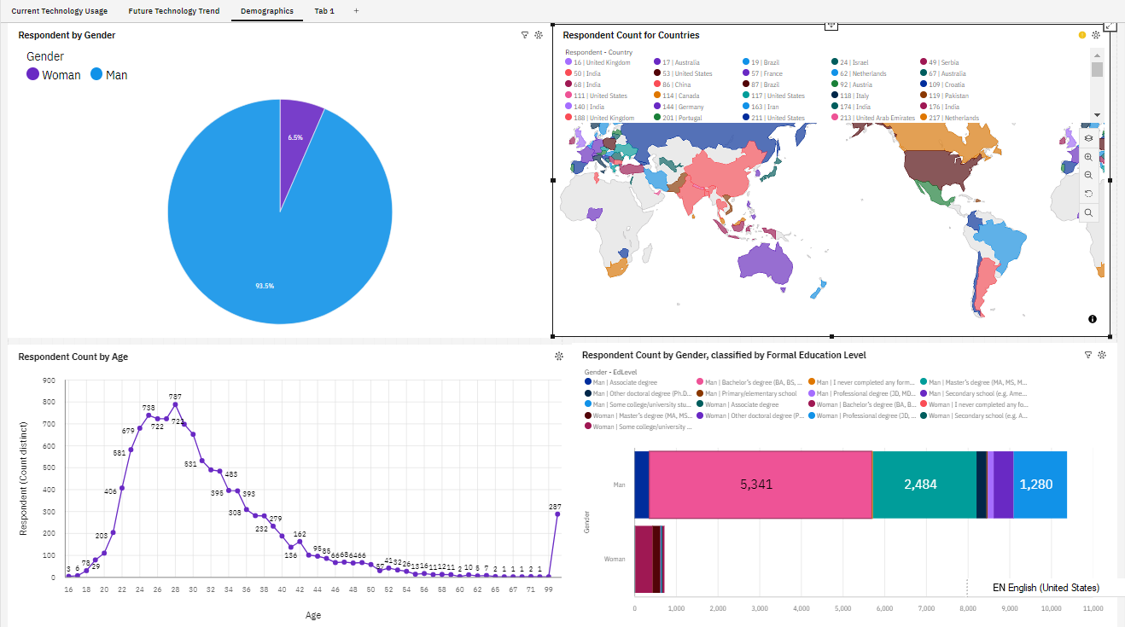
DASHBOARD – Demographics

Slide 15

DISCUSSION
What programming languages and database programs are in top demand?
Which technology should prospective developers and data professionals be learning?
Which technology should our education system focus more to prepare students in upcoming years?
Does higher education and degrees matter?
What is the developer demographics like? Is there a gender representation gap?

Slide 16
OVERALL FINDINGS & IMPLICATIONS
Findings
High Demand Technology:
Javascript, HTML/CSS, Typescript, Python languages
SQL, MySQL, PostgreSQL, MongosDB, and NoSQL database programs
Web API such as React.js and Vue.js
A severe gender representation gap (in favor of men)
Technology divide between countries.
Implications
Web development is still in high demand.
Current and prospective developers may consider picking up Python, Typescript, Javascript and HTML/CSS.
IT professional should continue to enhance competence in both SQL and NoSQL database programs.
Businesses need to adapt to changing technology preferences, especially in terms of talent acquisition and development.
Policy makers, educators, and organizations should work to minimize the gender representation gap in addition to the technology divide between countries.

Slide 17

CONCLUSION
Build job-ready skills for an in-demand career is critical. Based on the analysis of the subset data extracted from the Overflow developer 2019 survey, current and aspiring developers, students, educators, employers, and policy makers are suggested to consider building or gaining exposure of the following skills to keep pace with the changing technologies and remain competitive.
Javascript, HTML/CSS, Typescript, Python languages;
MySQL, PostgreSQL, MongoDB, and NoSQL database programs;
Open source Web API such as REST.js and Vue.js
Policy makers, educators, and organizations should work to minimize the gender representation gap in addition to the technology divide between countries

Slide 18

APPENDIX
APPENDIX A
Job Posting by Programming Language
APPENDIX B
Popular Languages
APPENDIX C
Resources

Slide 19
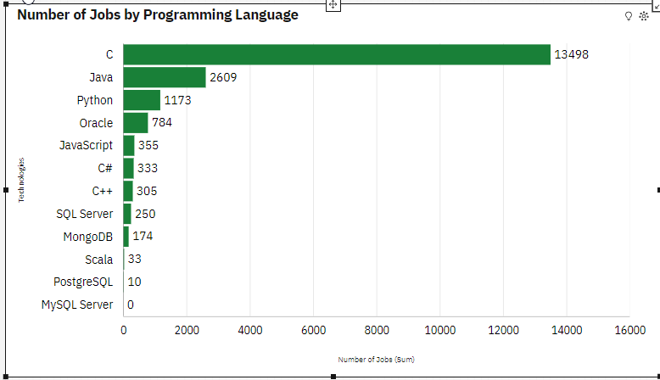
APPENDIX A JOB POSTINGS by Programming Language

Slide 20
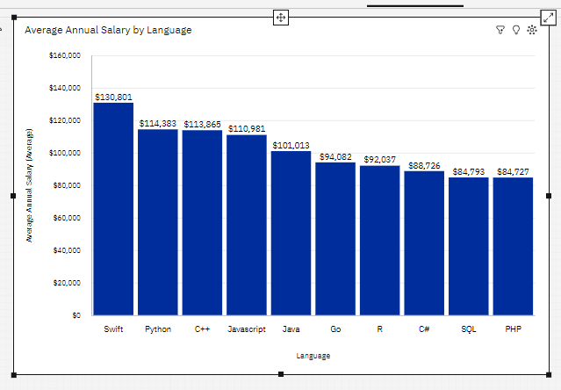
APPENDIX B POPULAR LANGUAGES

Slide 21
APPENDIX C RESOURCES
GitHub job listing
https://www.kaggle.com/promptcloud/jobs-on-naukricom
https://cf-courses-data.s3.us.cloud-object-storage.appdomain.cloud/%E2%86%AAIBM-DA0321EN-SkillsNetwork/labs/datasets/Programming_Languages.html
https://cf-courses-data.s3.us.cloud-object-storage.appdomain.cloud/IBM-DA0321EN-SkillsNetwork/LargeData/m1_survey_data.csv
https://cf-courses-data.s3.us.cloud-object-storage.appdomain.cloud/IBM-DA0321EN-SkillsNetwork/LargeData/m2_survey_data.csv

