Slide 1
LGBTQIA+ Pride Month

Slide 2
Introduction
State the significance of LGBTQIA+ Pride Month
What is LGBTQIA+ Pride Month?
Why does the United States celebrate it?
How do other countries celebrate Pride?
Tell your story
What does LGBTQIA+ Pride Month mean to you?
Why is it important to you?

Slide 3
Overview
Give a brief overview of what you’ll cover in your presentation.

Slide 4
History
Make a timeline of the important historical events or list historical contributions made by the LGBTQIA+ Community.
1st Event | 2nd Event | 3rd Event | 4th Event | 5th Event | 6th Event
Date | Date | Date | Date | Date | Date
Description | Description | Description | Description | Description | Description

Slide 5
Interesting facts
List some interesting facts about LGBTQIA+ Pride Month. Here are a few examples:
The LGBT rights movement in the US was kickstarted in 1969 with the Stonewall riots.
The rainbow flag was designed in 1978 by Gilbert Baker.
President Obama announced the designation of the first national monument to LGBTQIA+ rights in 2016.

Slide 6
Key People
Choose three notable people of LGBTQIA+ Community using Bing.com and discuss their lives and accomplishments. Here are some examples:
Bayard Rustin was an American leader in social movements for civil rights, socialism, nonviolence, and gay rights.
Harvey Milk was an American politician and the first openly gay elected official in the history of California.
Janet Mock is an American writer, television host, director, producer, and transgender rights activist.

Slide 7
Arts and literature
Provide examples of art and literature that are significant to LGBTQIA+ Pride Month. Here are a few examples:
The writings of Patricia Highsmith
The music of Bessie Smith
The artwork of Keith Haring

Slide 8
How to celebrate
List some ways you can celebrate LGBTQIA+ Pride Month. Here are a few examples:
Discover LGBTQIA+ artists
Read LGBTQIA+ authors
Listen to LGBTQIA+ musicians
Learn LGBTQIA+ history

Slide 9
Conclusion
Provide a brief summary of your presentation. Remind the audience what you covered in the previous slides.

Slide 10
Questions & answers
Invite questions from the audience.

Slide 11
Resources
List the resources you used for your research:
Source #1
Source #2
Source #3

Slide 12
测试新增页面标题

Slide 13
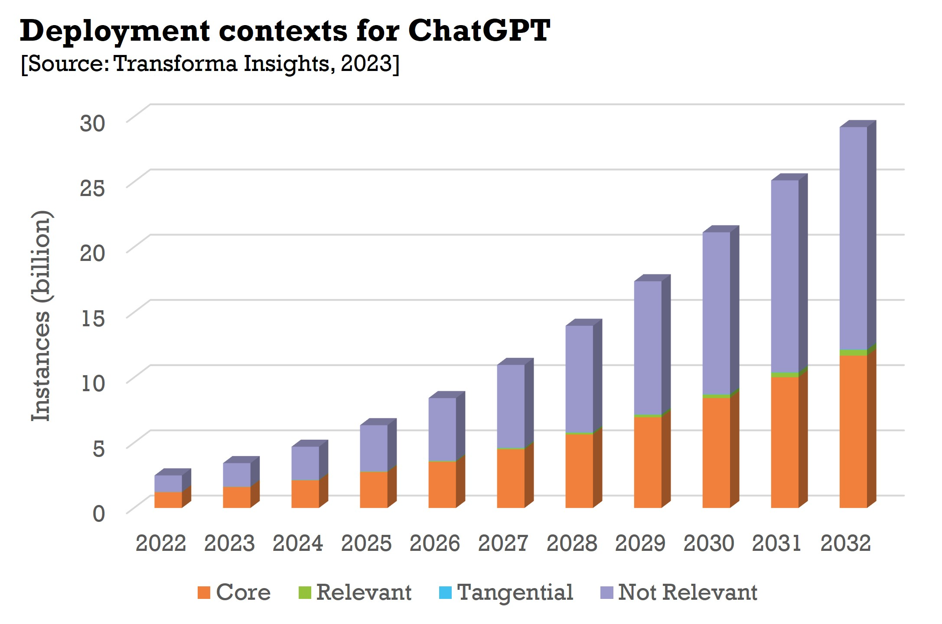
python-pptx 新增文本内容示例
1 | 1
1 | 1
填充原有的文本占位符
额外的文本框内容
这是一个新的段落。 这部分是加粗的文本。

