Slide 1
VMCS with a new perspective
Object Oriented Design Pattern (Continual Assessment)

Slide 2
Agenda
Design Problem
Candidate Design Pattern(s)
Motivation
Structure of Pattern
Class and Sequence Diagrams
Implementation Issues
A short demo of a use case

Slide 3
Design Problem
The ChangeGiver class is implementing the giveChange method which does an explicit “for loop” for every denomination
In this case, the sender needs to know each and every requester

Slide 4
Candidate Design Patters(s)
Design Patterns | Chain of Responsibility | Mediator
Intent | A handler is used for processing the message. Different handlers process different requests. | A mediator object is used to send messages from requesters to the appropriate classes.
Applicability | When there is a need for loose coupling, we can use this pattern to decouple the requester and receiver classes. | When there is a need for loose coupling, we can use this pattern by removing direct dependencies between classes.
Decision | We have decided to use the Chain of Responsibility design pattern. Each process will be handled by the respective handler. We decided not to have a mediator object to send messages. Chain of Responsibility design pattern allows loose coupling between the client and handler, in this case ChangeGiver class, and the handlers processing the requests. Each domination of change will be handled by the respective class. We need to dispense the larger denomination and subsequently the next bigger denominations sequentially. Therefore, each denomination need not know the others.

Slide 5
Motivation
We have decided to use the Chain of Responsibility design pattern. Each process will be handled by the respective handler. We decided not to have a mediator object to send messages since we know the sequence of which denomination to call
Chain of Responsibility design pattern allows loose coupling between the client and handler, in this case ChangeGiver class, and the handlers processing the requests. Each denomination of change will be handled by the respective class.

Slide 6
Structure of Pattern

Slide 7
Structure of Pattern
Client | ChangeGiver.java
Handler | ChangeGiverHandler.java
ConcreteHandler | CurrencyOneDollarChangeGiverHandler
 | CurrencyFiftyCentsChangeGiverHandler
 | CurrencyTwentyCentsChangeGiverHandler
 | CurrencyTenCentsChangeGiverHandler
 | CurrencyFiveCentsChangeGiverHandler

Slide 8
Class and Sequence Diagrams (Existing)

Slide 9
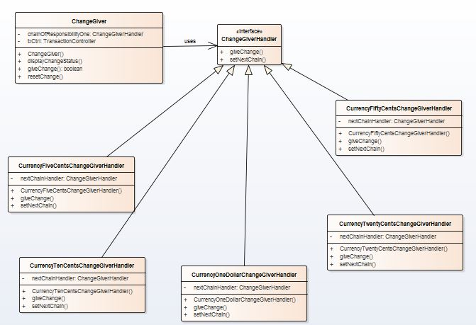
Class and Sequence Diagrams (Revised)

Slide 10
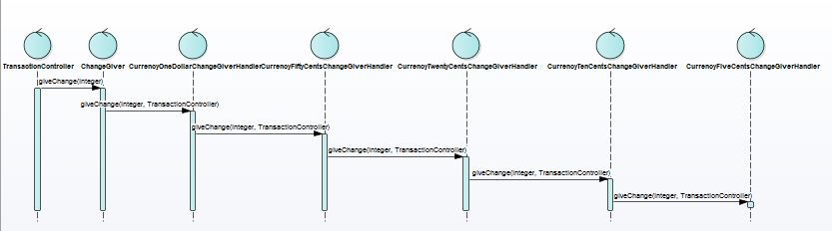
Class and Sequence Diagrams (Revised)

Slide 11
Implementation Issues
Issue | Rationale
Implementing the successor chain | The new links can be defined either in the Handler or the ConcreteHandler. For our implementation, the new links are defined in the ConcreteHandler itself. The following will list the sequence of calling the different handlers (based on dominations). One dollar 50 cents 20 cents 10 cents 5 cents
Connecting Successors | The handler does not maintain the successor for forwarding the requests. It is handled solely by the Client.
Representing Requests | Request parameter is taken as request code. The amount to be returned and the transaction controller are the parameters in this case. Since the change can be any amount, taking in a parameter will allow more flexibility on how the change is processed. But we are not using any Request class to bundle the request parameters.

Slide 12
A Short Demo – Code Snippet
// initialize the chain
this.chainOfResponsibilityOne = new CurrencyOneDollerChangeGiverHandler();
ChangeGiverHandler chainOfResponsibilityTwo = new CurrencyFiftyCentsChangeGiverHandler();
ChangeGiverHandler chainOfResponsibilityThree = new CurrencyTwentyCentsChangeGiverHandler();
ChangeGiverHandler chainOfResponsibilityFour = new CurrencyTenCentsChangeGiverHandler();
ChangeGiverHandler chainOfResponsibilityFive = new CurrencyFiveCentsChangeGiverHandler();
// set the chain of responsibility
chainOfResponsibilityOne.setNextChain(chainOfResponsibilityTwo);
chainOfResponsibilityTwo.setNextChain(chainOfResponsibilityThree);
chainOfResponsibilityThree.setNextChain(chainOfResponsibilityFour);
chainOfResponsibilityFour.setNextChain(chainOfResponsibilityFive);

Slide 13
A Short Demo – Code Snippet
/**
* @param nextChain The next handler for calculating the number of coins and the corresponding dominations for returning change
*/
void setNextChain(ChangeGiverHandler nextChain);
/**
* This method will calculate the number of 1 dollar, 50, 20, 10, and 5 cents to be returned to customer
* @param change The change that needs to be returned to customer
* @param txCtrl The TransactionController to set the number of coins their dominations
* @throws VMCSException If txCtrl fails to update cash store display on the amount to return
*/
void giveChange(int change, TransactionController txCtrl) throws VMCSException;

Slide 14
Thank you

