Slide 1
NETS 212: Scalable and Cloud Computing
Cloud storage
September 17, 2015

Slide 2
Announcements
HW1MS1 is due at 10pm tonight
This time it’s true!
Jokers are available
Please save them for unforeseen events!!
HW1MS2 is now available
Please start early!!
The first midterm is on October 1st
Open-book, open-notes

Slide 3
Plan for today
Key-value stores (KVS)
Basic concept; operations
Examples of KVS
KVS and concurrency
Key-multi-value stores; cursors
Key-value stores in the Cloud
Challenges
Specialized KVS
Two implementations
Amazon S3
Amazon DynamoDB
NEXT

Slide 4
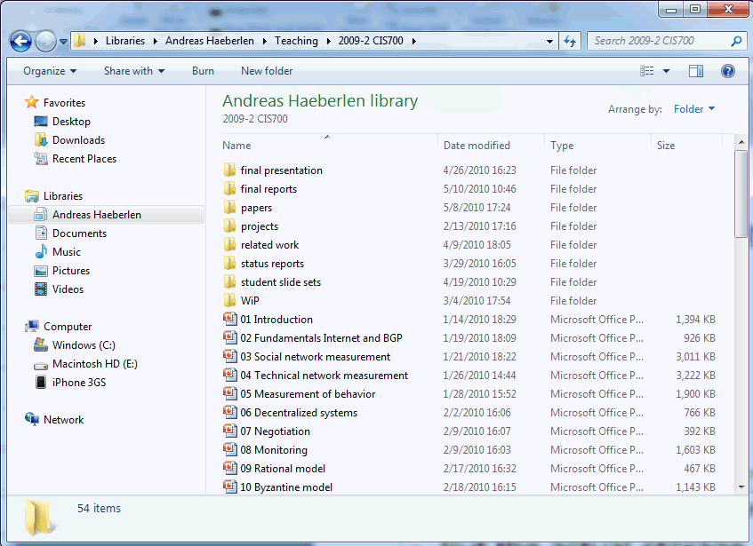



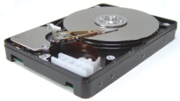
Complex service, simple storage
Variable-size files - read, write, append - move, rename - lock, unlock - ...
Operating system
Fixed-size blocks - read - write
PC users see a rich, powerful interface
Hierarchical namespace (directories); can move, rename, append to, truncate, (de)compress, view, delete files, ...
But the actual storage device is very simple
HDD only knows how to read and write fixed-size data blocks
Translation done by the operating system

Slide 5
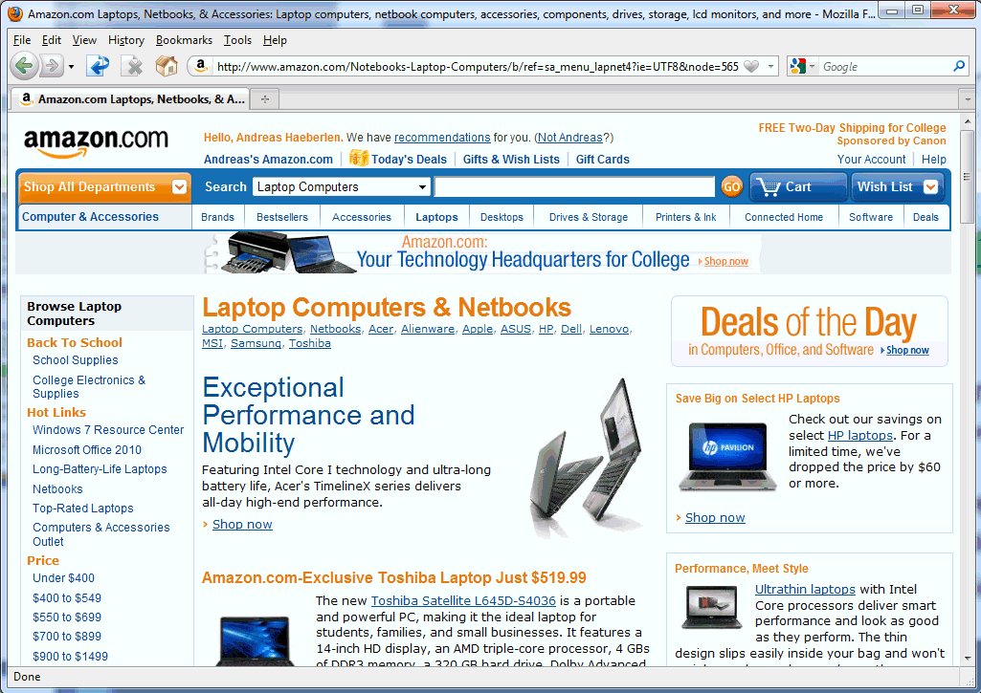


Analogy to cloud storage
Shopping carts Friend lists User accounts Profiles ...
Web service
Key/value store - read, write - delete
Many cloud services have a similar structure
Users see a rich interface (shopping carts, product categories, searchable index, recommendations, ...)
But the actual storage service is very simple
Read/write 'blocks', similar to a giant hard disk
Translation done by the web service

Slide 6

Key-value stores
Keys
Values
(bob, bschmitt@foo.com)
(gettysburg, "Four score and seven years ago...")
(29ck2dxa1, 0128ckso1$9#*!!8349e)
(windows, )
The key-value store (KVS) is a simple abstraction for managing persistent state
Data is organized as (key,value) pairs
Only three basic operations:
PUT(key, value)
GET(key) → value
Delete(key)

Slide 7
Examples of KVS
Where have you seen this concept before?
Conventional examples outside the cloud:
In-memory associative arrays and hash tables – limited to a single application, only persistent until program ends
On-disk indices (like BerkeleyDB)
"Inverted indices" behind search engines
Database management systems – multiple KVSs++
Distributed hashtables (e.g., on top of Chord/Pastry)

Slide 8

Plan for today
Key-value stores (KVS)
Basic concept; operations
Examples of KVS
KVS and concurrency
Key-multi-value stores; cursors
Key-value stores in the Cloud
Challenges
Specialized KVS
Two implementations
Amazon S3
Amazon DynamoDB
NEXT

Slide 9
Supporting an Internet service with a KVS
We’ll do this through a central server, e.g., a Web or application server
Two main issues:
There may be multiple concurrent requests from different clients
These might be GETs, PUTs, DELETEs, etc.
These requests may come from different parts of the network, with message propagation delays
It takes a while for a request to make it to the server!
We’ll have to handle requests in the order received (why?)
A
B
S

Slide 10
Managing concurrency in a KVS
What happens if we do multiple GET operations in parallel?
... over different keys?
... over the same key?
What if we do multiple PUT operations in parallel? or a GET and a PUT?
What is the unit of protection (concurrency control) that is necessary here?

Slide 11
Concurrency control
Most systems use locks on individual items
Each requestor asks for the lock
A lock manager processes these requests (typically in FIFO order) as follows:
Lock manager grants the lock to a requestor
Requestor makes modifications
Then releases the lock when it’s done
There are several kinds of locks, and several other alternatives
Example: S/X lock
See CIS 455 for more details

Slide 12
Limitations of per-key concurrency control
Suppose I want to transfer credits from my WoW account to my friend’s?
… while someone else is doing a GET on my (and her) credit amounts to see if they want to trade?
This is where one needs a database management system (DBMS) or transaction processing manager (app server)
Allows for “locking” at a higher level, across keys and possibly even systems (see CIS 330 for more details)
Could you implement higher-level locks within the KVS? If so, how?

Slide 13
Plan for today
Key-value stores (KVS)
Basic concept; operations
Examples of KVS
KVS and concurrency
Key-multi-value stores; cursors
Key-value stores in the Cloud
Challenges
Specialized KVS
Two implementations
Amazon S3
Amazon DynamoDB
NEXT

Slide 14
Key-Multi-Value stores
What if I want to have multiple values for the same key in a KVS?
Example: Multiple images with the same search keyword
Option 1: Make the “value” a collection object like a set
Then PUT really becomes GET → add → PUT
Option 2: Allow the KVS to store multiple values per key
Requires a cursor that scrolls through the matches
Similar to Java's notion of an iterator

Slide 15
Accessing data
with a cursor
How can we retrieve all the values a particular key maps to?
There could be a very large number of them (remember HW1MS1!)
Idea: Use a cursor
Follows the following programming pattern:
cursor = kvs.getFirstMatch(key);
while (cursor != null) { value = cursor.getValue(); cursor = kvs.getNextMatch(key, cursor); }

Slide 16
Recap: Key-value stores
KVS: A simple abstraction for managing persistent data state
Interface consists only of PUT and GET (+possibly DELETE)
Some variants allow multiple values per key
Examples: Distributed hashtables, associative arrays, ...
Extremely scalable implementations exist
Challenge: Concurrency control
From the perspective of the KVS, values for different keys are independent
Difficult to change multiple values atomically
Some applications may require higher-level locking

Slide 17
Plan for today
Key-value stores (KVS)
Basic concept; operations
Examples of KVS
KVS and concurrency
Key-multi-value stores; cursors
Key-value stores in the Cloud
Challenges
Specialized KVS
Two implementations
Amazon S3
Amazon DynamoDB
NEXT

Slide 18
Key-Value stores on the Cloud
Many situations need hosting of large data sets
Examples: Amazon catalog, eBay listings, Facebook pages, …
Ideal: Abstraction of a 'big disk in the clouds', which would have:
Perfect durability – nothing would ever disappear in a crash
100% availability – we could always get to the service
Zero latency from anywhere on earth – no delays!
Minimal bandwidth utilization – we only send across the network what we absolutely need
Isolation under concurrent updates – make sure data stays consistent

Slide 19
The inconveniences of the real world
Why isn't this feasible?
The “cloud” exists over a physical network
Communication takes time, esp. across the globe
Bandwidth is limited, both on the backbone and endpoint
The “cloud” has imperfect hardware
Hard disks crash
Servers crash
Software has bugs
Can you map these to the previous desiderata?

Slide 20
Finding the right tradeoff
In practice, we can't have everything
... but most applications don't really need 'everything'!
Some observations:
Read-only (or read-mostly) data is easiest to support
Replicate it everywhere! No concurrency issues!
But only some kinds of data fit this pattern – examples?
Granularity matters: “Few large-object” tasks generally tolerate longer latencies than “many small-object” tasks
Fewer requests, often more processing at the client
But it’s much more expensive to replicate or to update!
Maybe it makes sense to develop separate solutions for large read-mostly objects vs. small read-write objects!
Different requirements → different technical solutions

Slide 21
Specialized KVS
Cloud KVS are often specialized for a particular tradeoff or usage scenario
Example: Amazon’s solutions
Simple Storage Service (S3):
large objects – files, virtual machines, etc.
assumes objects change infrequently
objects are opaque to the storage system
SimpleDB/DynamoDB:
small objects – Java objects, records, etc.
generally updated more frequently; greater need for consistency
generally multiple attributes or properties, which are exposed to the storage system

Slide 22
Recap: KVS on the cloud
Ideally, we would simply like the abstraction of a 'big disk in the cloud'
Perfect durability, availability, consistency, throughput, ...
Practical constraints require compromises
Propagation delay, unreliable hardware/software, ...
Hence, we need to make the right tradeoff
For example, specialize KVS for particular workloads
No one-size-fits-all solution; different solutions are useful in different situations

Slide 23
Plan for today
Key-value stores (KVS)
Basic concept; operations
Examples of KVS
KVS and concurrency
Key-multi-value stores; cursors
Key-value stores in the Cloud
Challenges
Specialized KVS
Two implementations
Amazon S3
Amazon DynamoDB
NEXT

Slide 24
Big Objects: Amazon S3
S3 = Simple Storage System
Think roughly of an Internet file system
Stores large objects (=values) that may have access permissions
Used in “cloud backup” services like Jungle Disk
Used to distribute software packages
Used internally by Amazon to store virtual machines
“Up to 99.99999999% durability, 99.99% availability” (“ten nines” and “four nines”)

Slide 25
S3: Key concepts
S3 consists of:
objects – named items stored in S3
buckets of objects – think of these as volumes in a filesystem
the console includes a notion of folders, but these are not intrinsic to S3
Names within a bucket must uniquely identify a single object
i.e., keys must be unique

Slide 26
S3: Keys and objects
What can we use as keys?
Keys can be any string
What can we use as objects?
Objects can be from 1 byte to 5 TB, any format
Number of objects is 'unlimited'
Where can objects be stored?
Can be assigned to specific geographic regions (Washington, Virginia, California, Ireland, Singapore, Tokyo, ...)
Why is this important? (name at least four reasons!)
low latency to customer
minimize fault correlation
regulatory/legal requirements
low-storage-cost regions

Slide 27
S3: Different ways to access objects
Objects in S3 can be accessed
... via REST or SOAP
... via BitTorrent
... over the web: http://s3.amazonaws.com/bucket/key
Web Services use HTTP (the Web browser protocol over sockets) and XML to send requests and data
AWS Console also enables configuration
We’ll mostly be using Java(script) libraries to interact with S3
You’ll just call them as normal functions, but they will open and close sockets as necessary
http://bitbucket.org/jmurty/jets3t/wiki/Home
http://aws.amazon.com/sdkfornodejs/

Slide 28
S3: Access permissions
Permissions are assigned through Access Control Lists (ACLs)
Essentially, a list of users/groups → permissions
Bucket permissions are inherited by objects unless overridden at the object level
What can you control?
Can be at the level of buckets or individual objects
Available rights: Read, write, read ACL, write ACL
Possible grantees: Everyone, authenticated users, specific users (by AWS account email address)

Slide 29
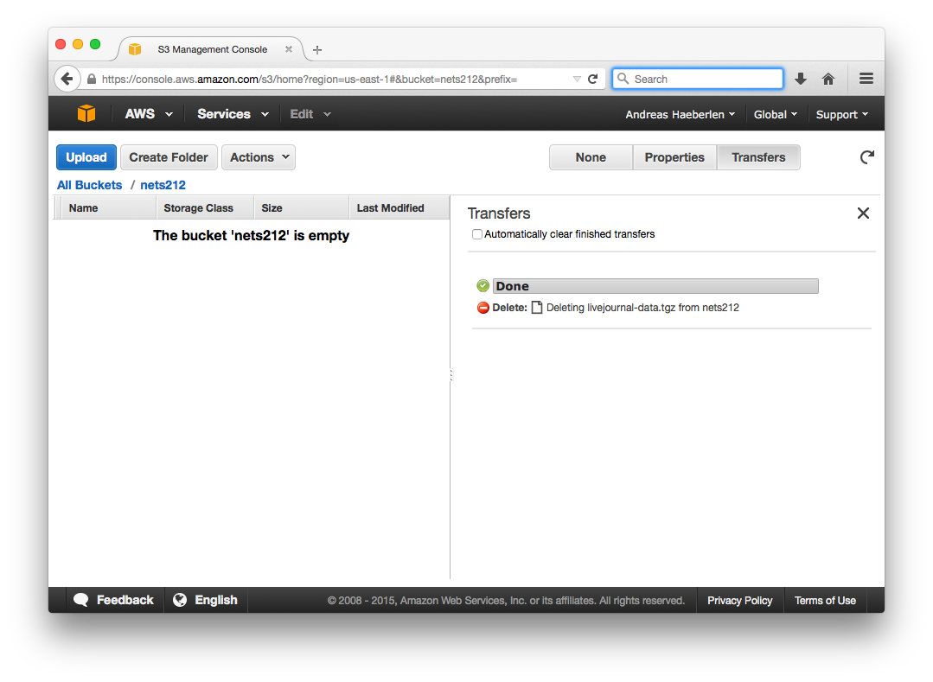
S3: Uploading an object
Step 1: Hit 'upload' in management console

Slide 30
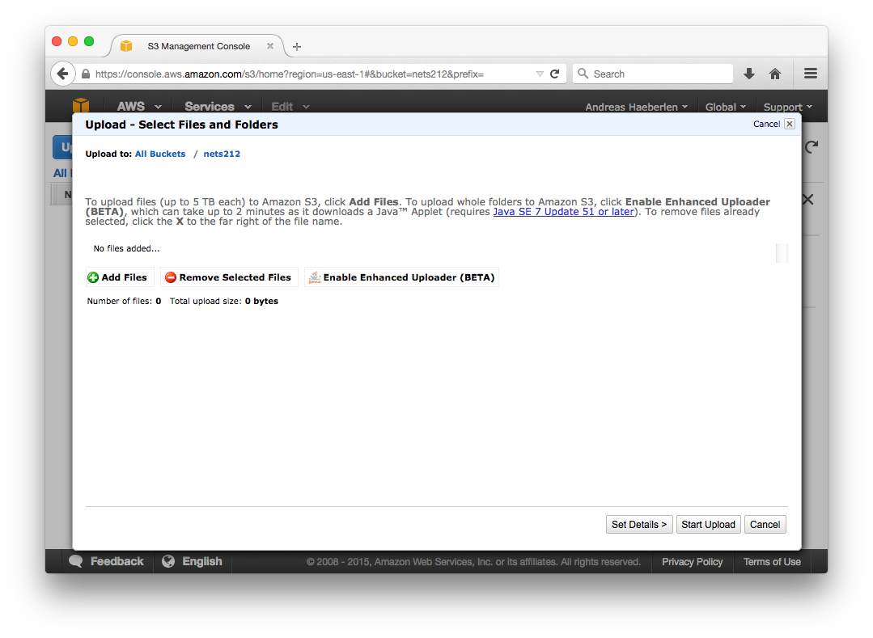
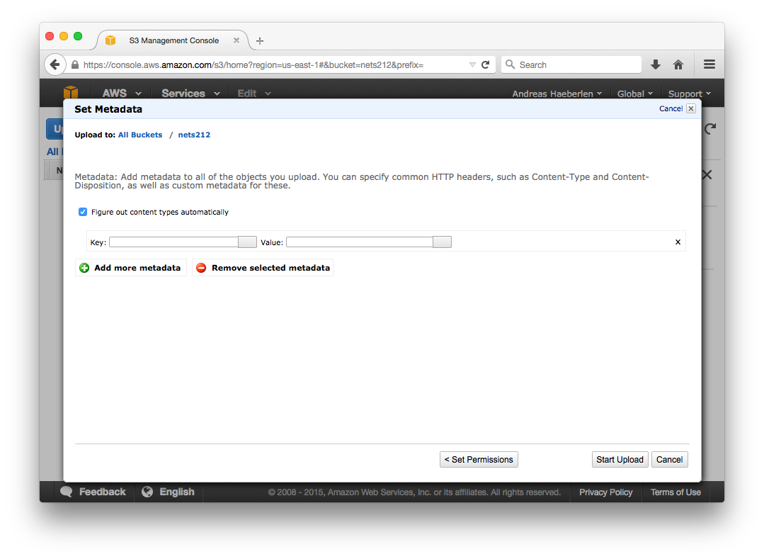
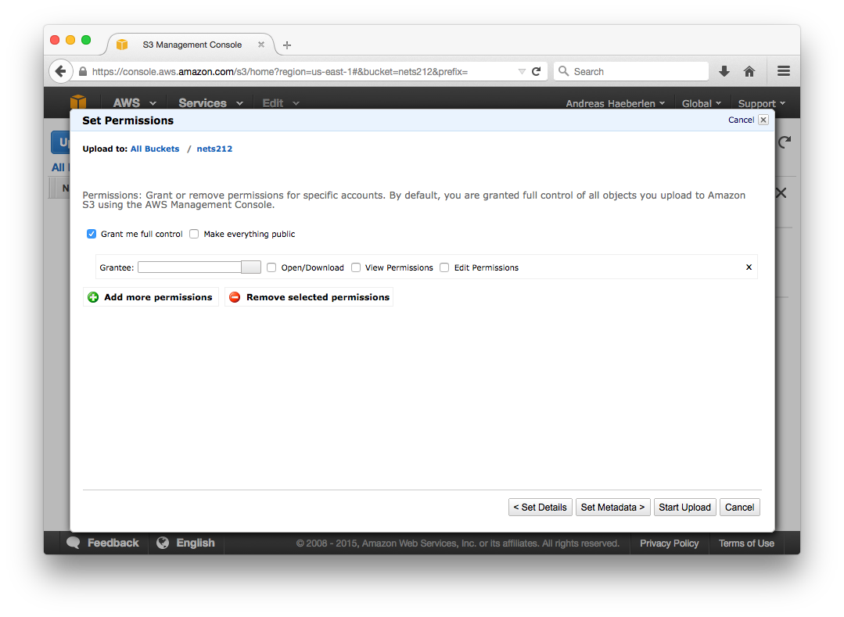
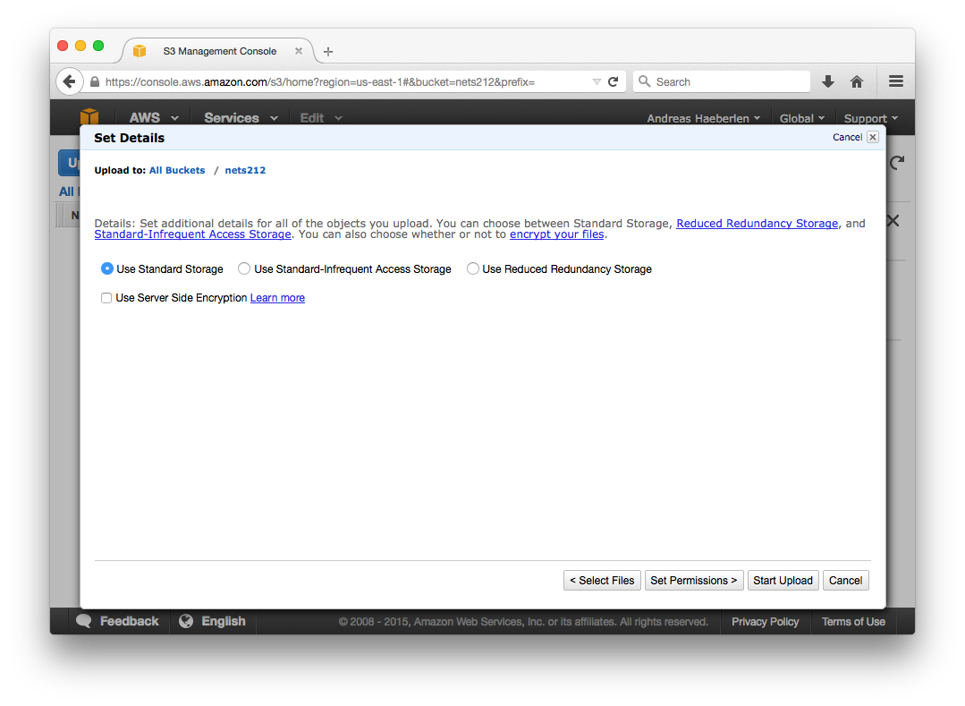
S3: Uploading an object
Step 2: Select files
Step 3: Choose storage class
Standard, reduced redundancy, or infrequent access
Step 3: Set metadata (or accept default)
Step 4: Set permissions (or make public)

Slide 31
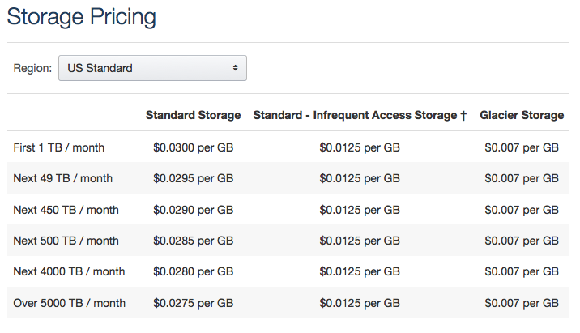
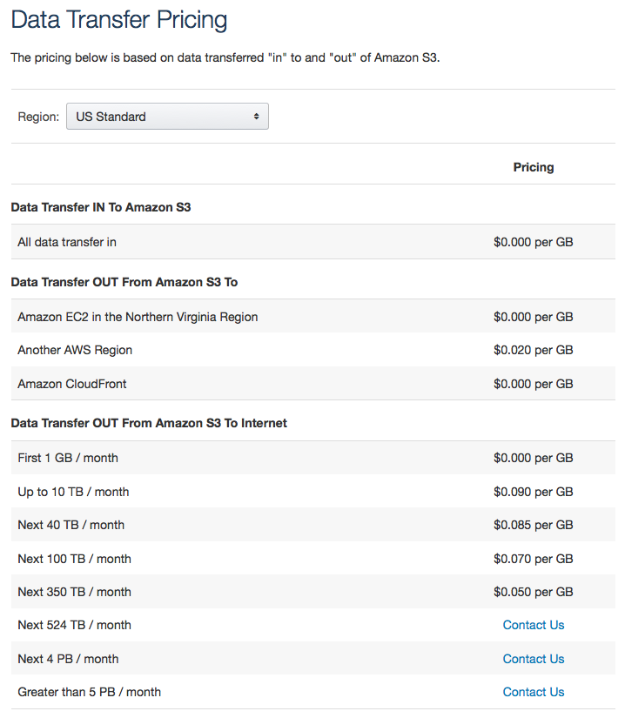
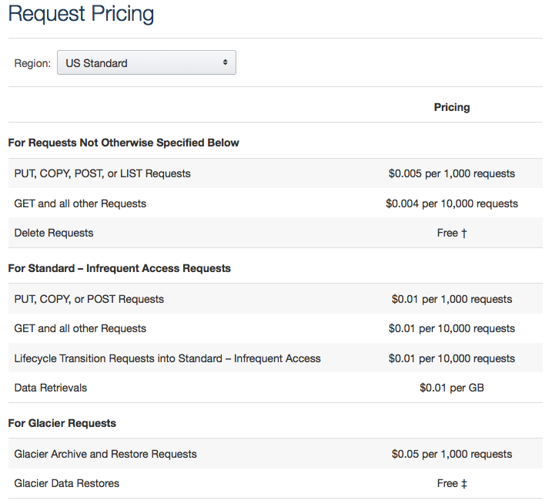
S3: Current pricing and usage
http://aws.amazon.com/s3/ (9/16/2015)

Slide 32
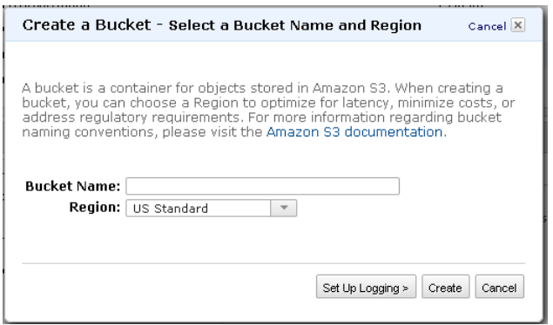
S3: Bucket operations
Create bucket
(optionally versioned; see later)
Delete bucket
List all keys in bucket (may not be 100% up to date)
Modify bucket permissions
Source: Amazon S3 User’s Guide

Slide 33
S3: Object operations
PUT object in bucket
GET object from bucket
DELETE object from bucket
Modify object permissions
The key issue: How do we manage concurrent updates?
Will I see objects you delete? the latest version? etc.

Slide 34
S3: Consistency models
Consistency model depends on operations
read-after-write consistency for PUTs of new objects
eventual consistency for overwrite PUTs and DELETEs
Read-after-write consistency:
Each read or write operation becomes effective at some point between its start time and its completion time
Reads return the value of the last effective write
W1: Cat
R1
Client 1:
Client 2:
W2: Dog
R2
Time

Slide 35
S3: Versioning
S3 handles consistency through versioning rather than locking
The idea: every bucket + key maps to a list of versions
[bucket+key] → [object v1] [object v2] [object v3] …
Each time we PUT an object, it gets a new version
The last-received PUT overwrites any previous ones!
When we GET:
An unversioned request likely receives the last version – but this is not guaranteed depending on propagation delays
A request for bucket + key + version uniquely maps to a single object!
Versioning can be enabled for each bucket
Why would you (not) want versioning?

Slide 36
Recap: Amazon S3
A key-value store for large objects
Buckets, keys, objects, folders
Various ways to access objects, e.g., HTTP and BitTorrent
Provides eventual consistency
+/- a few details that depend on the region
Supports versioning and access control
Access control is based on ACLs

Slide 37
Plan for today
Key-value stores (KVS)
Basic concept; operations
Examples of KVS
KVS and concurrency
Key-multi-value stores; cursors
Key-value stores in the Cloud
Challenges
Specialized KVS
Two implementations
Amazon S3
Amazon DynamoDB
NEXT

Slide 38

What is Amazon DynamoDB?
A highly scalable, non-relational data store
Despite its name, not really a database
Stronger consistency guarantees than S3
Highly scalable; built-in replication; automatic indexing
Fine-grained access control
No 'real' transactions, just a conditional put/delete
No 'real' relations, just a fairly basic select
S3
DynamoDB
RDS

Slide 39
A bit of history
Early 2000s: Amazon is bursting at the seams
So far, relying on commercially available technologies
But: various outages directly attributable to scalability limits, e.g., during the 2004 holiday shopping season
Need an ultra-scalable, highly reliable KV database!
2007: Dynamo paper published at SOSP
Used to power various core Amazon services, such as S3
But many developers preferred SimpleDB
Dynamo never adopted much beyond the core services.
Reason: Operational complexity. SimpleDB "just works"!
But SimpleDB has a number of important limitations (e.g., some operations assume that all of a table's data is on a single server!)

Slide 40
A bit of history
2012: DynamoDB introduced
Combines "lessons learned" from both SimpleDB and Dynamo
Inherits scalability & high performance from Dynamo
Inherits SimpleDB's richer data model & ease of use

Slide 41
DynamoDB: Data model
Name (key)
Attributes (key-multivalue)
CustomerID | First name | Last name | Street address | City | State | Zip | Email
123 | Bob | Smith | 123 Main St | Springfield | MO | 65801
456 | James | Johnson | 456 Front St | Seattle | WA | 98104 | james@foo.com
Items
Somewhat analogous to a spreadsheet:
Tables: Analogous to buckets
Items: Names with attribute-multivalue sets
For example, an item could have more than one street address
It is possible to add attributes later
'No' pre-defined schema

Slide 42
Indexes
Each table must have a primary key
Either one attribute (hash), or two (hash+range)
Must be unique
This is used internally to create a kind of index
You can create secondary indexes
Must be specified when the table is created

Slide 43
DynamoDB: Basic operations
ListTables, CreateTable, DeleteTable
DescribeTable, UpdateTable
GetItem/PutItem
Also Batch{Get,Write}Item
Supports conditional put
UpdateItem/DeleteItem
Query
Scan

Slide 44
DynamoDB: PUT and GET
PutItem has a very simple model:
Specify the table and the primary key
[key] → [list of name/value pairs], where we list Attribute.1.Name, Attribute.1.Value, etc.
GetItem
Specify the table and the primary key
Can have a 'projection expression' that specifies which attributes to get
Can choose whether the read should be consistent or not
What are the advantages of each choice?

Slide 45
DynamoDB: Conditional Put
DynamoDB also supports a conditional put
Item is updated only if a certain predicate holds for the existing item
Can test for presence/absence of attributes, attribute values, ...
Can we use this to guarantee consistency?
Idea: implement a version number, e.g., like this:
do {
List<Attributes> attribs = kvs.getAttributesFor(key);
... update the attribute values as we like ...
retCode = kvs.conditionalPut(key, attribs, (“version”, attribs.get(“version”)));
} while (retcode == ErrorCode.ConditionalCheckFailed);

Slide 46
DynamoDB: Query
Used to retrieve items via primary index or secondary index
Can ask for a specific hash key, or a certain range of range key values for a specific hash key
Example: Query the "DiscussionForum" table for a particular "Forum" name (hash key), or for a particular "Forum" (hash key) with a certain range of post times (range key)
Can filter results (similar to SQL's "where")
Can specific which attributes to return (similar to SQL's "select a,b,c from...")
Can choose whether or not reads should be consistent
Supports a cursor (via ExclusiveStartKey/LastEvaluatedKey)

Slide 47
DynamoDB: Scan
Used to retrieve arbitrary items
Internally performs a scan of the entire (!) table, then applies whatever filters and projections you specify
Flexible, but expensive!

Slide 48
Example: Indexer for a search engine

Slide 49
Alternatives to DynamoDB
There is a similar service to DynamoDB underneath most major “cloud” companies’ infrastructure
Google calls theirs BigTable
Yahoo’s is called PNUTS
See reading list at the end
All consist of items with a variable set of attribute-value pairs
More flexible than a relational DBMS table
But don’t support full-fledged transactions

Slide 50
Recap: Amazon DynamoDB
A scalable NoSQL data store
Tables, items, attributes, indexes, hash/range keys
Stronger consistency than S3
No pre-defined schema

Slide 51
Plan for today
Key-value stores (KVS)
Basic concept; operations
Examples of KVS
KVS and concurrency
Key-multi-value stores; cursors
Key-value stores in the Cloud
Challenges
Specialized KVS
Two implementations
Amazon S3
Amazon SimpleDB

Slide 52
Where could we go beyond this?
KVSs present one of the simplest data represen-tations: key + one or more objects/properties
Some alternatives:
Relational databases represent data as interlinked tables (in essence, a limited form of a graph)
Hierarchical storage systems represent data as nested entities
More general graph storage might represent entire graph structures with links
All are implementable over a KVS
But all allow higher level requests (e.g., paths), and might optimize for this
Example: I know that the customer always asks for images related to patients’ records, so maybe we should put the two in the same place

Slide 53
Summary: Cloud Key/Value Stores
Attempt to provide very high durability, availability in a persistent, geographically distributed storage system
Need to choose compromises due to limitations of communications, hardware, software
Large, seldom-changing objects – eventual consistency and versioned model in S3
Small, more frequently changing objects – lower-latency response, conditional updates in DynamoDB
Both are useful in different situations
We’ll be using DynamoDB in our assignments, incl HW1M2

Slide 54
Further reading
A. Rowstron and P. Druschel: "Storage management and caching in PAST, a large-scale, persistent peer-to-peer storage utility" (SOSP'01)
http://www.research.microsoft.com/~antr/PAST/past-sosp.pdf
F. Chang, J. Dean, S. Ghemawat, W. Hsieh, D. Wallach, M. Burrows, T. Chandra, A. Fikes, and R. Gruber: "Bigtable: A Distributed Storage System for Structured Data" (OSDI'06)
labs.google.com/papers/bigtable-osdi06.pdf
G. DeCandia, D. Hastorun, M. Jampani, G. Kakulapati, A. Laksh-man, A. Pilchin, S. Sivasubramanian, P. Vosshall, and W. Vogels: "Dynamo: Amazon's Highly Available Key-Value Store" (SOSP'07)
http://dl.acm.org/citation.cfm?id=1294281
B. Cooper, R. Ramakrishnan, U. Srivastava, A. Silberstein, P. Bohannon, H. Jacobsen, N. Puz, D. Weaver, and R. Yerneni: "PNUTS: Yahoo!'s Hosted Data Serving Platform" (PVLDB'08)
http://infolab.stanford.edu/~usriv/papers/pnuts.pdf
H. Lim, B. Fan, D. Andersen, and M. Kaminsky: "SILT: A Memory-Efficient, High-Performance Key-Value Store" (SOSP'11)
http://www.cs.cmu.edu/~dga/papers/silt-sosp2011.pdf

Slide 55

Stay tuned
Next time you will learn about: Cloud case studies

