Slide 1
Emotions in Social Networks: Distributions, Patterns, and Models
Shengmin Jin and Reza Zafarani
shengmin@data.syr.edu
Data Lab, EECS Department
Syracuse University
Notes:
Good afternoon, I’m Shengmin Jin from Syracuse University. This is a joint work with Reza Zafarani. Our study is to show how users emotions are connected to their friendships and their social networks.

Slide 2
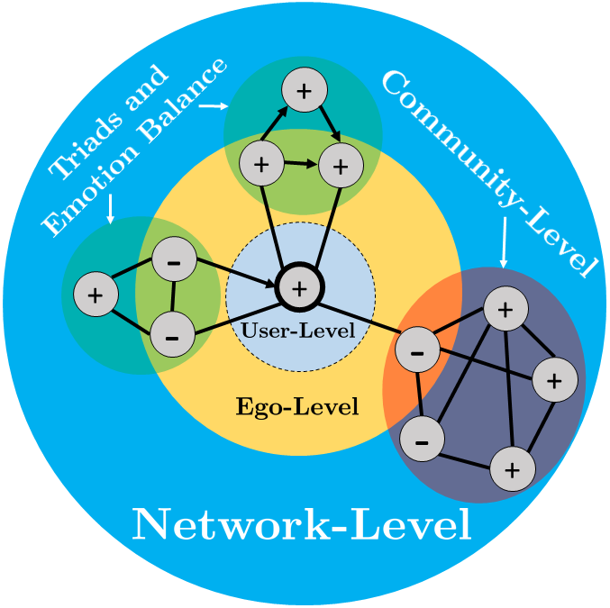
Emotions And Social Networks
Our goal is to understand how emotions
vary across users;
evolve over time; and
are connected to social ties
Five Levels to study social network data
User
Ego
Triad
Community
Whole-Network
Notes:
More specifically, our goal is to study how human emotions vary across users, how they change over time, and how they are related to social relationships.
It is very common in traditional Social Network Analysis to study networks at 5 different levels, they are the user level, which is the most basic unit of the social network; ego-level, basically you and your friends, so mostly two users: you and a friend; triad-level, including triple of nodes; to a subset of users, here we refer to the community level; finally the whole network level. So we follow this approach and investigate properties of emotions at each of these five levels.
After looking at the distributions and patterns, we come up with a model to simulate friendships based on user emotions.

Slide 3

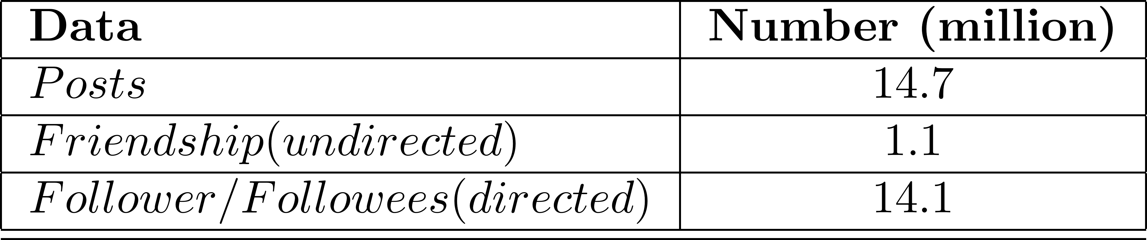
Dataset
Spanning more than 10 years of LiveJournal data.
Posts with emotions directly provided by users
Community memberships for all users.
The dataset is released on http://data.syr.edu/get/EmotionPatterns
Notes:
It has been challenging for us to get a large-dataset for such experiments.
First, you need to have friendships (both directed and undirected).
You need community memberships, as community detection can be subjective.
You need exact ground truth on emotions as sentiment classification can be imprecise.
We found livejournal as a candidate that provides all of that information. We crawled 10 years of livejournal data, including 14.7 million posts, where each post includes an emotion directly provided by the user (like happy or sad), 1.1 million friendships, 14.1 million follower/followee relations, and the community memberships for all users. The dataset is reasonably size and most experiments became intractable on a regular PC, so we used a large hadoop cluster for almost all experiments. Even though, the project took us 7 months to finish. We have released dataset to public on our website.

Slide 4
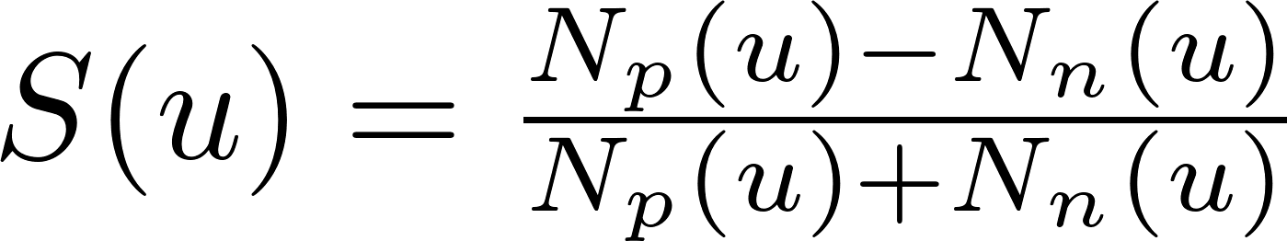
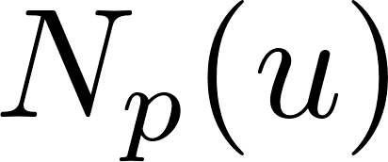
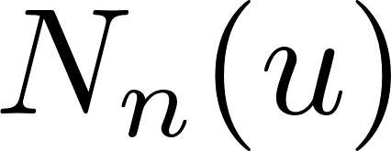
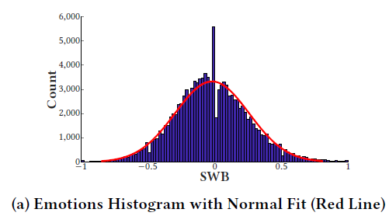
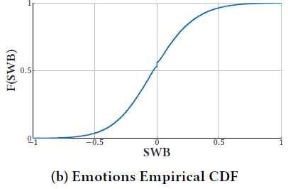
User Level
We determine how positive or negative a user is in general.
Subjective Well-Being (SWB)
where and represent the number of positive and negative posts for user u .
Notes:
To begin with our analysis, we first had to define how positive or negative a user is in general. In total we had 130 types of emotions which we manually labeled as positive or negative. Then, we used subjective well-being(SWB), which is defined as the fractional difference between the number of positive and negative posts a user has ever posted.
So, users’s SWB values can range from [-1, 1].
On the user-level, First, we check the distribution of user SWB. The figure is the emotions histogram. X-axis is the user swb, as we go to the right, users become more positive, while the opposite shows that users are more negative. Y axis is the count of users. The distribution is approximately normal; however, if you look at the CDF on the right, you can see there is a slight negative bias (probability of zero is greater than 0.5), which shows negative users are more in the data (actually 20% more than positive users). This confirms what is known as negativity bias in psychology.
Following these observations, we consider users with positive SWB as positive users, those with negative SWB as negative users.

Slide 5
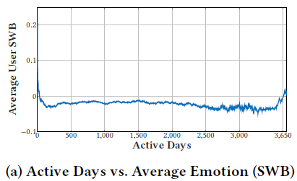
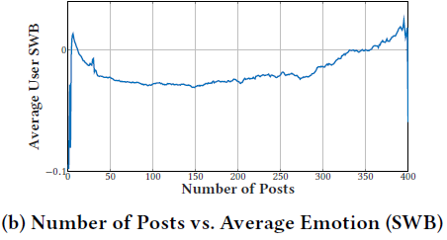
User Level
Emotions change over time or with more activity
Notes:
Next, we look at how emotions change over time or with more activity.
In the figure, x is the number of days a user has been active on the site, and y is the average user SWB. We find those leaving the site in a short time and also those who are very loyal to the site, like being active over 3,000 days, are more positive. The remaining users are slightly negative.
We also look at the activity level. On the right, x is the number of posts a user has posted and y is average emotions. A similar trend is observed. Users with very few or lots of posts are more positive.

Slide 6
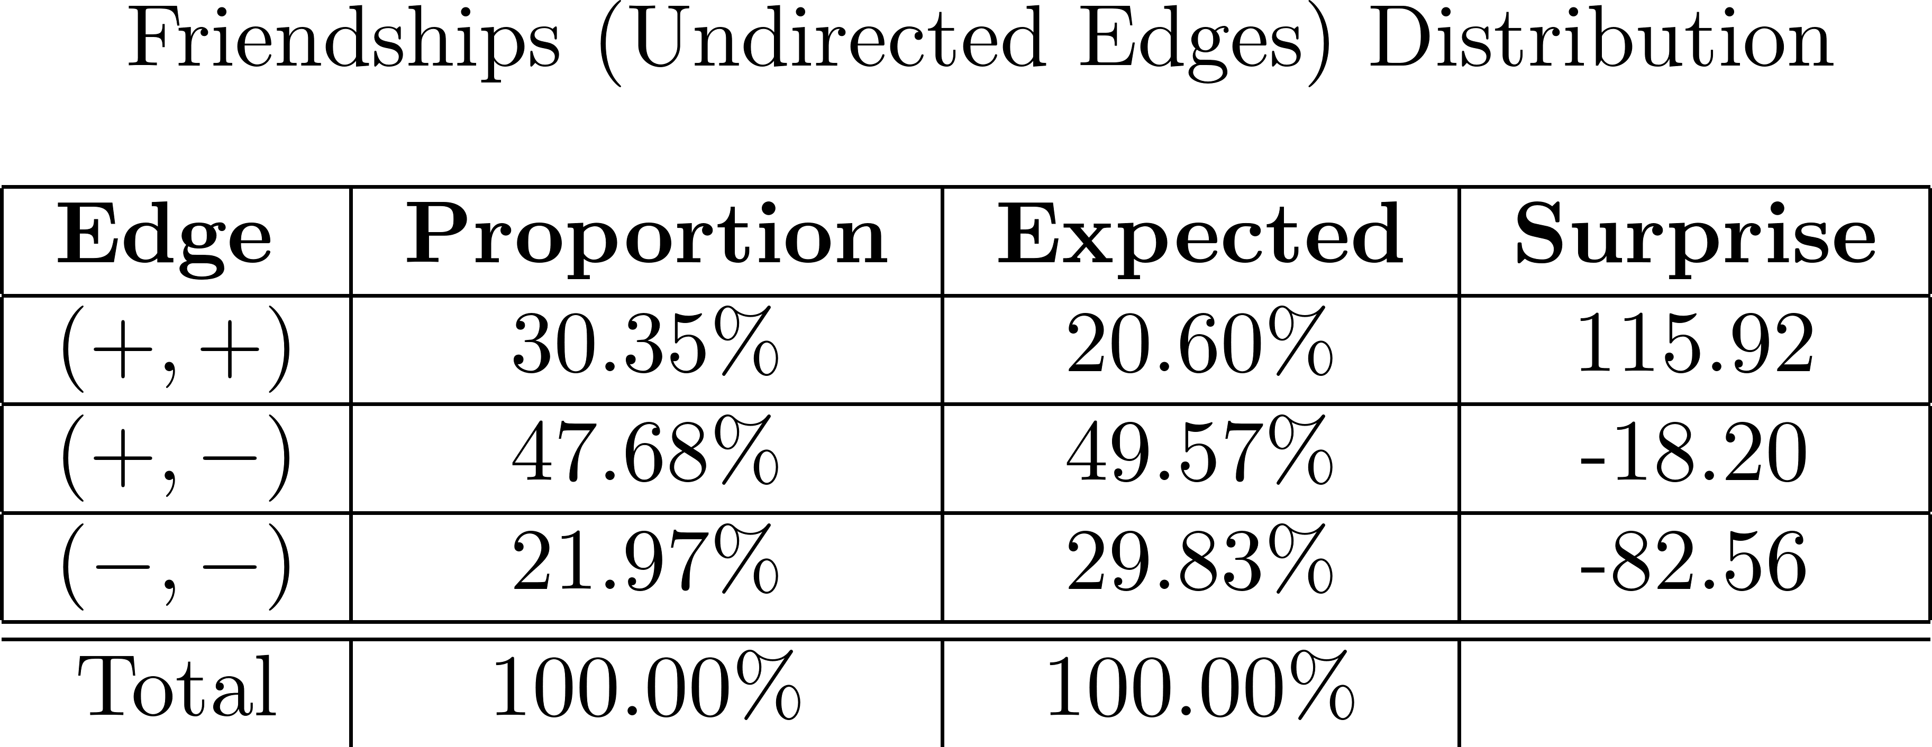
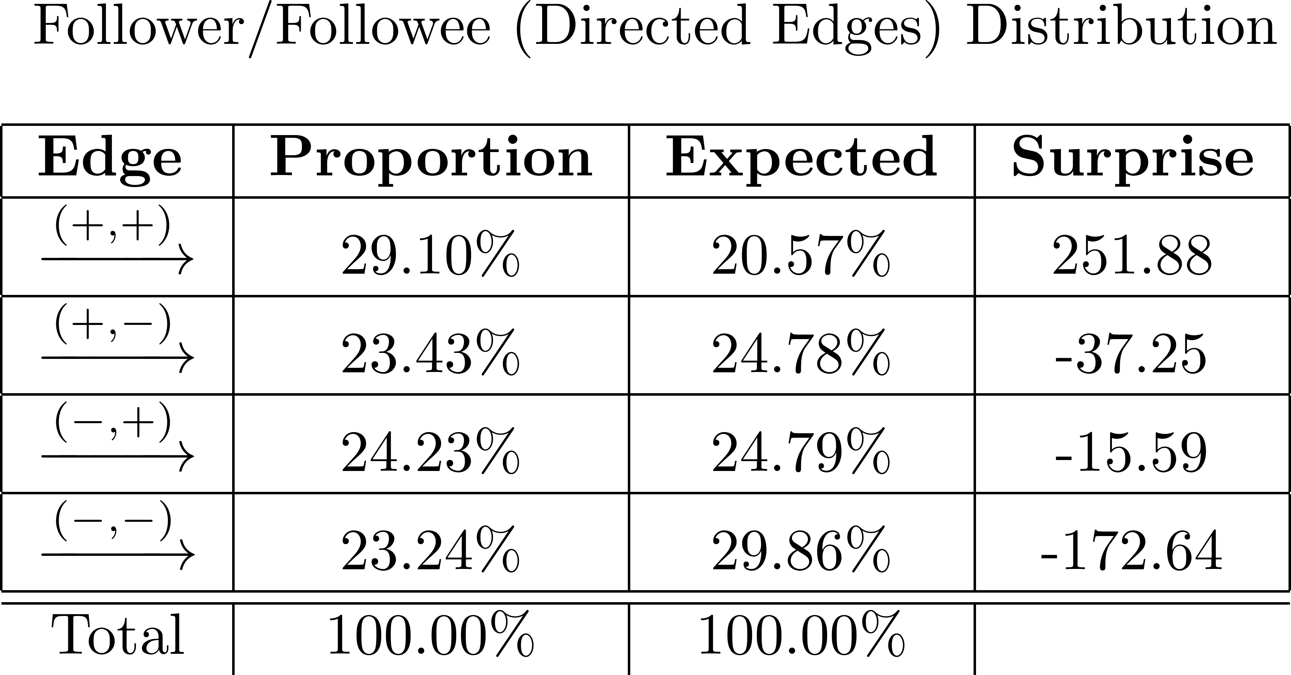
Ego Level
Undirected ego networks
(Friendship)
Directed ego networks
(Follower/Followee)
Only positive users demonstrate assortativity.
Notes:
Now, we move to the ego-level, which is between you and your friend, or you and someone you follow or follows you. ‘
In large social networks, users with similar characteristics get connected. This phenomenon is called assortativity.
We want to see whether this happens for users with different emotions, basically whether positive/positive users get together and negative/negative user get together. We measure the probability of seeing each type of edge in our dataset and (+,-) edges are see the most (about 47%).
Note that we have more negative users. So, we thought, maybe this is a random byproduct of having more negative users.
So, we computed the expected probabilties of edges by shuffling the signs of the nodes without changing the +, - proportions.
We calculate the surprise value to show the significance of the result. A surprise in the order of 10s means p-value is almost zero.
A positive surprise means we are seeing more than expected and negative means, we are seeing less than expected.
We found only positive users demonstrate assortativity. Only (+, +) friendships are more than expected. (−, +) and (−, −) are significantly less than expected. Even for negative users, they tend to befriend with positive users but not other negative users.
The same pattern is observed in the directed network. Only positive user following other positive users are more than expected.

Slide 7
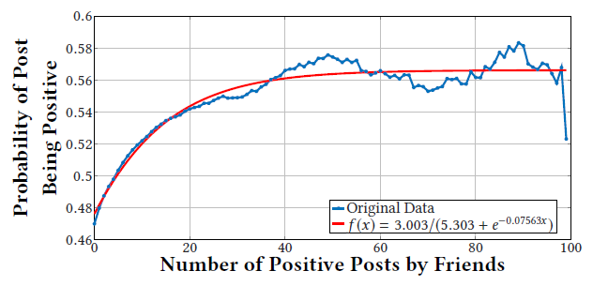
Ego Level
Emotion Correlations to Friends
Notes:
Next, we show the emotion correlation to friends. We look at the number of positive posts by one’s friends in a week, and see the probability of this user having a positive post. The figure shows with the increase in the number of positive posts by friends, this probability also increases. Previous diffusion of innovations studies show that the adoption rate of an innovation as a function of number of friends adopting it follows an S-shaped curve, which saturates from a certain point. Here, we also see this S-curve.

Slide 8
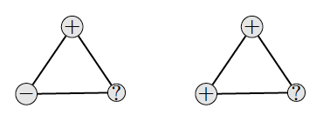
Triad Level
Scenario: Users A and B are friends, and A is a positive person and B is negative. They have a mutual friend C. Is C more likely to be positive or negative?
Notes:
Next is the triad level. Think about a social scenario: Users A and B are friends, and A is a positive person, B is negative. They have a mutual friend C. Is C more likely to be positive or negative? What if both A and B are positive?

Slide 9
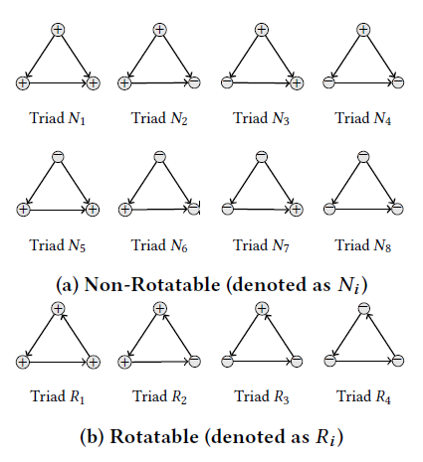
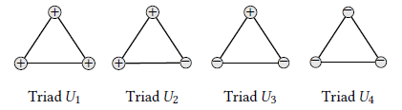
Emotional Balance
Undirected Triads (Friendship)
Directed Triads (Follower)
Triads with two or more positive users are emotionally balanced.
Notes:
To answer these questions, we consider all the possible ways of forming a triangle. For undirected case, there are four ways: The triads can be formed by 3 positive nodes, 2 positive 1 negative nodes, 2 negative 1 positive nodes and 3 negative nodes. For directed case, due to the direction of edges, there are 12 ways in total. And we find for both cases, triads with two or more positive users are significantly more than expected, while all the other triads are less than expected.
So, we define emotional balance. We denote triads with two or more positive users as being emotionally balanced.
Interestingly we found that being emotionally balanced is connected to the structural balance theory. Structural balance theory discusses more frequent triangles with positive and negative edges, and we discuss more frequent triangles with positive and negative nodes. So if we can find the relation between signed edges and edges formed by signed nodes, these two theories can also be connected. We found this connection making ‘Anything emotionally balanced is also structural balanced.’ and we discussed about it in the paper. Therefore, emotional balance is like a dual for structural balance theory.

Slide 10
Community Level
Are Community Members Emotionally-Similar?
Are Structural Properties of Communities Related to their Members’ Emotions?
Notes:
At the community level, we try to answer two questions. Whether community members are emotionally-similar and what is the relation between the structure of communities and their members’ emotions.

Slide 11
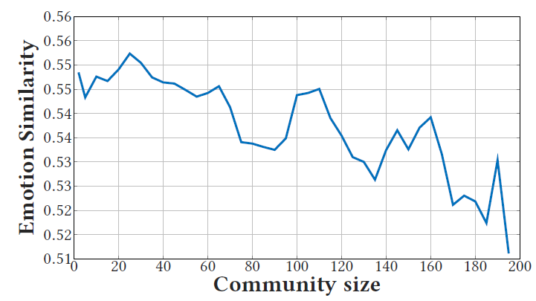
Are Community Members Emotionally-Similar?
58% users’ signs match average of their community-level SWB;
Members of smaller communities are more emotionally similar.
Notes:
To answer the first question, we calculate the average SWB of the communities that the user has joined. We consider a user to be emotionally-similar to her communities, when the sign of this average value matches the sign of her SWB. The signs match for 58% of the users, indicating that most community members are, on average, emotionally similar. If we look at the communities of a certain size, we find that members of smaller communities are more emotionally similar. As you can see, with the increase in the community size, the emotional similarity decreases.

Slide 12
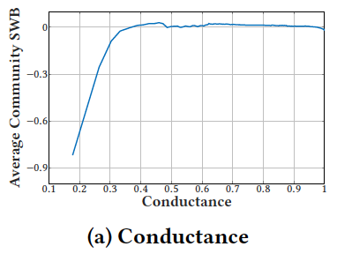
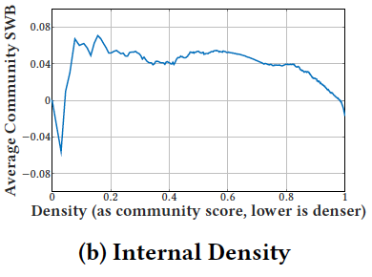
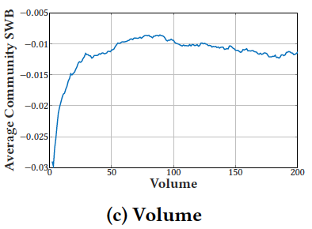
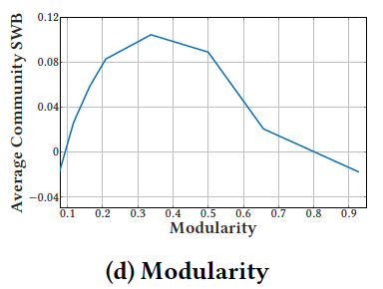
Structural Properties VS. Members’ Emotions
Use Measures: Conductance, Internal Density, Volume, Modularity
Insights:
Members of Isolated Communities are Extremely Negative
Members of Super Dense (or Super Sparse) Communities are Mostly Negative
Communities with Moderate Densities contain Positive Members.
Notes:
For the second question, we use measures including conductance, internal density, volume, and modularity to describe communities.
Low conductance indicates that the community is separated from the rest of the graph while high conductance indicates that the community is well-connected to the rest of the graph. As you can see from the figure, when the conductance is low, the average community SWB is extremely low. It shows members of Isolated Communities are Extremely Negative.
Internal density is the edge density of the community. We find Members of Super Dense (or Super Sparse) Communities are Mostly Negative, and Communities with Moderate Densities contain Positive Members.
We also look at the volume and modularity. Volume is the sum of the degrees of the community members. Modularity quantifies how different the community is from a community in a random graph generated with the same degree distribution.
There are some more results in the paper.

Slide 13
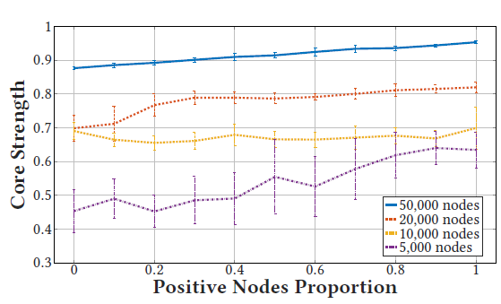
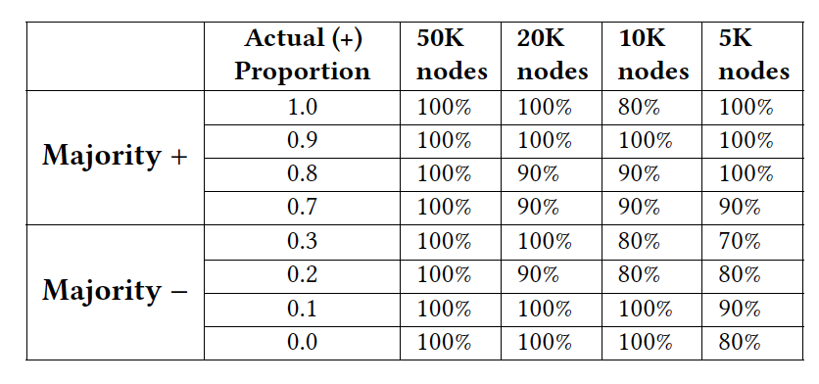
Network Level
The connection between user emotions and core-periphery structure;
Study the core strength and the degree of positivity of a graph
Use Stochastic Kronecker Graph to get the core strength
Notes:
The last level is the network level.
Previous observations show positive users tend to befriend with positive users, negative users also befriend with positive users, and only (+, +) edges are more than expected. It indicates there is a connection between emotions and core-periphery structure, to be specific, the positive users form the core of the network, and the negative users form the periphery. To validate our speculation, we sample many subgraphs of different size with various proportion of positive nodes. And we use Stochastic Kronecker Graph, which is a generative model to capture the core-periphery structure of a graph, to get the core strength. We find first, subgraphs with larger size have stronger core strength, second, with the increase in proportion of positive nodes, the core strength of the subgraph also increases. Naturally In return, we use the core strength to predict the emotions of the majority of a graph and we got a very good accuracy.

Slide 14
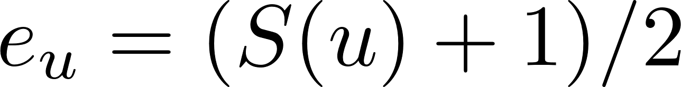
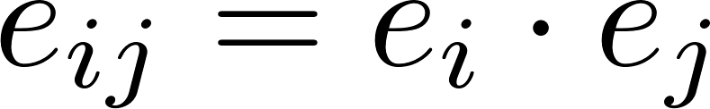
Emotional-Tie Model
Emotion Coreness for user u
A bijection that rescales SWB of a user from [-1, 1] to [0, 1]
Emotional Tie Strength for user i and j
Set emotional tie strength as the probability for i and j being friends.
Properties:
Distribution of edges and triads very close to that of original graph
High Density, Triads, Clustering
Notes:
Based on these findings, we come up with a model which we call the Emotional-Tie model to simulate the friendships based on emotions.
In a previous study of core-periphery property by Borgatti and Everett, they show that if one can denote the levels of coreness for both nodes i and j as values between 0 to 1, then we can use the product of the coreness as their tie strength.
In our case, we define emotion coreness by rescaling SWB to [0, 1], and set the emotional tie strength as the product of the emotion coreness for user i and j.
We use this tie strength as the probability for i and j being friends and simulate a random graph where edges are formed with this probability. The distribution of edges and triads in the simulated graph is very close to the original graph, and it has the properties like high density, triads, and clustering. We have proved these properties mathematically in our paper.

Slide 15
Conclusion
Emotional Patterns:
User-Level:
Negative Bias
Prolonged or more intense social media usage does not necessarily lead to sadness.
Ego-Level:
Happy users are friends with happy users, but it doesn’t happen between sad users;
A user is more likely to express an emotion as more friends express similar emotions.
Triad-Level:
Most triads are formed from two or more positive users (emotionally balanced).
Community-Level:
Community members have similar emotions;
This similarity is stronger in smaller communities;
A community’s structure is connected to its members’ emotions.
Network-Level:
Users with positive emotions form a core; users with negative emotions form its periphery.
Emotional-Tie Model
Notes:
In summary, we have identified the following emotional patterns at 5 levels from the user-level to the whole-network level.
For example, On the User-Level, we found a Negative Bias;
On the Ego-Level, Happy users are friends with happy users, but it doesn’t happen between sad users;
On the Triad-Level, Triads with two or more positive users are emotionally balanced;
At the Community-Level, Community members have similar emotions; especially for those in the smaller communities;
At the Network-Level, Positive Users form a core of the network; and negative users form its periphery.
Given user emotions, our Emotional-Tie model can simulate
friendships and exhibit the emotional patterns.
Our study can help to get a better understanding of human emotions, it can be used for systematic emotion prediction, evaluating emotional contagion, friend recommendation based on emotional compatibility.
That’s it. Thank you. I would be happy to take any questions.

