Slide 1
A Text-Independent Speaker Recognition System
Catie Schwartz
Advisor: Dr. Ramani Duraiswami
Mid-Year Progress Report

Slide 2
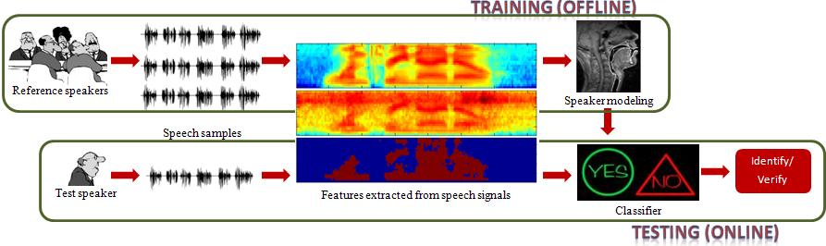
Speaker Recognition System
ENROLLMENT PHASE – TRAINING (OFFLINE)
VERIFICATION PHASE – TESTING (ONLINE)

Slide 3
Schedule/Milestones
Fall 2011
October 4 | Have a good general understanding on the full project and have proposal completed. Marks completion of Phase I
November 4 | GMM UBM EM Algorithm Implemented GMM Speaker Model MAP Adaptation Implemented Test using Log Likelihood Ratio as the classifier Marks completion of Phase II
December 19 | Total Variability Space training via BCDM Implemented i-vector extraction algorithm Implemented Test using Discrete Cosine Score as the classifier Reduce Subspace LDA Implemented LDA reduced i-vector extraction algorithm Implemented Test using Discrete Cosine Score as the classifier Marks completion of Phase III

Slide 4
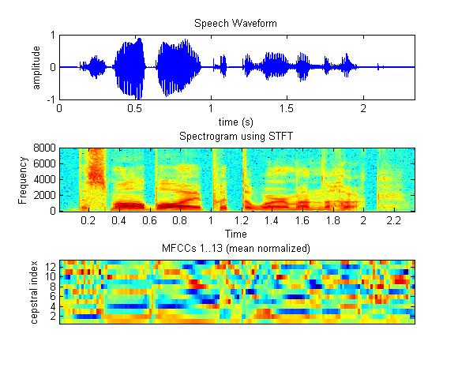
Algorithm Flow Chart Background Training
Background Speakers
Feature Extraction
(MFCCs + VAD)
GMM UBM
(EM)
Factor Analysis
Total Variability Space
(BCDM)
Reduced Subspace
(LDA)
Notes:
Use consistent tense

Slide 5
Algorithm Flow Chart GMM Speaker Models
Feature Extraction
(MFCCs + VAD)
GMM
Speaker
Models
Reference Speakers
GMM Speaker Models
(MAP Adaptation)
Log Likelihood Ratio (Classifier)
Test Speaker

Slide 6
Feature Extraction
Background Speakers
Feature Extraction
(MFCCs + VAD)
GMM UBM
(EM)
Factor Analysis
Total Variability Space
(BCDM)
Reduced Subspace
(LDA)
Notes:
Use consistent tense

Slide 7
MFCC Algorithm
Input: utterance; sample rate
Output: matrix of MFCCs by frame
Parameters: window size = 20 ms; step size = 10 ms
nBins = 40; d = 13 (nCeps)
Step 1: Compute FFT power spectrum
Step II : Compute mel-frequency m-channel
filterbank
Step III: Convert to ceptra via DCT
(0th Cepstral Coefficient represents “Energy”)

Slide 8
MFCC Validation
Code modified from tool set created by Dan Ellis (Columbia University)
Compared results of modified code to original code for validation
Ellis, Daniel P. W. PLP and RASTA (and MFCC, and Inversion) in Matlab. PLP and RASTA (and MFCC, and Inversion) in Matlab. Vers. Ellis05-rastamat. 2005. Web. 1 Oct. 2011. <http://www.ee.columbia.edu/~dpwe/resources/matlab/rastamat/>.

Slide 9
VAD Algorithm
Input: utterance, sample rate
Output: Indicator of silent frames
Parameters: window size = 20 ms; step size = 10 ms
Step 1 : Segment utterance into frames
Step II : Find energies of each frame
Step III : Determine maximum energy
Step IV: Remove any frame with either:
a) less than 30dB of maximum energy b) less than -55 dB overall

Slide 10



VAD Validation
Visual inspection of speech along with detected speech segments
original silent speech

Slide 11
Gaussian Mixture Models (GMM) as Speaker Models
Represent each speaker by a finite mixture of
multivariate Gaussians
The UBM or average speaker model is trained using an
expectation-maximization (EM) algorithm
Speaker models learned using a maximum a posteriori
(MAP) adaptation algorithm

Slide 12
EM for GMM Algorithm
Background Speakers
Feature Extraction
(MFCCs + VAD)
GMM UBM
(EM)
Factor Analysis
Total Variability Space
(BCDM)
Reduced Subspace
(LDA)
Notes:
Use consistent tense

Slide 13
EM for GMM Algorithm (1 of 2)
Input: Concatenation of the MFCCs of all background
utterances ( )
Output:
Parameters: K = 512 (nComponents); nReps = 10
Step 1: Initialize randomly
Step II: (Expectation Step)
Obtain conditional distribution of
component c

Slide 14
EM for GMM Algorithm (2 of 2)
Step III: (Maximization Step)
Mixture Weight:
Mean:
Covariance:
Step IV: Repeat Steps II and III until the delta in
the relative change in maximum likelihood
is less than .01

Slide 15
EM for GMM Validation (1 of 9)
Ensure maximum log likelihood is increasing at each step
Create example data to visually and numerically validate EM algorithm results

Slide 16
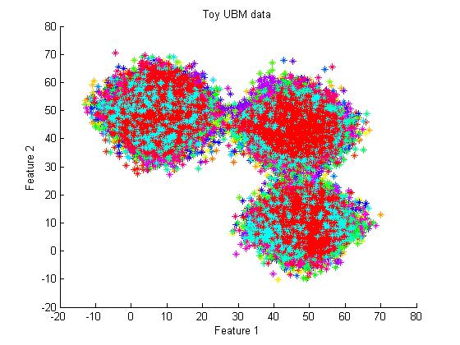
EM for GMM Validation (2 of 9) Example Set A: 3 Gaussian Components

Slide 17
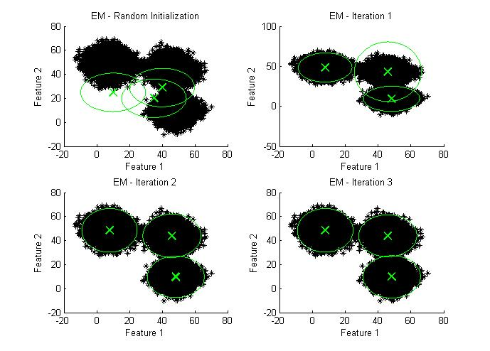
EM for GMM Validation (3 of 9) Example Set A: 3 Gaussian Components
Tested with K = 3

Slide 18
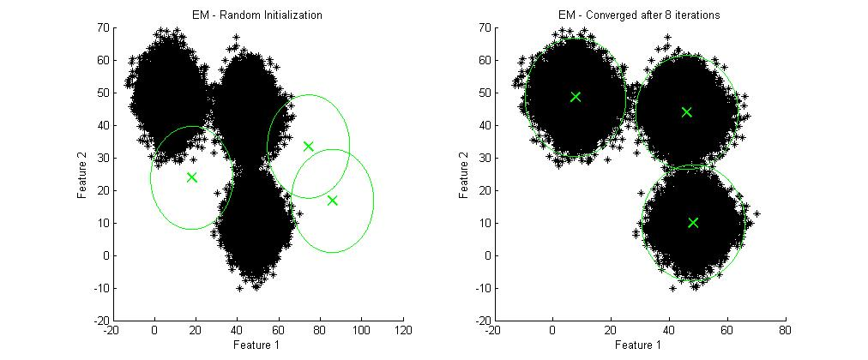
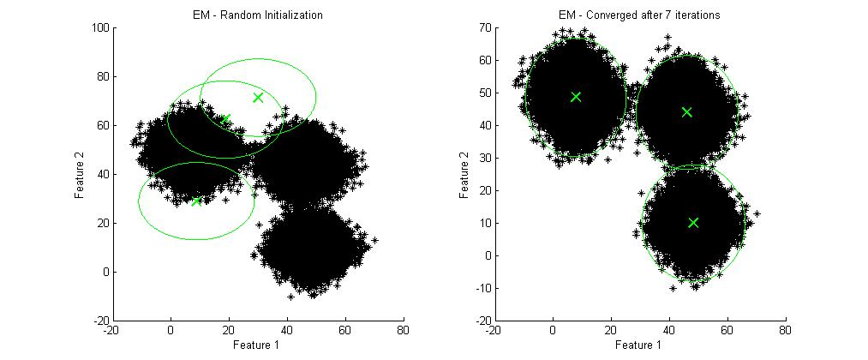
EM for GMM Validation (4 of 9) Example Set A: 3 Gaussian Components
Tested with K = 3

Slide 19
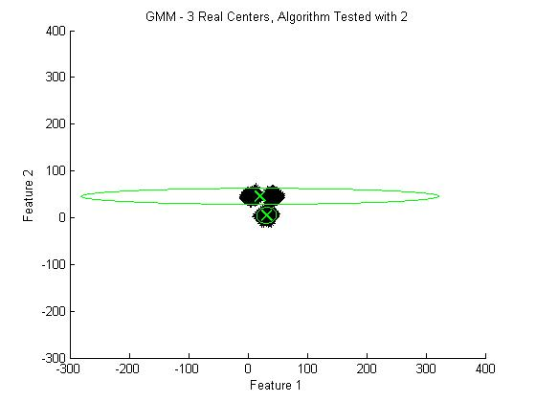
EM for GMM Validation (5 of 9) Example Set A: 3 Gaussian Component
Tested with K = 2

Slide 20
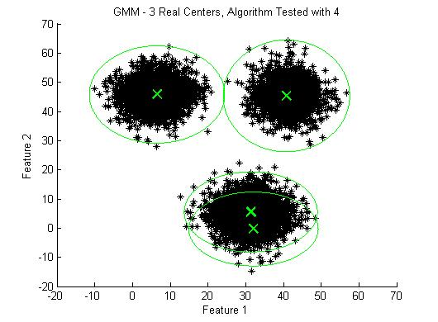
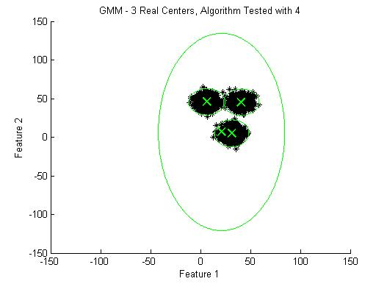
EM for GMM Validation (6 of 9) Example Set A: 3 Gaussian Component
Tested with K = 4

Slide 21
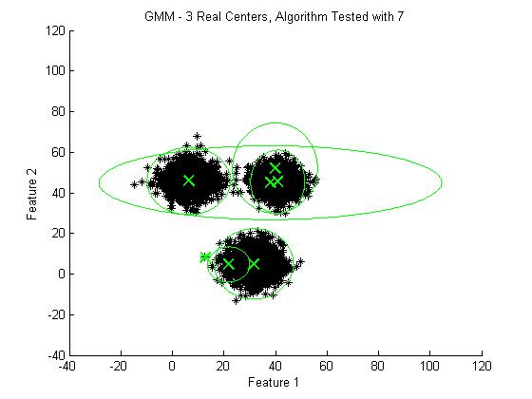
EM for GMM Validation (7 of 9) Example Set A: 3 Gaussian Component
Tested with K = 7

Slide 22
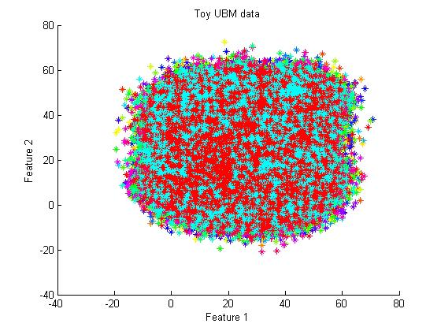
EM for GMM Validation (8 of 9) Example Set B: 128 Gaussian Components

Slide 23
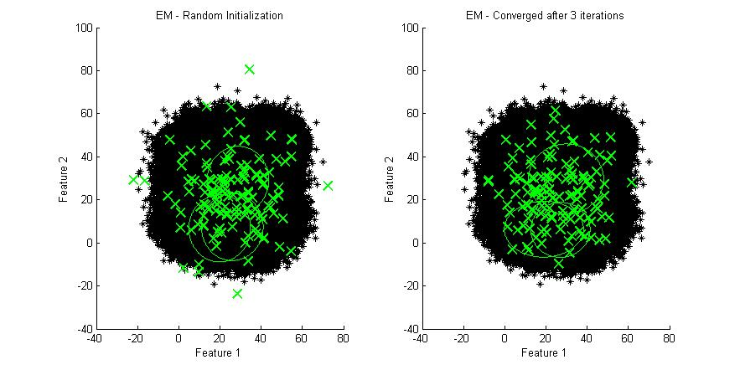
EM for GMM Validation (9 of 9) Example Set B: 128 Gaussian Components

Slide 24
Algorithm Flow Chart GMM Speaker Models
Feature Extraction
(MFCCs + VAD)
GMM
Speaker
Models
Reference Speakers
GMM Speaker Models
(MAP Adaptation)
Log Likelihood Ratio (Classifier)
Test Speaker

Slide 25
MAP Adaption Algorithm
Input: MFCCs of utterance for speaker ( );
Output:
Parameters: K = 512 (nComponents); r=16
Step I : Obtain via Steps II and III in the
EM for GMM algorithm (using )
Step II: Calculate
where

Slide 26
MAP Adaptation Validation (1 of 3)
Use example data to visual MAP Adaptation algorithm results

Slide 27
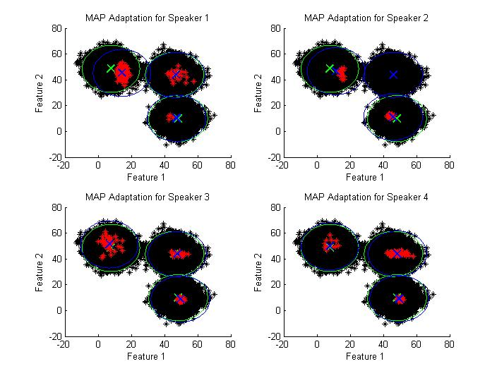
MAP Adaptation Validation (2 of 3) Example Set A: 3 Gaussian Components

Slide 28
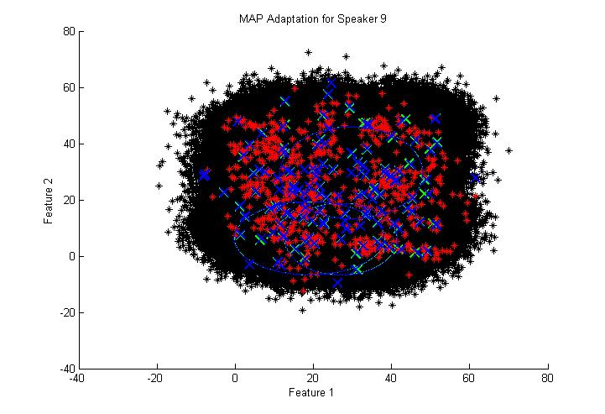
MAP Adaptation Validation (3 of 3) Example Set B: 128 Gaussian Components

Slide 29
Algorithm Flow Chart Log Likelihood Ratio
Feature Extraction
(MFCCs + VAD)
GMM
Speaker
Models
Reference Speakers
GMM Speaker Models
(MAP Adaptation)
Log Likelihood Ratio (Classifier)
Test Speaker

Slide 30
Classifier: Log-likelihood test
Compare a sample speech to a hypothesized speaker
where leads to verification of the hypothesized speaker and leads to rejection.
Reynolds, D. "Speaker Verification Using Adapted Gaussian Mixture Models." Digital Signal Processing 10.1-3 (2000): 19-41. Print.

Slide 31
Preliminary Results
Using TIMIT Dataset
Dialect
Region(dr) #Male #Female Total ---------- --------- --------- ---------- 1 31 (63%) 18 (27%) 49 (8%) 2 71 (70%) 31 (30%) 102 (16%) 3 79 (67%) 23 (23%) 102 (16%) 4 69 (69%) 31 (31%) 100 (16%) 5 62 (63%) 36 (37%) 98 (16%) 6 30 (65%) 16 (35%) 46 (7%) 7 74 (74%) 26 (26%) 100 (16%) 8 22 (67%) 11 (33%) 33 (5%) ------ --------- --------- ---------- 8 438 (70%) 192 (30%) 630 (100%)

Slide 32
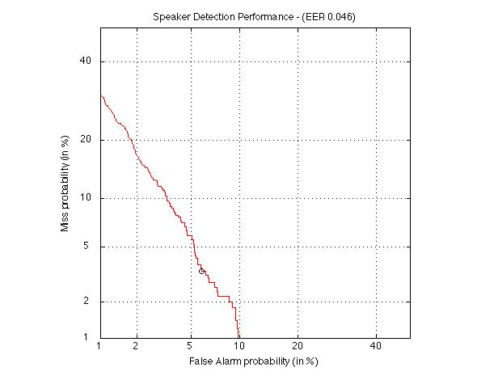
GMM Speaker Models DET Curve and EER

Slide 33
Conclusions
MFCC validated
VAD validated
EM for GMM validated
MAP Adaptation validated
Preliminary test results show acceptable performance
Next steps: Validate FA algorithms and LDA algorithm
Conduct analysis tests using TIMIT and SRE data bases

Slide 34
Questions?

Slide 35
Bibliography
[1]Biometrics.gov - Home. Web. 02 Oct. 2011. <http://www.biometrics.gov/>.
[2] Kinnunen, Tomi, and Haizhou Li. "An Overview of Text-independent Speaker Recognition: From Features to Supervectors." Speech Communication 52.1 (2010): 12-40. Print.
[3] Ellis, Daniel. “An introduction to signal processing for speech.” The Handbook of Phonetic Science, ed. Hardcastle and Laver, 2nd ed., 2009.
[4] Reynolds, D. "Speaker Verification Using Adapted Gaussian Mixture Models." Digital Signal Processing 10.1-3 (2000): 19-41. Print.
[5] Reynolds, Douglas A., and Richard C. Rose. "Robust Text-independent Speaker Identification Using Gaussian Mixture Speaker Models." IEEE Transations on Speech and Audio Processing IEEE 3.1 (1995): 72-83. Print.
[6] "Factor Analysis." Wikipedia, the Free Encyclopedia. Web. 03 Oct. 2011. <http://en.wikipedia.org/wiki/Factor_analysis>.
[7] Dehak, Najim, and Dehak, Reda. “Support Vector Machines versus Fast Scoring in the Low-Dimensional Total Variability Space for Speaker Verification.” Interspeech 2009 Brighton. 1559-1562.
[8] Kenny, Patrick, Pierre Ouellet, Najim Dehak, Vishwa Gupta, and Pierre Dumouchel. "A Study of Interspeaker Variability in Speaker Verification." IEEE Transactions on Audio, Speech, and Language Processing 16.5 (2008): 980-88. Print.
[9] Lei, Howard. “Joint Factor Analysis (JFA) and i-vector Tutorial.” ICSI. Web. 02 Oct. 2011. http://www.icsi.berkeley.edu/Speech/presentations/AFRL_ICSI_visit2_JFA_tutorial_icsitalk.pdf
[10] Kenny, P., G. Boulianne, and P. Dumouchel. "Eigenvoice Modeling with Sparse Training Data." IEEE Transactions on Speech and Audio Processing 13.3 (2005): 345-54. Print.
[11] Bishop, Christopher M. "4.1.6 Fisher's Discriminant for Multiple Classes." Pattern Recognition and Machine Learning. New York: Springer, 2006. Print.
[12] Ellis, Daniel P. W. PLP and RASTA (and MFCC, and Inversion) in Matlab. PLP and RASTA (and MFCC, and Inversion) in Matlab. Vers. Ellis05-rastamat. 2005. Web. 1 Oct. 2011. <http://www.ee.columbia.edu/~dpwe/resources/matlab/rastamat/>.

Slide 36
Milestones
Fall 2011
October 4 | Have a good general understanding on the full project and have proposal completed. Present proposal in class by this date. Marks completion of Phase I
November 4 | Validation of system based on supervectors generated by the EM and MAP algorithms Marks completion of Phase II
December 19 | Validation of system based on extracted i-vectors Validation of system based on nuisance-compensated i-vectors from LDA Mid-Year Project Progress Report completed. Present in class by this date. Marks completion of Phase III
Spring 2012
Feb. 25 | Testing algorithms from Phase II and Phase III will be completed and compared against results of vetted system. Will be familiar with vetted Speaker Recognition System by this time. Marks completion of Phase IV
March 18 | Decision made on next step in project. Schedule updated and present status update in class by this date.
April 20 | Completion of all tasks for project. Marks completion of Phase V
May 10 | Final Report completed. Present in class by this date. Marks completion of Phase VI

Slide 37
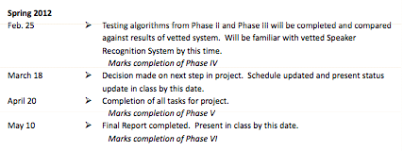
Spring Schedule/Milestones

Slide 38
Algorithm Flow Chart GMM Speaker Models Enrollment Phase
Feature Extraction
(MFCCs + VAD)
GMM
Speaker
Models
Reference Speakers
GMM Speaker Models
(MAP Adaptation)

Slide 39
Algorithm Flow Chart GMM Speaker Models Verification Phase
Feature Extraction
(MFCCs + VAD)
GMM
Speaker
Models
GMM Speaker Models
(MAP Adaptation)
Log Likelihood Ratio (Classifier)
Test Speaker

Slide 40
Algorithm Flow Chart (2 of 7) GMM Speaker Models Enrollment Phase
Feature Extraction
(MFCCs + VAD)
GMM
Speaker
Models
Reference Speakers
GMM Speaker Models
(MAP Adaptation)

Slide 41
Algorithm Flow Chart (3 of 7) GMM Speaker Models Verification Phase
Feature Extraction
(MFCCs + VAD)
GMM
Speaker
Models
GMM Speaker Models
(MAP Adaptation)
Log Likelihood Ratio (Classifier)
Test Speaker

Slide 42
Algorithm Flow Chart (4 of 7) i-vector Speaker Models Enrollment Phase
GMM
Speaker
Models
Feature Extraction
(MFCCs + VAD)
i-vector
Speaker
Models
Reference Speakers
i-vector Speaker Models

Slide 43
Algorithm Flow Chart (5 of 7) i-vector Speaker Models Verification Phase
GMM
Speaker
Models
Feature Extraction
(MFCCs + VAD)
i-vector
Speaker
Models
i-vector Speaker Models
Cosine Distance Score
(Classifier)
Test Speaker

Slide 44
Algorithm Flow Chart (6 of 7) LDA reduced i-vector Speaker Models Enrollment Phase
i-vector
Speaker
Models
LDA reduced
i-vectors
Speaker
Models
Feature Extraction
(MFCCs + VAD)
Reference Speakers
LDA Reduced i-vector
Speaker Models

Slide 45
Algorithm Flow Chart (7 of 7) LDA reduced i-vector Speaker Models Verification Phase
i-vector
Speaker
Models
LDA reduced
i-vectors
Speaker
Models
Feature Extraction
(MFCCs + VAD)
LDA Reduced i-vector
Speaker Models
Cosine Distance Score
(Classifier)
Test Speaker

Slide 46
Feature Extraction
Mel-frequency cepstral coefficients (MFCCs) are
used as the features
Voice Activity Detector (VAD) used to remove silent
frames

Slide 47
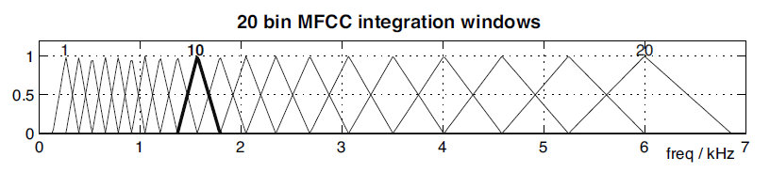
Mel-Frequency Cepstral Coefficents
MFCCs relate to physiological aspects of speech
Mel-frequency scale – Humans differentiate sound best at low frequencies
Cepstra – Removes related timing information between different frequencies and drastically alters the balance between intense and weak components
Ellis, Daniel. “An introduction to signal processing for speech.” The Handbook of Phonetic Science, ed. Hardcastle and Laver, 2nd ed., 2009.

Slide 48
Voice Activity Detection
Detects silent frames and removes from speech utterance

Slide 49
GMM for Universal Background Model
By using a large set of training data representing a set of universal speakers, the GMM UBM is where
This represents a speaker-independent distribution of feature vectors
The Expectation-Maximization (EM) algorithm is used to determine

Slide 50
GMM for Speaker Models
Represent each speaker, , by a finite mixture of multivariate Gaussians
where
Utilize , which represents speech data in general
The Maximum a posteriori (MAP) Adaptation is used to create
Note: Only means will be adjusted, the weights and covariance of the UBM will be used for each speaker

