Slide 1



面向神经科学的植入式微纳光电材料与器件
Implantable Optoelectronic Devices
for Advanced Neural Interfaces
Xing Sheng 盛 兴
Ph.D., Professor
Department of Electronic Engineering
IDG/McGovern Brain Research Institute
Tsinghua University
1

Slide 2
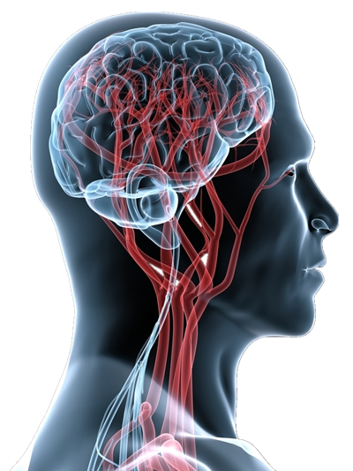

Technology for the Brain
Brain Science:
the Last Frontier
“Progress in science depends on:
new techniques,
new discoveries,
and new ideas,
probably in that order.”
---- Sydney Brenner
2

Slide 3
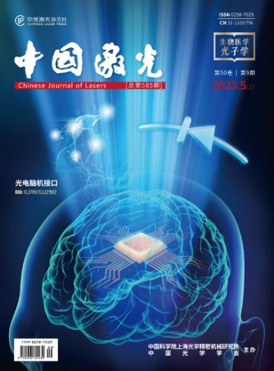
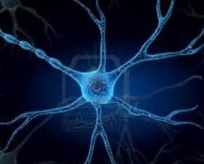
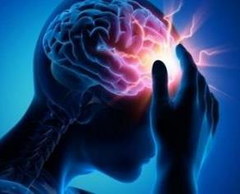
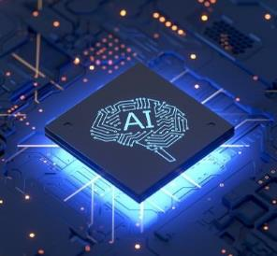
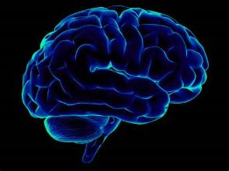
Implantable Neural Interfaces
Non-conventional technology in our lab
  Microscale, implantable electrical and optical materials and devices
Science
Application
X. Sheng, et al.,
Chin. J. Lasers 50, 0907301 (2023)
Fundamental Discovery
Clinics & Medicine
3

Slide 4
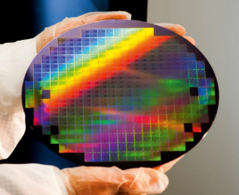
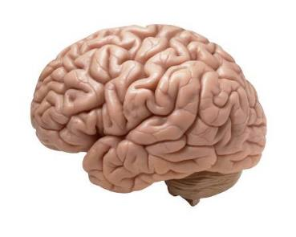
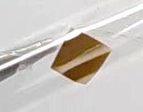
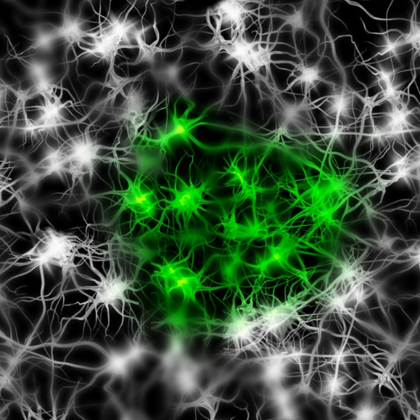
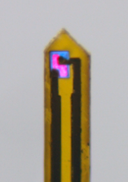
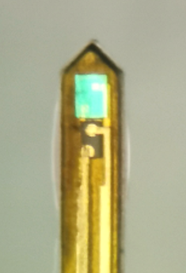
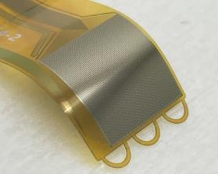
Implantable Neural Interfaces
mismatch
conventional devices
brain
tissue
100 mm
0.1 mm
modulation
Microscale
Devices
Neural
Systems
sensing
4

Slide 5
Implantable Neural Interfaces
Optogenetic stimulation
Optical based non-genetic stimulation
PNAS (2018)
Nature Comm. (2022)
iScience (2022)
Nature Biomed. Eng. (2023)
Science Advances (2023)
PNAS (2024)
0.1 mm
modulation
Microscale
Devices
Neural
Systems
5

Slide 6
Implantable Neural Interfaces
Ca²⁺ fluorescence sensing
Temperature sensing
Dopamine sensing
Oxygen sensing
ElectroCorticoGraphy (ECoG)
PNAS (2018)
Light Sci. Appl. (2022)
Microsystems & Nanoengr. (2020)
Nature Photonics (2024)
Science Bulletin (2025)
0.1 mm
Microscale
Devices
Neural
Systems
sensing
6

Slide 7
Summary
Mature electronic and optical materials (Si, III-Vs, oxides, ...)
Classical principles (quenching, optoelectronics, multiplex, ...)
Unusual design and fabrication strategies
Implantable neural interface devices and systems
From fundamental neuroscience to applied neuroengineering
0.1 mm
modulation
Microscale
Devices
Neural
Systems
sensing
7

