Slide 1
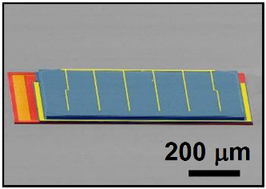
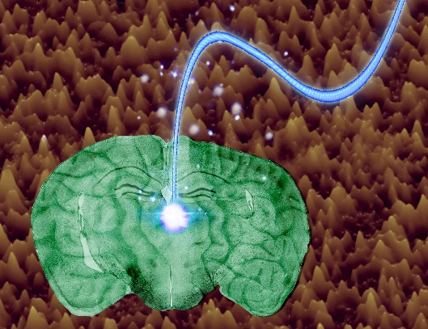
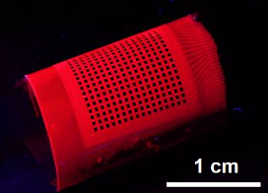
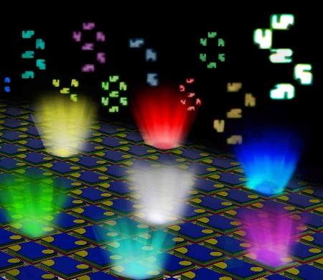
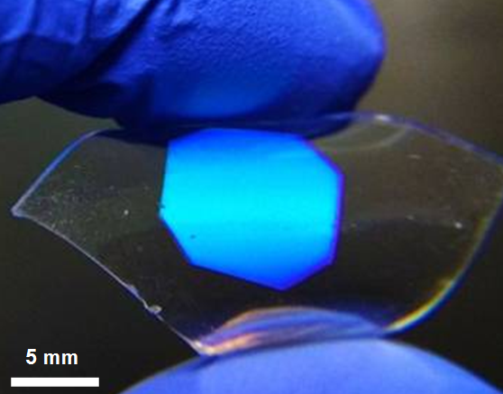
Microscale Photonic Devices
solar cells
lasers
fibers
Nature Mater. (2014)
Laser Photon. Rev. (2015)
Adv. Opt. Mater. (2018)
photodetectors
LEDs
filters
UV
Adv. Opt. Mater. (2014)
PNAS (2021)
Adv. Opt. Mater. (2018)
receivers
emitters
passive
Notes:
In the beginning, I would like to give you an overview about our research interests. Our efforts are focused on the design and fabrication of advanced photonic materials and devices, basically, all kinds of devices that can receive, emit, or guide the light. And use them for different applications like energy, communication and healthcare. Here are a few examples. For light receivers, we developed vertically stacked, multijunction solar cells by printing methods. These microscale solar cells can capture the entire broadband solar spectrum and realize ultrahigh efficiency. In this work, we developed thin-film silicon based photodiode arrays and transferred them onto a fluorecence based flexible substrate. We use these detector arrays to obtain visible-blind ultraviolet detection and imaging. We also transferred thin-film III-V lasers on silicon substrates to achieve a on-chip light source for next-generation photonic integrated circuit. We fabricated microscale, III-V LEDs with different colors on flexible substrates and use them for biomedical applications, I will talk about some of this work later. In addition, we are working on implantable fibers and microneedles based on biodegradable materials and using them for optical stimulation and light triggered drug release.

Slide 2
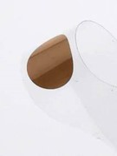
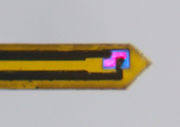
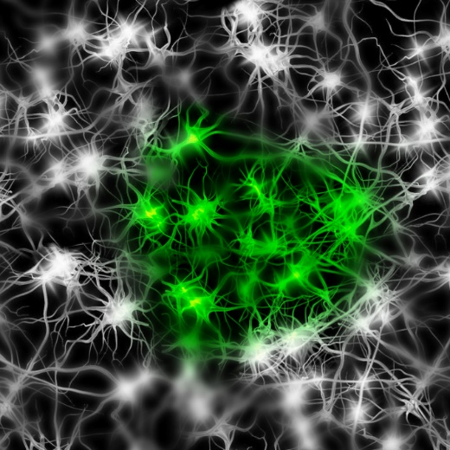
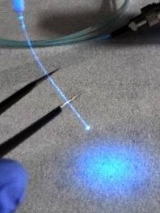
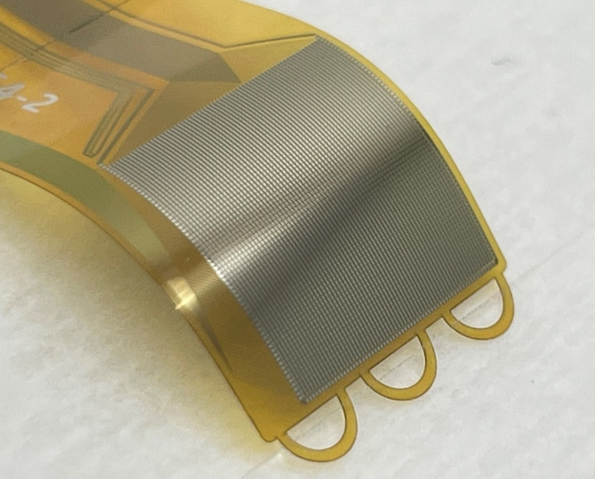
Implantable Neural Interfaces
Modulation
Sensing
Microscale Optoelectronic
Materials and Devices
Neural Systems
Notes:
In the beginning, I would like to give you an overview about our research interests. Our efforts are focused on the design and fabrication of advanced photonic materials and devices, basically, all kinds of devices that can receive, emit, or guide the light. And use them for different applications like energy, communication and healthcare. Here are a few examples. For light receivers, we developed vertically stacked, multijunction solar cells by printing methods. These microscale solar cells can capture the entire broadband solar spectrum and realize ultrahigh efficiency. In this work, we developed thin-film silicon based photodiode arrays and transferred them onto a fluorecence based flexible substrate. We use these detector arrays to obtain visible-blind ultraviolet detection and imaging. We also transferred thin-film III-V lasers on silicon substrates to achieve a on-chip light source for next-generation photonic integrated circuit. We fabricated microscale, III-V LEDs with different colors on flexible substrates and use them for biomedical applications, I will talk about some of this work later. In addition, we are working on implantable fibers and microneedles based on biodegradable materials and using them for optical stimulation and light triggered drug release.

Slide 3
Implantable Neural Interfaces
Modulation
Optogenetic stimulation
Optical based non-genetic stimulation
Nature Comm. (2022)
PNAS (2018)
iScience (2022)
Nature Biomed. Eng. (2023)
Science Advances (2023)
Notes:
In the beginning, I would like to give you an overview about our research interests. Our efforts are focused on the design and fabrication of advanced photonic materials and devices, basically, all kinds of devices that can receive, emit, or guide the light. And use them for different applications like energy, communication and healthcare. Here are a few examples. For light receivers, we developed vertically stacked, multijunction solar cells by printing methods. These microscale solar cells can capture the entire broadband solar spectrum and realize ultrahigh efficiency. In this work, we developed thin-film silicon based photodiode arrays and transferred them onto a fluorecence based flexible substrate. We use these detector arrays to obtain visible-blind ultraviolet detection and imaging. We also transferred thin-film III-V lasers on silicon substrates to achieve a on-chip light source for next-generation photonic integrated circuit. We fabricated microscale, III-V LEDs with different colors on flexible substrates and use them for biomedical applications, I will talk about some of this work later. In addition, we are working on implantable fibers and microneedles based on biodegradable materials and using them for optical stimulation and light triggered drug release.

Slide 4
Implantable Neural Interfaces
Sensing
Ca²⁺ fluorescence sensing
Temperature sensing
Dopamine sensing
Oxygen sensing
...
PNAS (2018)
Light Sci. Appl. (2022)
Microsystems & Nanoengr. (2020)
Nature Photonics (2024)
Notes:
In the beginning, I would like to give you an overview about our research interests. Our efforts are focused on the design and fabrication of advanced photonic materials and devices, basically, all kinds of devices that can receive, emit, or guide the light. And use them for different applications like energy, communication and healthcare. Here are a few examples. For light receivers, we developed vertically stacked, multijunction solar cells by printing methods. These microscale solar cells can capture the entire broadband solar spectrum and realize ultrahigh efficiency. In this work, we developed thin-film silicon based photodiode arrays and transferred them onto a fluorecence based flexible substrate. We use these detector arrays to obtain visible-blind ultraviolet detection and imaging. We also transferred thin-film III-V lasers on silicon substrates to achieve a on-chip light source for next-generation photonic integrated circuit. We fabricated microscale, III-V LEDs with different colors on flexible substrates and use them for biomedical applications, I will talk about some of this work later. In addition, we are working on implantable fibers and microneedles based on biodegradable materials and using them for optical stimulation and light triggered drug release.

