Slide 1

When Knowledge Graph
meet Python
Yongpan Sheng

Slide 2

目录
Preliminaries
CONTENTS
The Pipeline of Knowledge Graph Construction by Data-driven manner
Python Tools for Graph Data Management
Domain-specific Knowledge Graph Construction

Slide 3

Preliminaries
AI system = Knowledge + Reasoning

Slide 4
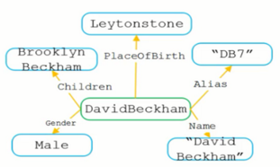
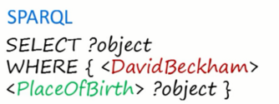
Preliminaries
1024
Q: 1M = ? B
Leytonstone
Q: Where was David Beckham born?
How dose the AI system works?
机器运算的过程即是符号操作的过程 （机器的潜台词：“我”有储备，so easy ！）。
Q: 1M = 1024 B
Q: Where was David Beckham born?
Knowledge as triples
<DavidBeckham, Name, “David Beckham”>
<DavidBeckham, PlaceOfBirth, Leytonstone>
<subject, relation, object>

Slide 5
Preliminaries
Q: Where was David Beckham born?
Knowledge as triples
<DavidBeckham, Name, “David Beckham”>
<DavidBeckham, PlaceOfBirth, Leytonstone>
<subject, relation, object>
Mapping from natural questions to structured queries executable on knowledge graph
（机器的潜台词：“我”会推理，so easy ！）。
所以，通俗的来说，在AI system中：要么从原有的知识体系中直接提取信息来使用，要么进行推理。
将知识融合在机器中，使机器能够利用我们人类知识、专家知识解决问题，这就是早期知识工程（Knowledge Engineering）的核心内涵。

Slide 6
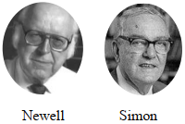
本页PPT借鉴于复旦大学肖仰华老师《大数据时代的知识工程与知识管理》
Preliminaries
Explaining AI system from the perspective of KE – Symbolism
符号主义的主要观点
认知即计算
知识是信息的一种形式，是构成智能的基础
知识表示、知识推理、知识运用是人工智能的核心
Physical Symbol System
A physical symbol system has the necessary and sufficient means of
general intelligent action. [R1]
The mind can be viewed as a device operating on bits of
information according to formal rules. [R2]
A special entity category (“good old fashioned AI”,
proposed by John Haugeland)
Focused on these kind of high level symbols, such as <dog> and
<tail>
AI System = Knowledge + Reasoning
R1：Newell, Allen; Simon, H. A. (1976), “Computer Science as Empirical Inquiry: Symbols and Search”, Communications of the ACM, 19 (3)
R2：Dreyfus, Hubert (1979), What Computers Still Can't Do, New York: MIT Press.

Slide 7
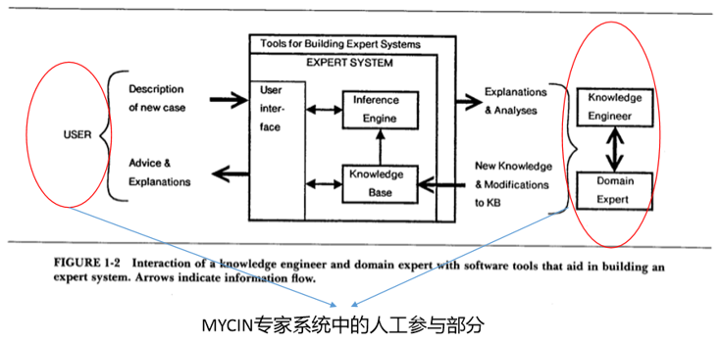
本页PPT借鉴于复旦大学肖仰华老师《大数据时代的知识工程与知识管理》
Preliminaries
Conventional KE – Features and Challenges
自上而下：严重依赖专家和用户的干预（规模有限、质量存疑）
Major difficulties:
1、知识获取困难
e.g., 领域知识难以表达（形式化），因为它往往是一种隐性知识、过程知识。
2、知识应用困难
（1）开放性应用易于超出预先设定的知识边界；（2）有的应用需要尝试知识的支撑，而常识知识往往难以定义、表达、表征。
3、很难处理异常情况 e.g., 鸵鸟不会飞

Slide 8
Preliminaries
大数据时代催生KE飞速前进发展

Slide 9
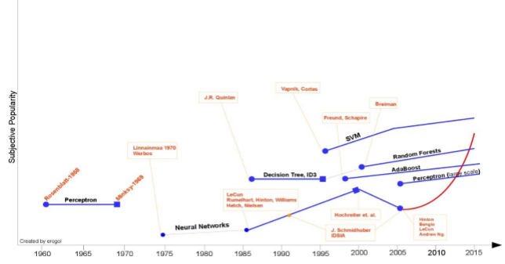
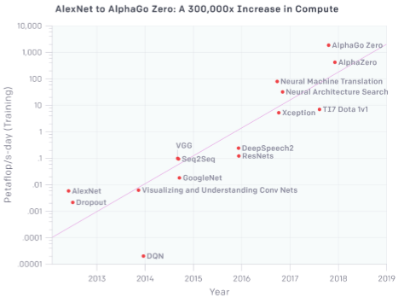
本页PPT借鉴于复旦大学肖仰华老师《大数据时代的知识工程与知识管理》
Preliminaries
大数据时代的机遇 – 大规模知识自动获取
Big Data + Machine Learning[R1] + Powerful Computation[R2]
完全意义上的自下而上的方式
从海量的数据中去挖掘异构、动态、碎片化的知识
e.g., 从Web corpora、搜索日志等都可挖掘出有价值的知识
R1, http://www.erogol.com/brief-history-machine-learning/
R2, https://openai.com/blog/ai-and-compute/

Slide 10
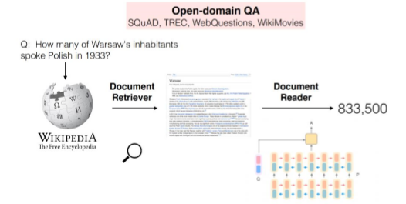
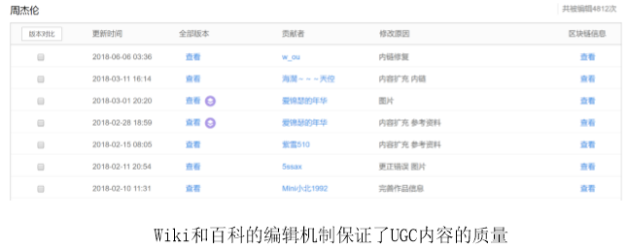
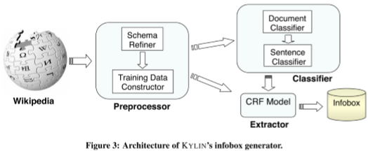
本页PPT借鉴于复旦大学肖仰华老师《大数据时代的知识工程与知识管理》
Preliminaries
大数据时代的机遇 – 大量UGC
Web 2.0时代，存在大量UGC
（User Generated Content）
提供获得广大用户一致认可的高质量数据源
e.g., Wikipedia，百度百科
为自动挖掘知识提供了高质量的数据源
为构建抽取模型提供了高质量的样本
Ref：Danqi Chen, etc. Reading Wikipedia to Answer Open-Domain Questions
Ref： Fei Wu, etc. Autonomously Semantifying Wikipedia

Slide 11
本页PPT借鉴于复旦大学肖仰华老师《大数据时代的知识工程与知识管理》
Preliminaries
大数据时代的到来，使得知识库技术突破了长久以来制约其发展的规模与质量瓶颈。知识图谱是这一突破的代表性产物。知识工程（KE）在知识图谱（KG）技术的引领下进入了全新的阶段（大数据时代的知识工程BigKE）, BigKE将显著提升机器的认知水平。

Slide 12
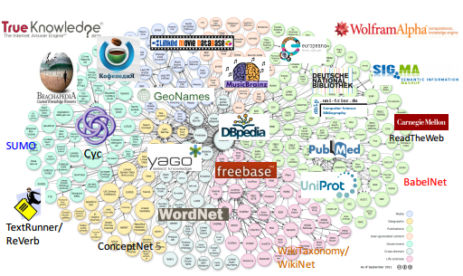
本页PPT借鉴于复旦大学肖仰华老师
《Data-driven Approaches for Large-scale Knowledge Graph Construction》
Preliminaries
Knowledge Graph – KG引领KE复兴
Knowledge graph is a large-scale semantic network
consisting of entities and concepts as well as the
semantic relationships among them
Large scale
Semantically rich
Friendly structure
High quality
Why knowledge graphs?
Understanding the semantic of text needs background
knowledge
A robot brain needs knowledge base to understand the
word

Slide 13
Preliminaries
Knowledge Graph – KG引领KE复兴
Common large-scale KG
名称 | 开始时间 | 依赖资源 | 规模#（实体/概念/关系/事实）
Cyc/OpenCyc | 1984 | 专家知识 | 239,261/116,822/18,014/2,093,000
WordNet | 1985 | 专家知识 | 155,287/117,659/18/-
ConceptNet | 1999 | 群体智能（多语言） | -/8,000,000/36/21,000,000
YAGO | 2007 | WordNet + Wikipedia | 4,595,906/488,469/77/
DBpedia | 2007 | Wikipedia + 专家知识 | 17,315,785/754/2843/79,030,098
Freebase | 2008 | Wikipedia + 领域知识+ 群体智能 | 58,726,427/2,209/39,151/ 3,197,653,841
NELL | 2010 | 机器学习 | -/287/327/2,309,095
BabelNet | 2012 | WordNet + Wikipedia （多语言） | 9,671,518/6,117,108/1,307,706,673/-
Wikipedia | 2012 | Freebase + 群体智能 | 45,766,755/-/-/-
Google Knowledge Graph | 2012 | 基于Freebase | 570M/1500/35000/18000M
Knowledge Vault | 2014 | 机器学习 | 45M/1100/4469/271M

Slide 14

本页PPT借鉴于复旦大学肖仰华老师《大数据时代的知识工程与知识管理》
Preliminaries
Knowledge Graph – KG引领KE复兴
知识图谱有着广泛的应用场景

Slide 15
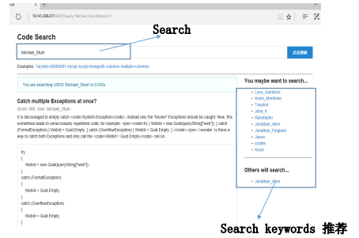
本页PPT借鉴于复旦大学肖仰华老师《大数据时代的知识工程与知识管理》
Preliminaries
Knowledge Graph – 智慧搜索
精准搜索意图理解
精准分类
语义理解
个性化
Why knowledge graphs?
表格、文本、图片、视频
文案、素材、代码、专家
多粒度搜索
篇章级、段落级、语句级
跨媒体搜索
不同媒体数据联合完成搜索任务
一切皆可搜索，搜索必达

Slide 16
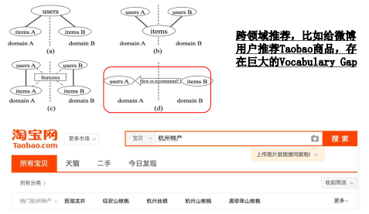
本页PPT借鉴于复旦大学肖仰华老师《大数据时代的知识工程与知识管理》
Preliminaries
Knowledge Graph – KG引领KE复兴
场景化推荐
任务型推荐
冷启动环境下的推荐
跨领域推荐
知识型推荐
电商领域的场景化推荐
精准感知任务与场景，想用户之未想
从基于用户行为的推荐发展到行为与语义融合的智能推荐

Slide 17
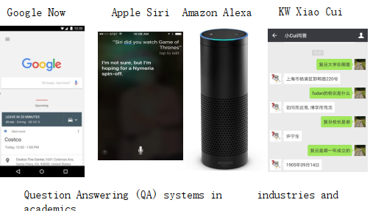

本页PPT借鉴于复旦大学肖仰华老师《大数据时代的知识工程与知识管理》
Preliminaries
Knowledge Graph – 智能问答
人机交互方式将更加自然，对话式交互取代关键词搜索成为主流交互方式
一切皆可回答：图片问答、新闻问答、百科问答

Slide 18
目录
The Pipeline of Knowledge Graph Construction by Data-driven manner
CONTENTS
Python Tools for Graph Data Management
Domain-specific Knowledge Graph Construction

Slide 19
The Pipeline of Knowledge Graph Construction by Data-driven manner
1
Data-driven approaches for large-scale KG construction

Slide 20
Pipeline of Knowledge Graph Construction by Data-driven manner
Data-driven VS Hand crafted
Manually constructed KG
Examples：WordNet, Cyc
Size：Small (Huge human cost)
Quality：Almost Perfect (Each relation is checked by experts)
Auto-constructed KG
Automatically extracted from huge Web Resource
Examples：Probase、WikiTaxonomy, etc
Size：Huge (From huge corpus)
Quality：Good (The accuracy can’t reach 100%)
Because of the huge size, there are many wrong facts

Slide 21
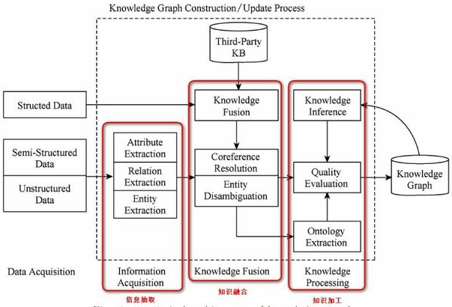
Pipeline of Knowledge Graph Construction by Data-driven manner
Data-driven approaches for large-scale KG construction
知识抽取
属性抽取
关系抽取
实体抽取
知识融合
知识合并
共指消解
实体消歧
知识加工
知识推理
质量评估
本体构建
知识更新
AI System = Knowledge + Reasoning
Figure 1: Data-driven KG construction techniques
刘峤，李杨等人, 知识图谱构建技术综述, 计算机研究与发展, 53 (3)，2016

Slide 22
Pipeline of Knowledge Graph Construction by Data-driven manner
Data-driven approaches for large-scale KG construction
Data acquisition
结构化的数据（工业界常用）
半结构化的数据（工业界常用）
非结构化的数据（学术界常用）
知识抽取
限定域关系抽取（判别的语义关系是预先定义的）
输入一个句子以及标识句子中所出现的实体指称的条件下，系统将其分类到所属的语义类别上（已有研究常把这一任务看成是一个文本分类问题）。
开放域关系抽取（不需要预先定义关系，而是使用实体上下文中的一些词语来描述实体之间的关系）
e.g., 在语句“姚明出身在上海”中，通过开放域关系抽取方法抽取出的结果为（姚明，出生于，上海）
限定域关系抽取
基于模板的关系抽取方法
基于机器学习的关系抽取方法
信息抽取方法相对简单，数据噪声小，经过人工过滤后能够得到高质量的三元组事实。
涉及的NLP分析与处理技术，难度较大。互联网的更多信息都是以非结构化的文本形式存在的。

Slide 23
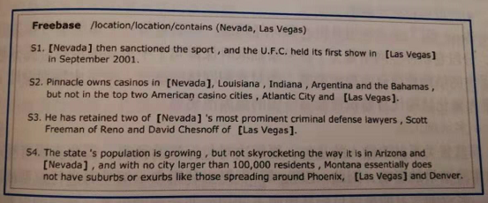
Pipeline of Knowledge Graph Construction by Data-driven manner
Data-driven approaches for large-scale KG construction
基于模板的关系抽取
e.g., 用以下模板表示收购关系（acquisition）
X is acquired by Y
X is purchased by Y
X is bought by Y
基于机器学习的关系抽取方法
有监督的关系抽取方法（e.g., 基于特征工程的方法，基于核函数的方法，基于神经网络的方法）
弱监督的关系抽取方法
Distant Supervision（远程监督），即如果两个实体之间存在某种关系，则所有包含这两个实体的句子都表达了这种关系，这些句子的集合被称为一个“包”。

Slide 24
Pipeline of Knowledge Graph Construction by Data-driven manner
Data-driven approaches for large-scale KG construction
开放域关系抽取（Open-domain Information Extraction, Open IE）
华盛顿大学的AI研究小组最早提出Open IE的想法
TextRunner、Kylin、WOE、ReVerb等系统相继被开发
以TextRunner为例进行介绍（核心：将动词作为关系名称，通过动词链接两个论元，从而挖掘论元之间的关系）
1、语料自动生成：主要通过依存句法分析，结合启发式的规则自动生成语料
E.g., 启发式的规则包括：关系指代词是两个实体之间依存路径上的动词或动词短语。
2、分类器的训练：利用朴素贝叶斯分类器进行训练，其使用的特征包括：关系指示词的词性、实体的类型等。
3、关系三元组的抽取：利用训练好的分类器对Web文本上的三元组进行抽取。
4、关系三元组可信度计算：将存储起来的相似三元组进行合并，然后根据网络数据的冗余性，计算合并后的三元组在Web文本中出现的次数。
Open IE方法普遍存在的问题：（1）三元组识别错误（incoherent extractions）；（2）无信息三元组抽取（un-informative extractions）
Michele, Michael, Stephen, et al., Open information extraction from the web, IJCAI, 2007.

Slide 25
Pipeline of Knowledge Graph Construction by Data-driven manner
Data-driven approaches for large-scale KG construction
知识融合（为跨领域的信息需求提供服务）
从融合的知识图谱类型来看：
垂直方向的融合（融合较高层通用本体与较低层领域本体或实例数据）
水平方向的融合（融合相同层次的知识图谱）
知识融合中的关键技术
匹配框架（元素级、结构级的匹配）
实体对齐（e.g., 等价关系合并；互动百科与百度百科中的实体“刘洋”描述的是同一个对象）
冲突检测与消解（使多个知识图谱形成一致的结果）
典型的知识融合系统
AgreementMaker：一个集成系统，包含了若干自动对齐的方法
Falcon：一个采用分治法设计的对齐系统
RiMOM：一个采用动态多策略的对齐框架

Slide 26
Pipeline of Knowledge Graph Construction by Data-driven manner
Data-driven approaches for large-scale KG construction
知识加工
知识推理
质量评估
本体构建
知识推理
基于符号演算的推理（逻辑上）
基于数值计算的推理（基于张量分解的方法、基于能量函数的方法）
符号演算和数值计算的融合推理
常识知识推理
质量评估
对知识的可信度进行量化，通过舍弃置信度较低的知识，从而保障知识库的质量

Slide 27
Pipeline of Knowledge Graph Construction by Data-driven manner
Data-driven approaches for large-scale KG construction
知识更新
知识更新是一个不断迭代更新的过程
从逻辑与内容两个方面来分析
从逻辑层面来分析
概念层的更新（往往需要借助于专业团队来完成）
数据层的更新（包括新增或更新实体、关系，以及属性）
当前流行的方法是选择百科等可靠知识库，将其中出现频率较高的事实和属性加入到知识库
从知识图谱的内容层面来分析
数据驱动的全面更新（资源消耗极大，从1到全部）
增量式更新（添加新增知识，资源消耗小）

Slide 28

Python Tools of Graph Data Management
2
Stanford CoreNLP
KnowItAll system
networkx
Gephi

Slide 29
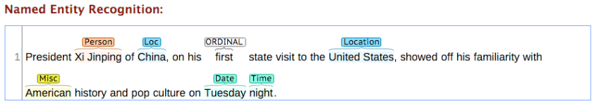
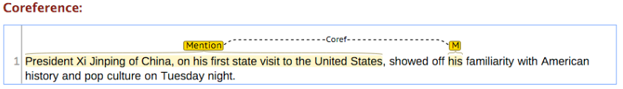
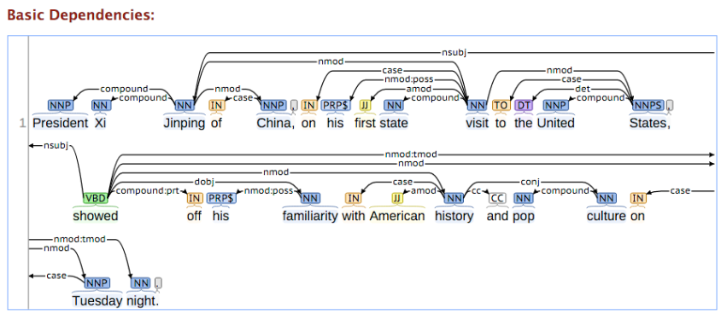
Python Tools of Graph Data Management
https://stanfordnlp.github.io/CoreNLP/
Stanford CoreNLP
Python API interface:
https://stanfordnlp.github.io/CoreNLP/other-languages.html

Slide 30
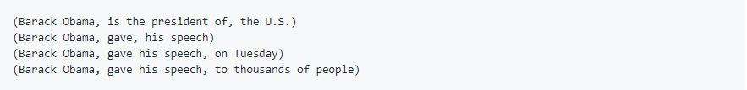
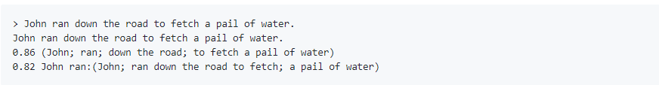
Python Tools of Graph Data Management
KnowItAll system: https://github.com/knowitall/openie
KnowItAll system
Python 调用 Java KnowItAll接口（Jpype实现python调用）:
https://blog.csdn.net/fengmm521/article/details/78446431
Example 1:
N-ary relation extraction
Example 2:
Each extraction associates a confidence score

Slide 31
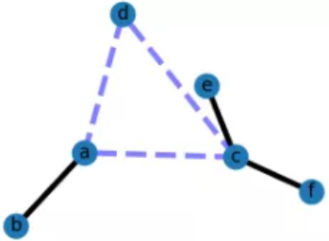
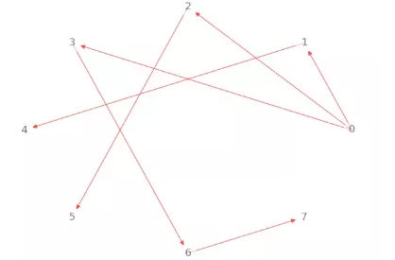
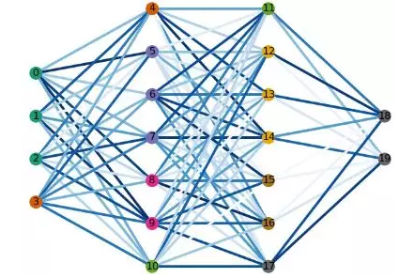
Python Tools of Graph Data Management
networkx
https://mp.weixin.qq.com/s/WYM7k9gddAndlLBuQWTbSA
Networkx是一个基于python的复杂网络分析库，内置了常用的图与复杂网络分析算法，可以方便的进行复杂网络数据分析、仿真建模等工作。
生成随机网络、经典网络、建立网络模型、网络绘制
以图（简单无向图、有向图、多重图等）为基本数据结构，支持通过在线数据源生成图结构
权重图
最短路径算法
多层感知机网络

Slide 32
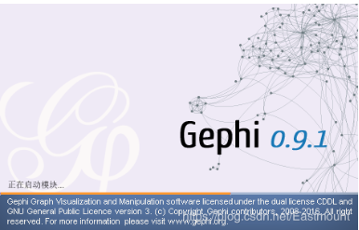
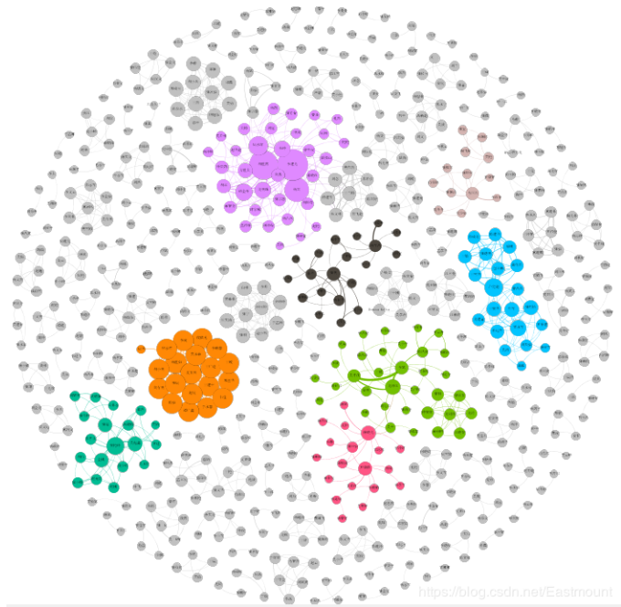
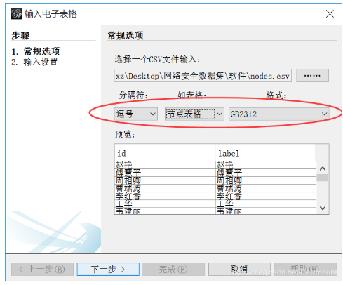
Python Tools of Graph Data Management
Gephi
https://download.csdn.net/download/u011217593/8091061
Gephi是一款基于JVM的复杂网络分析软件
支持多种复杂的网络结构
能够通过图密度分析、PageRank的算法对网络进行分析

Slide 33
Domain-specific Knowledge Graph Construction
3
A Conceptual Knowledge Graph oriented News Data

Slide 34
Domain-specific Knowledge Graph Construction
A Conceptual Knowledge Graph oriented News Data

Slide 35

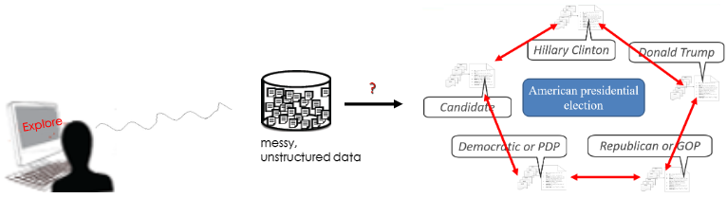
A Conceptual Knowledge Graph oriented News Data
Motivation
With the emergence of massive text corpora in many domains and languages, the sheer size and rapid growth of this new data poses many challenges understanding and connecting significant insights from these massive unstructured texts.

Slide 36
A Conceptual Knowledge Graph oriented News Data
Motivation
How to mine and organize meaningful concepts and their semantic connections from a set of related documents under the same topic.
Traditional relation extraction systems require people to the pre-specify the set of relations of interest. Obviously, it is not appropriate for the news documents with diverse relation schemas.
Given a query topic, a user is often expected to understand core topic information serving by a large conceptual graph, rather than having a collection of relevant documents.

Slide 37
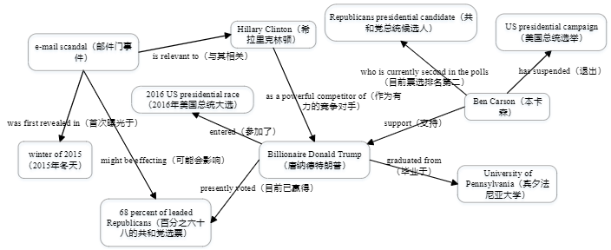
A Conceptual Knowledge Graph oriented News Data
We present a system that extracts salient entities, concepts, and their relationships from a set of related documents, discovers connections within and across them, and presents the resulting information in a graph-based visualization.
Figure 1: Example of a conceptual graph on the topic “presidential election of the US”

Slide 38
A Conceptual Knowledge Graph oriented News Data
The objective of our system is to assist users in quickly finding meaningful and salient connections and facts from a collection of relevant documents, and in summary, it can be best described as a combination of three major subtasks:
Subtask 1: Candidate Fact Extraction
Given a collection of documents clustered around a topic . The goal of this subtask is to extract a set of facts from . Each of facts is essentially triple, for subject relation , and object . Since we need to estimate the coherence of these preferred facts for , we refer to them as candidate facts.
Subtask 2: Fact Filtering
Given a specified document topic , the goal of the subtask is to find a subset of
and each of them should be coherent with .
Conceptual Knowledge Graph Construction
The goal of the subtask is to determine which of the facts from generated by the previous subtask are more likely to be salient, which of their entities and concepts to merge and, when merging, which of the available labels to leverage in the final conceptual graph .

Slide 39
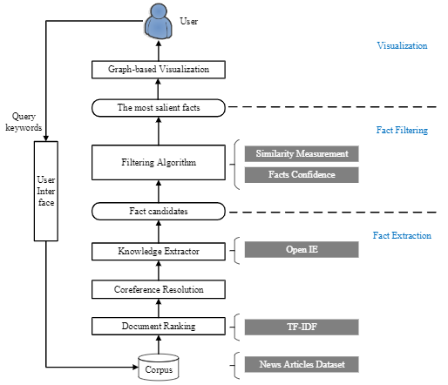
A Conceptual Knowledge Graph oriented News Data
Figure 2: System architecture

Slide 40
A Conceptual Knowledge Graph oriented News Data
Approaches and Implementation
News data
Fact Extraction
Fact Filtering
Conceptual Graph Construction

Slide 41
A Conceptual Knowledge Graph oriented News Data
News data
Our dataset include 5 categories, and for each category we have 2 popular events and each of which represents a document topic. Every topic cluster comprises approximately 30 documents with on average 1,316 tokens, which leads to an average topic cluster size of 2,632 tokens. It is 3 times larger than typical DUC¹ clusters of 10 documents.
The articles in our dataset stem from a larger news document collection released by Signal Media as well as crawled from Web Blogs by ourselves, we rely on event keywords to filter them so as to retain related ones for different topics.
¹Document Understanding Conference, https://duc.nist.gov/

Slide 42
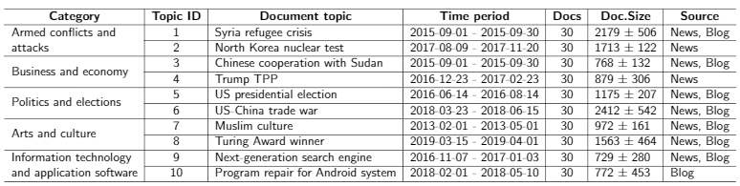
A Conceptual Knowledge Graph oriented News Data
News data
Table 1: Dataset description

Slide 43
A Conceptual Knowledge Graph oriented News Data
Approaches and Implementation
News data
Fact Extraction
Fact Filtering
Conceptual Graph Construction

Slide 44
A Conceptual Knowledge Graph oriented News Data
Open-Domain Knowledge Extraction
Document Ranking. The system first select the words appearing in the document collection with sufficiently high frequency as topic words, and computes standard TF-IDF weights² for each word. Documents under the same topic are ranked according to the TF-IDF weights of the topic words in each document. The top-k documents for every topic are selected for further processing.
Coreference Resolution. Pronouns and other form of coreference are resolved in each document using Stanford CoreNLP system¹. “she” may be replaced by “Angela Merkel”, for instance.
Sentence Ranking. Our system computes the TextRank importance scores⁴ for all sentences within the ranked top-k document list. It then considers only those sentences with sufficiently high scores.
¹https://stanfordnlp.github.io/CoreNLP/index.html
²https://en.wikipedia.org/wiki/Tf%E2%80%93idf
⁴https://github.com/letiantian/TextRank4ZH/blob/master/README.md

Slide 45
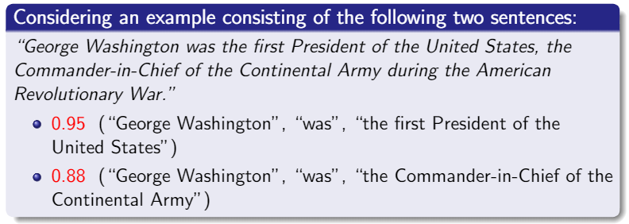
A Conceptual Knowledge Graph oriented News Data
Open-Domain Knowledge Extraction
Our candidate fact extraction is based on a publicly available system for open information extraction, namely the KnowItAll project’s Open IE 4⁴.
⁴https://github.com/knowitall/openie

Slide 46
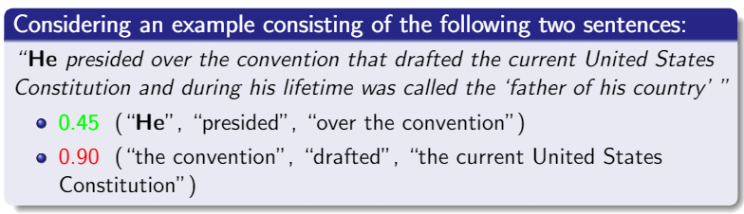
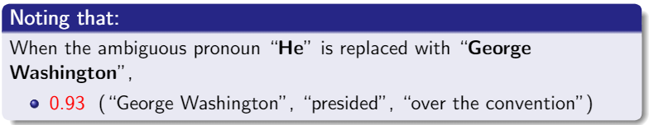
A Conceptual Knowledge Graph oriented News Data
Open-Domain Knowledge Extraction

Slide 47
A Conceptual Knowledge Graph oriented News Data
Approaches and Implementation
News data
Fact Extraction
Fact Filtering
Conceptual Graph Construction

Slide 48
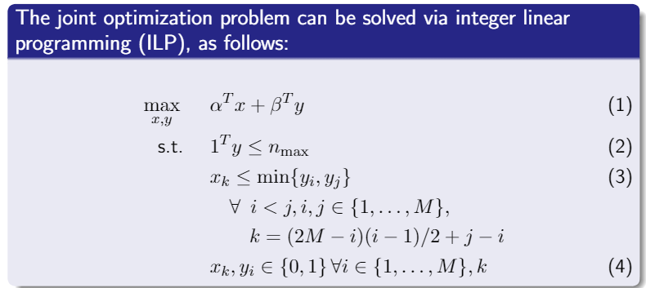
A Conceptual Knowledge Graph oriented News Data
Fact Filtering
Our candidate fact The filtering algorithm aims at hiding less representative facts in the visualization, seeking to retain only the most salient, confident and compatible facts. This is achieved by optimizing for a high degree of coherence between facts with high confidence.

Slide 49
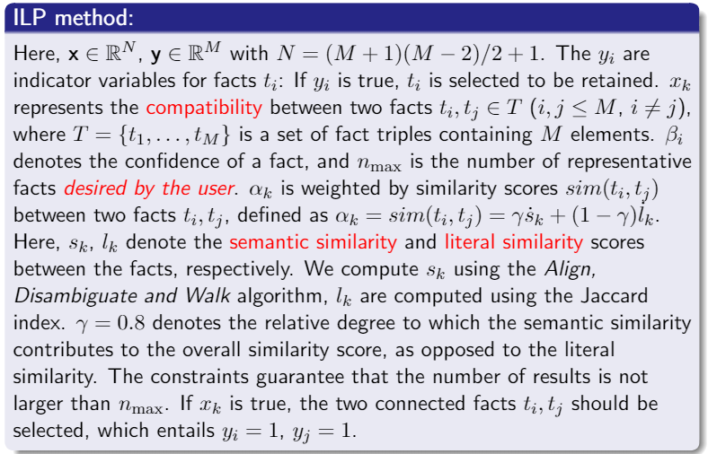
A Conceptual Knowledge Graph oriented News Data
Fact Filtering

Slide 50
A Conceptual Knowledge Graph oriented News Data
Approaches and Implementation
News data
Fact Extraction
Fact Filtering
Conceptual Graph Construction

Slide 51
A Conceptual Knowledge Graph oriented News Data
Conceptual Knowledge Graph Construction
Merge Equivalent Concepts and Add Relations.
Literal features of entities. e.g., Billionaire Donald Trump, Donald Trump, Donald John Trump, Trump, etc. all refer to the same person.
Entity linking from search engine. For NER, they can use the powerful entity linking ability from a search engine for deciding on coreference. ADW⁵ tool is used for semantically similarity computation between concepts for coreference.
Annotators were able to add up to three synthetic relations with freely defined labels to connect the subgraphs into a fully connected graph.
⁵Align, Disambiguate and Walk, https://github.com/pilehvar/ADW

Slide 52
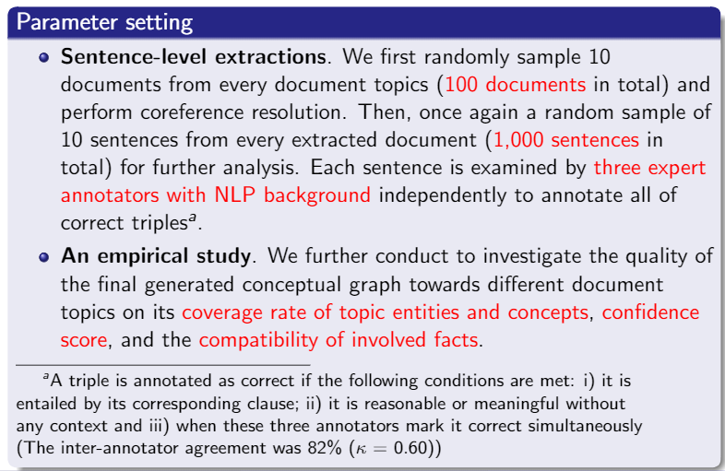
A Conceptual Knowledge Graph oriented News Data
Experiments – Experimental setting

Slide 53
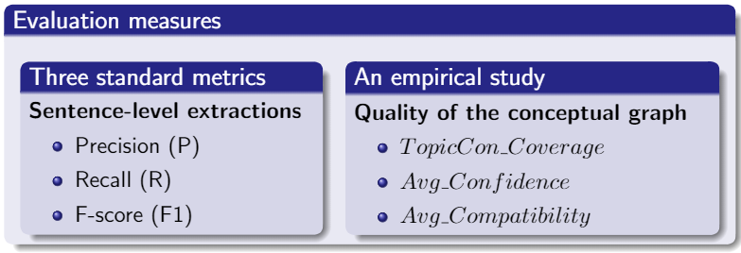
A Conceptual Knowledge Graph oriented News Data
Experiments – Evaluation measures
Experiments – Performance analysis of our extraction approach
Table 1: Evaluation of precision, recall, and F-score on five independent document topics (including
topic 1 to topic 5) from two datasets

Slide 54
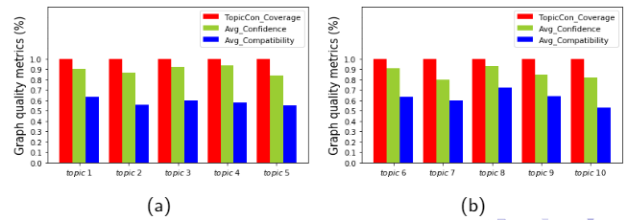
A Conceptual Knowledge Graph oriented News Data
Experiments – Performance analysis of our extraction approach
Table 1: Evaluation of precision, recall, and F-score on five independent document topics (including
topic 6 to topic 10) from two datasets
Experiments – Quality analysis of the conceptual knowledge graph

Slide 55
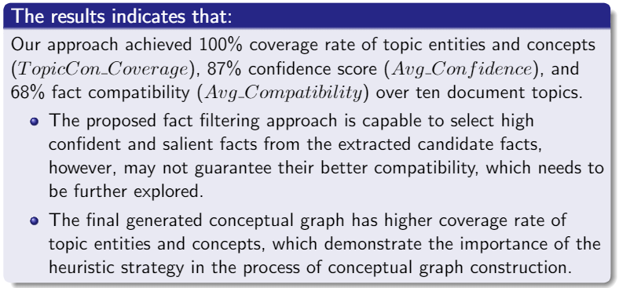
A Conceptual Knowledge Graph oriented News Data

Slide 56
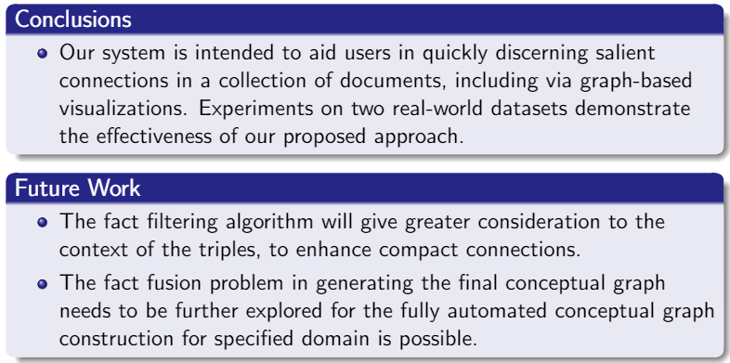
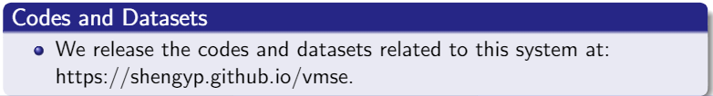
A Conceptual Knowledge Graph oriented News Data

Slide 57


THANK YOU
shengyp2011@163.com
18508233610

