Slide 1
A Halting Algorithm to Determine the Existence of Decoder
ShengYu Shen et.al
School of Computer
National Univ. of Defense Tech.
China

Slide 2
Content
Motivations
Framework
Step 1
Step 2
Experimental result
Conclusion
Future works

Slide 3
Motivations
Encoding and decoding is a major topic of:
  Computer science
  Electronic engineering
Examples:
  Hardware: PCI, Ethernet, CDMA,…
  Software: TCP/IP, Multimedia,…

Slide 4
Personal Motivation
My full time job is designing routing and interfacing chips for super computers.
Our last super computer is TH-1:
  5th in TOP500 last year
  Maybe 1st this year
Many complicated design issues
  Complex coding mechanism
  Bandwidth matching between multiple clock domains
  Deskew
  …

Slide 5
Motivations (cont.)
Designing decoder and encoder by hand is a tedious and error-prone job.
Encoder is a total specification of decoder.
So, can we synthesize the decoder automatically from the encoder?

Slide 6
Our previous works
First appear in ICCAD’09.
Complementary synthesis in two steps:
  Deciding whether the decoder exists.
  Building the decoder (not related to this paper).

Slide 7
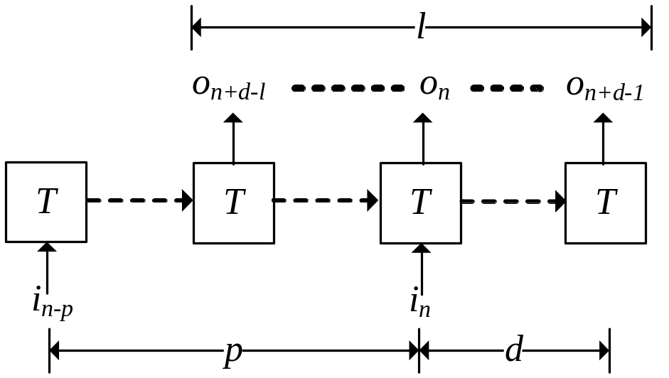
If the decoder exists
Parameterized Complementary Condition (PC), finding p,d and l such that
  Input letter i_{n} can be uniquely determined by output sequence o_{n+d-l},…,o_{n+d-1}.
  p is the length of prefix sequence to rule out unreachable states.
  d is the delay between input and output.
  l is the length of output sequence.

Slide 8
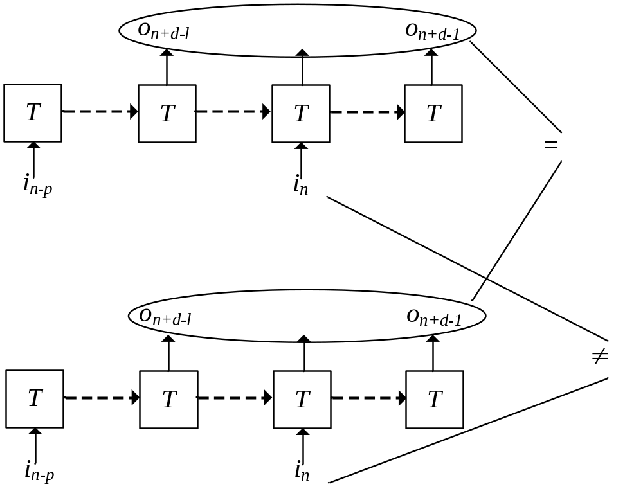
SAT instance of checking PC
Construct two state transition paths
Constrain their output to be same
Constrain their input to be different
UNSAT of this instance means PC holds for this particular combination of p,d and l

Slide 9
If the decoder exists (cont.)
ICCAD’09 approach: just enumerating all combination of p,d and l.
If the decoder exists, this algorithm is very fast even for very large encoder.
But if the decoder does not exist, this algorithm does not halt.

Slide 10
Content
Motivations
Framework
Step 1
Step 2
Experimental result
Conclusion
Future works

Slide 11
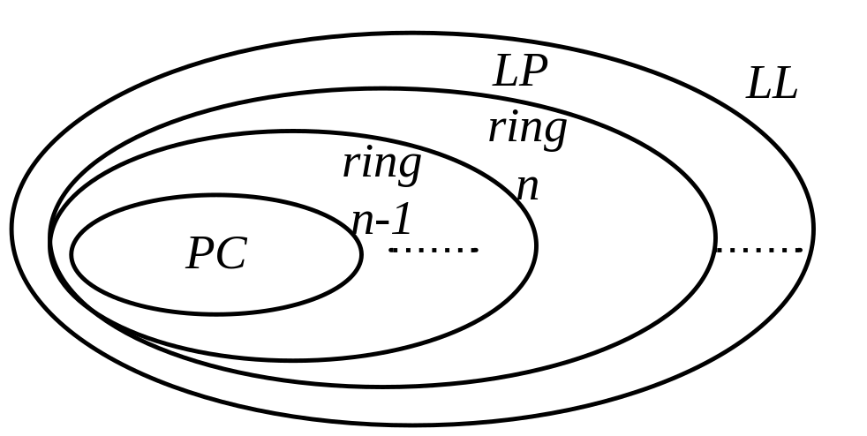
Checking PC in two steps
Step 1:
  fast but incomplete,
  Over-approximating PC
Step 2 :
  slow but complete,
  Constructing an onion-ring between PC and its over-approximation .

Slide 12
Content
Motivations
Framework
Step 1
Step 2
Experimental result
Conclusion
Future works

Slide 13
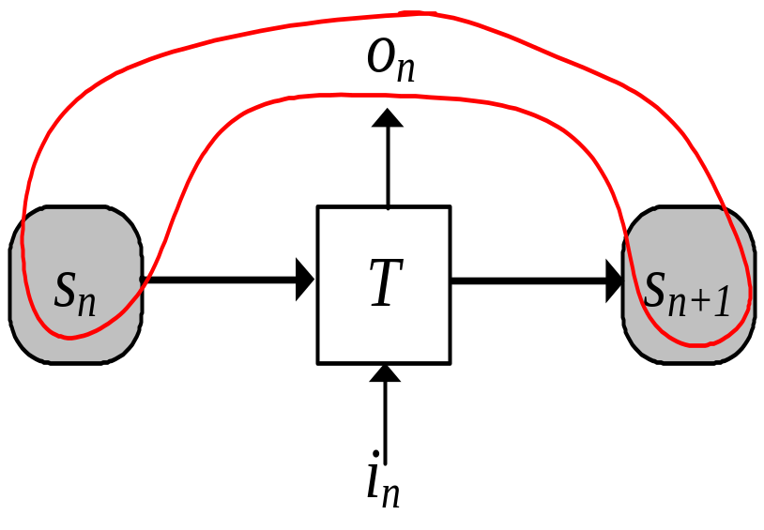
Unique and non-unique state set
S^{U} is the set of states in which i_{n} can be uniquely determined by s_{n},o_{n} and s_{n+1}
S^{N} = S-S^{U}

Slide 14
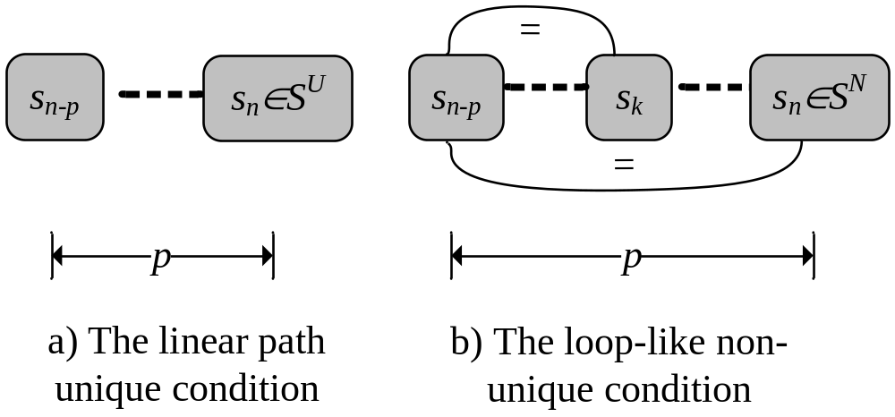
Over-approximating PC
Linear Path Unique Condition (LP) :If there exist p such that all state transition path of length p always reach S^{U}
Loop-like Non-unique Condition (LL):If there exist p such that there is a loop-like path of length p that does NOT reach S^{U}

Slide 15
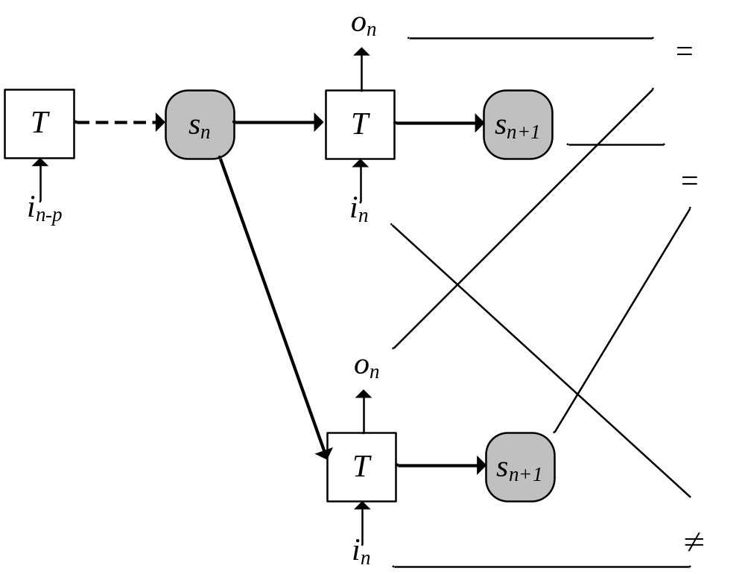
SAT instance of LP
Construct two state transition paths that share prefix
Constrain their output, and next state to be same
Constrain their input to be different
UNSAT of this instance means LP holds for this particular p

Slide 16
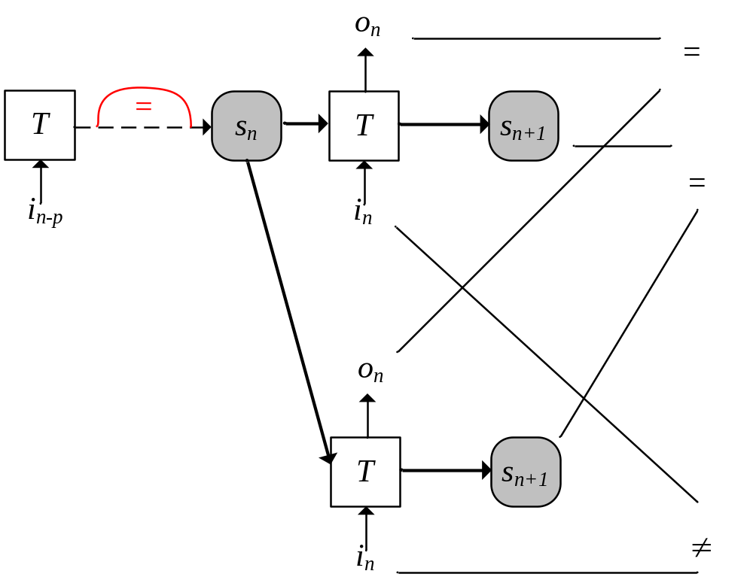
SAT instance of LL
Similar to that of LP
Add constraints to detect loops on prefix of length p
SAT of this instance means LL holds for this particular p

Slide 17
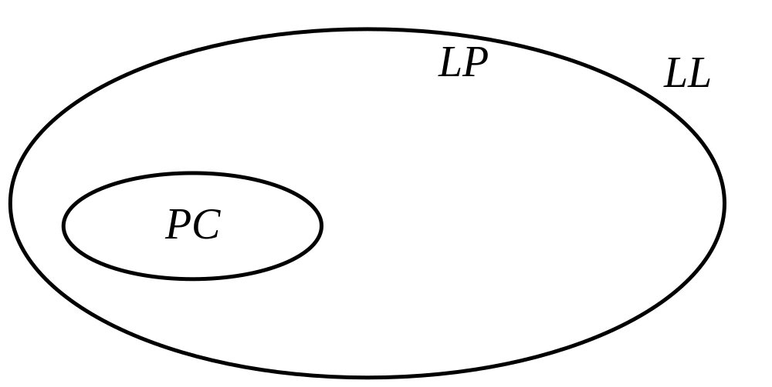
Relations of PC, LP and LL
PC->LP : this means LP is an over-approximation of PC
LL <-> ¬LP : this means LP, and therefore also PC, can be falsified by proving LL

Slide 18
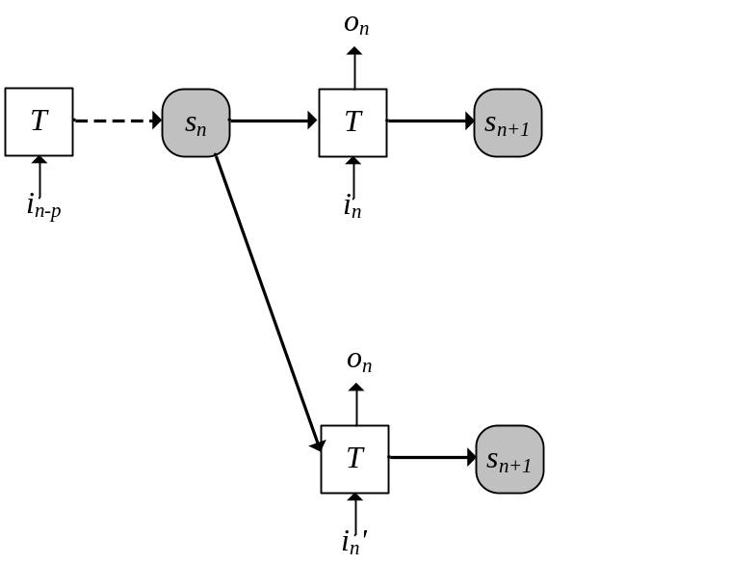
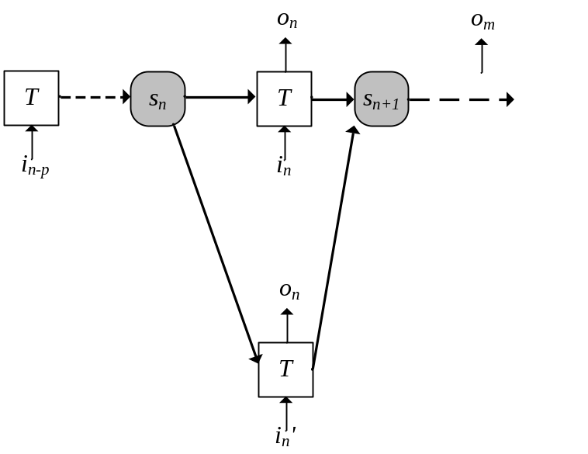
PC->LP: Sketch of proof
If LP does not hold, then the SAT instance at left is SAT
We can run this circuit further from s_{n+1},to get the SAT instance at right side
This means for output sequence of any length, we can always find one of its valuation that corresponds to two different i_{n} and i_{n}’

Slide 19
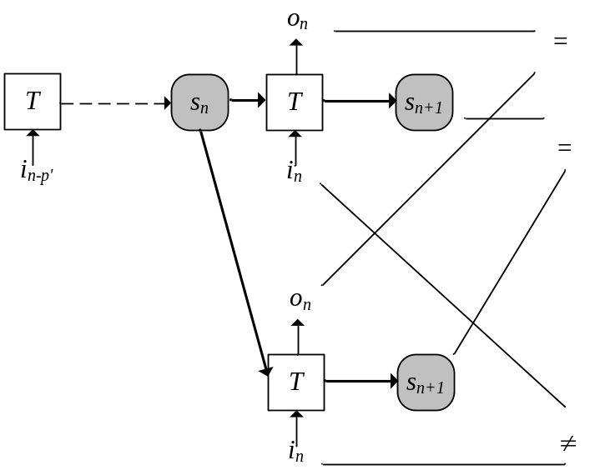
LL -> ¬LP : Sketch of proof
Expanding the loop to get longer prefix of length p’, where p’>p
This will falsify LP directly, so LL-> ¬LP

Slide 20


¬LP -> LL : Sketch of proof
¬LP means for every valuation of p, SAT instance on left is SAT
If p is larger than the recurrence diameter, then there will be a loop in the prefix, just like the figure on right side

Slide 21
Algorithm of step 1
for p = 0 -> ∞
  if SAT instance of LP is UNSAT then
    LP holds
  else if SAT instance of LL is SAT then
    LN holds, and PC is falsified
This algorithm will eventually halt, because LL <-> ¬LP

Slide 22
Content
Motivations
Framework
Step 1
Step 2
Experimental result
Conclusion
Future works

Slide 23
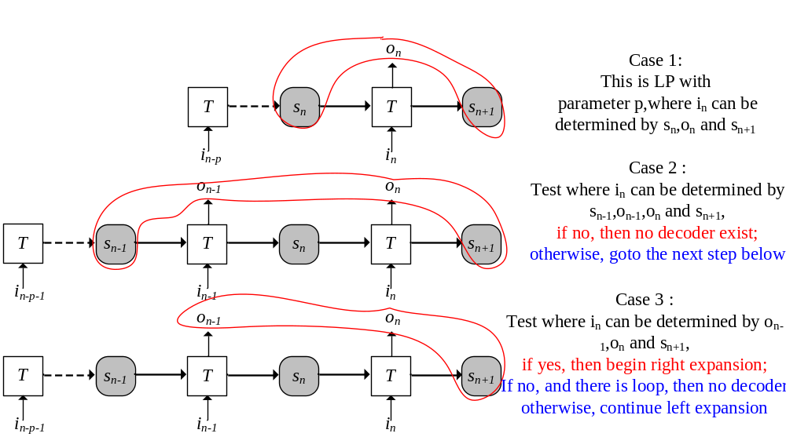
Left expansion

Slide 24
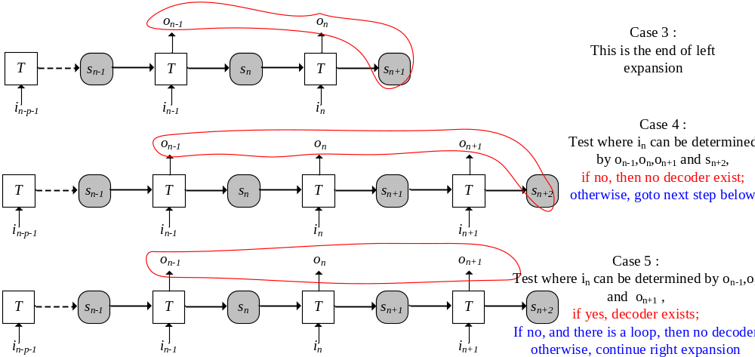
Right expansion

Slide 25
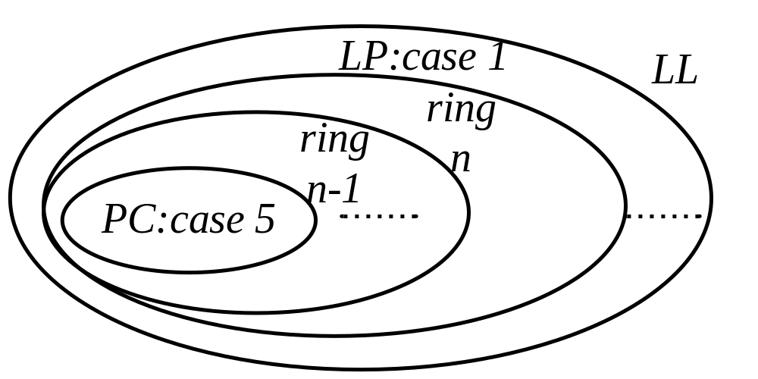
All these cases form an onion-ring
If PC holds, then Case 5 -> case 4 -> case 3 -> case 2 -> case 1
That is to say, they form an onion ring

Slide 26
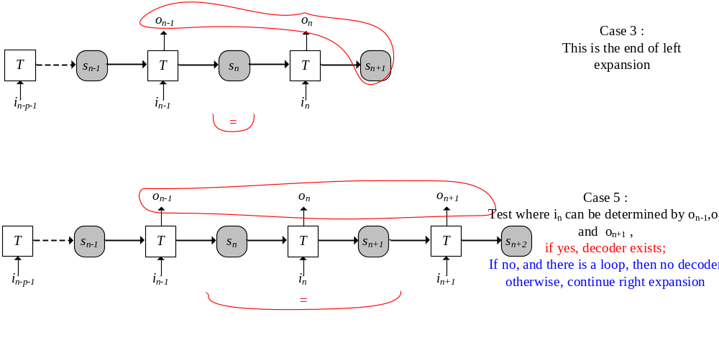
Reaching termination by finding a loop
If PC does not hold, there will be a loop in case 3 or 5

Slide 27
Content
Motivations
Framework
Step 1
Step 2
Experimental result
Conclusion
Future works

Slide 28
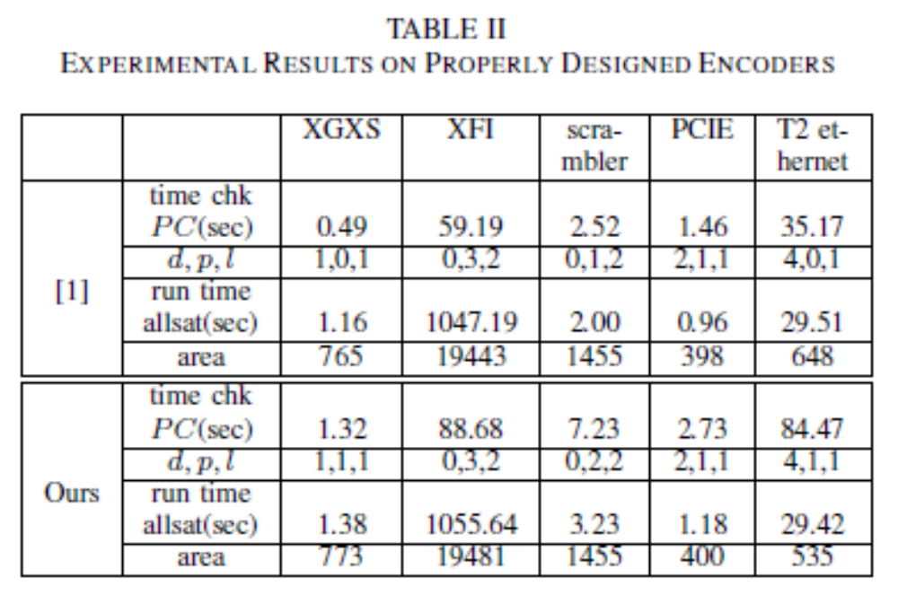
Experimental results
Run time is much longer
But run time to build decoder is not affected
Circuit area are also not affected

Slide 29
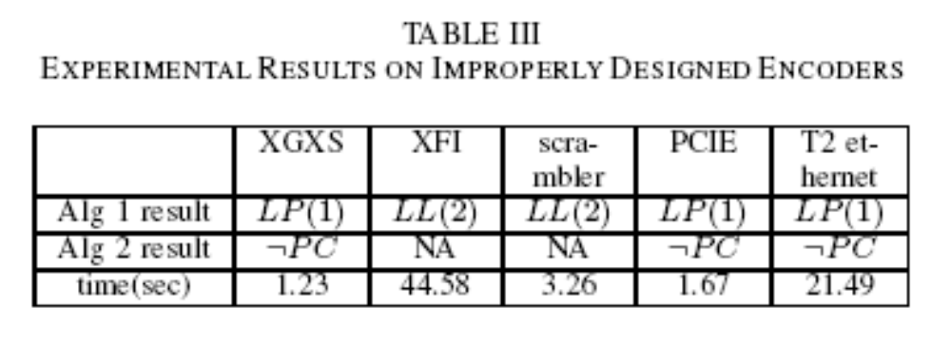
Experimental results(cont.)
We can always terminate and recognize the improper design encoders

Slide 30
Content
Motivations
Framework
Step 1
Step 2
Experimental result
Conclusion
Future works

Slide 31
Conclusion
This paper proposes the first halting algorithm that checks whether a particular encoder has corresponding decoder.
Theoretical analysis and experimental results show that our approach always distinguishes correct encoders from their incorrect variants and halts properly.

Slide 32
Content
Motivations
Framework
Step 1
Step 2
Experimental result
Conclusion
Future works

Slide 33
Some more interesting cases
Multiple valuation of parameters
Parameters Change on the fly
Multiple clocks design without parameters at all

Slide 34
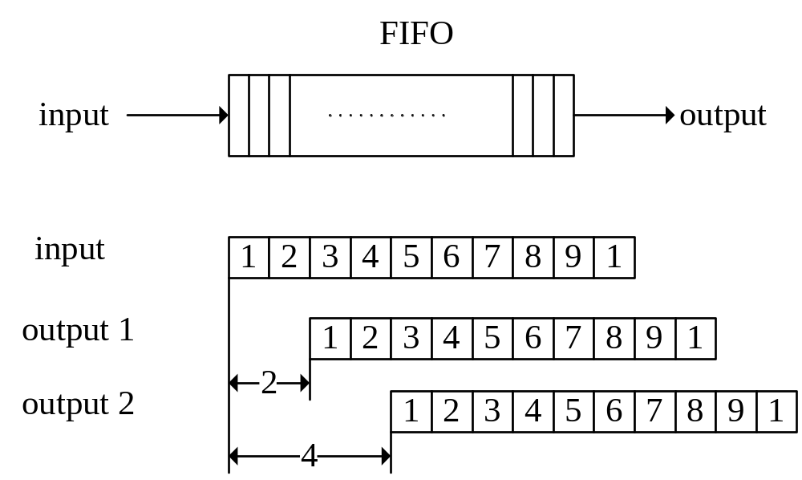
Multiple valuations of parameters
FIFO can be seen as an encoder
Decoder exists for it
There are multiple possible values for parameter d
These value does not change for a certain running
In this case, how to determine the existence of decoder?

Slide 35
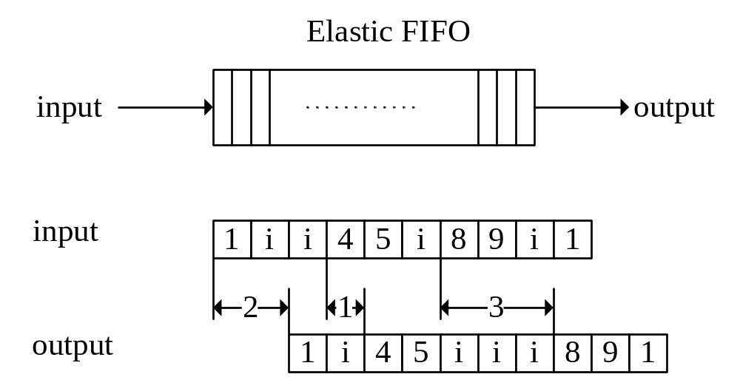
Parameters Change on the fly
Elastic FIFO that can delete or insert idle letter, but does not change valid data
By inserting and deleting idle letter, the delay change on the fly
Decoder exists if we only care about the valid data stream
But how to determine?

Slide 36
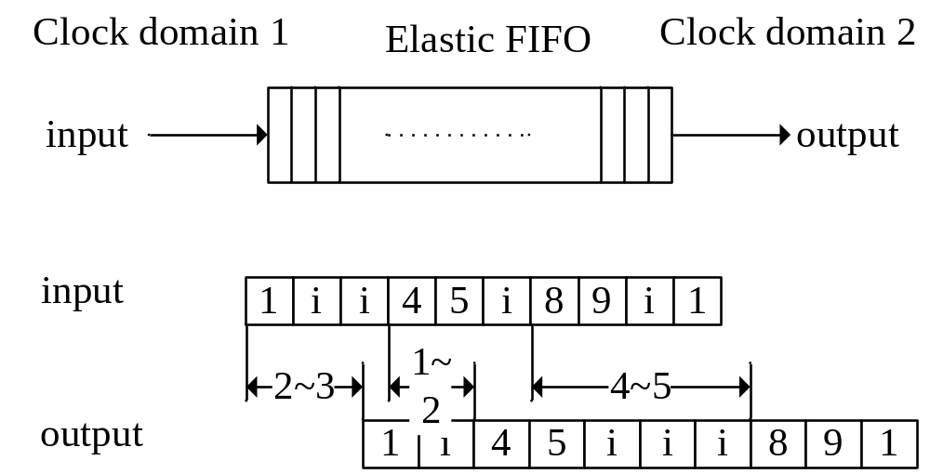
Multiple clocks design without parameter
Two clocks with different period
No unique standard to measure the timing relation between input and output stream

