Slide 1
Synthesizing Complementary Circuits Automatically
ShengYu Shen
School of Computer
National University of Defense Technology

Slide 2
Outline
Motivation
Checking Complementary Condition
Building Complementary Circuit
Experimental results
Summary

Slide 3
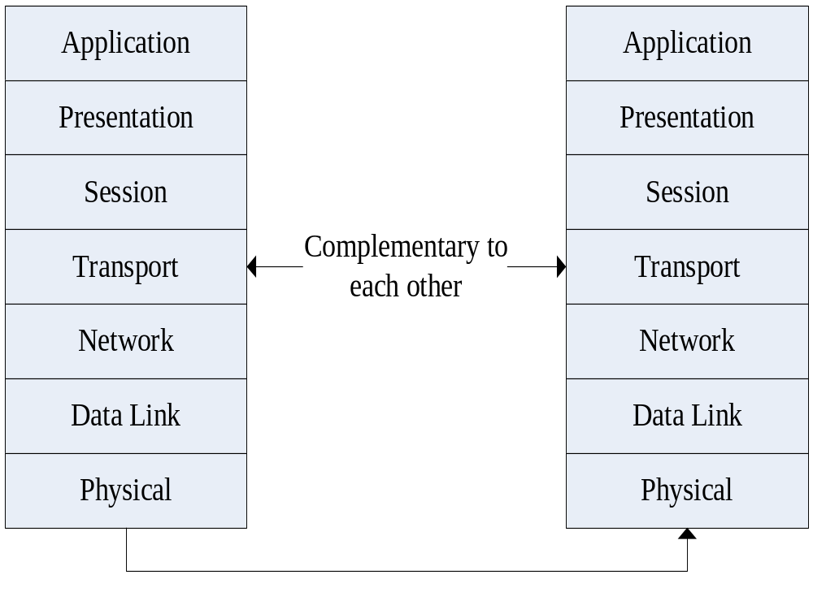
OSI seven-layer model

Slide 4
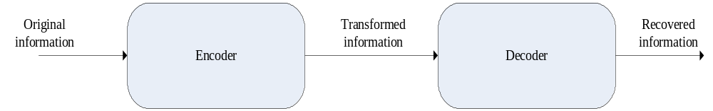
Complementary Circuits

Slide 5
Difficulties in design, verification and debug of such circuits
Deep pipeline
Complex encoding mechanism
Data stream that is hard to be recognized by human
…

Slide 6
So
It would be a great help if we can synthesize decoder from encoder.

Slide 7
Outline
Motivation
Checking Complementary Condition
Building Complementary Circuit
Experimental results
Summary

Slide 8
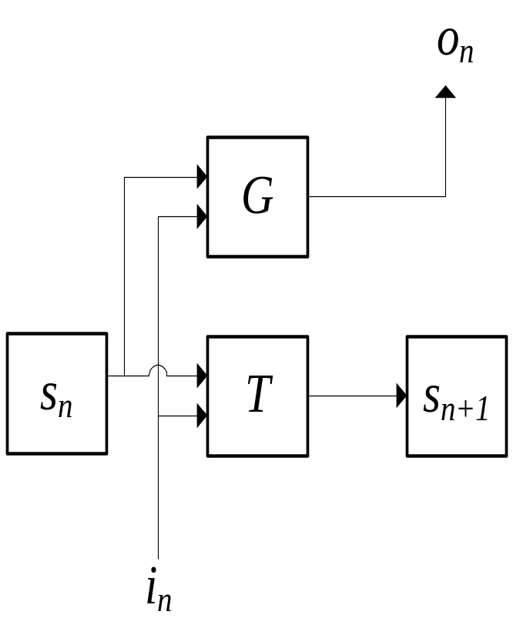
Mealy finite state machine

Slide 9
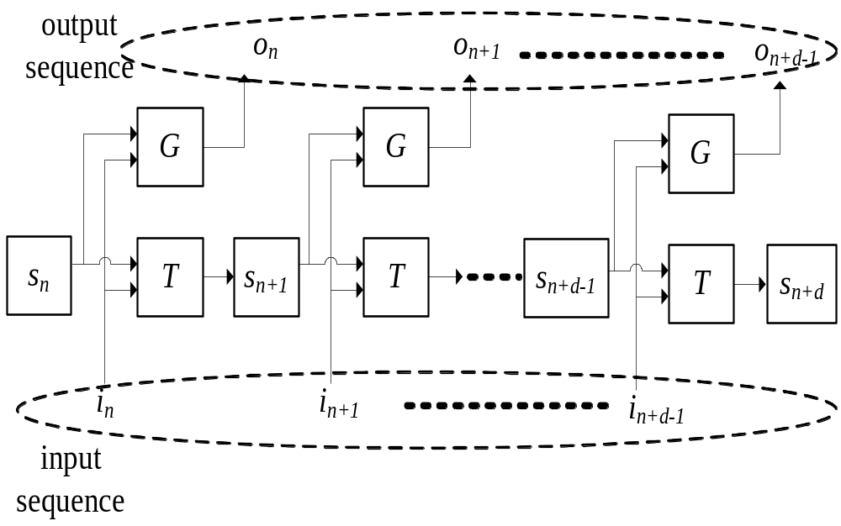
Unfolding Transition Relation of encoder E

Slide 10
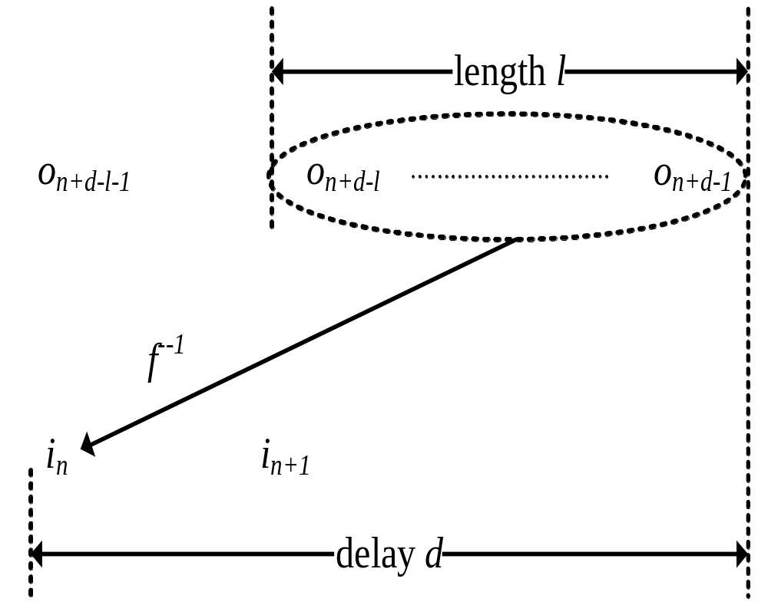
f⁻⁻¹ that compute input alphabet i_{n} from output alphabet sequence

Slide 11
Existence of f⁻¹
For every output sequence <o_{n+d-l},…,o_{n+d-1}>, there exist no more than 1 i_{n} that satisfy unfolding relation
UNSAT
Output are equal
Inputs are not equal

Slide 12
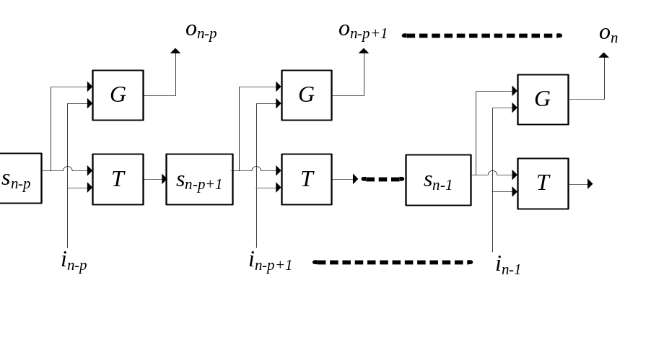
Approximating reachable state set
Output are equal
Inputs are not equal

Slide 13
Existence of f⁻¹(cont.)
If we succeed in checking UNSAT of last formula, we now have:
  Value of parameter d, l and p
  SAT instance F_{E} of unfolding relation
We need to characterize f⁻¹ from F_{E}

Slide 14
Outline
Motivation
Checking Complementary Condition
Building Complementary Circuit
Experimental results
Summary

Slide 15
Partitioning f⁻¹
f⁻¹ take <o_{n+d-l},…,o_{n+d-1}> as input and compute i_{n}
Assume <o_{n+d-l},…,o_{n+d-1}> is represented by O_{var}
Assume i_{n} is represented by I_{var}
f⁻¹ can be partitioned into multiple f_{v}⁻¹,each take O_{var} and and compute a v∈I_{var}
So we will focus on characterizing f_{v}⁻¹ below

Slide 16
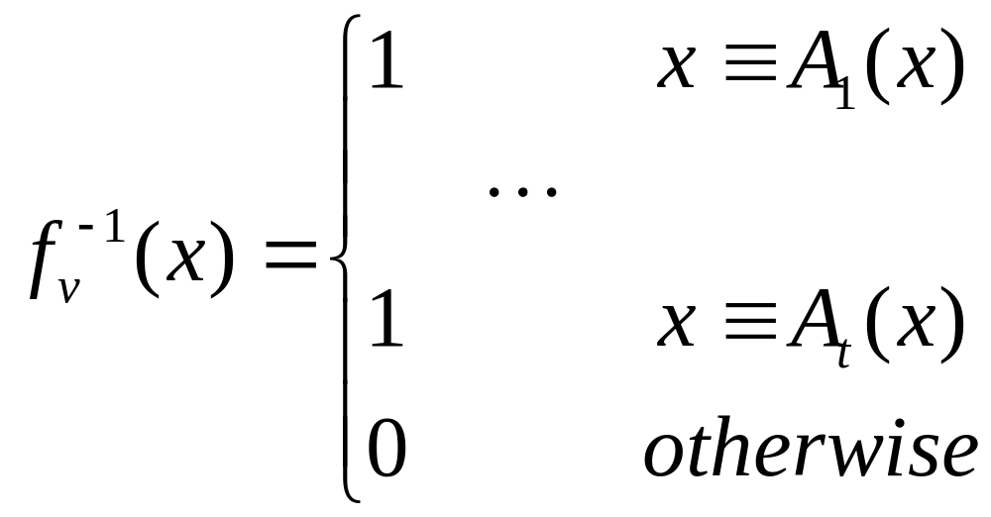
Naïve approach based on ALLSAT to characterize f_{v}⁻¹ from F_{E}
Assume SA_{v}={A₁,…A_{t}} is the set of satisfying assignments of F_{E}
f_{v}⁻¹ can be defined as
But SA_{v} is too large to be enumerated by existing approaches

Slide 17
Merging satisfying assignments by removing irrelevant variables
problem
  For a formula F on variable set V
  Target variable v that should always be 1
  Variable subset U⊆V whose satisfying assignment we would like to enumerate
  Satisfying assignment A
For each u∈U, if F∧¬v∧A|_{U-{u}} is UNSAT, then absence of u can’t make v to be 0, it is still 1,then u is a variable irrelevant to v≡1
By removing u from U, A and A|_{U-{u}}|^{u←¬A(u)} can be merged

Slide 18
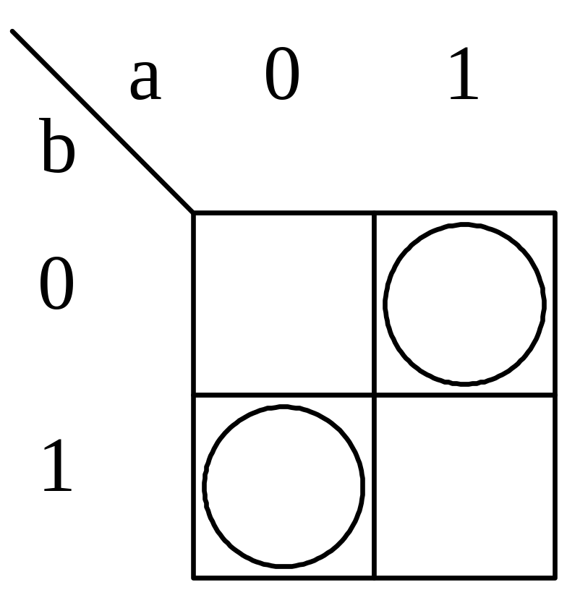
Existing ALLSAT can’t handle XOR efficiently

Slide 19
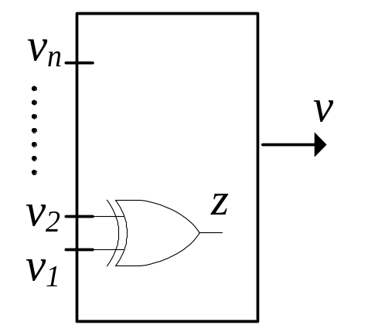
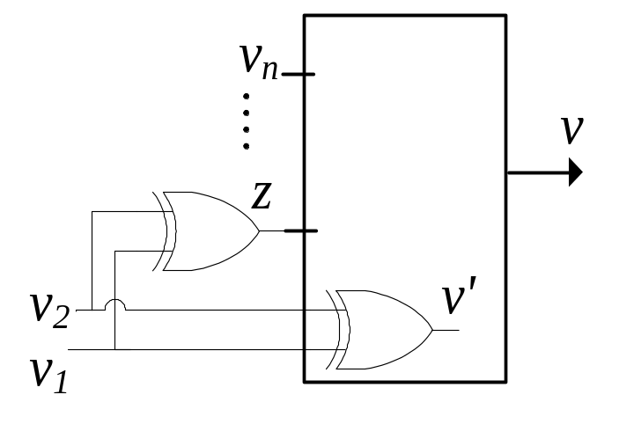
Idea of dealing with XOR
U
Firstly, discover XOR gates z=v₁⊕v₂ between every pair of v₁,v₂ ∈U
Then, change U to U∪{z}-{v₁,v₂},

Slide 20
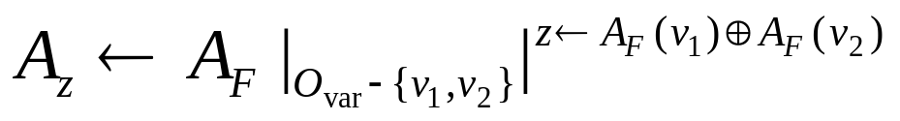
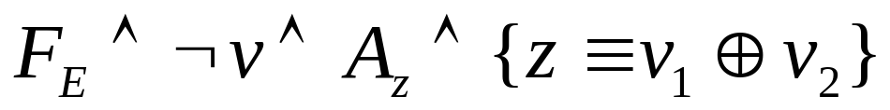
Checking existence of z=v₁⊕v₂
The assignment that replace v₁ and v₂ with z:
UNSAT of following formula means that A_{Z} can’t make v to be 0, so v must still be 1. Thus, XOR gate z=v₁⊕v₂ exists.

Slide 21
Replacing U with U∪{z}-{v₁,v₂}
Thus, A and A|_{U-{v1,v2}}|^{v1←¬A(v1)}|^{v2←¬A(v2)} can be merged into A|_{U-{v1,v2}}|^{z←A(v1)⊕A(v2)}

Slide 22
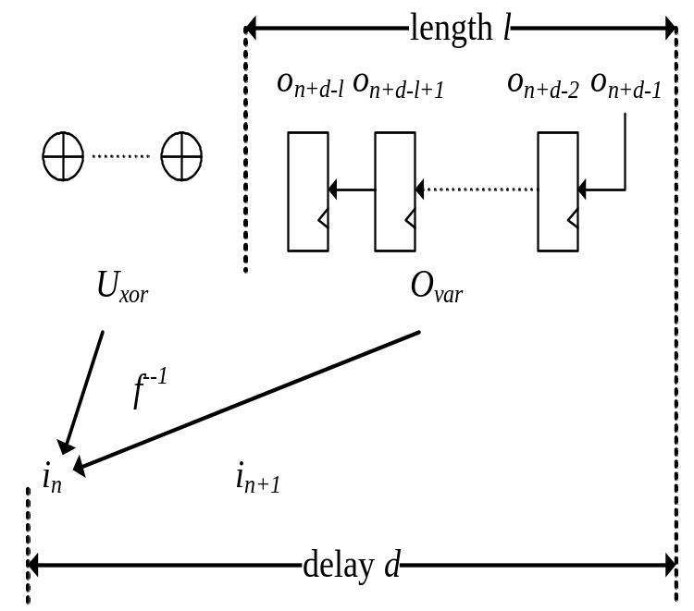
Built E⁻¹ structure
Instance register bank for <o_{n+d-l},…,o_{n+d-2}>, and connect output of o_{i} to input of o_{i-1}
Instancing discovered XOR gates

Slide 23
Verilog source code of E⁻¹
Assume SA_{v}={A₁,…A_{t}} is the set of satisfying assignment
U_{xor} is output pin of discovered XOR gates
always@(list of variables in O_{var}∪U_{xor}) begin
  if(cond₁||…||cond_{t})
    v=1’b1;
  else
    v=1’b0;
end

Slide 24
Outline
Motivation
Checking Complementary Condition
Building Complementary Circuit
Experimental results
Summary

Slide 25
Benchmarks
XGXS encoder compliant to clause 48 of IEEE-802.3ae 2002 standard.
XFI encoder compliant to clause 49 of the same IEEE standard.
66 bit scrambler.
PCIE physical coding module.
Ethernet module of Sun’s OpenSparc T2 processor.

Slide 26
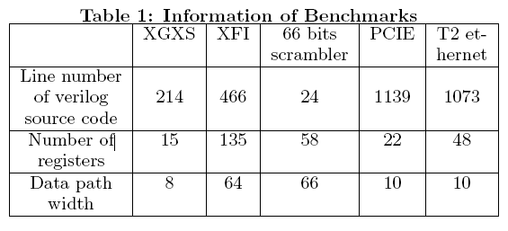
Complexity of benchmarks

Slide 27
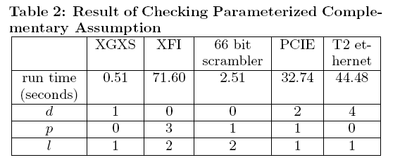
Result of checking parameterized complementary condition

Slide 28
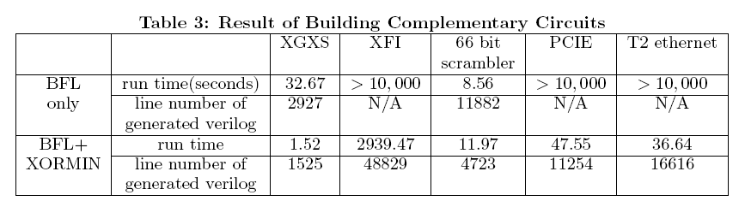
Result of building E⁻¹

Slide 29
Outline
Motivation
Checking Complementary Condition
Building Complementary Circuit
Experimental results
Summary

Slide 30
Summary
We can deal with many complex encoders from industrial projects, including PCIE and 10G ethernet
All E⁻¹ can be built within 3000 seconds

Slide 31
Future works
Automatically inferring assertions that ruling out invalid input alphabets
Using SMT solver to deal with array
Improving the circuit area

Slide 32
That is all, thanks

