Slide 1
Inferring Assertion for Complementary Synthesis
ShengYu Shen
School of Computer Science,
National University of Defense Technology

Slide 2
Content
Motivations
Framework
Finding configuration letter without decoder
Enlarging the configuration letter with interpolant
Experimental result
Conclusion and Future works

Slide 3
What is complementary synthesis
Encoding and decoding are major topics of:
  Computer science
  Electronic engineering
Examples:
  Hardware: PCI-E, Ethernet, CDMA,…
  Software: TCP/IP, Multimedia,…
Many complicated design issues
  Complex coding mechanism
  Bandwidth matching between multiple clock domains
  Deskew…
Designing decoder and encoder by hand is a tedious job.

Slide 4
What is complementary synthesis (cont.)
On the other hand, encoder is a total specification of decoder.
So, can we synthesize the decoder automatically from the encoder?

Slide 5
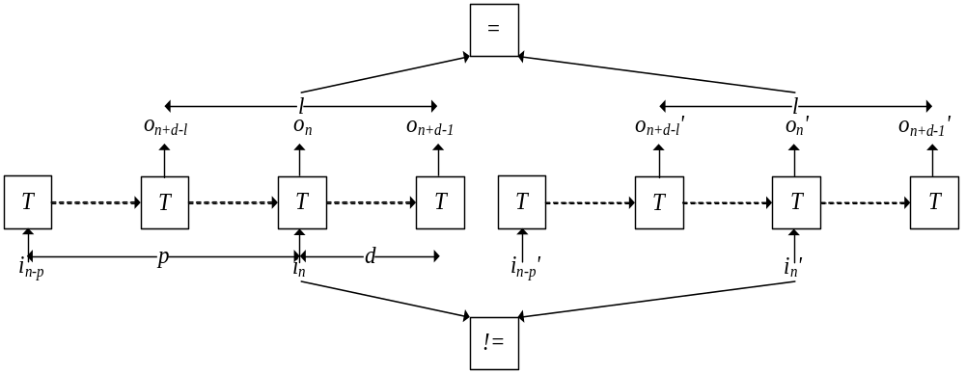
Our previous works
Complementary synthesis (ICCAD’09) decides the decoder’s existence by checking Parameterized Complementary Condition (PC), which finds p,d and l for the encoder such that the encoder’s input letter i_{n} can be uniquely determined by its output sequence o_{n+d-l},…,o_{n+d-1}.
p, d and l are the window size

Slide 6
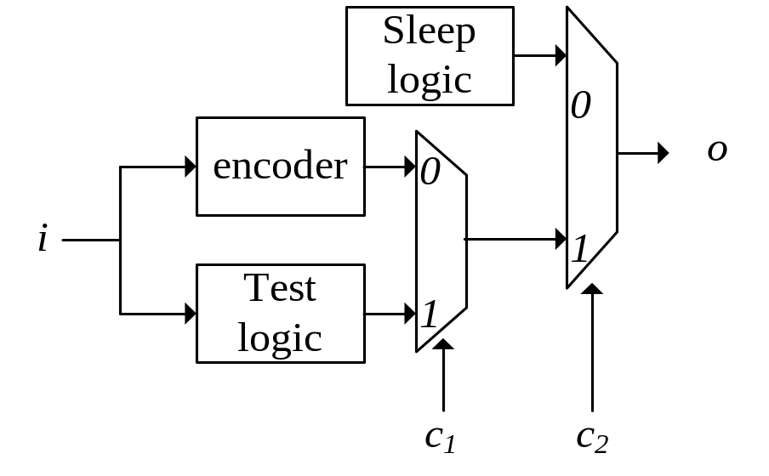
Its problem
The user need to manually specify an assertion, to disable those logic not related to encoding.
However, specifying this assertion need the user read lots of documentation and try many combinations.
For example, XFI encoder have 120 configuration pins.
Even with these efforts, the specified assertion may still be incorrect.

Slide 7
Motivation of this paper
So can we infer this assertion automatically?

Slide 8
Content
Motivations
Framework
Finding configuration letter without decoder
Enlarging the configuration letter with interpolant
Experimental result
Conclusion and Future works

Slide 9
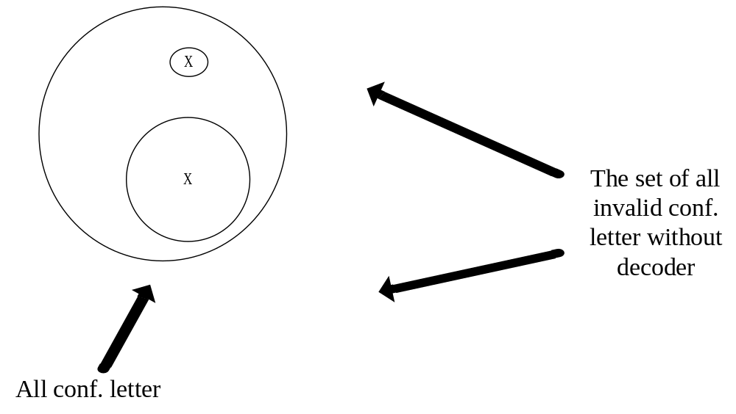
Ideas

Slide 10
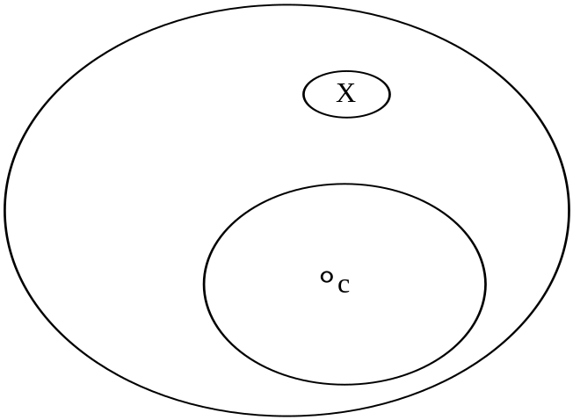
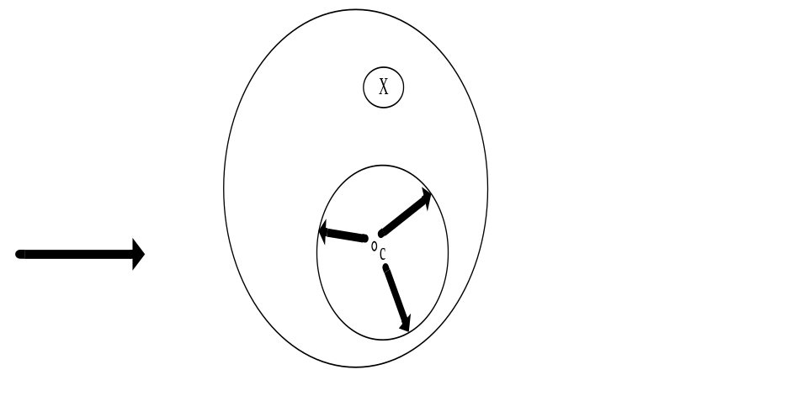
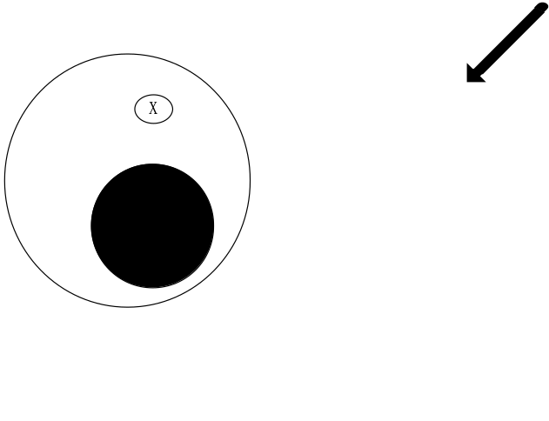
Ideas (cont.)

Slide 11
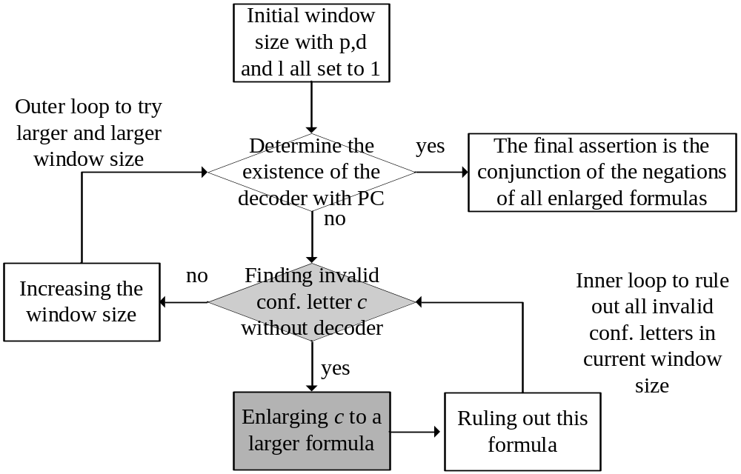
Framework

Slide 12
Content
Motivations
Framework
Finding configuration letter without decoder
Enlarging the configuration letter with interpolant
Experimental result
Conclusion and Future works

Slide 13
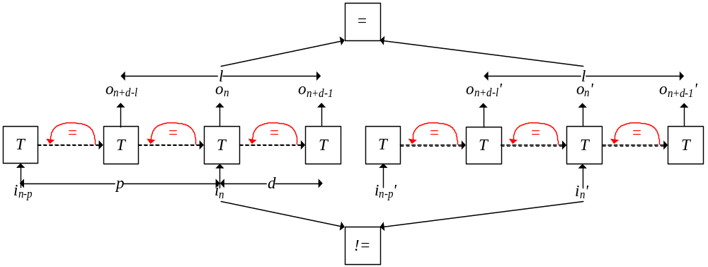
Finding invalid conf. letter without decoder
Loop-like Non-complementary Condition (LN):
  Very similar to PC
  Except six loops in state transition sequences
  If this instance is SAT then we have found an invalid conf. letter c that leads to the decoder’s nonexistence.

Slide 14
Content
Motivations
Framework
Finding configuration letter without decoder
Enlarging the configuration letter with interpolant
Experimental result
Conclusion and Future works

Slide 15
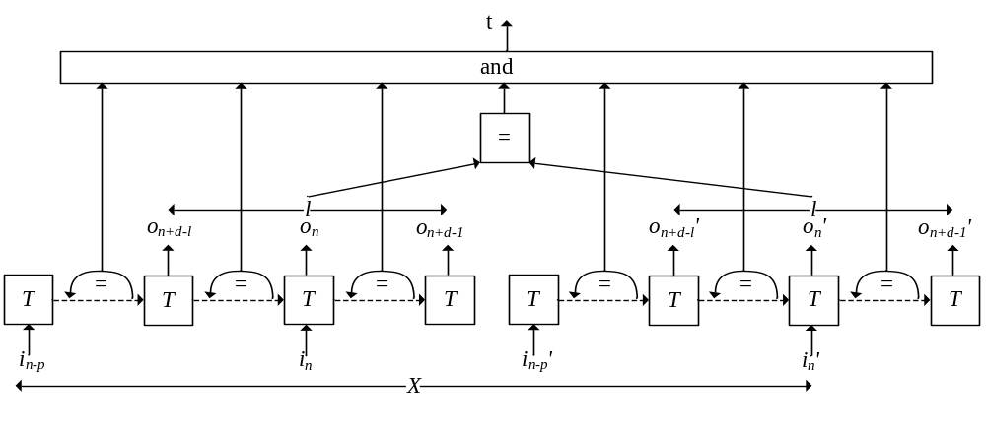
Enlarging the conf. letter with Craig interpolant
A new formula R(t,c,X) equals to LN
The target variable t means:1) the two output sequences are equal, and
2) the six loops actually exist.
c is the configuration letter,
X is the set of all other input variables.

Slide 16
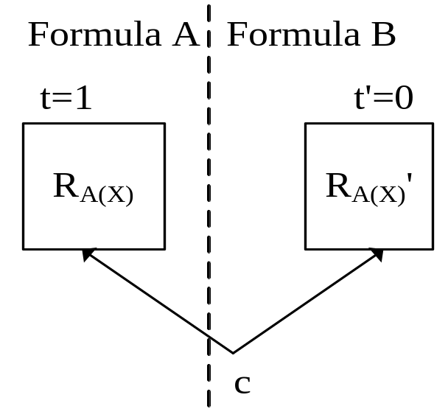
Enlarging the case with Craig interpolant (cont.)
A(X) is the satisfying assignment of X obtained from the satisfied instance LN
Assign A(X) to R(t,c,X), to obtain R_{A(X)}(t,c)= R(t,c,A(X))
The Craig interpolant of A with respect to B is a set of c that can make t==1, that is, the set of c that leads to the nonexistence of decoder

Slide 17
Content
Motivations
Framework
Finding configuration letter without decoder
Enlarging the configuration letter with interpolant
Experimental result
Conclusion and Future works

Slide 18
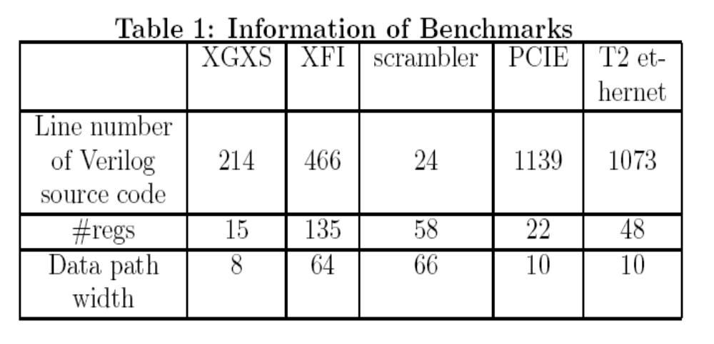
Benchmarks

Slide 19
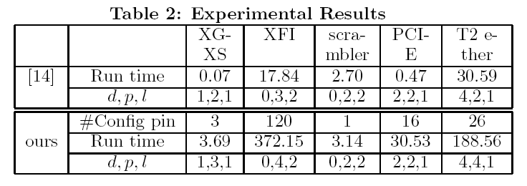
Experimental result

Slide 20
Content
Motivations
Framework
Finding configuration letter without decoder
Enlarging the configuration letter with interpolant
Experimental result
Conclusion and Future works

Slide 21
Conclusion
This paper proposes the first fully automatic approach to infer assertion for complementary synthesis.
Experimental results show that our approach can infer assertions for many complex encoders, such as PCI-E and Ethernet.

Slide 22
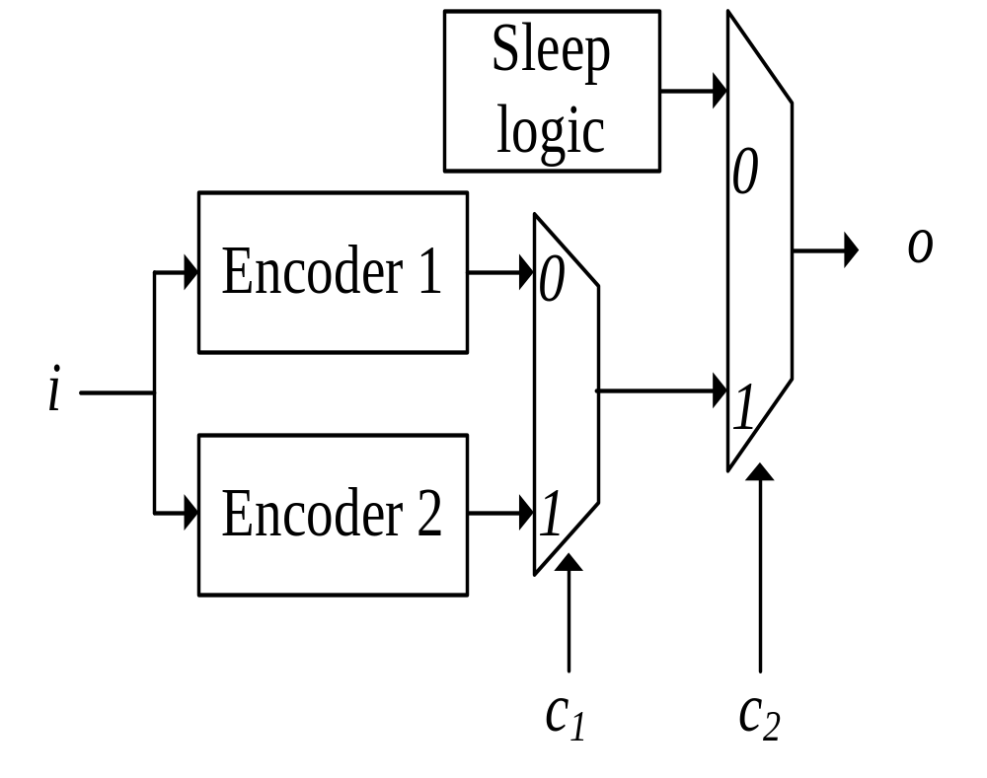
Future work: Dealing with multiple decoders
We need to find out all these decoders.
To help the user select the correct one, we need to find out in what condition does these decoders exist.

Slide 23
That is all
Thanks
For peoples with questions, please speak slowly and loudly, because my English hearing is somewhat poor.

