Slide 1
Inferring Assertion for Complementary Synthesis
ShengYu Shen
School of Computer Science,
National University of Defense Technology

Slide 2
Content
Motivations
Framework
Detecting case without decoder
Enlarging the case with Craig interpolant
Experimental result
Conclusion and Future works

Slide 3
Motivations
Encoding and decoding is a major topic of:
  Computer science
  Electronic engineering
Examples:
  Hardware: PCI, Ethernet, CDMA,…
  Software: TCP/IP, Multimedia,…
Many complicated design issues
  Complex coding mechanism
  Bandwidth matching between multiple clock domains
  Deskew…

Slide 4
Motivations (cont.)
Designing decoder and encoder by hand is a tedious and error-prone job.
Encoder is a total specification of decoder.
So, can we synthesize the decoder automatically from the encoder?

Slide 5
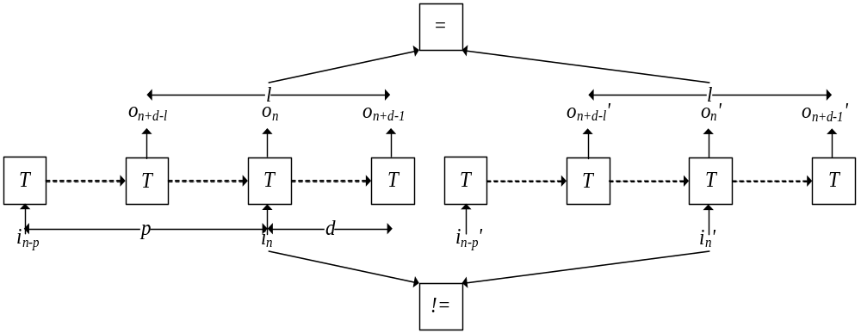
Our previous works
Complementary synthesis (ICCAD’09) in two steps:
  Deciding the existence of the decoder with Parameterized Complementary Condition (PC), finding p,d and l such that Input letter i_{n} can be uniquely determined by output sequence o_{n+d-l},…,o_{n+d-1}.
  Building the decoder (not related to this paper).

Slide 6
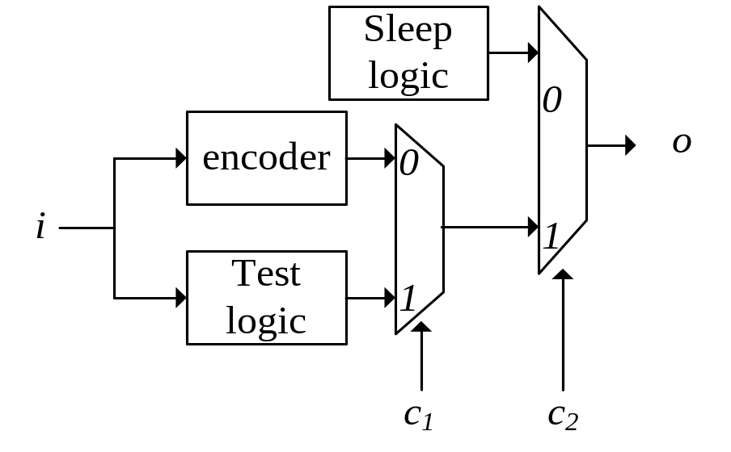
Our previous works (cont.)
The user need to manually specify an assertion, to disable those logic not related to encoding.
However, specifying this assertion need the user read lots of documentation and try many combinations.
For example, XFI encoder have 120 configuration pins.
Even with these efforts, the specified assertion may still be incorrect.

Slide 7
Motivations (cont.)
So can we infer this assertion automatically?

Slide 8
Content
Motivations
Framework
Detecting case without decoder
Enlarging the case with Craig interpolant
Experimental result
Conclusion and Future works

Slide 9
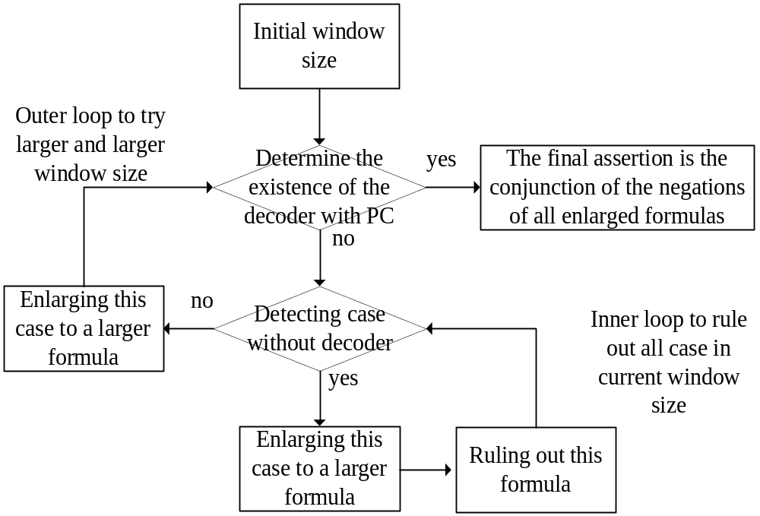
Framework

Slide 10
Content
Motivations
Framework
Detecting case without decoder
Enlarging the case with Craig interpolant
Experimental result
Conclusion and Future works

Slide 11
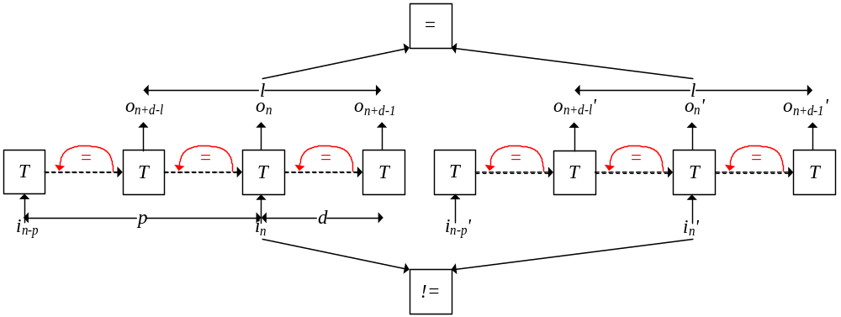
Detecting case without decoder
Loop-like Non-complementary Condition (LN):
  Very similar to PC
  Except three loops in state transition sequence

Slide 12
Content
Motivations
Framework
Detecting case without decoder
Enlarging the case with Craig interpolant
Experimental result
Conclusion and Future works

Slide 13
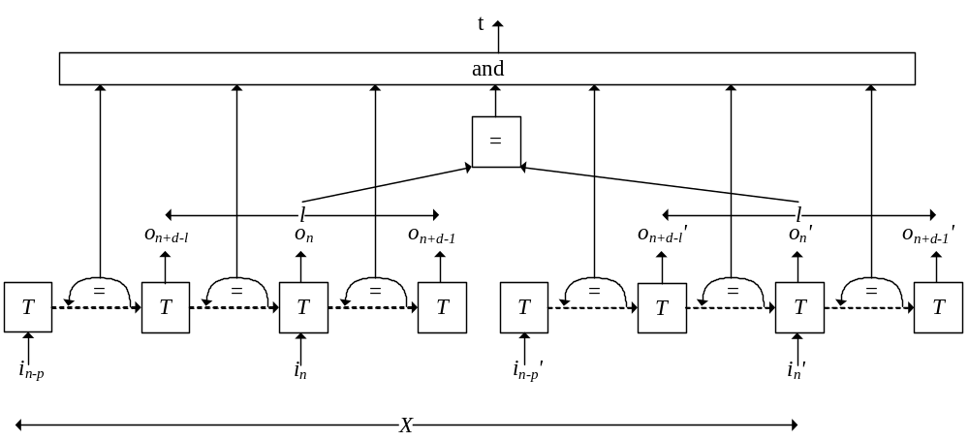
Enlarging the case with Craig interpolant
An new formula R(t,c,X) equal to LN,
but with new target variable t that is the conjunction of the six loops and the equality of the two output sequences.
configuration pins valuation c,
and all other input variable X

Slide 14
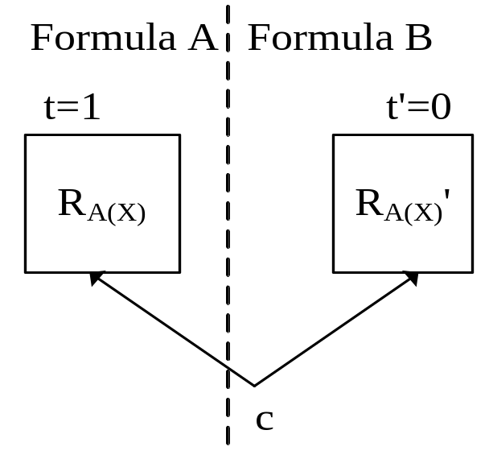
Enlarging the case with Craig interpolant (cont.)
A(X) is the satisfying assignment of X obtained from the satisfied SAT instance LN
We assign A(X) to R(t,c,X), to obtain R_{A(X)}(t,c)= R(t,c,A(X))
The Craig interpolant of A with respect to B is a set of c that can make t==1, that is, the set of c that leads to the nonexistence of decoder

Slide 15
Content
Motivations
Framework
Detecting case without decoder
Enlarging the case with Craig interpolant
Experimental result
Conclusion and Future works

Slide 16
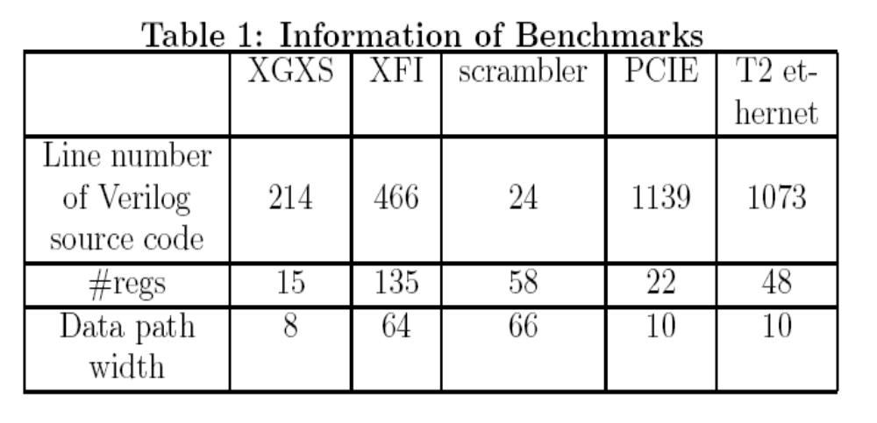
Benchmarks

Slide 17
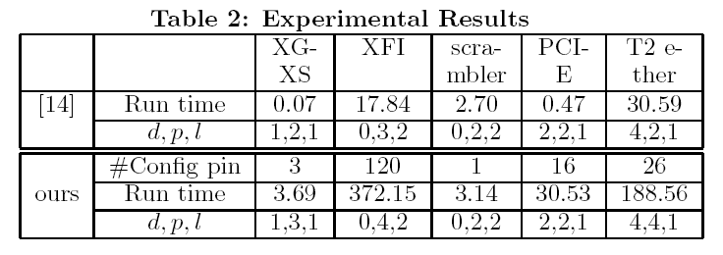
Experimental result

Slide 18
Content
Motivations
Framework
Detecting case without decoder
Enlarging the case with Craig interpolant
Experimental result
Conclusion and Future works

Slide 19
Conclusion
This paper proposes a fully automatic approach to infer assertion for complementary synthesis.
Experimental results show that our approach can infer assertions for many complex encoders, such as PCI-E and Ethernet.

Slide 20
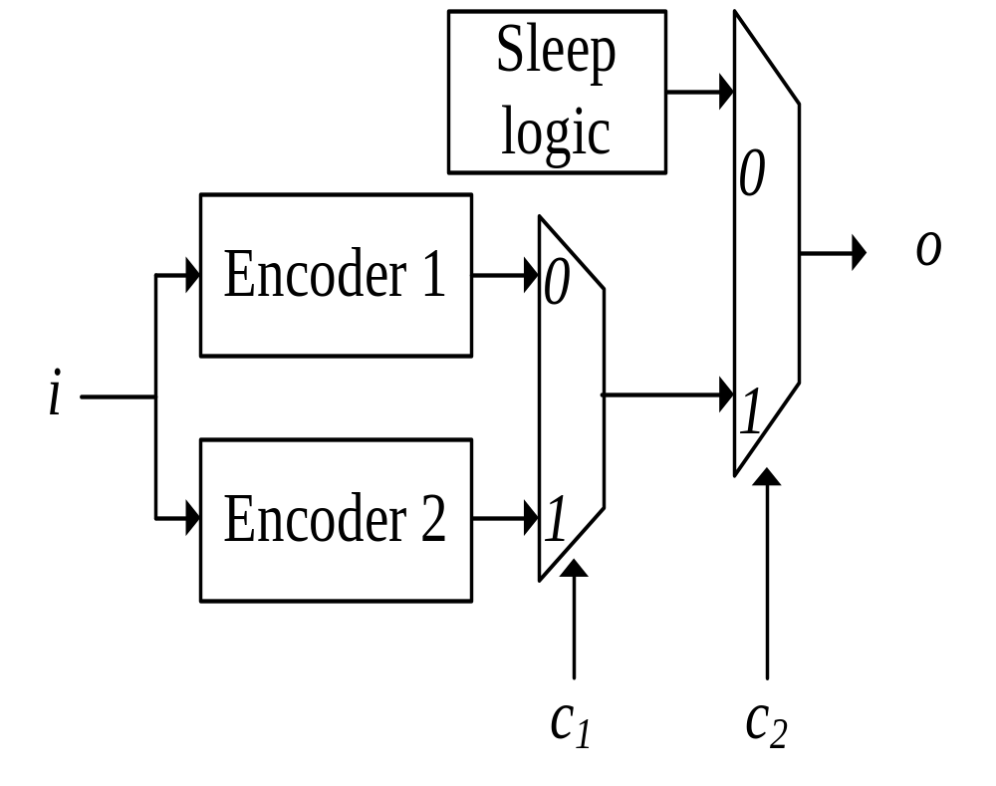
Future work: Dealing with multiple decoders
Finding out these decoders’ transition relations.
Finding out in what condition does these decoder exists, to help the user select the correct one.

Slide 21
Future work: Dealing with long loop
LN depends on detecting loop to determine the nonexistence of decoder.
If the encoder contains very long loop, current algorithm fails to detect them.

Slide 22
That is all
Thanks

