Slide 1
On Finding All Minimally Unsatisfiable Subformulas
Mark Liffiton and Karem Sakallah
University of Michigan
{liffiton, karem}@eecs.umich.edu
June 21, 2005

Slide 2
Problem Description
Given: Infeasible set of constraints C
Goal: All Minimal Unsatisfiable Subsets of C
  AKA “MUSes”
  Minimal Unsat.: All proper subsets satisfiable
  Compact explanations of infeasibility
{C₁,C₂,C₃,C₄,C₅} ◻ UNSAT
{C₁,C₃,C₄} ◻ UNSAT
(MUS)
{ C₃,C₄} ◻ SAT
{C₁, C₄} ◻ SAT
{C₁,C₃ } ◻ SAT

Slide 3
Running Example
Boolean CNF example:
4 constraints (clauses)
2 MUSes:
    MUS₁ = {(a),(¬a)}
    MUS₂ = {(a),(¬a ∨ b),(¬b)}
ϕ = (a) (¬a) (¬a ∨ b) (¬b)

Slide 4
Outline
Problem Description
Motivation
Maximal Satisfiability / Minimal Unsatisfiability
Algorithms
Experimental Results
Future Work

Slide 5
Motivation
Diagnosis of infeasibility
  User feedback
    User creates constraint system.
    Infeasible when expect/require feasibility.
    MUSes point user to minimized causes of infeasibility.
    Aid understanding of large, infeasible systems
  Automatic processes
    Generally: Any process that needs to reason about infeasible constraint systems
    Counterexample-guided abstraction refinement (CEGAR) in model checking systems

Slide 6
Why All MUSes?
Generally:
  A set of constraints is infeasible as long as it contains any MUSes
  Correcting one MUS may leave others
  Optimal corrections could require knowledge of all MUSes
Specific example: CEGAR
  Abstraction used to reduce state space
  MUSes used to generalize spurious counterexamples for refinement of abstraction
  Many generalizations possible, many of them induce poor refinement

Slide 7
First Step: Max-SAT and MSSes
Max-SAT
  Maximum cardinality satisfiable set of clauses
Maximal Satisfiable Subsets (MSSes)
  Inaugmentable satisfiable set of clauses
(a) | (¬a) | (¬a ∨ b) | (¬b)
 | ◻ | ◻ | ◻
(a) | (¬a) | (¬a ∨ b) | (¬b)
 | ◻ | ◻ | ◻
◻ |  |  | ◻
(a) | (¬a) | (¬a ∨ b) | (¬b)
 | ◻ | ◻ | ◻
◻ |  |  | ◻
◻ |  | ◻
ϕ = (a) (¬a) (¬a ∨ b) (¬b)

Slide 8
A Hint of Duality
MSS
  Satisfiable
  Cannot be made larger
MUS
  Unsatisfiable
  Cannot be made smaller

Slide 9
Another Step: CoMSSes
A CoMSS is the complement of an MSS
Each CoMSS provides an irreducible “fix” to the formula: removing its clauses makes the formula satisfiable (turns it into an MSS).
(a) | (¬a) | (¬a ∨ b) | (¬b)
○ | ◻ | ◻ | ◻
◻ | ○ | ○ | ◻
◻ | ○ | ◻ | ○
◻ = element
of MSS
○ = element
of CoMSS
ϕ = (a) (¬a) (¬a ∨ b) (¬b)

Slide 10
The Link: CoMSSes and MUSes
Known:
  A formula is SAT iff it contains no MUSes
  Removing the clauses in a CoMSS from a formula makes it SAT
∴ Removing the clauses in a CoMSS removes at least one clause from every MUS in a formula.
Every CoMSS is an irreducible hitting set of the collection of all MUSes.

Slide 11
Hitting Sets in the Example
Given a collection of sets M, a hitting set of M is a set that contains at least one element from each set in M.
MUS₁ = {(a),(¬a)}
MUS₂ = {(a),(¬a ∨ b),(¬b)}
CoMSS₁ = {(a)}
CoMSS₂ = {(¬a),(¬a ∨ b)}
CoMSS₃ = {(¬a),(¬b)}
ϕ = (a) (¬a) (¬a ∨ b) (¬b)

Slide 12
The Duality: CoMSSes and MUSes
Additionally, each MUS is an irreducible hitting set of the collection of all CoMSSes
Hitting sets provide a transformation from one collection to the other
hitting sets
CoMSSes
MUSes
hitting sets

Slide 13
Exploiting the Relationship
In practice, finding satisfiable subsets of constraints is easier than unsatisfiable
  i.e., MSSes easier to find than MUSes
  Because SAT is “easier” than UNSAT
How to Find All MUSes:
  Find CoMSSes
  Compute minimal hitting sets of the CoMSSes

Slide 14
Outline
Problem Description
Motivation
Maximal Satisfiability / Minimal Unsatisfiability
Algorithms
Experimental Results
Conclusions and Future Work

Slide 15
Algorithms for Finding All MUSes
Separate steps | CAMUS (Compute All Minimal Unsatisfiable Subsets – Liffiton & Sakallah)
Interleaved steps | DAA (Dualize and Advance – Bailey & Stuckey)

Slide 16
CAMUS: Finding All CoMSSes
Augment CNF with clause selector variables
  C_{i} = x_{i1} ∨ x_{i2} ∨ … ∨ x_{in}
  becomes
  C_{i} = ¬y_{i} ∨ x_{i1} ∨ x_{i2} ∨ … ∨ x_{in}
  Y-variables permit enabling/disabling constraints within DPLL-style search
A CoMSS can be obtained by solving an optimization problem
  Find a solution to the augmented formula with the fewest y-variables assigned FALSE
  Add blocking clauses to block old solutions

Slide 17
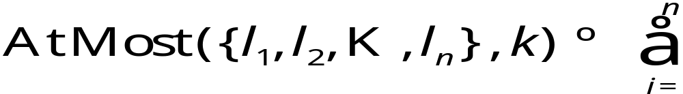
CAMUS: Finding All CoMSSes
Optimization: Solve incrementally using a sliding objective
  Start by finding all CoMSSes w/ 1 clause, then all w/ 2, etc… until all found
  Implemented with an AtMost constraint
  Within a single bound, the algorithm can utilize a single incremental search, exploiting all common SAT techniques (esp. learned clauses)

Slide 18
CAMUS: Finding All CoMSSes
ϕ = (a) (¬a) (¬a ∨ b) (¬b)
Clauses
a
¬a
¬a ∨ b
¬b
Clauses
¬y₁ ∨ a
¬y₂ ∨ ¬a
¬y₃ ∨ ¬a ∨ b
¬y₄ ∨ ¬b
Clauses
¬y₁ ∨ a
¬y₂ ∨ ¬a
¬y₃ ∨ ¬a ∨ b
¬y₄ ∨ ¬b
y₁
Clauses
¬y₁ ∨ a
¬y₂ ∨ ¬a
¬y₃ ∨ ¬a ∨ b
¬y₄ ∨ ¬b
y₁
y₂ ∨ y₃
Clauses
¬y₁ ∨ a
¬y₂ ∨ ¬a
¬y₃ ∨ ¬a ∨ b
¬y₄ ∨ ¬b
y₁
y₂ ∨ y₃
y₂ ∨ y₄
Add clause-selector variables
Add AtMost constraint
First solution – y₁ is FALSE
Add blocking clause and COMSS
No further solutions, increment AtMost
Second solution – y₂ and y₃ are FALSE
Add blocking clause and CoMSS
Third solution – y₂ and y₄ are FALSE
Add blocking clause and CoMSS
No further solutions, even without AtMost constraint
CoMSSes
{a}
CoMSSes
{a}
{¬a, ¬a ∨ b}
CoMSSes
{a}
{¬a, ¬a ∨ b}
{¬a, ¬b}
AtMost({¬y₁ ,¬y₂,¬y₃,¬y₄} , 1)
AtMost({¬y₁ ,¬y₂,¬y₃,¬y₄} , 2)

Slide 19
CAMUS: Obtaining a Single MUS
Goal: Irreducible Hitting Set
  Straightforward construction, no search
  Iteratively choose clauses to add to MUS
    Choice can be arbitrary
  For each chosen clause, alter remaining problem to make that clause essential

Slide 20
CAMUS: Obtaining a Single MUS
CoMSS₁ = {(a)}
CoMSS₂ = {(¬a),(¬a ∨ b)}
CoMSS₃ = {(¬a),(¬b)}
Select a clause to add to the MUS (¬a ∨ b)
ϕ = (a) (¬a) (¬a ∨ b) (¬b)

Slide 21
CAMUS: Obtaining a Single MUS
CoMSS₁ = {(a)}
CoMSS₂ = {(¬a),(¬a ∨ b)}
CoMSS₃ = {(¬a),(¬b)}
Select a clause to add to the MUS (¬a ∨ b)
Select a CoMSS in which it appears (CoMSS₂)
ϕ = (a) (¬a) (¬a ∨ b) (¬b)

Slide 22
CAMUS: Obtaining a Single MUS
CoMSS₁ = {(a)}
CoMSS₂ = {(¬a),(¬a ∨ b)}
CoMSS₃ = {(¬a),(¬b)}
Select a clause to add to the MUS (¬a ∨ b)
Select a CoMSS in which it appears (CoMSS₂)
Remove any other clauses in that CoMSS from the problem
  This makes the chosen clause essential for that CoMSS
ϕ = (a) (¬a) (¬a ∨ b) (¬b)

Slide 23
CAMUS: Obtaining a Single MUS
CoMSS₁ = {(a)}
CoMSS₂ = {(¬a ∨ b)}
CoMSS₃ = {(¬b)}
Select a clause to add to the MUS (¬a ∨ b)
Select a CoMSS in which it appears (CoMSS₂)
Remove any other clauses in that CoMSS from the problem
  This makes the chosen clause essential for that CoMSS
Remove any CoMSSes in which the clause appears
  They are now “hit” by the MUS
ϕ = (a) (¬a) (¬a ∨ b) (¬b)

Slide 24
CAMUS: Obtaining a Single MUS
CoMSS₁ = {(a)}
CoMSS₃ = {(¬b)}
Select a clause to add to the MUS (¬a ∨ b)
Select a CoMSS in which it appears (CoMSS₂)
Remove any other clauses in that CoMSS from the problem
  This makes the chosen clause essential for that CoMSS
Remove any CoMSSes in which the clause appears
  They are now “hit” by the MUS
Iterate until no CoMSSes remain
ϕ = (a) (¬a) (¬a ∨ b) (¬b)

Slide 25
CAMUS: Obtaining All MUSes
Use general form of single MUS method
Branch on choice of clause and CoMSS to make all possible MUSes
Tree is not irredundant, so ordering heuristics and memoization are used to prune / limit the tree size
Very fast in practice: Millions of MUSes in minutes

Slide 26
Bailey & Stuckey’s Algorithm
Dualize And Advance (DAA)
Finds CoMSSes by “growing” MSSes
Interleaves MUS construction w/ MSS search

Slide 27
DAA: Finding CoMSSes
Grow MSS from a satisfiable seed
Add corresponding CoMSS to collection
ϕ = (a) (¬a) (¬a ∨ b) (¬b)
a
¬a
MSS={a , ¬a∨b}
¬a∨b
¬b

Slide 28
DAA: Computing Hitting Sets
Calculate irreducible hitting sets of CoMSSes after each additional CoMSS is found
  Incremental cross-product
  Minimize results
ϕ = (a) (¬a) (¬a ∨ b) (¬b)
New Hitting Sets
HS₁={¬a}
{¬a , a}
New CoMSS
{a}
Minimize
(remove subsumed)
HS₂={¬a∨b , ¬b}
{¬a∨b , ¬b , a}

Slide 29
DAA: Computing Hitting Sets
Check each new hitting set for satisfiability
  If UNSAT, add to collection of MUSes
  If SAT, use as seed for growing next MSS
New Hitting Sets
{¬a , a}
Both are UNSAT, both are MUSes
None are SAT, thus done
{¬a∨b , ¬b , a}

Slide 30
Comparison for Boolean CNF
Overall: CAMUS is much faster than DAA for Boolean CNF (Usually about 2-3 orders of magnitude faster)
Mostly due to:
  Integration with SAT solver
  Calculating hitting sets once, not checking them for SAT/UNSAT

Slide 31
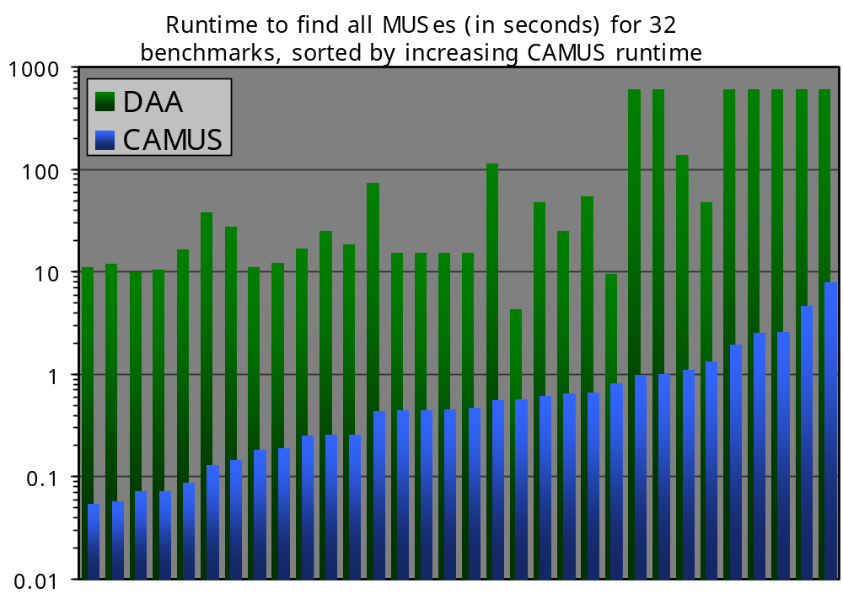
Experimental Results
>600

Slide 32
Future Work
Relaxations / approximations
  Trade off completeness/correctness for speed
  Find fewer than all MUSes
  Find non-minimal USes
  Utilize ideas from Dualize and Advance
Investigating further applications of the algorithm
  Anywhere that constraints are used, potentially
  New territory, due to novelty of solution

Slide 33
Thank You

Slide 34
Related Work
Finding a single US (potentially multiple)
  Bruni & Sassano, zCore, AMUSE, others
    Boolean CNF
    Modify or use information from a standard SAT search
  Chinneck, et al
    Linear programs
    “Irreducible Infeasible Subset” (IIS)
  None guarantee minimality (irreducibility)
Minimizing a US to an MUS
  Jinbo Huang: “A Minimal Unsatisfiability Prover”

Slide 35
Related Work (cont.)
Theoretical work
  Complexity of identifying MUSes
    Deciding whether a CNF formula is minimally unsatisfiable is DP-Complete
  Complexity bounds on identifying certain classes of MUSes

