Slide 1
WiSync: An Architecture for Fast Synchronization through On-Chip Wireless Communication
Sergi Abadal etc. UIUC
Demo by Han Shen

Slide 2
Motivation
Recent advances in CMOS RF technology
Challenges in shared-memory programming
Frequent read-n-write of global variables
Mutual exclusion lock
Repeated broadcast/reductions(Data Communications)
Previous work
Hardware support: Barrier Network(Cray T3D), Synchronization register(Cray T3E)
Costly on scaled manycore chip
WiSync: Leverage on-chip wireless communication for inter-core synchronization

Slide 3
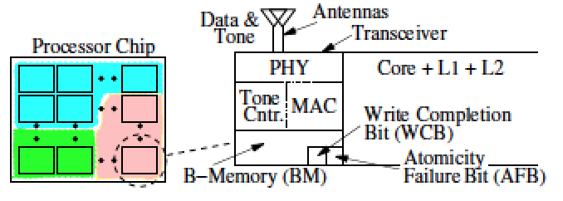
WiSync Architecture
Each Core has:
L1、L2 Cache
Two Channels: Data & Tone
A Transceiver: PHY, MAC, Tone Controller
Broadcast Memory
Two Bits: WCB & AFB

Slide 4
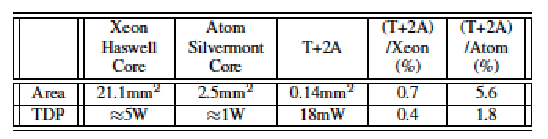
Hardware Prerequisite
Wireless Tradeoff
Area/Power VS Bandwidth
Bandwidth up, area/power up
General: 60GHZ 16~20GHZ bandwidth; 90GHZ
65nm CMOS for 16Gb/s, costs: 0.2mm² 31.2mW
22nm CMOS for 16Gb/s, costs: 0.1mm² 16mW
Affordable Cost!

Slide 5
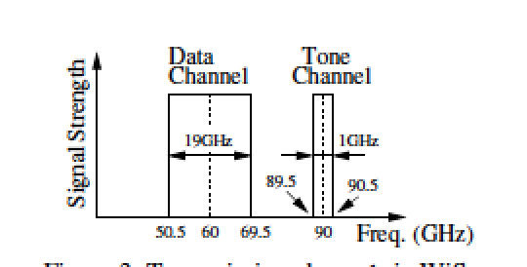
Wireless Transmission
Data Channel
77 bits per message(64 datum + 11 address + Bulk bit+ Tone bit)
5 cycles with collision detection(Exponential backoff)
Bulk bit: send 4 continuous location in bulk(15 cycle)
Tone bit: For barrier synchronization
Tone Channel
Manycore synchronization
Sense-Reversing Barrier
Multiple concurrent barriers: Time Multiplexing

Slide 6
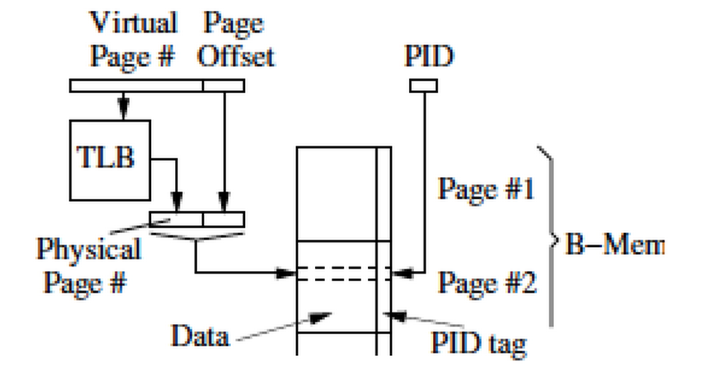
Broadcast Memory Management
TLB-like Memory Management
64bit data + PID tag
Virtual address translation
4*4KB page

Slide 7
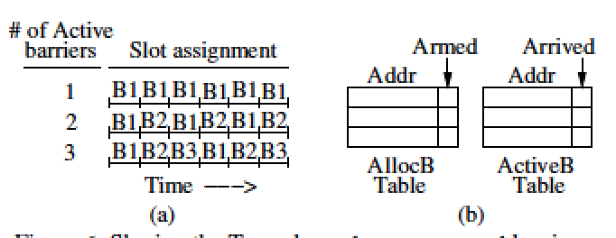
Time Multiplexing
Program allocate barrier: AllocBTable(BM Addr + Armed bit)
Program reach barrier: ActiveB copy entry(BM Addr + Arrived bit)
Slot awareness

Slide 8
Atomic Instruction
Store Synchronization
Update other nodes first
Collision and retry
Update WCB
RMW:
Test&Set, Fetch&Inc, Fetch&Add, Compare&Swap(CAS)
Write Completion Bit(WCB)&Atomicity Failure Bit(AFB)
Read to pipeline, update in pipeline, write back(Collision)
Updated after read to pipeline: Set AFB

Slide 9
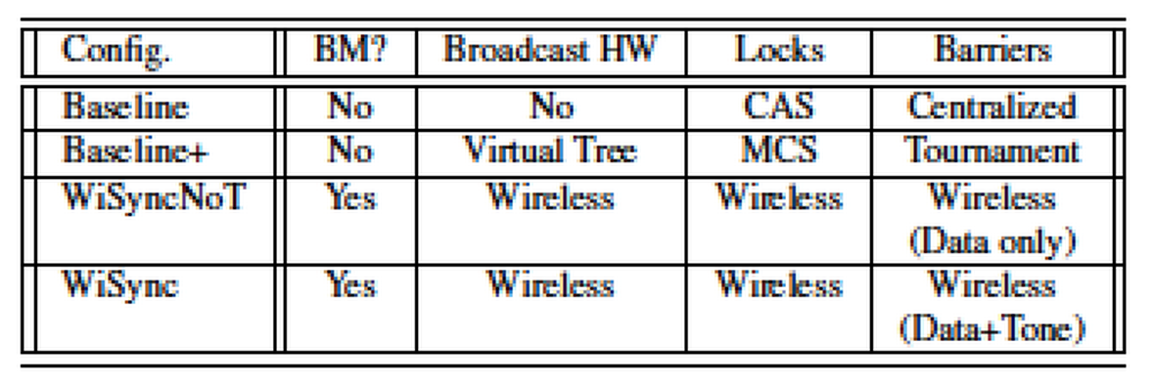
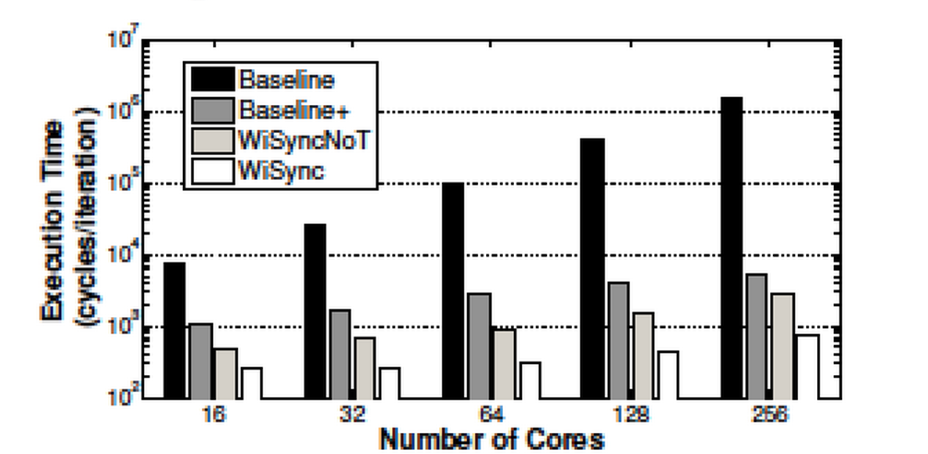
Evaluation

Slide 10
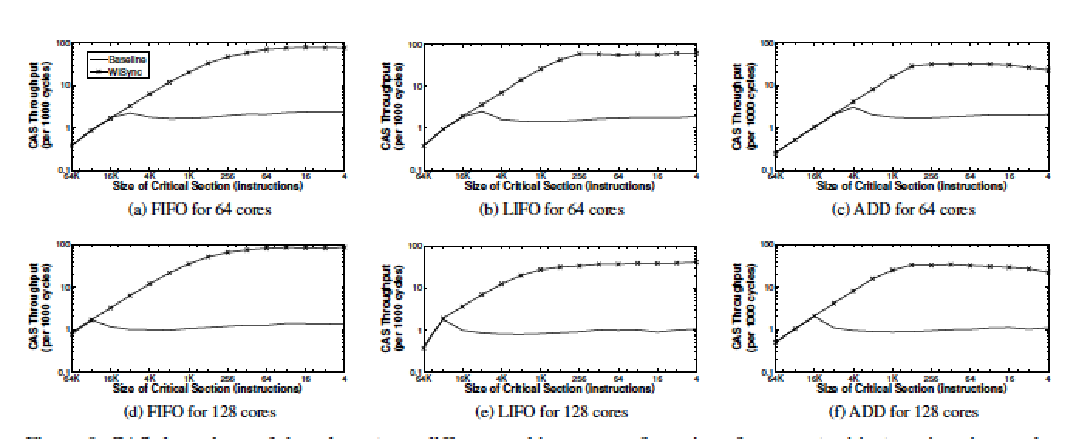
CAS Throughput

Slide 11
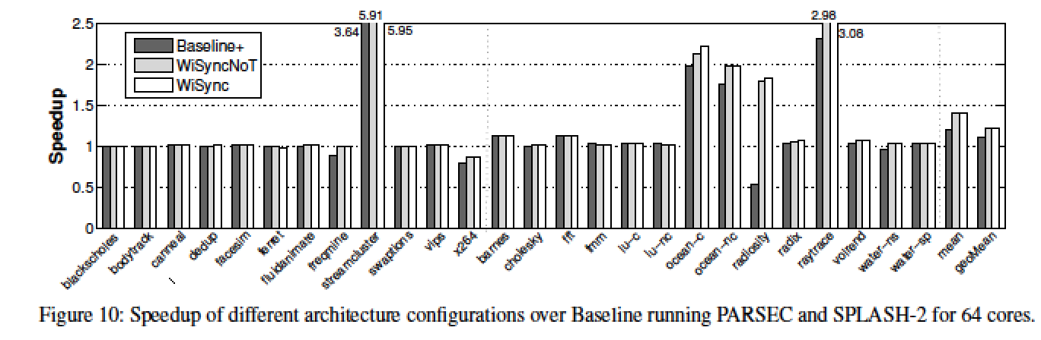
Speedup of Application

Slide 12
Conclusion
Outperform baseline for an order of magnitude
Outperform applications PARSEC&SPLASH-2 1.12X

