Slide 1
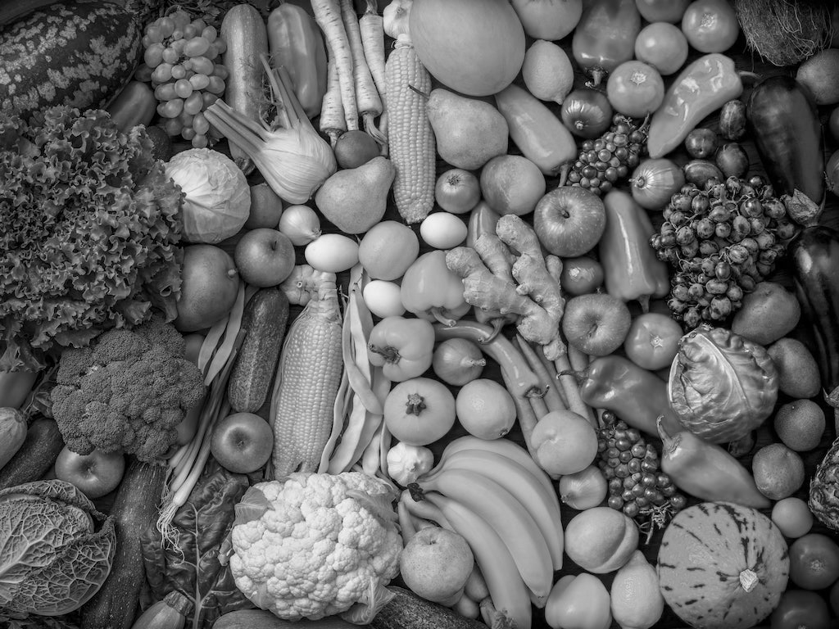
Organic Products Case Study
Hewei Shen

Slide 2
Business Problem
Which kind of customers are most likely to buy organic products?
How can we use statistical models to identify organic buyers?
Is the additional cost of stocking organic products palatable?
Notes:
We have 3 main business problems we want to solve.
Which kind of customers are most likely to purchase organic products? This question will be answered through exploratory analysis. A profile of the organic buyer will be provided and we will go through each attribute to have a detailed look.
How can we use statistical models to identify organic buyers? We built 4 classification models to predict whether a customer will be an organic buyer. In the model summary part we will present the models and elaborate why we chose our final model.
3. Is the additional cost of stocking organic products palatable? This question will be answered in the final recommendation part, by investigating whether customers who purchase organic products are also highly profitable customers.

Slide 3
Profile of Organic Buyers
Customer Age
Customer Gender
Average
47
Majority between
36 - 64
81% Female
Amount Spent In The Store
Time As Loyalty Card Member
Average
3368$
Majority between
1¢ - 6053$
Average
6year
Majority between
3 - 9year
Notes:
This page is a profile of typical organic buyers in our dataset. We got all the statistics through exploratory analysis.
‘Majority between’ simply means the middle 70 percentile of each attribute.

Slide 4
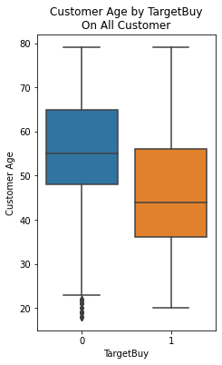
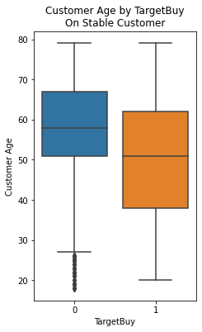
Customer Age
62
56
Median 51
Median 44
36
38
Notes:
In the detailed exploratory analysis of each attribute, we further divide the customers into two groups, stable customers and minimum spenders. Stable customers are those who spend more than one dollar, while minimum spenders are those who spend less than one dollar, typically one or two cents. We have 15530 stable customers and 6693 small spenders.
For the customer age attribute, the organic buyers are generally younger than the non-organic buyers.

Slide 5
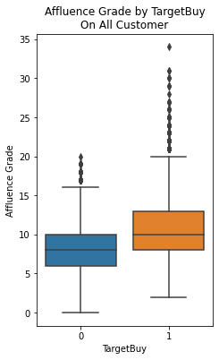
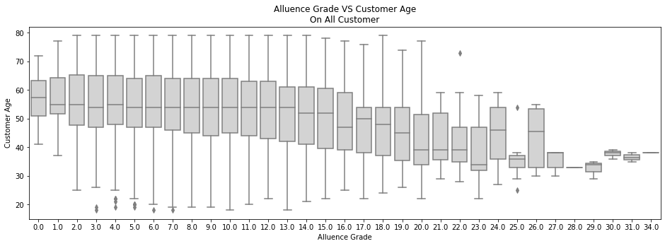
Affluence Grade
Affluence grade reflects household income level, on a scale from 1 to 30
Higher affluence grade represents higher household income
Notes:
As seen in the left boxplot, organic buyers have higher affluence grades, about 2 levels higher than non-organic buyers. That means richer families tend to purchase organic products. It’s also worth noticing that customers with extremely high affluence grades (larger than 20) are all organic buyers.
The right boxplot shows the relationship between customer age and affluence grade. Customers with high affluence grades generally are younger, with an average age of around 40. The middle 50 percentile of our organic buyers fall into the orange rectangle, about 50-60 years old.

Slide 6
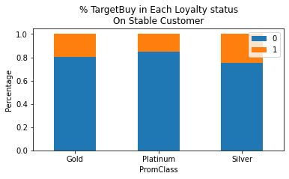
Loyalty Status
Tin
Silver
Gold
Platinum
0
¢1
$5,000
$20,000
Amount Spent
22%
38%
37%
Notes:
There are noticeable patterns in the percentage of customers who purchase organic products across the different loyalty status groups. The group with higher loyalty status has a lower percentage of organic buyers.
Besides, all the tin customers are minimum spenders who spent only 1 cent in the store.

Slide 7
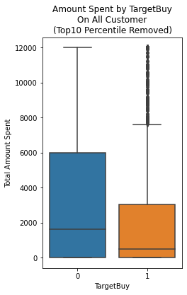
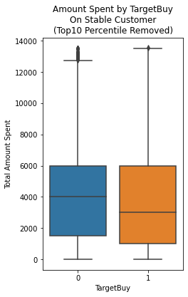
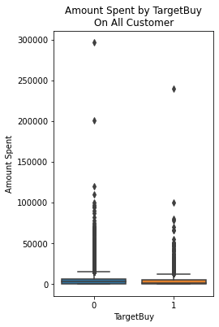
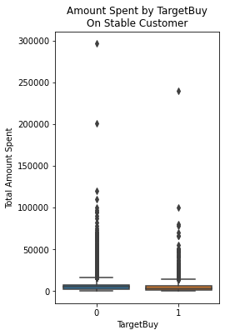
Amount
Spent
Avg
6579
Avg
4767
5427
3368
Notes:
The two mini boxplots on the left show the dollar amount that customers spent in the store for all customers and stable customers respectively. Since it’s hard to see with such a great amount of large amount spenders on the top, we added the boxplots with the top 10 percentile sampled removed (large boxplot on the right).
We can see the pattern that organic buyers spend less in the store on average.

Slide 8
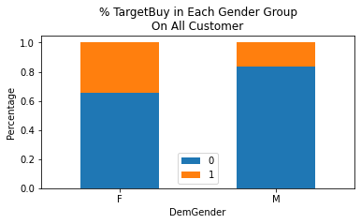
Customer Gender
35%
Female organic buyer
17%
Male organic buyer
Notes:
After excluding the unknown gender group, we can see from the stacked column chart that the percentage of organic buyers is significantly higher within the female group.

Slide 9
Classification Model Summary
Train Set
Test Set
Model | Accuracy | Precision | Recall | AUC | Accuracy | Precision | Recall | AUC
L1 C = 0.1 | 0.8084 | 0.7043 | 0.3901 | 0.8019 | 0.8157 | 0.7215 | 0.4171 | 0.8105
L1 C = 0.01 | 0.8059 | 0.7130 | 0.3618 | 0.7979 | 0.8179 | 0.7483 | 0.3995 | 0.8056
L2 | 0.8063 | 0.7111 | 0.3672 | 0.7991 | 0.8166 | 0.7375 | 0.4031 | 0.8058
Decision Tree | 0.8177 | 0.6859 | 0.4869 | 0.8020 | 0.8158 | 0.6800 | 0.4849 | 0.8105
Notes:
This is a summary of our four classification models. The first three use logistic regression while the last uses the decision tree model.
Comparing all the metrics, we chose the decision tree model as our final model, which has a comparatively high value in all four metrics, especially for the recall. Since we want to capture the most features of organic buyers.

Slide 10
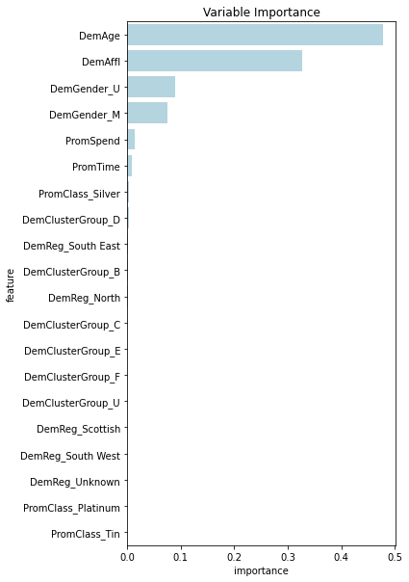
Variance Importance
The most important variances in decision tree model
Customer Age
Affluence Level
Customer Gender
Notes:
This page answers the question of what factors seem to have the most impact on a customer’s likelihood to purchase organic products. Based on the decision tree model, the three most important variances are customer age, affluence level, and customer gender.

Slide 11
Recommendations
Select organic products that target female customers aged between 40-60 with affluence grade of 7-15, since those are the attributes of major organic buyers
Constantly introduce new organic products in order to convert those who only want to have a try of organic products to constant buyers
Keep organic products attractive to customers with high affluence grades (>20), since they are all organic buyers

