Slide 1
Complex Network Modeling Project
24S151092
Siyuan Zhou

Slide 2
Network Construction
Initialize the network
Join nodes
Priority connection

Slide 3
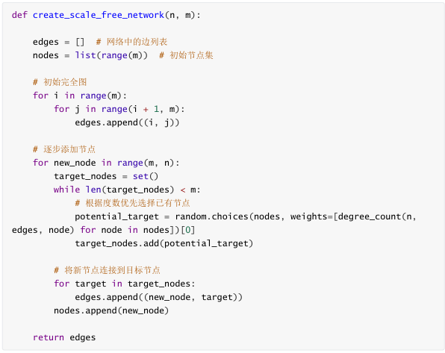
Network Construction
Node: represents an individual;
Edge: represents the relationship or connection between individuals;

Slide 4
Network Evolution
Evolve the network, keep the original network and add new nodes
Adding new nodes
Edge reconnection

Slide 5
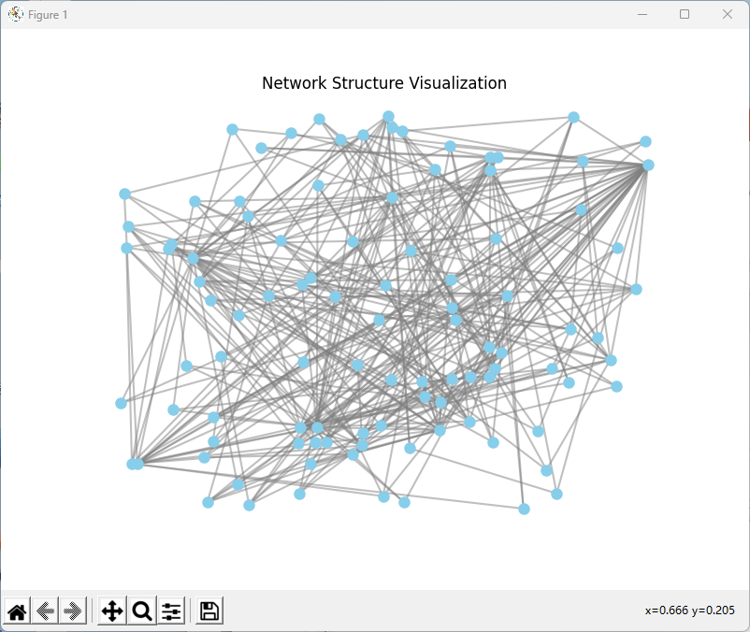
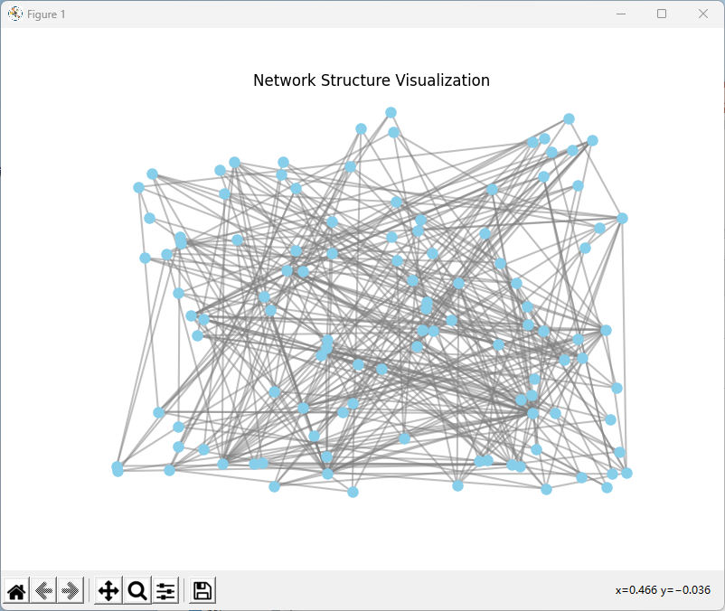
Contrast Before and After

Slide 6
Network Analysis
Compute the node degree distribution of the network
Calculate the average shortest path length
Calculate the clustering coefficient

Slide 7
Node Degree Distribution
Just traverse every edge of the graph.

Slide 8
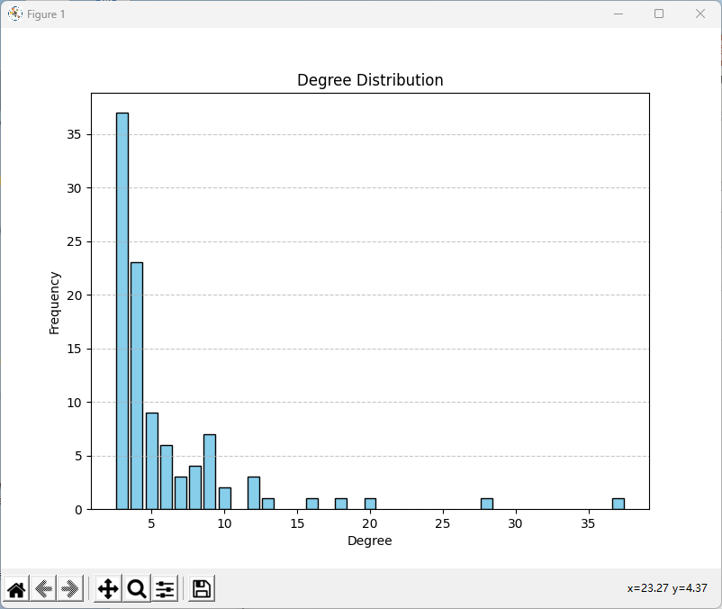
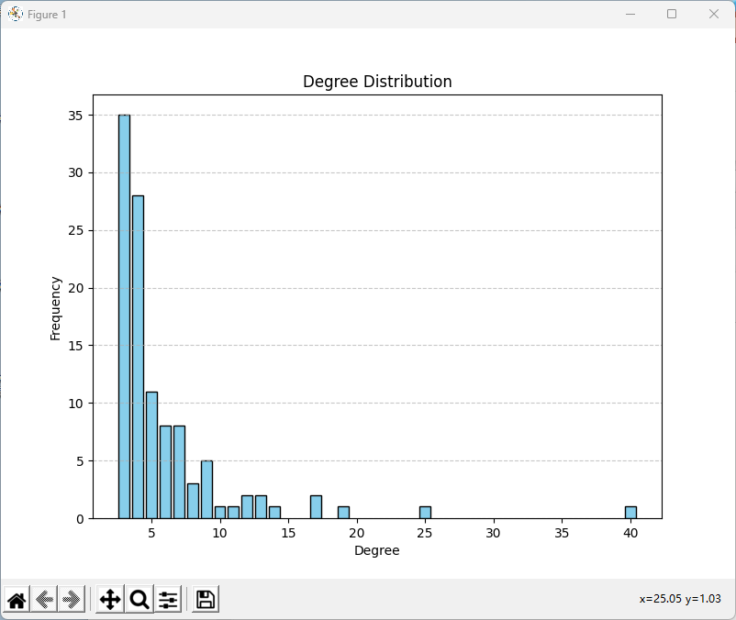
Contrast Before and After

Slide 9
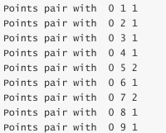

Average Shortest Path Length
Use breadth-first search to find the shortest path between each pair of nodes, and then sum them up to get the average shortest path length.

Slide 10
Clustering Coefficient
Find the neighbors of the current node
Count the number of edges between neighbors
Finally, calculate the clustering coefficient

Slide 11
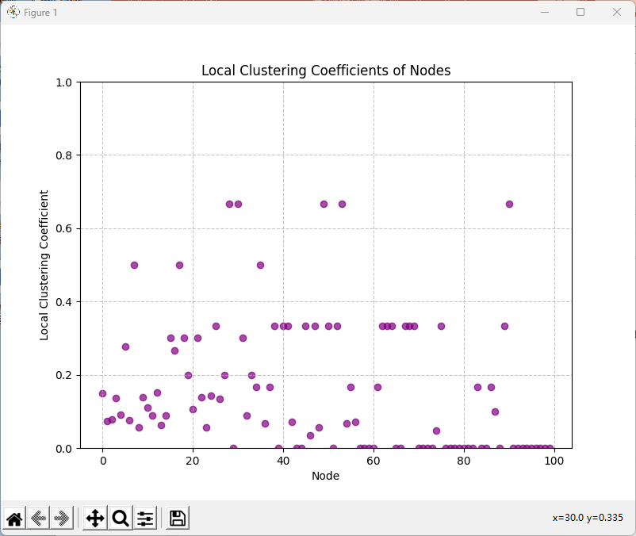
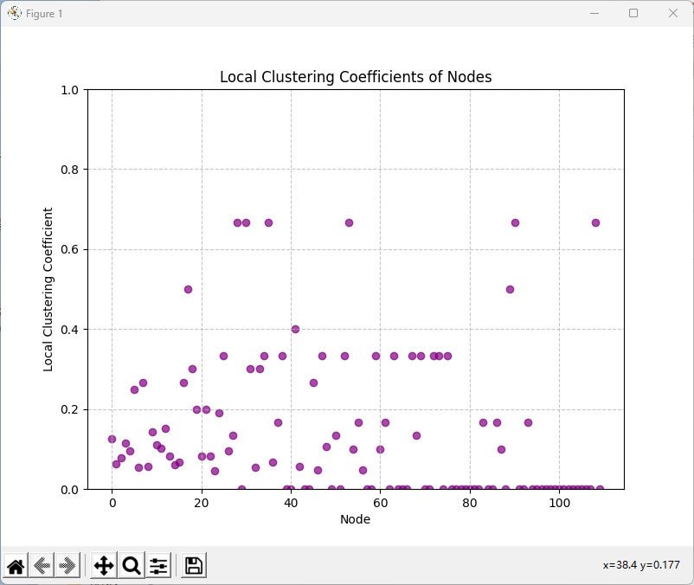
Local CC

Slide 12
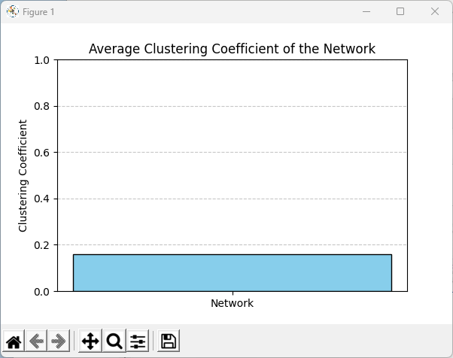
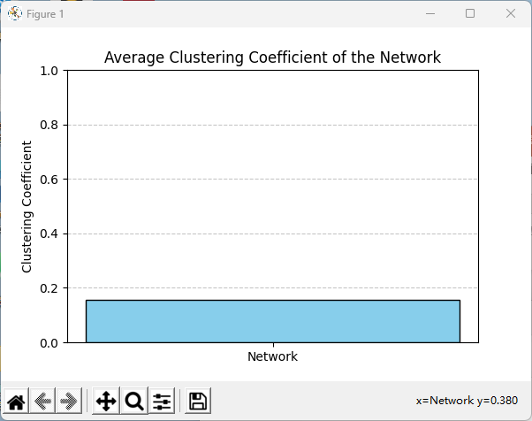
Contrast Before and After

Slide 13
Simulating Dynamic Behavior
Random attacks on simulated networks: Random attacks are performed by randomly shuffling the order of nodes and then removing nodes and related edges.
Simulate intentional attacks on the network: The intentional attack first sorts the degrees from large to small, and then removes the corresponding nodes and related edges from the beginning.

Slide 14
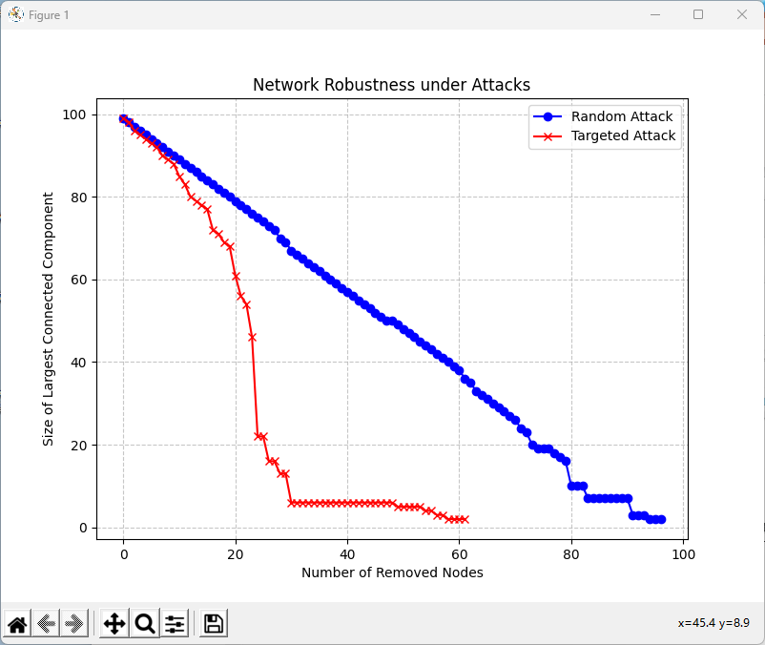
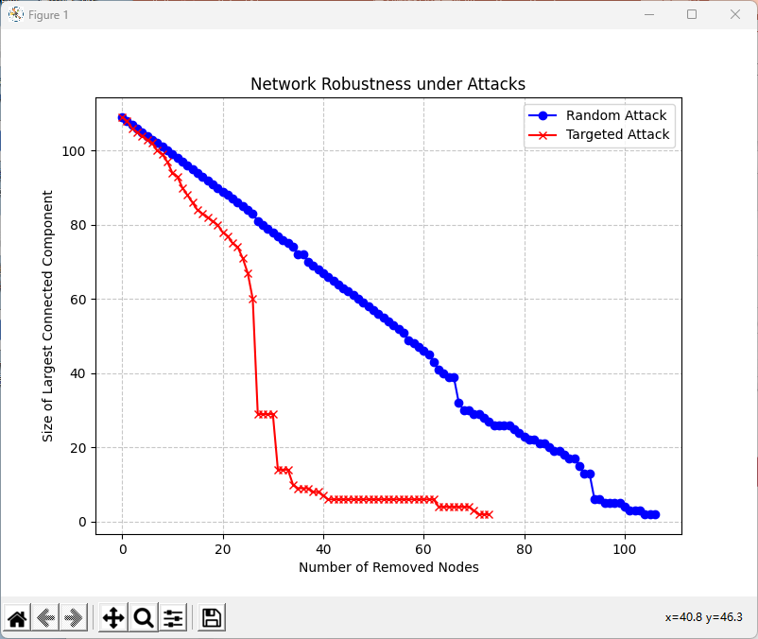
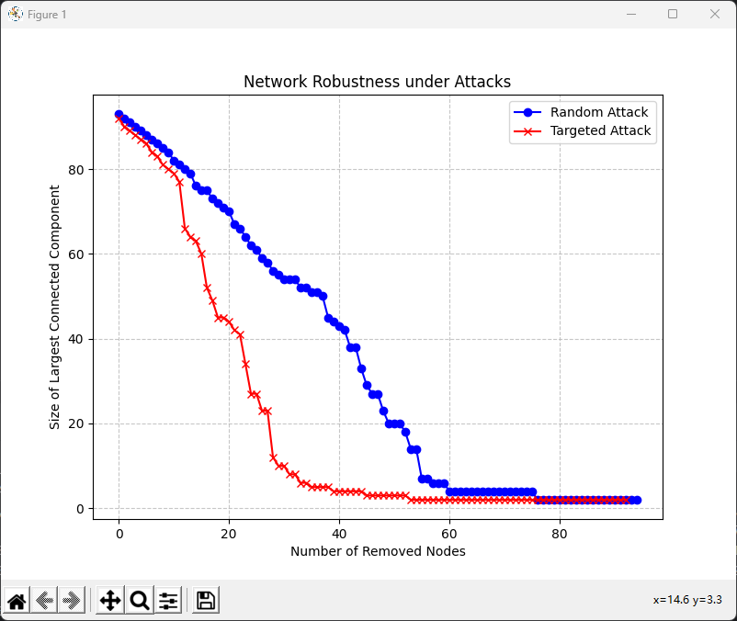
Simulating Dynamic Behavior

Slide 15
The Size Of The Largest Connected Subgraph
We measure the connectivity and impact of the network after the attack by calculating the size of the largest connected subgraph in the current graph.
By building a stack to perform a depth-first search, each time the longest path is recorded and recorded in largest_size
Finally, brute force traverses each node to obtain the size of the largest connected subgraph.

Slide 16
The Coreness of Nodes
Arrange by degree
First remove nodes with small degrees, then update the core degree
Then remove the current node and update the degree of its neighbors
Update the queue each time iterate

Slide 17
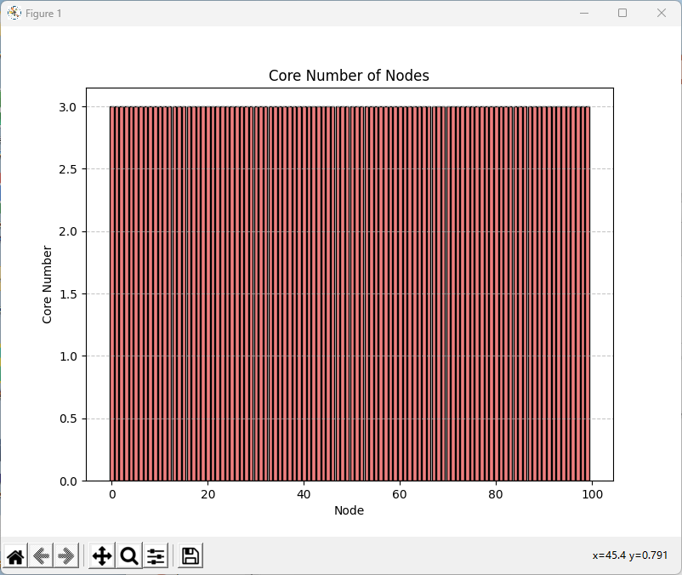
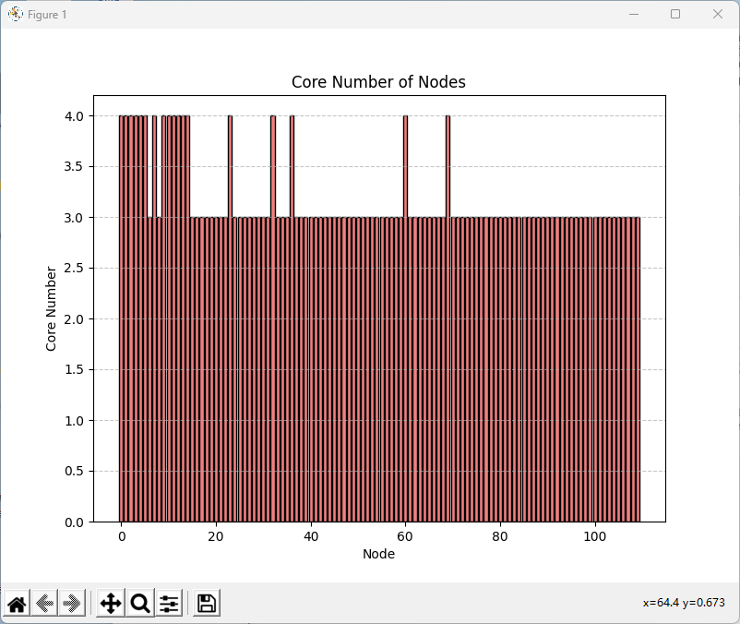
Contrast Before and After

Slide 18

Whether is a Small World
Calculate the clustering coefficient and average path length of the target network
Creating random networks and comparing them
Determining small-world properties

Slide 19
Conclusion
Small-world characteristics:
A high clustering coefficient,
A short path length
Short path lengths mean that information travels more efficiently in the network.

Slide 20
谢谢大家

