Slide 1
Chapter 14
Polya counting

Slide 2
Summary
Permutation and symmetry groups
Burnside theorem
Polya counting formula
Assignments

Slide 3
Coloring a regular tetrahedron
Suppose to color the four corners of a regular tetrahedron with two colors, red and blue, how many different colorings are there?
Case a: the tetrahedron is fixed in space, then each corner is distinguished from the others by its position, and it matters which color each corner gets. Thus all 16 colors are different.

Slide 4
Case b: the tetrahedron are allowed to move around. In other words, the corners are indistinguishable. The only way two colorings can be distinguished from one another is by the number of corners of each color. Thus there are total 5 different colorings.

Slide 5
Coloring a square
Suppose we color the 4 corners of a square with the colors red and blue. How many different colorings are there?

Slide 6
Equivalent and inequivalent colorings
For both the tetrahedron and square, if allowed to freely move around, the 16 ways to color its corners are partitioned into parts in such a way that two colorings in the same part are regarded as the same (the colorings are equivalent), and two colorings in different parts are regarded as different (the colorings are inequivalent).
The number of inequivalent colorings is thus the number of different parts.

Slide 7
Permutation and symmetry groups

Slide 8
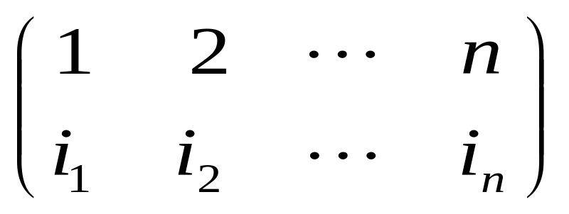
Permutation and function
Let X be a finite set. Without loss of generality, we take X to be the set {1, 2, 3, …, n}. Each permutation i₁, i₂, i₃, …, i_{n} of X can be viewed as a one-to-one function from X to itself defined by
f: X → X , where f(1) = i₁, f(2) = i₂, …., f(n) = i_{n}.
A permutation is denoted by a 2-by-n array as follows:

Slide 9
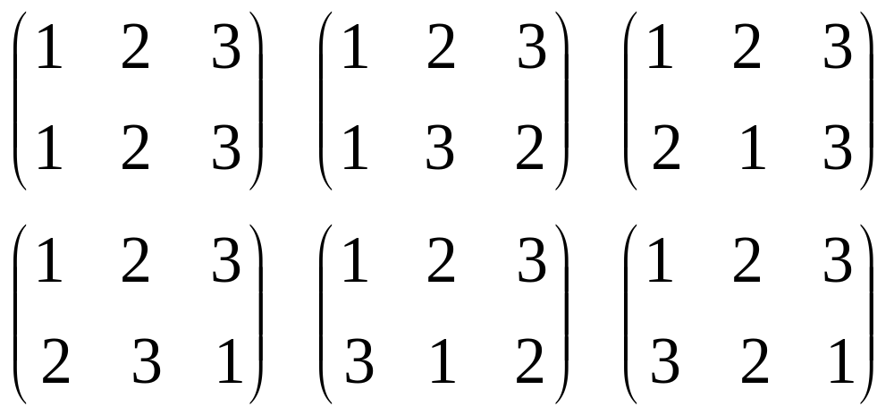
Example
The 3! = 6 permutations of {1, 2, 3} regarded as functions are

Slide 10
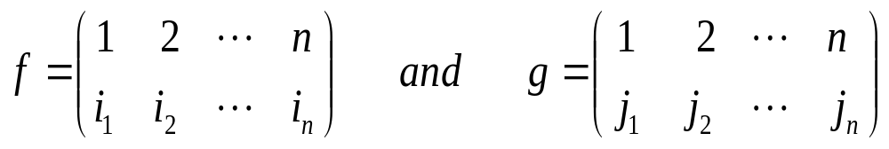
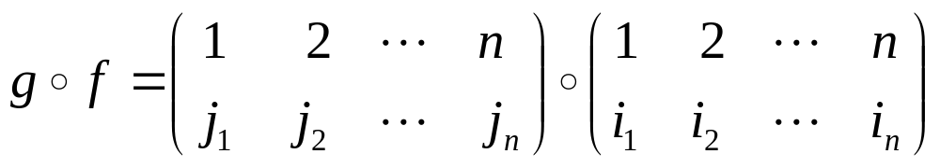
Composition of permutations
Let
are two permutations of {1, 2, …, n}. Then their composition, in the order f followed by g, is the permutation
where (g 。f) (k) = g(f(k)) = j_{ik}.

Slide 11
Binary operation
We denote the set of all n! permutations of {1, 2, …, n} by S_{n}.
Composition of functions defines a binary operation on S_{n}: if f and g are in S_{n}, then g 。f is also in S_{n}.

Slide 12
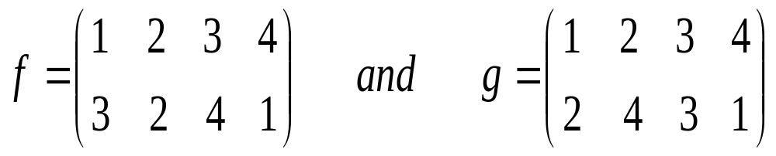
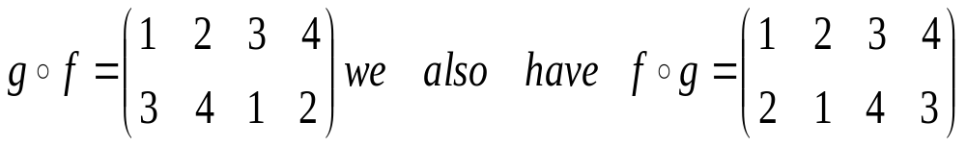
Example
Let f and g be the permutations in S₄ defined by
Then, (g。f)(1) = 3, (g 。f)(2) = 4, (g 。f)(3) = 1,
(g 。f)(4) = 2, and thus

Slide 13
Laws on composition operation
Associative law: (f 。g) 。h = f 。(g 。h))
Commutative law: f 。g ≠ g 。f
Identity permutation: l(k) = k for all k = 1, 2, …, n;
Inverse f⁻¹: f⁻¹(k) = s provided f(s) = k.
f。f⁻¹ = f⁻¹ 。f = l.
Composition with itself:
f¹ = f, f² = f 。f, …, f^{k} = f 。f 。f 。…。f (k f’s)

Slide 14
Getting inverse from the array
Step 1: interchange rows 1 and 2
Step 2: rearrange columns so that the integers 1, 2, …, n in the first row occur in the natural order
Define f⁰ = l. The inverse of the identity permutation is itself: l⁻¹ = l.

Slide 15
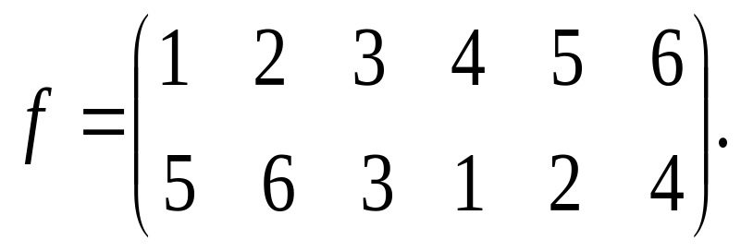
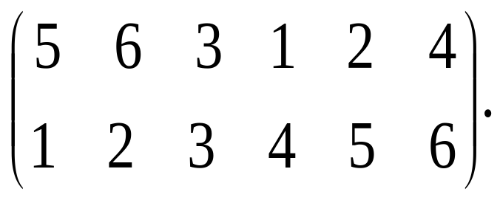
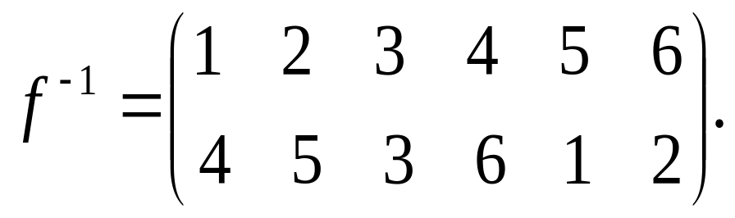
Example
Consider the permutation in S₆ given by
Then interchange rows 1 and 2, we get
Rearranging columns we get

Slide 16
Permutation group
A permutation group, is defined to be a non-empty subset G of permutations in S_{n}, satisfying the following three properties:
(closure under composition) For all permutations f and g in G, f。g is also in G.
(identity) The identity permutation l of S_{n} belongs to G.
(closure under inverses) For each permutation f in G, the inverse f⁻¹ is also in G.

Slide 17
Symmetric group
The set S_{n} of all permutations of X = {1, 2, …, n} is a permutation group, called the symmetric group of order n.
The set G ={l} consisting only of the identity permutation is a permutation group.

Slide 18

Cancellation law
Every permutation group satisfies the cancellation law
This is because we may apply f⁻¹ to both sides of the equation and, using the association law.

Slide 19
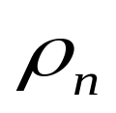
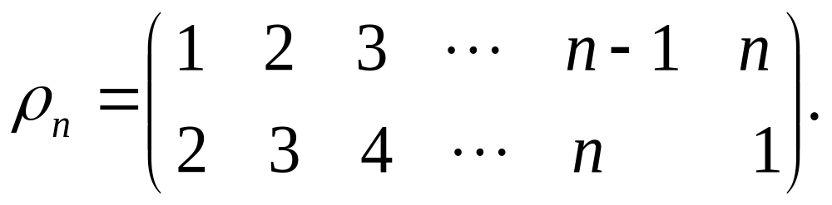
Examples
let n be a positive integer and let denote the permutation of {1, 2, …, n} defined by
thus (i) = i+1 for i = 1, 2, …, n-1 and (n) = 1. think of the integers from 1 to n as evenly spaced around a circle or on the corners of a regular n-gon, as shown, for n = 8, in the figure.

Slide 20
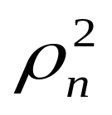
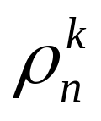
Indeed we may consider as the rotation of the circle by an angle of 360/n degree. The permutation is then the rotation by 2 × (360/n) degree, and more generally, for each non-negative integer k,
is the rotation by k × (360/n) degree.
1
2
8
3
4
7
6
5

Slide 21

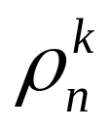
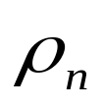
If r equals k mod n, then = . Thus there are only n distinct powers of , namely, ρ_{n}⁰ = l, ρ_{n}, ρ_{n}², …, ρ_{n}^{n-1}.
Also ρ_{n}⁻¹ = ρ_{n}^{n-1}, and more generally,
(ρ_{n}^{k})⁻¹ = ρ_{n}^{n-k} for k = 0, 1, …, n-1.
We thus conclude that
C_{n} = {ρ_{n}⁰ = l, ρ_{n}, ρ_{n}²,… ρ_{n}^{n-1}}
is a permutation group. It is an example of a cyclic group of order n.

Slide 22
Symmetry
Let Q be a geometrical figure. A symmetry of Q is a (geometric) motion that brings the figure Q onto itself. The geometric figures like a square, a tetrahedron, and a cube are composed of corners (or vertices) and edges, and in the case of three-dimensional figure, of faces (or sides). As a result, each symmetry acts as a permutation on the corners, on the edges, and in the case of three dimensional figures, on the faces.

Slide 23
Symmetry groups
We conclude that the symmetries of Q act as a permutation group G_{C} on its corners (called corner-symmetry group), a permutation group G_{E} on its edges (called edge-symmetry group), and in the case Q is three dimensional, a permutation group G_{F} on its faces (called face-symmetry group).

Slide 24
Example
Consider the following square Q with its corners labeled 1, 2, 3, 4 and edges labeled a, b, c and d. There are 8 symmetries of Q and they are of two types. They are the 4 rotations about the corner of the square through the angles of 0, 90, 180, and 270 degrees.
These 4 symmetries constitute the planer symmetries of Q, the symmetries where the motion takes place in the plane containing Q. The planer symmetries by themselves form a group.
a
1
2
d
b
4
c
3

Slide 25
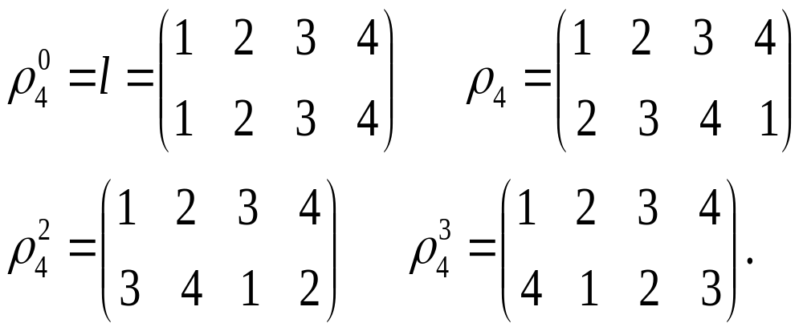
The other symmetries are the four reflections about the lines joining opposite corners and the lines joining the midpoints of opposite sides. For these symmetries the motion takes place in space since to “flip” the square one needs to go outside of the plane containing it.
The rotations acting on the corners give the four permutations
1
a
2
d
b
4
c
3

Slide 26
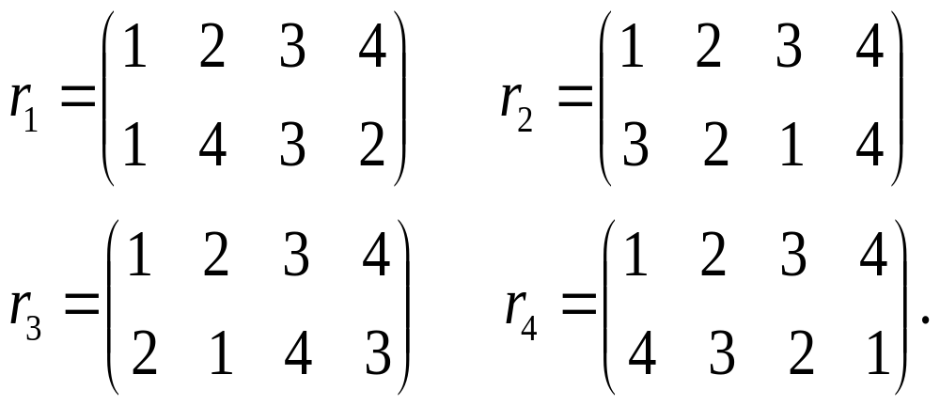
The reflections acting on the corners give the four permutations
Thus the corner-symmetry group of a square is
G_{C} = {ρ₄⁰=l, ρ₄, ρ₄², ρ₄³, r₁, r₂, r₃, r₄}.
1
a
2
d
b
4
c
3

Slide 27
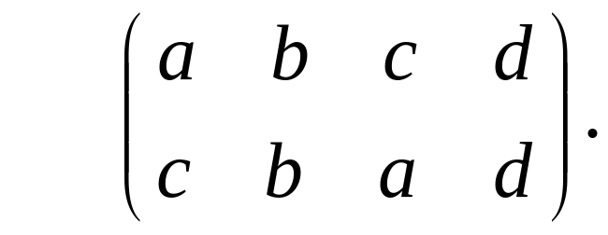
Consider the edges of Q to be labeled a, b, c and d in the figure. The edge-symmetry group G_{E} is obtained from the corner-symmetry group G_{C} by replacing 1, with a, 2 with b, 3 with c and 4 with d. Thus, for instance, doing this replacement in r₂, we get
and this is the permutation of the edges that results when the square is reflected about the midpoints of the lines b and d.
1
a
2
d
b
4
c
3

Slide 28
Dihedral group
In a similar way we can obtain the symmetry group of a regular n-gon for any n ≥ 3. Besides the n rotations ρ_{n}⁰=l, ρ_{n}, ρ_{n}², …, ρ_{n}^{n-1}, we have n reflections r₁, r₂, …, r_{n}. If n is even, then there are n/2 reflections about opposite corners and n/2 reflections about the lines joining the midpoints of opposite sides. If n is odd, then the reflections are the n reflections about the lines joining a corner to the side opposite it. The resulting group
G_{C} = {ρ_{n}⁰=l, ρ_{n}, ρ_{n}²,…, ρ_{n}^{n-1}, r₁, r₂, …, r_{n}} of 2n permutations of {1, 2, …, n} is an instance of a dihedral group of order 2n.

Slide 29
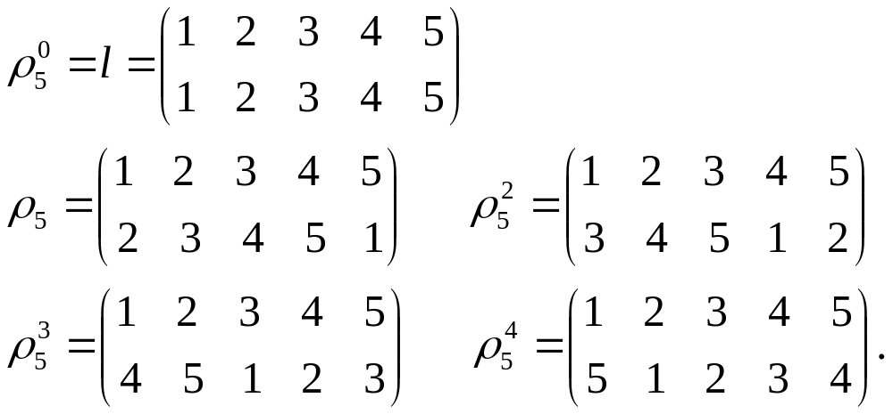
Example
Consider the regular pentagon with its vertices labeled 1, 2, 3, 4 and 5. Its corner symmetry group D₅ contains 5 rotations.
The 5 rotations are
1
5
2
4
3

Slide 30
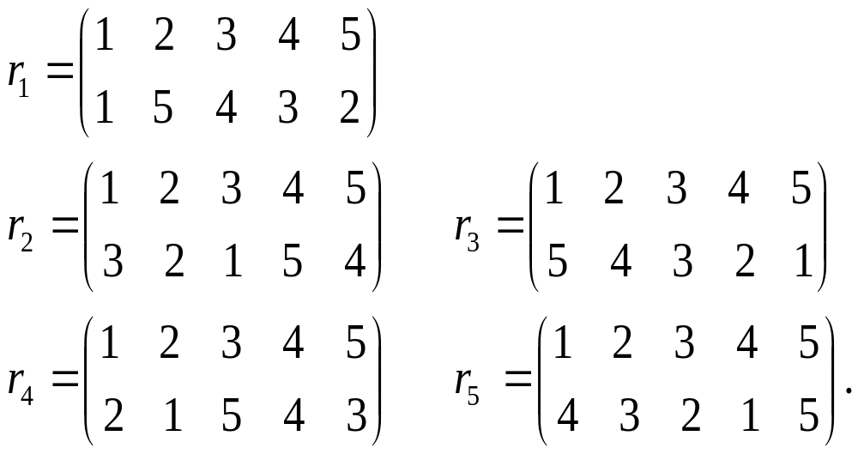
Let r_{i} denote the reflection about the line joining corner i to the side opposite it (i = 1, 2, 3, 4, 5). Then we have
1
5
2
4
3

Slide 31
Coloring
Suppose we have a group G of permutations of a set X where X = {1, 2, …, n}. A coloring of X is an assignment of a color to each element of X. Let C be a collection of colorings of X.

Slide 32
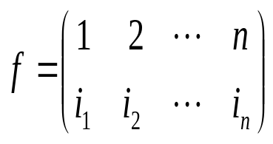
f*c
Let c be a coloring in C, is a permutation in G. denote the colors of 1, 2, …, n as c(1), c(2), …, c(n), respectively.
(f*c)(i_{k}) = c(k)
It means, by applying f, k is changed to i_{k}, then the color in i_{k} is c(k).
In other word, f is a permutation on the color set C.

Slide 33
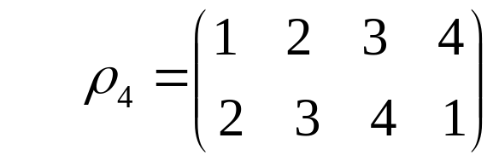
Example
1
2
Let f =
c = (R, B, B, R)
Then f*c = (R, R, B, B)
c
4
3
1
2
f*c
4
3

Slide 34
Equivalent coloring
Let G be a group of permutations acting on a set X. Let C be a collection of colorings of X such that for all f in G and all c in C, the coloring f*c of X is also in C. Thus G acts on C in the sense that it takes colorings in C to colorings in C.
Let c₁ and c₂ be two colorings in C. c₁ is equivalent (under the action of G) to c₂ provided there is a permutation f in G such that f*c₁ = c₂.

Slide 35
Example
1
a
2
1
a
2
a
Consider the previous example where G_{C} = {ρ₄⁰=l, ρ₄, ρ₄², ρ₄³, r₁, r₂, r₃, r₄}. Let c = {R, B, B, R)
1
2
d
l*c= c
b
d
ρ₄*c
b
d
ρ₄²*c
b
4
c
3
4
c
3
4
c
3
1
a
2
a
2
1
a
2
1
d
ρ₄³*c
b
d
b
d
r₂*c
r₁*c
b
4
c
3
4
c
3
4
c
3
1
a
2
1
a
2
d
r₃*c
d
r₄*c
4
c
3
4
c
3

Slide 36
Burnside’s theorem

Slide 37
Stabilizer
Let G(c) = {f: f in G, f*c = c}, that is G(c) is the set of all permutations that fix the coloring c. we call G(c) the stabilizer of c.
E.g., in the previous example, G(c) = {l, r₄} is a stabilizer of coloring c = {R, B, B, R}.
We denote C(f) = {c: c in C, f*c = c}.

Slide 38
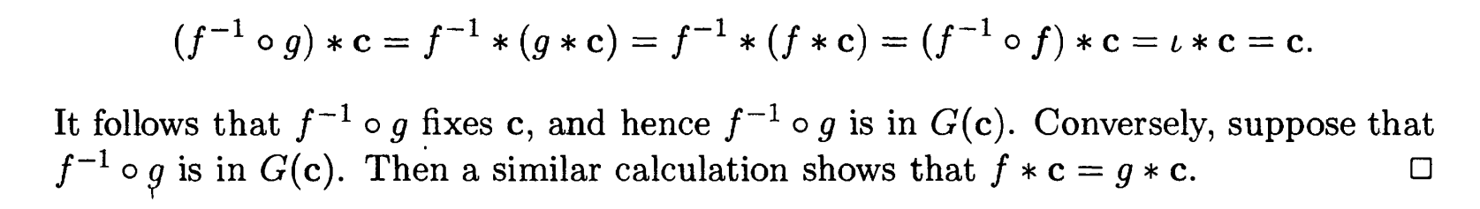
Theorem 14.2.1
For each coloring c, the stabilizer G(c) of c is a permutation group. Moreover, for any permutations f and g in G, g*c = f*c if and only if f⁻¹。g is in G(c).
Proof: (closure under composition) (identity) (closure under inverses)

Slide 39
Corollary 14.2.2
Let c be a coloring in C. the number
|{f*c: f in G}| of colorings that are equivalent to c equals the number |G|/|G(c)| obtained by dividing the number of permutations in G by the number of permutations in the stabilizer of c.

Slide 40
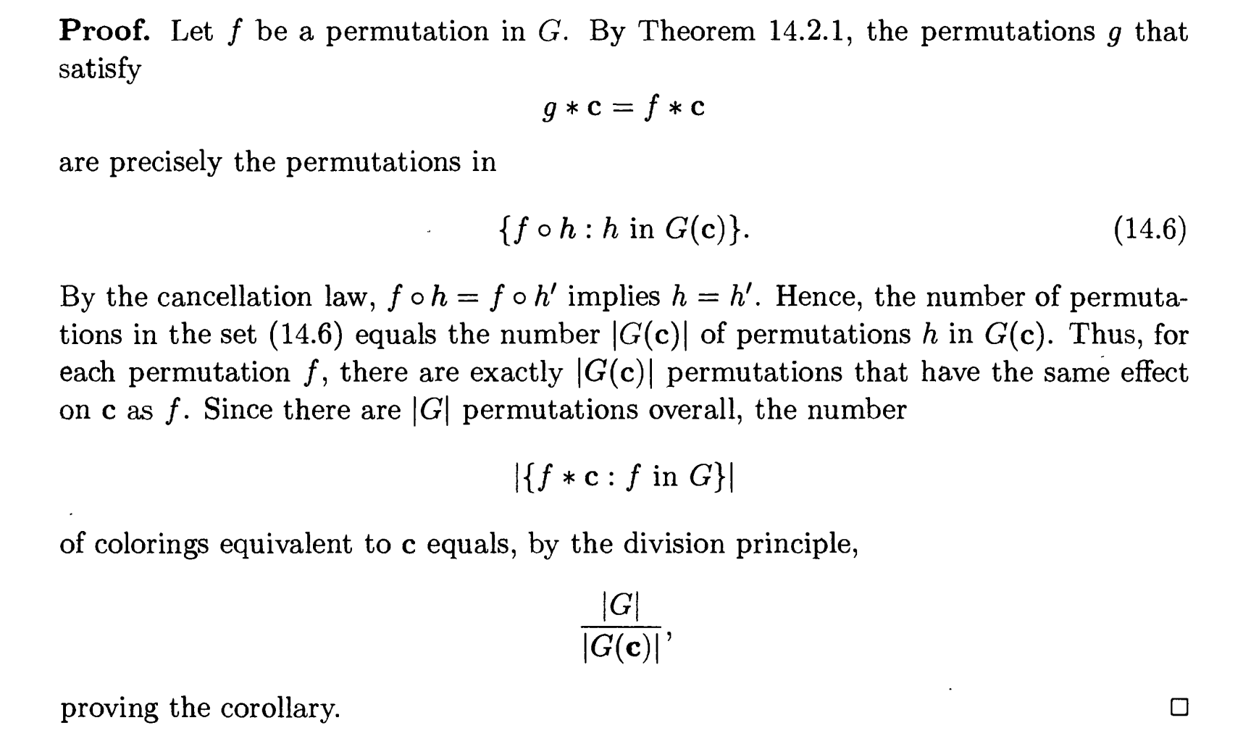
Let h = f⁻¹。g, then g = f 。h, h is in G(c)

Slide 41
Exercise
1
a
2
1
a
2
a
Consider the example of coloring a square with 2 colors where G_{C} = {ρ₄⁰=l, ρ₄, ρ₄², ρ₄³, r₁, r₂, r₃, r₄}. Let c = {R, B, B, R). Then |G| = ??? and |G(c)| =??
1
2
d
l*c= c
b
d
ρ₄*c
b
d
ρ₄²*c
b
4
c
3
4
c
3
4
c
3
1
a
2
a
2
1
a
2
1
d
ρ₄³*c
b
d
b
d
r₂*c
r₁*c
b
4
c
3
4
c
3
4
c
3
1
a
2
1
a
2
d
r₃*c
d
r₄*c
4
c
3
4
c
3

Slide 42
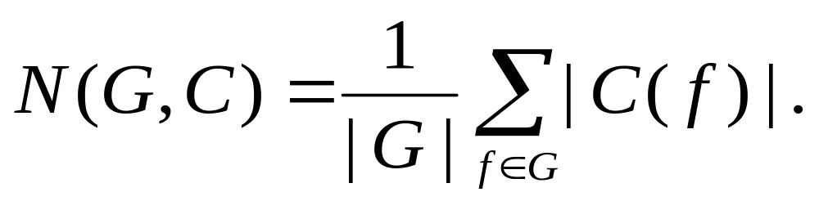
Burnside’s theorem
Let G be a group of permutations of X and let C be a set of colorings of X such that f*c is in C for all f in G and all c in C. Then the number N(G, C) of inequivalent colorings in C is given by
In words, the number of inequivalent colorings in C equals the average of the number of colorings fixed by the permutations in G.

Slide 43
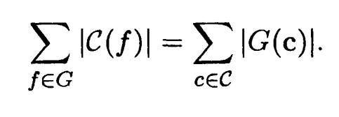
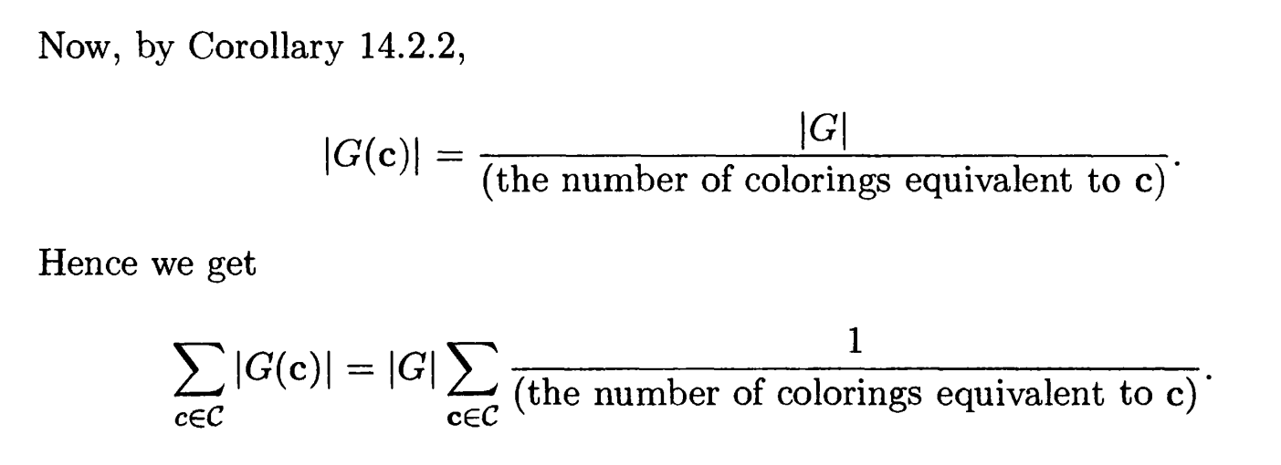
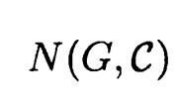
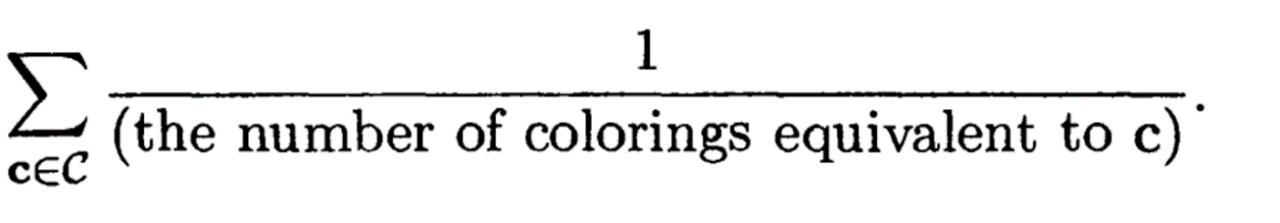

We count the number of pairs (f, c)
such that f fixes c;

Slide 44
Example 1
(counting circular permutations). How many ways are there to arrange n distinct objects in a circle?
Hints: the answer is the number of ways to color the corners of a regular n-gon Q with n different colors which are inequivalent with respect to the group of rotations of Q.

Slide 45
Let C consist of all n! ways to color the n corners of Q in which each of the n colors occurs once. Then the cyclic group C_{n} = {ρ_{n}⁰ = l, ρ_{n}, ρ_{n}², …, ρ_{n}^{n-1}} acts on C, and the number of circular permutations equals the number of inequivalent colorings in C. The identity permutation l in C_{n} fixes all n! colorings in C. every other permutation in C does not fix any coloring in C since in the colorings of C every corner has a different color. Hence, by Burnside’s theorem,
N(C_{n}, C) = 1/n (n!+0+…+0) = (n-1)!.

Slide 46
Example 2
(counting necklaces). How many ways are there to arrange n ≥ 3 differently colored beads in a necklace?
Hints: it is almost the same as previous example except that necklace can be flipped over. The group G of permutations now has to be taken to be the entire vertex-symmetry group of a regular n-gon. Thus in this case G is the dihedral group D_{n} of order 2n. The only permutation that can fix a coloring is the identity and it fixes all n! colorings. Hence,
N(D_{n}, C) = 1/2n (n!+0+…+0) = (n-1)!/2.

Slide 47
Example 3
How many inequivalent ways are there to color the corners of a regular 5-gon with the colors red and blue?
Hints: The group of symmetries of a regular 5-gon is the dihedral group D₅={ρ₅⁰=l, ρ₅, ρ₅², ρ₅³, ρ₅⁴, r₁, r₂, r₃, r₄, r₅} (see the example in page 29-30). Let C be the set of all 2⁵ = 32 colorings of the corners of a regular 5-gon. We compute the number of colorings left fixed by each permutation in D₅ and then apply Burnside’s theorem.

Slide 48
The identity l fixes all colorings. Each of the other 4 rotations fixes only two colorings, namely, the coloring in which all corners are red, and the coloring in which all corners are blue. Thus, |C(ρ₅⁰)| = 32 and |C(ρ₅^{i})| = 2 where i = 1, 2, 3, 4.
Now consider any of the reflections, say r₁. In order that a coloring be fixed by r₁, corners 2 and 5 must have the same color and corners 3 and 4 must have the same color. Hence, the colorings fixed by r₁ are obtained by picking a color for corner 1 (two choice), picking a color for 2 and 5 (two choice) and picking a color for corners 3 and 4 (again two choices). Hence the number of colorings fixed by r₁ equals 8. A similar calculation holds for each reflection and hence |C(r_{j})| = 8 for each j = 1, 2, 3, 4, 5. Therefore, the number of inequivalent colorings is
N(D₅, C) = 1/10 (32+2×4 + 8 ×5) = 8.

Slide 49
Example 4
How many inequivalent ways are there to color the corners of a regular 5-gon with the colors red, blue, and green?
Hints: refer to example 3. now the set C of all colorings number 3⁵ = 243. The identity fixes all 243 colorings. Every other rotation fixes only 3 colorings. Each reflection fixes 3×3×3=27 colorings. Hence
N(D₅, C) = 1/10 (243+3×4+27×5) = 39.

Slide 50
Exercise
How many inequivalent ways are there to color the corners of a regular 5-gon with p colors?
Answer: 1/10 (p⁵+4×p+5×p³)

Slide 51
Example 5
Let S = {∞{r}, ∞{b}, ∞{g}, ∞{y}} be multiset of four distinct objects r, b, g, y, each with an infinite repetition number. How many n-permutations of S are there if we do not distinguish between a permutation read from left to right and the permutation read from right to left?
Thus for instance, r, g, g, g, b, y, y is regarded as equivalent to y, y, b, g, g, g, r.

Slide 52
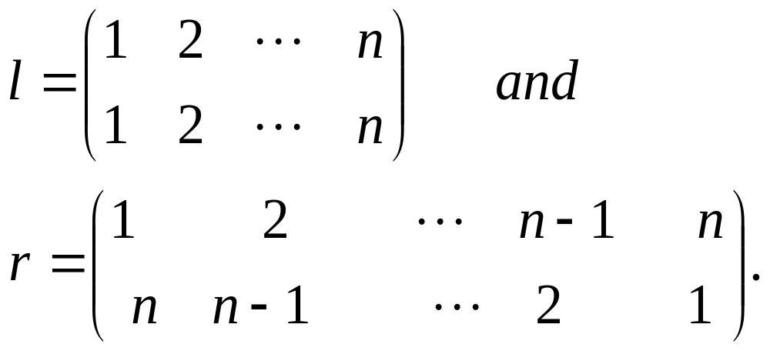
Solution
The answer is the number of inequivalent ways to color the integers from 1 to n with the four colors red, blue, green and yellow under the action of the group of permutations G = {l, r}, where

Slide 53
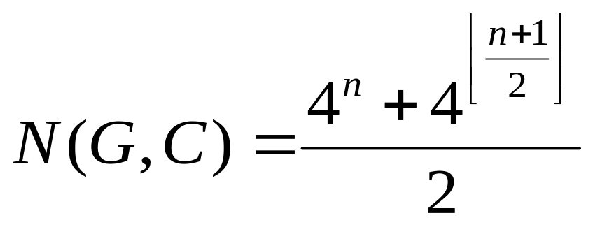
Note that G is a group. Why? Let C be the set of all 4^{n} ways to color the integers from 1 to n with the given four colors. Then l fixes all colorings in C. The number of colorings fixed by r depends on whether n is even or odd. First, suppose n is even. Then a coloring is fixed by r iff 1 and n have the same color, 2 and n-1 have the same color, …., n/2 and n/2+1 have the same color. Hence r fixes 4^{n/2} colorings in C. Now suppose that n is odd. Then a coloring is fixed by r iff 1 and n have the same color, 2 and n-1 have the same color, …, (n-1)/2 and (n+3)/2 have the same color.
Hence the number of colorings fixed by r is
4^{(n-1)/2}×4 = 4^{(n+1)/2}. Thus

Slide 54
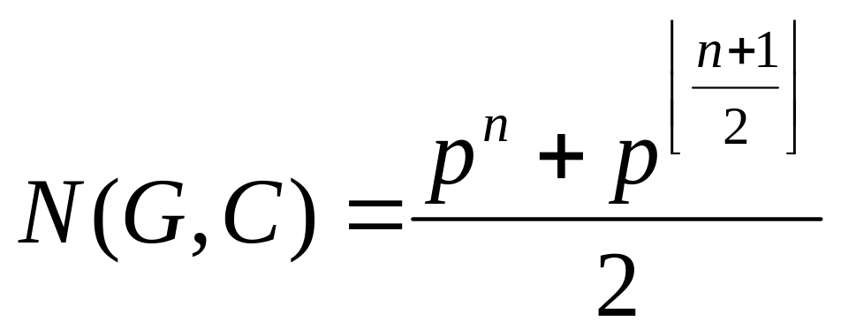
Exercise
If instead of four color, we have p colors, what is the number of inequivalent colorings?
Answer:

Slide 55
Polya’s counting formula

Slide 56
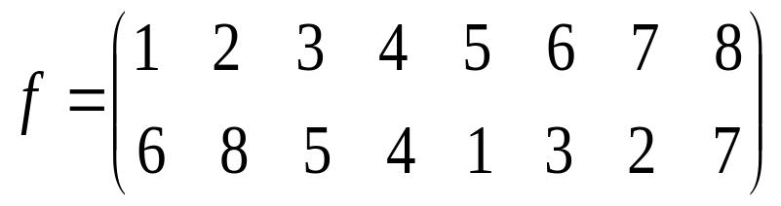
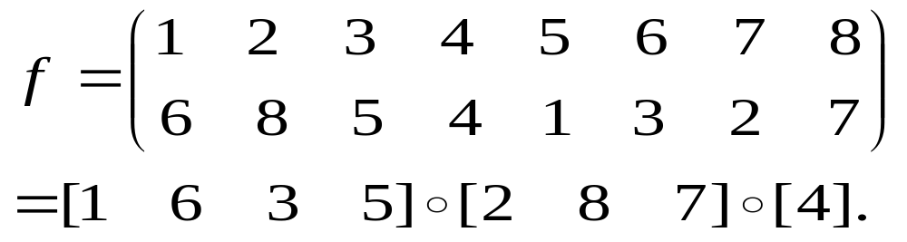
Factorization
Let be a
permutation of the set {1,2,3,4,5,6,7,8}. Then f has a factorization as follows:

Slide 57
Cycle factorization
Let f be any permutation of the set X. Then with respect to the operation of composition f has a factorization
f = [i₁ i₂ … i_{p}]。[j₁ j₂ .. j_{q}] 。…。[l₁ l₂…l_{r}] into cycles where each integer in X occurs in exactly one of the cycles. We call it cycle factorization of f.
The cycle factorization of f is unique apart from the order in which the cycles appear, and this order is arbitrary.
Every element of X occurs exactly once in the cycle factorization.

Slide 58
Example 1
D₄ | Cycle factorization
ρ₄⁰ | [1]。[2]。[3]。[4]
ρ₄¹ | [1 2 3 4]
ρ₄² | [1 3]。[2 4]
ρ₄³ | [1 4 3 2]
r₁ | [1]。[2 4]。[3]
r₂ | [1 3]。[2]。[4]
r₃ | [1 2]。[3 4]
r₄ | [1 4]。[2 3]
Determine the cycle factorization of each permutation in the dihedral group D₄ of order 8 (the corner symmetry group of a square).

Slide 59
Example 2
D₅ | Cycle factorization
ρ₅⁰ | [1]。[2]。[3]。[4]。[5]
ρ₅¹ | [1 2 3 4 5]
ρ₅² | [1 3 5 2 4]
ρ₅³ | [1 4 2 5 3]
ρ₅⁴ | [1 5 4 3 2]
r₁ | [1]。[2 5]。[3 4]
r₂ | [1 3]。[2]。[4 5]
r₃ | [1 5]。[3] 。[2 4]
r₄ | [1 2]。[3 5]。[4]
r₅ | [1 4]。[2 3]。[5]
Determine the cycle factorization of each permutation in the dihedral group D₅ of order 10 (the corner-symmetry group of a regular 5-gon).

Slide 60
Example 3
Let f be the permutation of X = {1, 2, 3, 4, 5, 6, 7, 8, 9}. The cycle factorization of f is f = [1 4 7 3]。[2 9]。[5 6]。[8]. Suppose that we color the elements of X with the colors red, white, and blue, and let C be the set of all such colorings. How many |C(f)| colorings in C are left fixed by f?
Hints: for each cycle, all the elements in the same cycle will be colored with the same color. Hence, the total colorings |C(f)| = 3⁴ = 81.

Slide 61
#(f)
#(f) is the number of cycles in the cycle factorization of a permutation f.
E.g., for f = [1 4 7 3]。[2 9]。[5 6]。[8], #(f) = 4.
It is independent of the sizes of the cycles.

Slide 62
Theorem 14.3.1
Let f be a permutation of a set X. Suppose we have k colors available with which to color the elements of X. Let C be the set of all colorings of X. Then the number |C(f)| of colorings of C that are fixed by f equals k^{#(f)}.

Slide 63
Example
How many inequivalent ways are there to color the corners of a square with the colors red, white, and blue?
Let C be the set of all 3⁴ = 81 colorings of the corners of a square with colors red, white and blue. The corner-symmetry group of a square is the dihedral group D₄, the cycle factorization of whose elements was computed in Example 1.

Slide 64
D₄ | Cycle factorization
ρ₄⁰ | [1]。[2]。[3]。[4]
ρ₄¹ | [1 2 3 4]
ρ₄² | [1 3]。[2 4]
ρ₄³ | [1 4 3 2]
r₁ | [1]。[2 4]。[3]
r₂ | [1 3]。[2]。[4]
r₃ | [1 2]。[3 4]
r₄ | [1 4]。[2 3]
#(f) | |C(f)|
4 | 3⁴=81
1 | 3¹=3
2 | 3²=9
1 | 3¹=3
3 | 3³=27
3 | 3³=27
2 | 3²=9
2 | 3²=9
Hence, the answer is
N(D₄,C) = (81+3+9+3+27+27+9+9)/8 = 21

Slide 65
Type of a permutation
Let f be a permutation of X where X has n elements. Suppose that the cycle factorization of f has e₁ 1-cycles, e₂ 2-cycles, … and e_{n} n-cycles. Then 1e₁+2e₂+…+ne_{n} = n. we call the n-tuple (e₁, e₂,…,e_{n}) the type of the permutation f and write type(f) = (e₁, e₂,…,e_{n}) .
#(f) = (e₁ + e₂+…+ e_{n})
Different permutation may has the same type. Why?

Slide 66
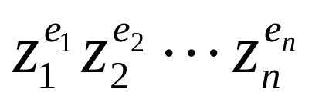
Monomial of a permutation
We introduce n indeterminates z₁, z₂, …, z_{n} where z_{k} is to correspond to a k-cycle (k=1, 2, …,n). To each permutation f with type(f) = (e₁, e₂,…,e_{n}) we associate the monomial of f, mon(f) =

Slide 67
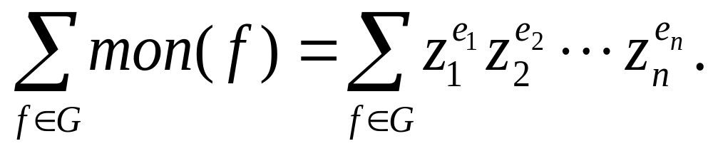
Generating function
Let G be a group of permutations of X. The generating function for the permutations in G according to type is
If we combine terms, the coefficient of
equals the number of permutations in G of type(e₁, e₂, …, e_{n}).

Slide 68
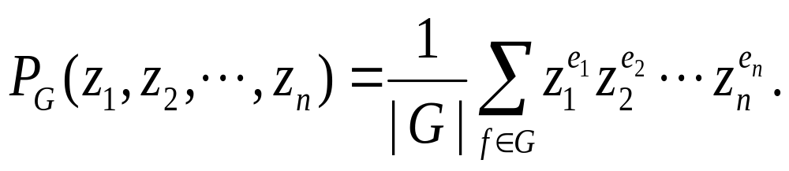
Cycle index
The cycle index of G is the generating function divided by the number |G| of permutations in G. That is

Slide 69
Example
Determine the cycle index of the dihedral group D₄.
P_{D4}(z₁,z₂,z₃,z₄)=(z₁⁴+2z₄+3z₂²+2z₁²z₂)/8
D₄ | Cycle factorization
ρ₄⁰ | [1]。[2]。[3]。[4]
ρ₄¹ | [1 2 3 4]
ρ₄² | [1 3]。[2 4]
ρ₄³ | [1 4 3 2]
r₁ | [1]。[2 4]。[3]
r₂ | [1 3]。[2]。[4]
r₃ | [1 2]。[3 4]
r₄ | [1 4]。[2 3]
type | monomial
(4,0,0,0) | z₁⁴
(0,0,0,1) | z₄
(0,2,0,0) | z₂²
(0,0,0,1) | z₄
(2,1,0,0) | z₁²z₂
(2,1,0,0) | z₁²z₂
(0,2,0,0) | z₂²
(0,2,0,0) | z₂²

Slide 70
Exercise
Determine the cycle index of the dihedral group D₅.
Refer to the example in page 562 of textbook.
Answer
P_{D5} (z₁, z₂,z₃, z₄, z₅) = (z₁⁵+4z₅+5z₁z₂²)/10.

Slide 71
Theorem 14.3.2
Let X be a set of n elements and suppose we have a set of k colors available with which to color the elements of X. Let C be the set of all k^{n} colorings of X. Let G be a group of permutations of X. Then the number of inequivalent colorings is the number |N(G, C)| = P_{G}(k, k,…, k) obtained by substituting z_{i}=k, (i =1, 2, …, n) in the cycle index of G.

Slide 72
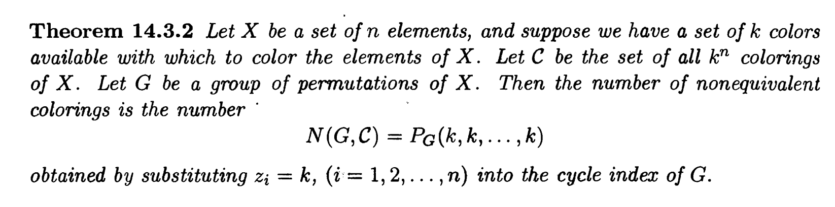
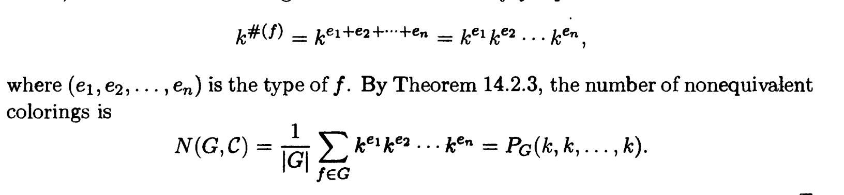

Slide 73
Example
We are given a set of k colors. What is the number of inequivalent ways to color the corners of a square?
The cycle index of the dihedral group D₄ has already been determined to be P_{D4}(z₁,z₂,z₃,z₄)=(z₁⁴+2z₄+3z₂²+2z₁²z₂)/8.
Hence the answer is P_{D4}(k,k,k,k)=(k⁴+2k+3k²+2k³)/8.
If k = 6, then the number of inequivalent colorings is
P_{D4}(6,6,6,6)=(6⁴+2×6+3×6²+2×6³)/8 = 231.

Slide 74
Exercise
Let p be a prime number. Determine the number of different necklaces that can be made from p beads of n different colors.

Slide 75
Example
How many inequivalent colorings are there of the corners of a regular 5-gon in which three corners are colored red and two are colored blue?
Hints: (a) |C| = 10; (b) For the cycle factorization of each permutation, compute the number of fixed colorings; (c) Apply Burnside theorem.

Slide 76
Theorem 14.3.3
Let X be the set of elements and let G be a group of permutations of X. Let {u₁, u₂, …, u_{k}} be a set of k colors and let C be any set of colorings of X with the property that G acts as a permutation group on C. Then the generating function for the number of inequivalent colorings of C according to the number of colors of each kind is the expression
P_{G}(u₁+…+u_{k}, u₁²+…+u_{k}², …., u₁^{n}+…+u_{k}^{n}).

Slide 77
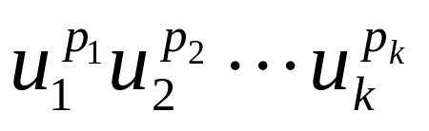
Theorem 14.3.3 (cont’d)
P_{G}(u₁+…+u_{k}, u₁²+…+u_{k}², …., u₁^{n}+…+u_{k}^{n}) is obtained from the cycle index P_{G}(z₁, z₂,…z_{n}) by making the substitutions z_{j}=u₁^{j}+…u_{k}^{j} (j = 1, 2, …, n).
The coefficient of equals the number of inequivalent colorings in C with p₁ elements of X colored u₁, p₂ elements colored u₂,…, p_{k} elements colored u_{k}.

Slide 78
Example 1
Determine the generating function for inequivalent colorings of the corners of a square with 2 colors and also those with 3 colors.
P_{D4}(z₁,z₂,z₃,z₄)=(z₁⁴+2z₄+3z₂²+2z₁²z₂)/8. Let the two colors be r and b. Then the generating function is
P_{D4}(r+b, r²+b², r³+b³, r⁴+b⁴)
= 1/8 [(r+b)⁴ + 2(r⁴+b⁴)+3(r²+b²)²+2(r+b)²(r²+b²)]
= r⁴+r³b+2r²b²+rb³+b⁴. (how to color?)
Continue the case for 3 colors by yourself !!!!!

Slide 79
Example 2
Determine the generating function for inequivalent colorings of the corners of a regular 5-gon with 2 colors and also those with 3 colors.
The cycle index of D₅ is P_{D5} (z₁, z₂,z₃, z₄, z₅) = (z₁⁵+4z₅+5z₁z₂²)/10. Then the generating function for inequivalent colorings is
P_{D5}(r+b,r²+b²,…,r⁵+b⁵)=r⁵+r⁴b+2r³b²+2r²b³+rb⁴+b⁵.
the total number of inequivalent colorings equals 1+1+2+2+1+1=8.
Continue for the case with 3 colors by yourself.

Slide 80
Example 3
Determine the symmetry group of a cube and the number of inequivalent ways to color the corners and faces of a cube with a specified number of colors.
1
2
There are 24 symmetries of a cube, and they are rotations of four types different kinds.
4
3
5
6
8
7

Slide 81
Step 1 determine the symmetries
(1) the identity rotation l (number is 1)
(2) the rotations about the centers of the three pairs of opposite faces by
  (a) 90 degrees (number is 3)
  (b) 180 degree (number is 3)
  (c) 270 degree (number is 3)
(3) the rotations by 180 degree about midpoints of opposite edges (number is 6)
(4) the rotations about opposite corners by
  (a) 120 degrees (number is 4)
  240 degree (number is 4).

Slide 82
Step 2 compute the type
1
2
1
2
1
2
4
4
4
3
3
3
5
6
5
6
5
6
8
8
8
7
7
7
(a) (0,0,0,2,0,0,0,0)
(b) (0,4,0,0,0,0,0,0)
(c) (0,0,0,2,0,0,0,0)
(0,4,0,0,0,0,0,0)
(2,0,2,0,0,0,0,0)
(2,0,2,0,0,0,0,0)
Compute the face type by yourself !!!!

Slide 83
Step 3 cycle index
symmetry | number | Corner type | Face type
(1) | 1 | (8,0,0,0,0,0,0,0) | (6,0,0,0,0,0)
2(a) | 3 | (0,0,0,2,0,0,0,0) | (2,0,0,1,0,0)
2(b) | 3 | (0,4,0,0,0,0,0,0) | (2,2,0,0,0,0)
2(c) | 3 | (0,0,0,2,0,0,0,0) | (2,0,0,1,0,0
3 | 6 | (0,4,0,0,0,0,0,0) | (0,3,0,0,0,0
4(a) | 4 | (2,0,2,0,0,0,0,0) | (0,0,2,0,0,0
4(b) | 4 | (2,0,2,0,0,0,0,0) | (0,0,2,0,0,0
P_{GC}(z₁, z₂,…z₈)= 1/24 (z₁⁸ + 6z₄²+9z₂⁴ + 8z₁²z₃²).

Slide 84
Step 4 generating function
Suppose we apply two colors r and b. The generating function for inequivalent colorings of the corners of a cube is
P_{GC}(r+b, r²+b², …, r⁸+b⁸)
= r⁸ +r⁷b + 3r⁶b²+3r⁵b³+7r⁴b⁴+3r³b⁵+3r²b⁶+rb⁷+b⁸.
Hence the total number of inequivalent colorings for the corners is 23.
Computer the total number of inequivalent colorings for the faces by yourself !!!!

Slide 85
Assignments
13(b)(d)
20
26
44

