Slide 1
Lecture 6
IEP and Applications

Slide 2
Summary
Review of IEP
Combinations with repetition
Derangements
Permutations with forbidden position
Chessboard polynomial

Slide 3
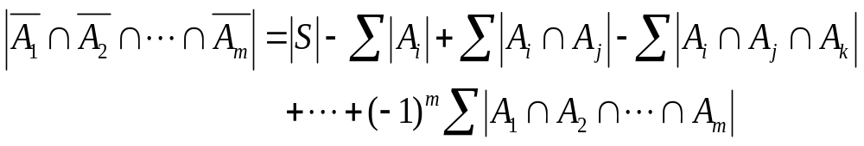
The inclusion-exclusion principle (IEP)
The number of objects in S which have none of the properties P₁, P₂, …., P_{m} is given by
where the first sum is over all 1-combination {i} of {1,2,3…,m}, the second sum is over all 2-combinations {i, j} of {1,2,..,m}, the third sum is over all 3-combinations {i, j, k} of {1,2,…,m}, and so on.

Slide 4
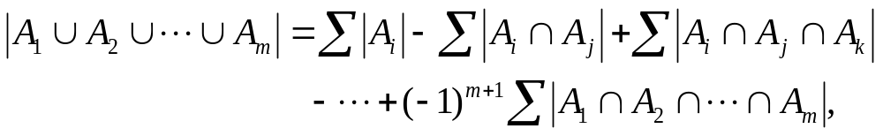
A corollary of IEP
The number of objects of S which have at least one of the properties P₁, P₂, …, P_{m} is given by
where the summations are as specified in IEP.

Slide 5
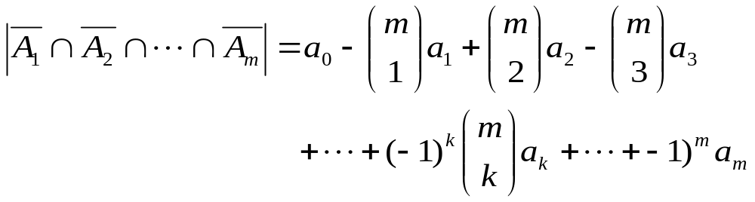
Special case for IEP
Assume that the size of the set A_{i1} ∩ A_{i2} ∩ … ∩ A_{ik} that occurs in the IEP depends only on k and not on which k sets are used in the intersection. Then
where a_{k} = |A_{i1} ∩ A_{i2} ∩ … ∩ A_{ik}|. This is because the kth summation that occurs in the IEP contains C(m, k) summands each equal to a_{k}.

Slide 6
Section 6.2
Combinations with repetition

Slide 7
Review: Combinations of Multisets
If S is a multiset, then an r-combination of S is an unordered selection of r of the objects of S. Thus an r-combination is itself a multiset, a submultiset of S.
Example. If S = {2{a}, 1{b}, 3{c}}, then the 3-combinations of S are {2{a}, 1{b}}, {2.a, 1.c}, {1.a, 1.b, 1.c}, {1.a, 2.c}, {1.b,2.c}, {3.c}.

Slide 8
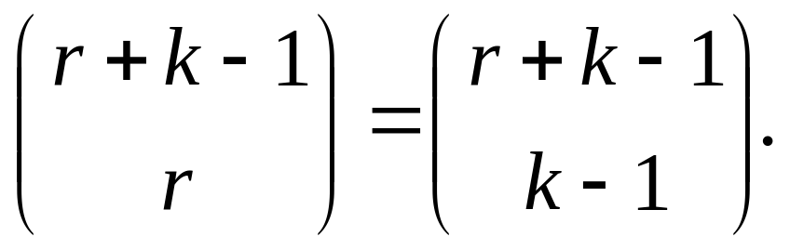
Review: r-combinations
Let S be a multiset with objects of k different types where each has an infinite repetition number (or the repetition number is greater than r). Then the number of r-combinations of S equals
It corresponds to the number of non-negative integral solutions of equation x₁+x₂+…+x_{k}=r.

Slide 9
About repetition number
Suppose T is a multiset and an object x of T of the a certain type has repetition number which is greater than r. Then the number of r-combinations of T equals the number of r-combinations of the multiset obtained from T by replacing the repetition number of x by r.
Furthermore, any repetition number which is greater than r can be replaced by r.

Slide 10
Example
The number of 8-combinations of the multiset {3{a}, ∞{b}, 6{c}, 10{d}, ∞{e}} is the same as the number of 8-combinations of the multiset {3{a}, 8{b}, 6{c}, 10{d}, 8{e}}.

Slide 11
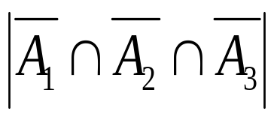
Combinations with repetition
Example 1: Determine the number of 10-combinations of the multiset T = {3{a}, 4{b}, 5{c}}.
Hint: Let T* = {∞{a}, ∞{b}, ∞{c}}, P₁ (resp., P₂, and P₃) be the property that a 10-combination of T* has more than 3 a’s (resp., 4 b’s and 5 c’s) and A₁ (resp., A₂ and A₃) be the 10—combinations of T* which have property P₁ (resp., P₂ and P₃). We wish to determine the size of the set

Slide 12
Hint (cont’d)
The set A₁ consists of all 10-conbinations of T* in which a occurs at least 4 times. If we take any one of these 10-combinations in A₁ and remove 4 a’s, we are left with a 6-combination of T*. Conversely, if we take a 6-combination of T* and add 4 a’s to it, we get a 10-combination of T* in which a occurs at least 4 times. Thus the number of 10-combinations in A₁ equals the number of 6-combinations of T*. Hence, |A₁| = C(6+3-1,6) = 28. Similarly, A₂ (resp., A₃) equals the number of 5 (resp., 4)-combinations of T*. Hence, |A₂| = C(5+3-1,5)=21, |A₃| = C(4+3-1,4)=15.

Slide 13
Hints (cont’d)
The set A₁∩A₂ consists of all 10-combinations of T* in which a occurs at least 4 times and b occurs at least 5 times. By above analysis, |A₁∩A₂ | equals the number of 1-combinations of T*, so that |A₁∩A₂ | = C(1+3-1, 1) =3. Similarly, |A₂∩A₃|=0, |A₁∩A₃|=1 and |A₁ ∩ A₂∩A₂|=0. Putting all these results into the IEP, we obtain = 6.

Slide 14
r-combination and integral solution
The number of r-combinations of the multiset {n₁*a₁, n₂*a₂,…,n_{k}*a_{k}} equals the number of integral solutions of the equation
x₁+x₂+…+x_{k}=r
which satisfy 0≤x_{i}≤n_{i} (i=1,2,…,k).
The number of these solutions can be calculated by the method just illustrated.

Slide 15
Combinations with repetition
Example 2: What is the number of integral solutions of the equation x₁ + x₂ +x₃ +x₄ = 18 which satisfy 1≤x₁≤5, -2≤x₂≤4, 0≤x₃≤5, 3≤x₄≤9?
Hint: The equation equivalent to y₁ + y₂ +y₃ +y₄ = 16 which satisfy 0≤y₁≤4, 0≤y₂≤6, 0≤y₃≤5, 0≤y₄≤6? The following solution similar to example 1.

Slide 16
Second solution
Let S be the set of all non-negative integral solutions of the above equation, P₁ (P₂, P₃ and P₄) be the property that y₁ ≥ 5 (y₂ ≥ 7, y₃≥6 and y₄≥7) and A_{i} be the subset of S consisting of the solutions satisfying property P_{i}(i = 1, 2, 3, 4). Let z₁ = y₁ – 5, z₂ = y₂ ,z₃ = y₃ and z₄ = y₄. Then the number of solutions in A₁ is the same as the number of non-negative integral solutions of z₁ +z₂+z₃+z₄=11. Hence, |A₁| = C(11+4-1, 11).
CONTINUE BY YOURSELF.

Slide 17
Derangements

Slide 18
Derangements
A derangement of {1, 2, …, n} is a permutation i₁i₂…i_{n} of {1, 2, …, n} such that i₁ ≠ 1, i₂ ≠ 2, …, i_{n} ≠ n (i.e., no integer is in its natural position).
We denote by D_{n} the number of derangements of {1, 2, …, n}.

Slide 19
Examples
List the derangements for the set with n object, where n = 1,2, 3, 4, respectively.
For n =1, there are no derangements.
For n =2, the only derangement is 2 1
For n =3, there are two derangements:
2 3 1 and 3 1 2.
For n = 4, there are 9 derangements:
2143, 2341, 2413, 3142, 3412, 3421, 4123, 4312, 4321.

Slide 20
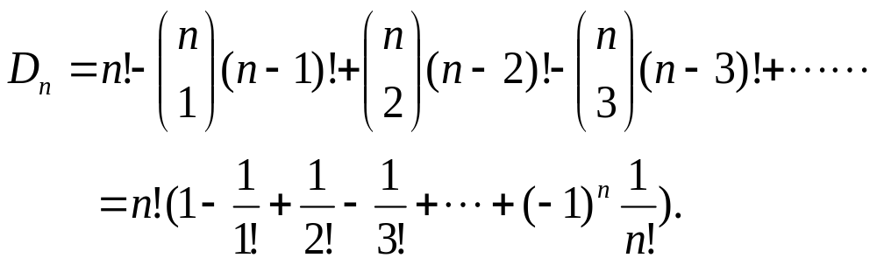
Exercise
Calculate D_{n} by applying IEP.

Slide 21
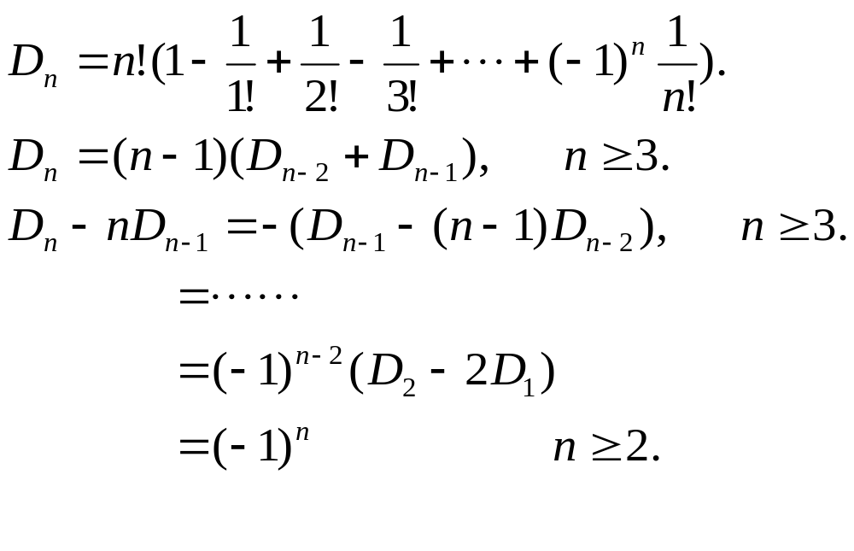
Formulas for Counting D_{n}
For n ≥ 1

Slide 22
Examples
At a party there are n men and n women. In how many ways can the n women choose male partners for the first dance? How many ways are there for the second dance if everyone has to change partners?
Answer: for the first dance there are n! possibilities. For the second dance, the number of possibilities is D_{n}.

Slide 23
Exercise
Suppose the n men and n women at the party above check their hats before the dance. At the end of the party their hats are returned randomly. In how many ways can they be returned if each man gets a male hat and each women gets a female hat, but no one gets the hat he or she checked?

Slide 24
Permutations with forbidden positions

Slide 25
Definition of P(X₁, X₂,…,X_{n})
Let X₁, X₂, …, X_{n} be (possibly empty) subsets of {1, 2, …, n}. We denote by P(X₁, X₂,…,X_{n}) the set of all permutations i₁i₂…i_{n} of {1, 2, …, n} such that i₁ is not in X₁, i₂ is not in X₂, …, i_{n} is not in X_{n.}
Let p(X₁, X₂,…,X_{n}) = | P(X₁, X₂,…,X_{n}) |

Slide 26
Examples
Let n = 4 and let X₁={1, 2}, X₂ ={2, 3}, X₃ ={3, 4} and X₄ ={1, 4}. Then P(X₁, X₂, X₃, X₄) consists of all permutations i₁i₂ i₃i₄ of {1,2 ,3 ,4} such that i₁ ≠ 1,2; i₂ ≠ 2,3; i₃ ≠ 3,4; i₄ ≠ 1,4. Hence, P(X₁, X₂, X₃, X₄) = {3412, 4123} and p(X₁, X₂,…,X_{n}) = 2.
Let X_{k} = {k} (k =1, 2, …,n). Then the set P(X₁, X₂,…,X_{n}) equals the set of all permutations i₁i₂…i_{n} of {1, 2, …, n} for which i_{k} ≠ k. We conclude that P(X₁, X₂,…,X_{n}) is the set of derangements of {1,2, …, n} and we have p(X₁, X₂,…,X_{n}) = D_{n}.

Slide 27

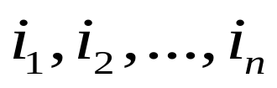



Placement of non-attacking rooks in chessboard
The permutation
of corresponds to the placement of
n rooks on the board in the square with coordinates .
The permutations in
correspond to placements of n non-attacking rooks on an n-by-n board in which there are certain squares in which it is forbidden to put a rook.

Slide 28




An example
Let ,
Then are in one-to-one correspondence with the placement of 5 non-attacking rooks on the board with forbidden positions as shown.
1
2
3
4
5
1
x
x
2
x
3
x
4
x
x
5
x
x

Slide 29
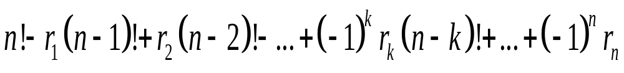


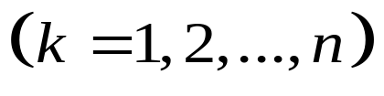
Placement of rooks in chess board
The number of ways to place n non-attacking, indistinguishable rooks on an n-by-n board with forbidden positions equals
(2)
Where is the number of ways to place non-attacking rooks on the n-by-n board where each of the k rooks is in a forbidden position.

Slide 30
An example
1
2
3
4
5
Determine the number of ways to place 5 non-attacking rooks on the following 5-by-5 board, with forbidden positions as shown.
1
x
2
x
x
3
x
x
4
x
x
5

Slide 31
Solution
We will decide the values of r₁, r₂, …, r₅. r₁ is the number of forbidden positions 7. Before evaluating r₂, r₃,…,r₅, we note that the set of forbidden positions can be partitioned into two “independent” parts, one part F₁ containing three positions and the other part F₂ containing four.
1
2
3
4
5
1
x
2
x
x
3
x
x
4
x
x
5
“Independent” means squares in different parts do not belong to a common row or column.

Slide 32
Evaluate r₂
We now evaluate r₂, the number of ways to place 2 non-attacking rooks in forbidden positions. The rooks may be both in F₁, both in F₂ or one in F₁ and one in F₂.
Hence, r₂ = 1+2+3x4 =15.
Continue to evaluate r3, r4, r5 by yourself.
1
2
3
4
5
1
x
2
x
x
3
x
x
4
x
x
5

Slide 33
Evaluate r₂
1
2
3
4
5
1
x
2
x
x
3
X
x
x
4
x
x
5

Slide 34
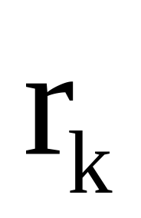


What is your problem?
What is your problem on calculating ?
Notes:
Discrete Mathematics and its Applications
(c)2001-2002, Michael P. Frank

Slide 35
Chessboard polynomial
A permutation of n-objects corresponds
to a non-attacking placement of n rooks
on a n-by-n chessboard.
x
e.g., 32451
x
x
x
x

Slide 36
Chessboard polynomial
The form of chessboard can be extended
Let r_{k} (C）denote the number of placement of k chesses to the chessboard C.

Slide 37
Examples
r₁( )=1，
r₁( )=2，
r₁( )=2，
r₂( )=0，
r₂( )=1。

Slide 38
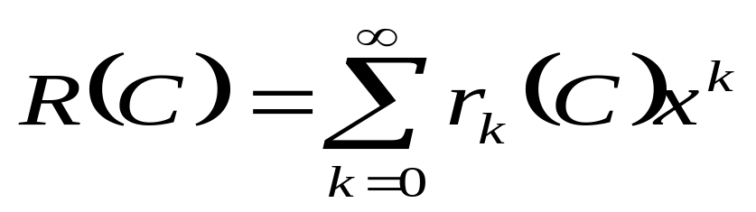
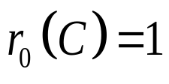

Chessboard polynomial
Let C be a chessboard.
is defined as the chessboard polynomial.
let ，even if

Slide 39
Chessboard polynomial
For a specified grid i in C, let C_{i} be a chessboard induced from C by deleting the row and the column of grid i；let C_{e} be induced from C by deleting grid i from C.

Slide 40
An example
*
C_{i}
C_{e}

Slide 41
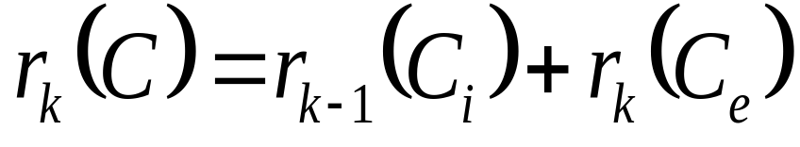
Chessboard polynomial
For a specified grid i, if place a chess, we get r_{k－1}(C_{i})；
otherwise，the number of placement is r_{k}(C_{e}).

Slide 42

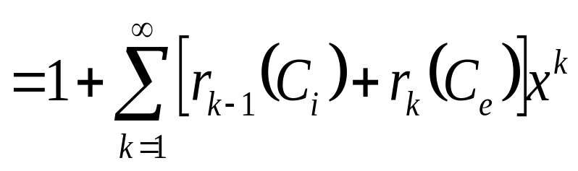
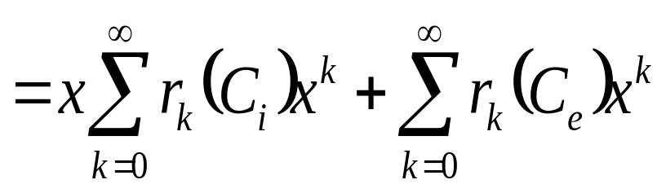
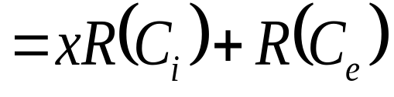
Chessboard polynomial
(3)

Slide 43
Examples
R( )=1+ x；
R( )= xR( )+ R( )= x+ (1+ x)=1+2x；
R( )= x R( ) + R( )
= x(1 + x )+1 + x
=1+ 2x +x²

Slide 44
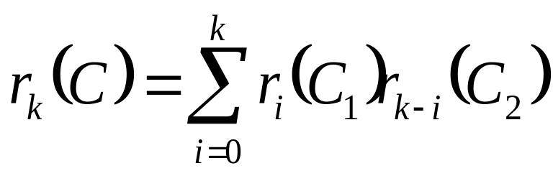
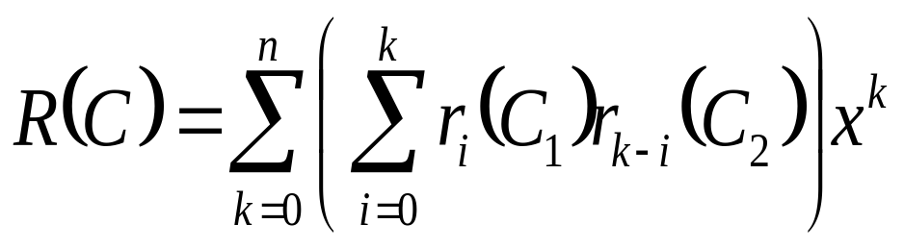
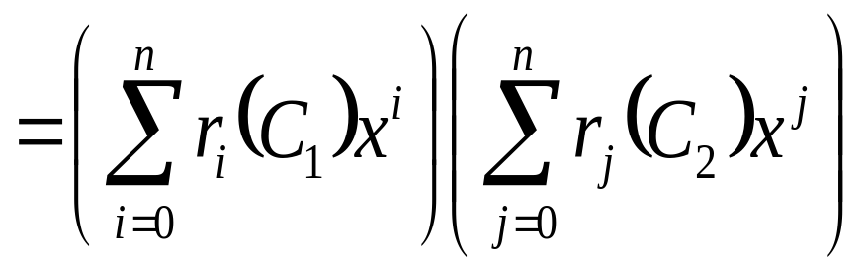
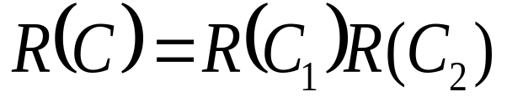
Chessboard polynomial
If C consists of two independent parts
C₁ and C₂
(4)

Slide 45
Chessboard polynomial
By the formulas（3）and（４），a complex
board can be separated into several simpler
ones in order to get the polynomial.
e.g, R ( ) = xR( )+R( )
= x(1+ x)² +(1+2x)²
=1+ 5x +6x² + x³
*
R( ) = xR( ) + R( )
= 1+6x +10 x² +4x³

Slide 46
Exercise
A B C D
Determine the number of ways to place 4 non-attacking rooks on the following 4-by-4 board, with forbidden positions as shown.
1 2 3 4
R( )=1+6x+10x²+4x³
R₄(C) =4!－6(4－1)!+10(4－2)!－4(4－3)!
+0(4－4)!=4
Notes:
Discrete Mathematics and its Applications
(c)2001-2002, Michael P. Frank

Slide 47
Section 6.5
Another forbidden position problem

Slide 48
Problem description
Suppose a class of 8 boys take a walk every day. They walk in a line of 8 so that every boy except the first is preceded by another. In order that a child not see the same person in front of him, on the second day they decide to switch positions so that no boy is preceded by the same boy who preceded him the first day. In how many ways can they switch positions?

Slide 49
Illustration of the problem
If we assign to the boys the numbers 1, 2, …, 8 with the last boy in the column of the first day receiving the number 1, …, and the first boy receiving the number 8 as in 1 2 3 4 5 6 7 8, then we are asked to determine the number of permutations of the set {1 2 3 4 5 6 7 8} in which the patterns 12, 23, 34 ,….,78 do not occur.
E.g., 31542876 is an allowable permutation while 84312657 is not.

Slide 50
Formulas for Counting Q_{n}
For n ≥1
Q_{n} = n! –C(n-1, 1)(n-1)! + C(n-1, 2) (n-2)! – C(n-1, 3)(n-3)! + …+(-1)^{n-1}(C(n-1, n-1)1!.
Q₁=1, Q₂=1, Q₃=3 and Q₄=11.
Q_{n} = D_{n} + D_{n-1}, (n≥2).

Slide 51
Assignments
3
8
11
25
31

