Slide 1
Crystal Toolkit: Visualize a material
https://next-gen.materialsproject.org/toolkit

Slide 2
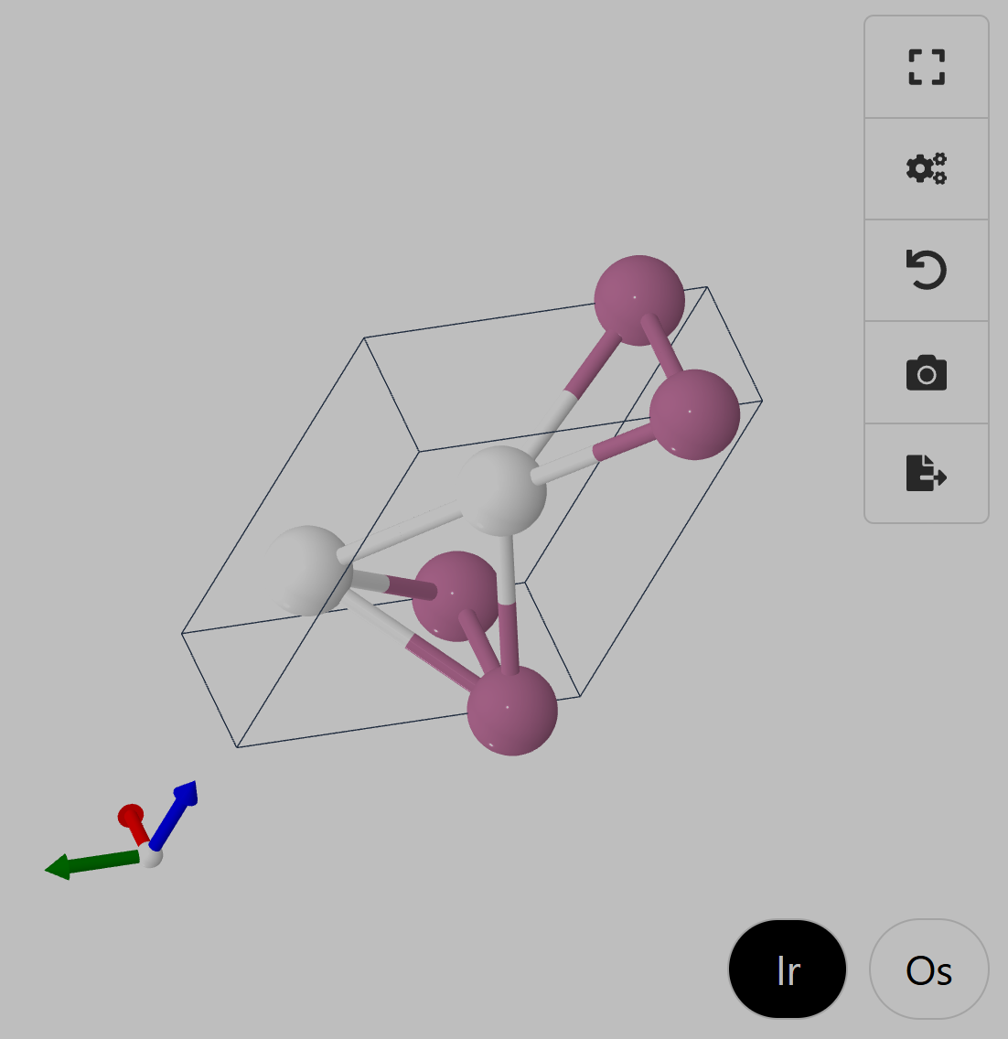
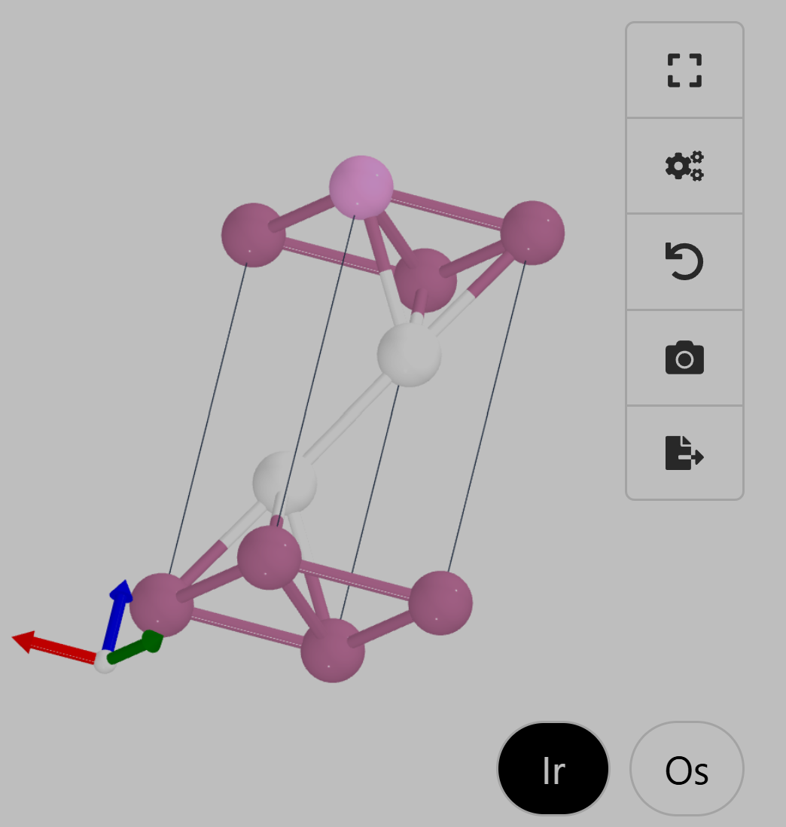
Relaxation Issue? -- Ir₂Os (Gen_13.cif)
What Mattergen found:
Matched to the dataset:

