Slide 1
Title
  Inventors: Jun Shen
  Date: 26-10-2017
  Short description:
      Collect the abbreviations you meet for 5G
  Innovation type: software feature
  Current status: development is complete

Slide 2
Background
  Understanding the meaning of abbreviations
      When we read documents or read and write code, we encounter abbreviations that we don’t understand.
      We may finding 5G abbreviations web search explanations, but in this web we can’t find all of them. Then we may find other data.
      It’s a waste of time.
Notes:
Introduce the basic driver of the innovation

Slide 3
Innovation Description
  Description about the innovation
  There are two modes of this tool. One is to build a MySQL server, we use this tool to connect, then maintain data and query information, to achieve shared goals.
  Another way is to read the form of a single file, which can be used as a personal abbreviations storage and query.
Notes:
detail description of the innovation with words and figures including the following point

Slide 4
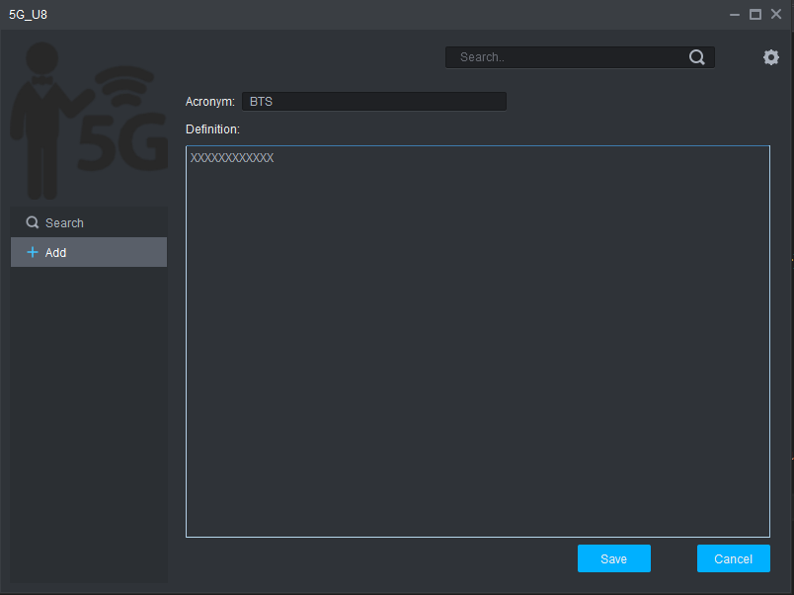
Innovation Description
  Description about the innovation
  About add interface.
Notes:
detail description of the innovation with words and figures including the following point

Slide 5
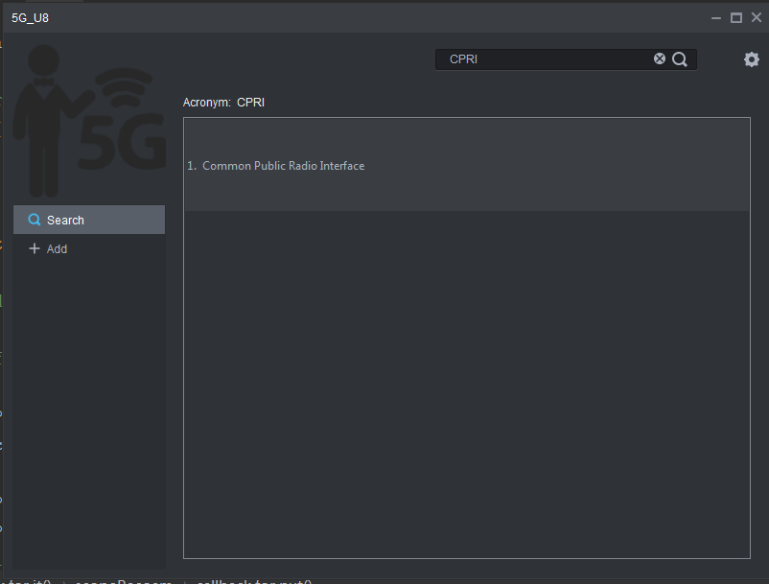
Innovation Description
  Description about the innovation
  About search interface.
Notes:
detail description of the innovation with words and figures including the following point

Slide 6
Innovation point
  Current approach
      Search from 5G abbreviations web.
  Innovation point
      Use abbreviations tool to search and share.
Notes:
if has, simply introduce current solution similar to the innovation
introduce the innovation point which is clear different with similar solution

Slide 7
Benefit and value
  Benefit and Value of innovation:
      Save time and improve efficiency.
Notes:
introduce the benefit and the value of the innovation to customer or product.
Introduce the advantage and disadvantage of this innovation

Slide 8
Effort and Cost
  Effort estimation for demo: benefit and feasibility:
      60h
  Cost of equipment and tools to make it happen
      Visual Studio + Qt tools
Notes:
introduce the benefit and the value of the innovation to customer or product.
Introduce the advantage and disadvantage of this innovation

Slide 9
Future extension
  Next job
      Add new features and improve experience.
Notes:
if any, descript the next job for the extension of this innovation
including extension for more scenario, larger application range, lower cost and fewer limitation..

Slide 10
Reference and Supported
      SQLite open source
  http://www.sqlite.org/
Notes:
Reference materials and their links

Slide 11
History
Version | Date | Author | Decision | Notes/Review body
1.0 | 26-10-2017 | Jun Shen |  | Demo

