Slide 1

Java程序分析
SootUp（二）
JOSTAR

Slide 2

IR选择
Java Bytecode
Jimple
IR
PK
✅

Slide 3



Java Bytecode
iload
iadd
imul
pop
…
expression
表达式不明确
表达式可以是任意大小
instruction
putfield
invokestatic
istore
…
不一定总可以构造表达式
action
定义数量可能大于赋值次数
iconst 5
iload 0
iadd
istore 1
iload 3
iconst 5
iload 6
iload 3
iadd
imul
idiv
istore 0
iload0
iload 0
iload 2
if_icmpeq label1
goto label2
label1:
ineg
label2:
istore 1
iload0
iload 0
iload 2
if_icmpeq
T
F
ineg
istore1
$$var1 = 5+var0$$
$$var0 = (var3+var6)∗5/var3$$
$$var1 = var0 or –var0$$

Slide 4
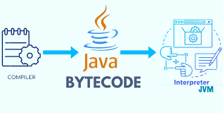
Java Bytecode
You are nice, bro!

Slide 5
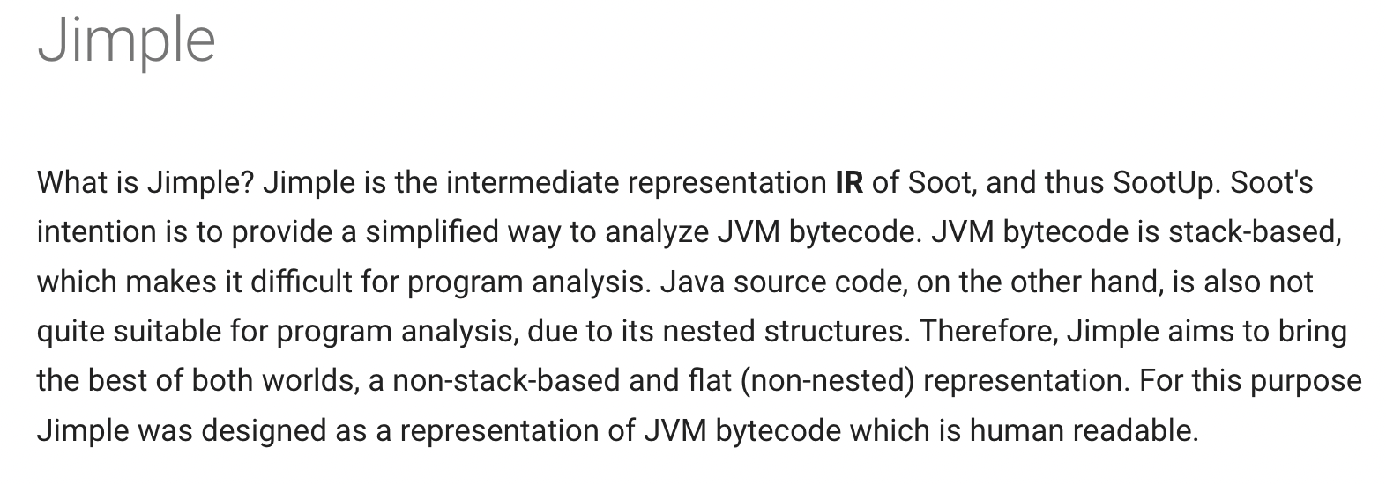
Jimple介绍
sable-thesis.pdf (washington.edu)

Slide 6
Jimple语句
AssignStmt
IdentityStmt
Def
IfStmt
GotoStmt
IntraProcControlFlow
SwitchStmt
InvokeStmt
Stmt
InterProcControlFlow
ReturnVoidStmt
Throw
ReturnStmt
ThrowStmt
Monitor
EnterMonitorStmt
ExitMonitorStmt
Other
NopStmt
RetStmt

Slide 7
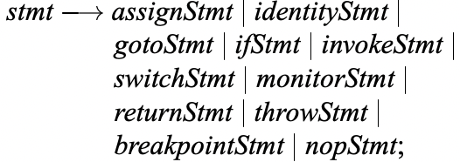
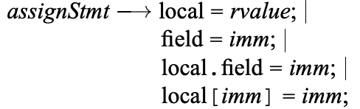
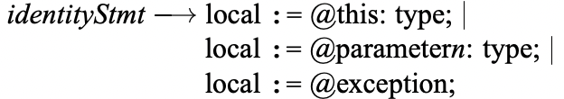
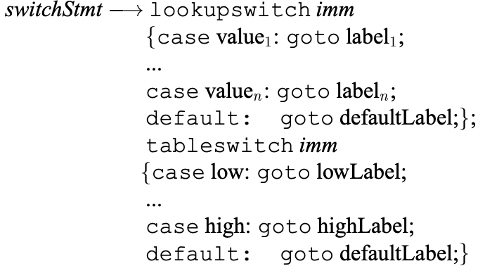



Jimple语句形式

Slide 8
FieldRef
Jimple表达式
StaticFieldRef
LValue
JArrayRef
Local
Constant
Ref
InstanceOfExpr
BinopExpr
RValue
Value
Immediate
UnaryExpr
CastExpr
Expr
NewArrayExpr
NewMultiArrayExpr
InvokeExpr
NewExpr
PhiExpr

Slide 9
Jimple类型
VoidType
ReferenceType
Type
PrimitiveType
BottomType
UnknownType

Slide 10
Jimple IR示例
Jimple - SootUp (soot-oss.github.io)

Slide 11

控制流图CFG
控制流图是建模了程序控制流向的有向图$G=(N,E)$
N为基本块，E为控制流的转移关系
int x
void foo() {
int x = 0;
if (x > 1) {
print(“true”)
} else {
print(“false”)
}
}
x = 0
x > 1?
print(“true”)
print(“false”)
return

Slide 12
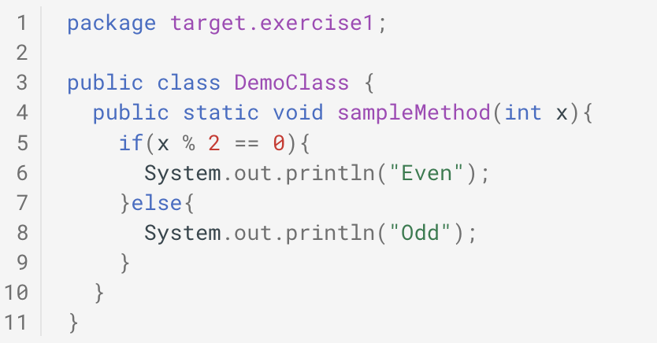
实践二——控制流图的可视化

Slide 13
谢谢!

Slide 14


Java程序分析框架

