Slide 1


IR
IMDb
Internet Movie Database
Group 5
李宇捷 (Ethan)
沈奎勳 (Joseph)
陳柏瑋
洪旻昌 (Bryan)
01057108
01057115
01057138
01057158

Slide 2







What is IMDb?
The Internet Movie Database (IMDb) is an online database of information related to films, television series, podcasts, home videos, video games, and streaming content online – including cast, production crew and personal biographies, plot summaries, trivia, ratings, and fan and critical reviews.
- Wikipedia
2

Slide 3
Functionality
1. Actor-Related Keywords
Display keywords based on reviews relevant to the actors.
2. Sentiment Grouping
Analyze and group user reviews based on each content’s sentiments.
3. Review Summary
Construct a summarization of reviews for each rating level.
3

Slide 4
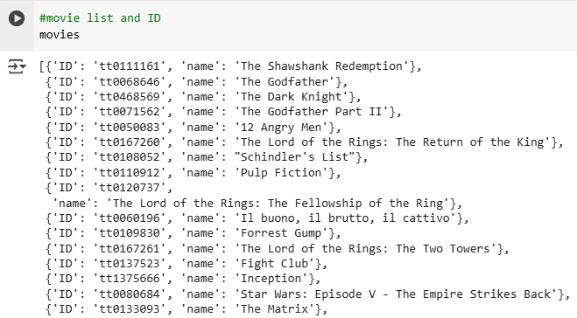
Movie List Retrieval
Retrieve movies’ [ID] and [Title]
4

Slide 5
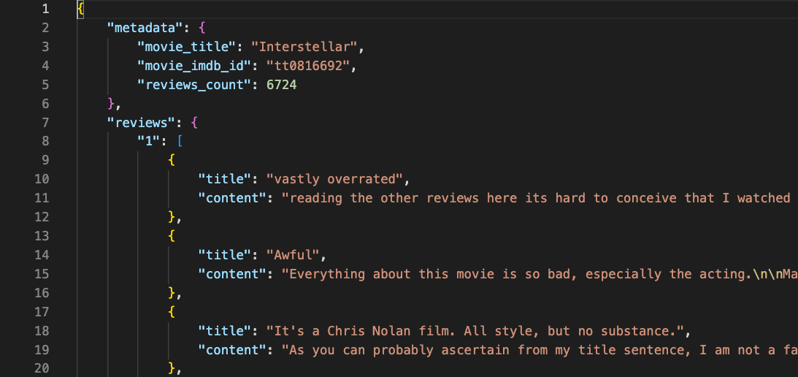
Review Retrieval
Retrieve movies’ [Reviews]
Rating range: [1, 10]
5

Slide 6
Collected Data
Total movie: 39 movies.
Total review: 92,621 reviews.
The least number of reviews: 436 reviews.
The most number of reviews: 10,837 reviews.
6

Slide 7
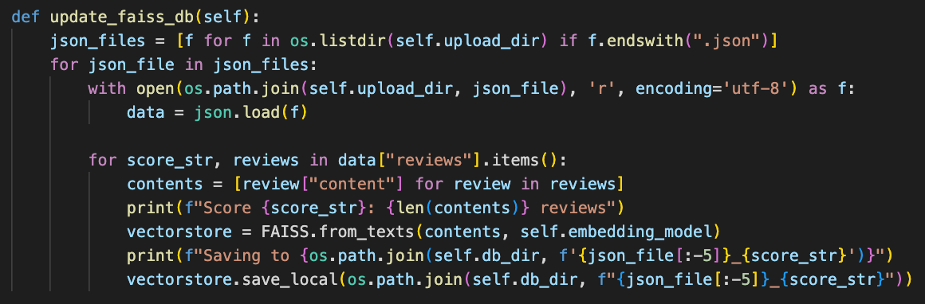
Database Construction
Construct a local database to store reviews and its embedding into FAISS vector database. Model used: intfloat/multilingual-e5-large-instruct (embedding size = 1024)
7

Slide 8
#Functionality-1
Actor-Related Keywords
8

Slide 9
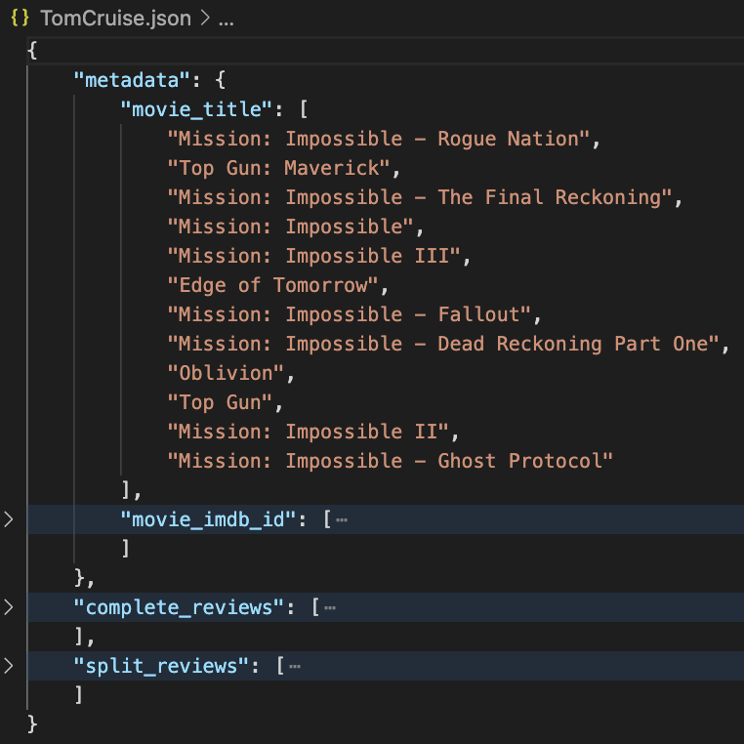
#Functionality-1
Actor-Related Keywords
Corpus Construction: Review Selection
Query target words
actor's name
actor's role
complete_reviews: retrieve whole reviews that consist one of the query’s target words.
split_reviews: retrieve sentences that consist one of the query’s target words.
9

Slide 10
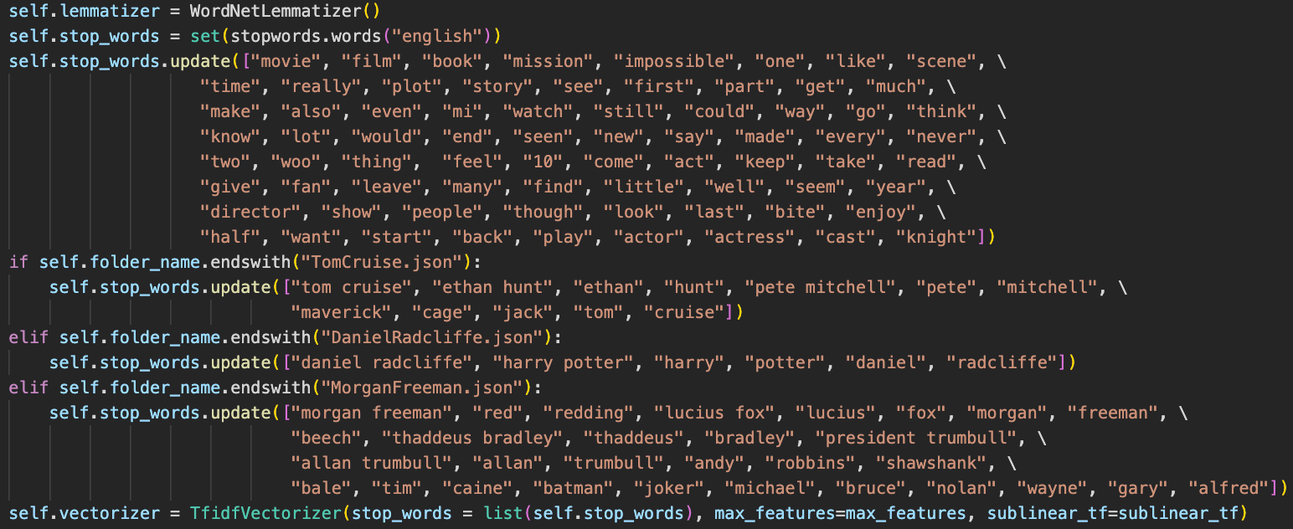
#Functionality-1
Actor-Related Keywords
Document Processing: Lemmatize, Stop Words, TF-IDF Vector
10

Slide 11
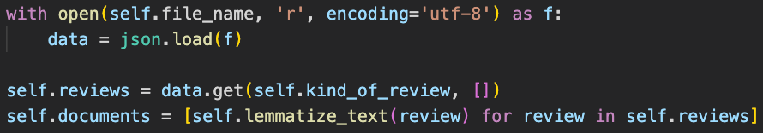
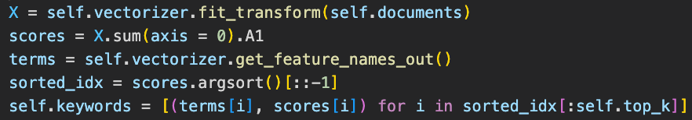
#Functionality-1
Actor-Related Keywords
Corpus Processing
Retrieve Top-k Related Keywords
11

Slide 12
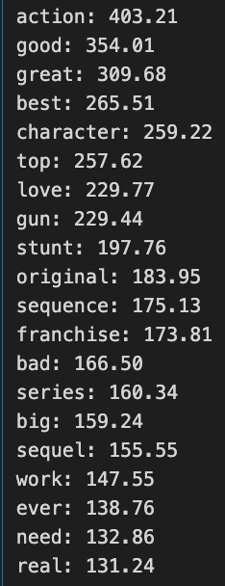
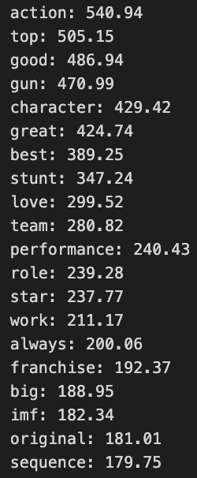
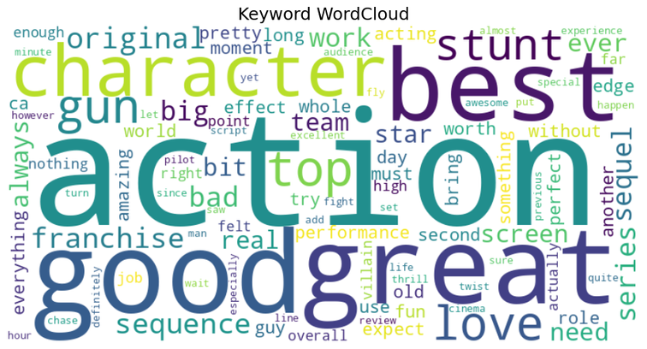
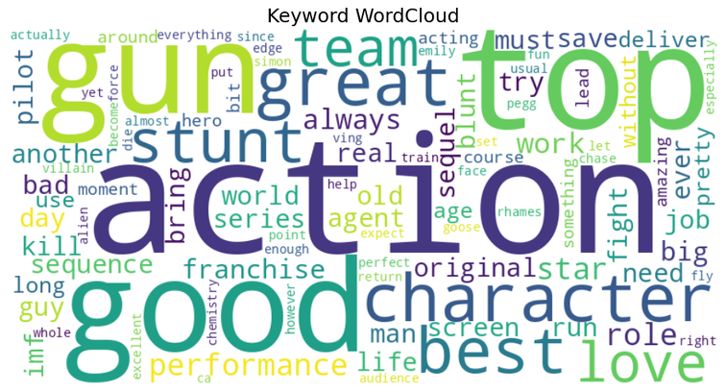
#Functionality-1
Actor-Related Keywords
Result of Top-20 Related Keywords
Actor: Tom Cruise
Source: 12 Movies with 15,922 Reviews
complete_reviews: 10,953 Data
split_reviews: 27,731 Data
12

Slide 13
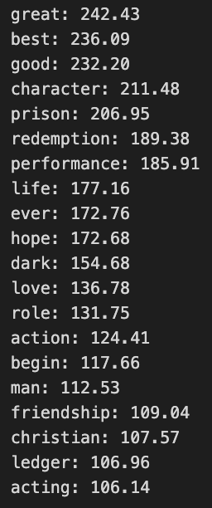
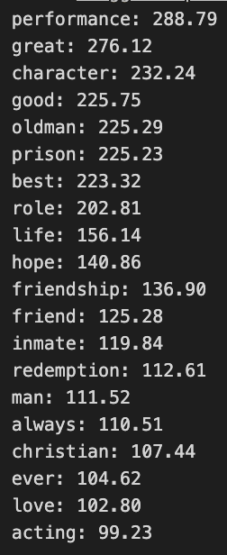
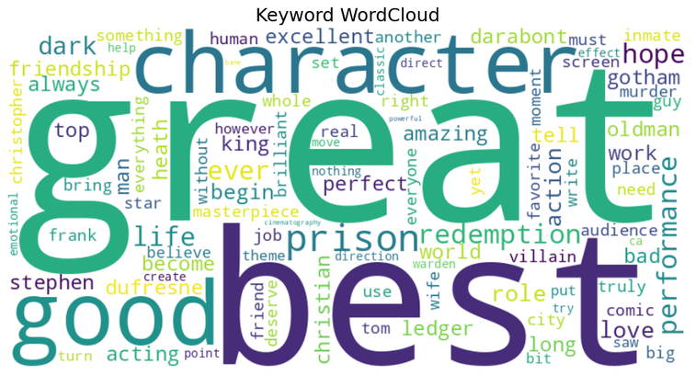
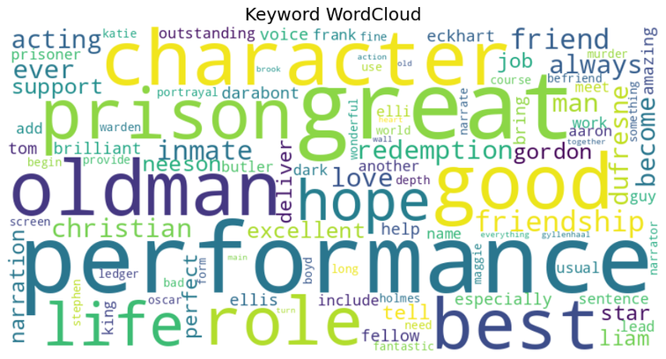
#Functionality-1
Actor-Related Keywords
Result of Top-20 Related Keywords
Actor: Morgan Freeman
Source: 9 Movies with 21,233 Reviews
complete_reviews: 7,653 Data
split_reviews: 11,320 Data
13

Slide 14
#Functionality-2
Group by Sentiment
14

Slide 15
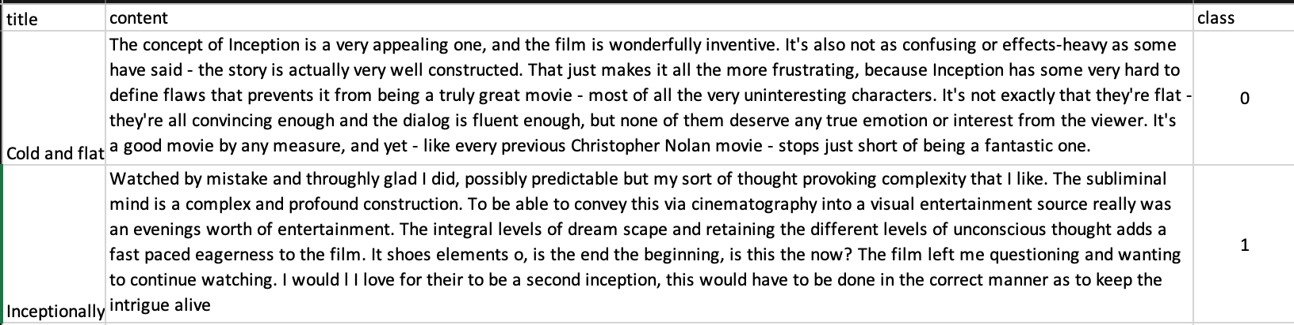
#Functionality-2
Group by Sentiment
Retrieve tf.keras.datasets.imdb data (as training and testing set) and manually create additional testing data.
Total: 25,000 data for training and 25,000 data for testing.
Manually classify additional training data into two categories: “Positive” (1) and “Negative” (0).
Total: 300 data with 123 positive data and 177 negative data.
6
15

Slide 16
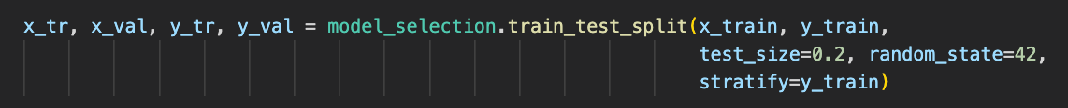
#Functionality-2
Group by Sentiment
Split training data into training and validation data to train the neural network.
In the following two pages, the data from Keras is used as :
- training,
- validation, and
- first testing
6
16

Slide 17
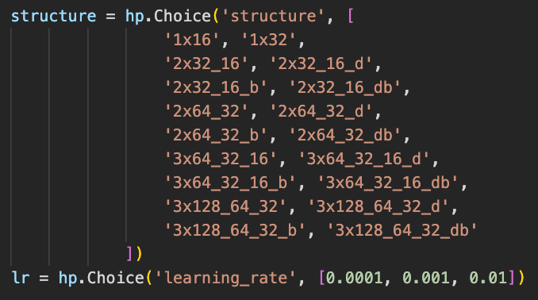
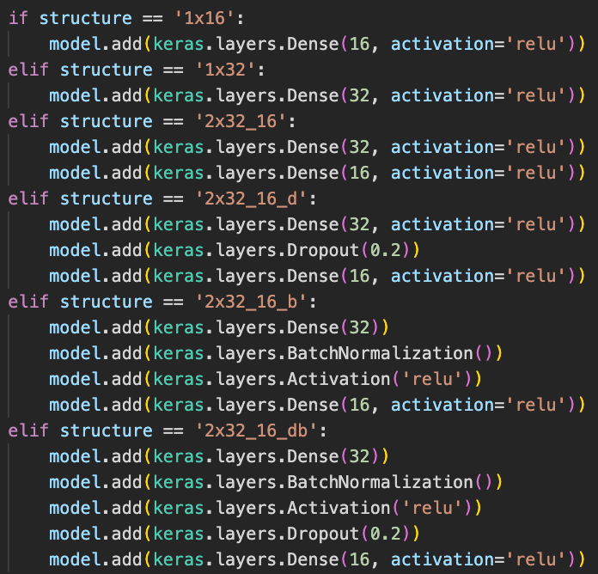
#Functionality-2
Group by Sentiment
Trained 54 kinds of neural networks with different structures and/or hyperparameters.
6
17

Slide 18
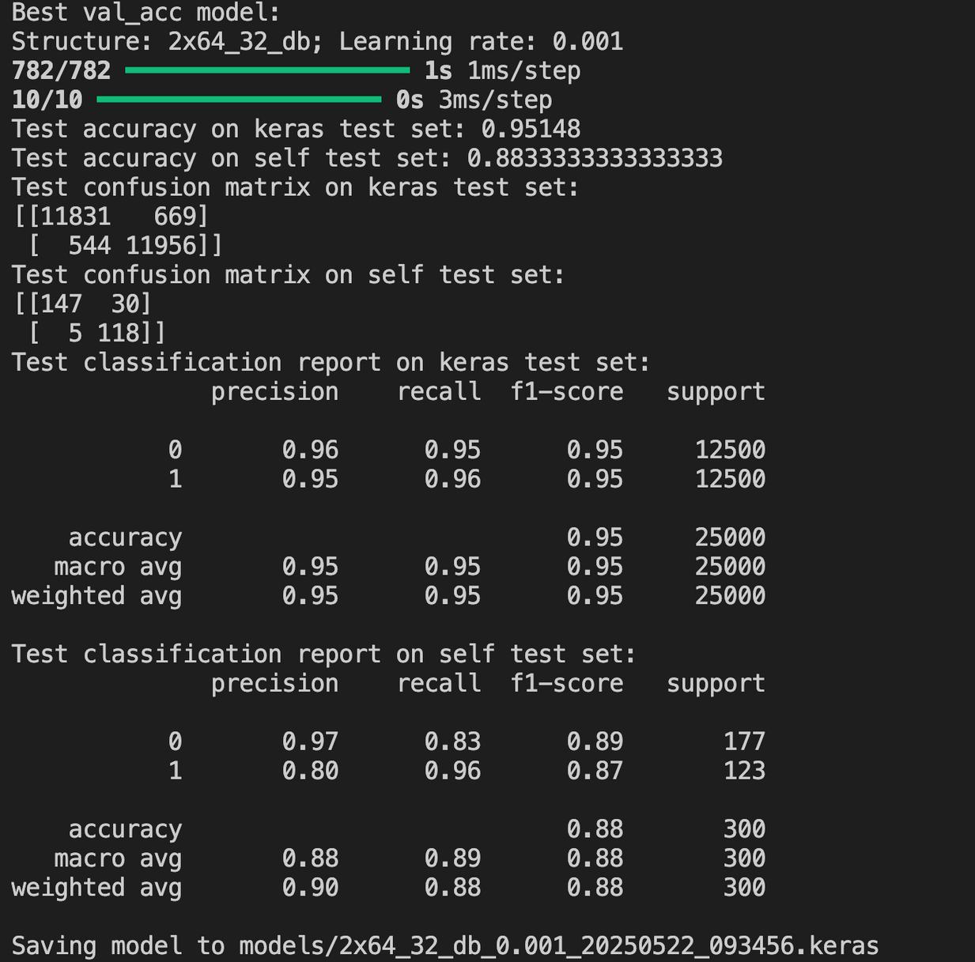
#Functionality-2
Group by Sentiment
Performance of neural networks with best validation accuracy on both Keras and own test set.
6
18

Slide 19
#Functionality-3
Review Summary
19

Slide 20
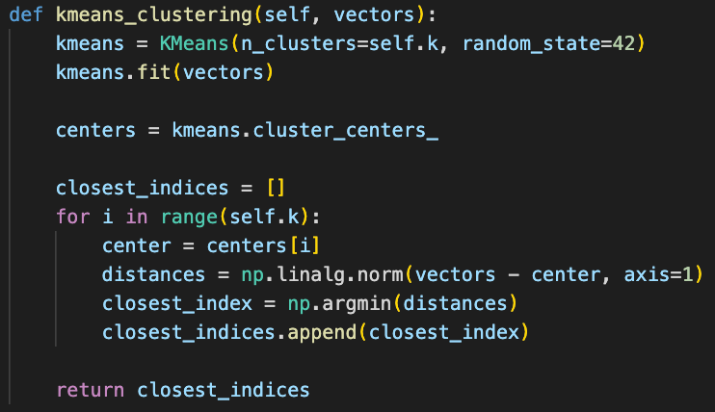
#Functionality-3
Review Summary
Use k-means clustering to split embedding into k-groups.
6
20

Slide 21
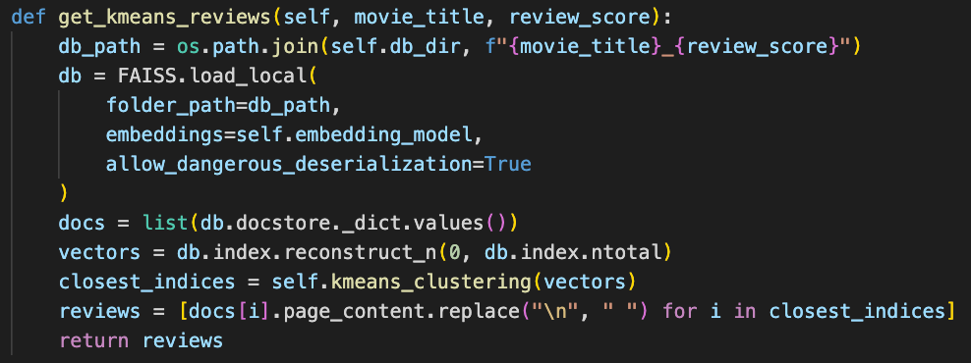
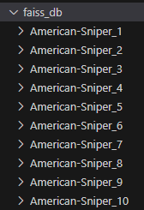
#Functionality-3
Review Summary
Retrieve reviews that are closest to the centroid of each cluster.
6
21

Slide 22
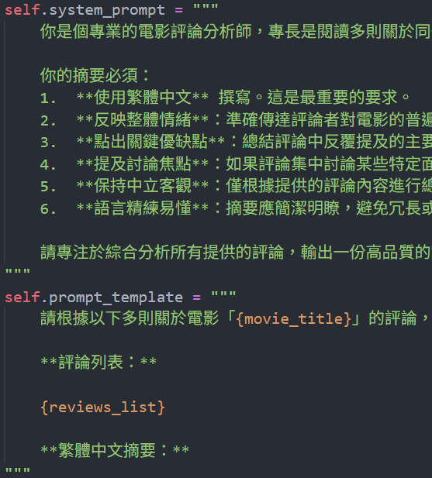
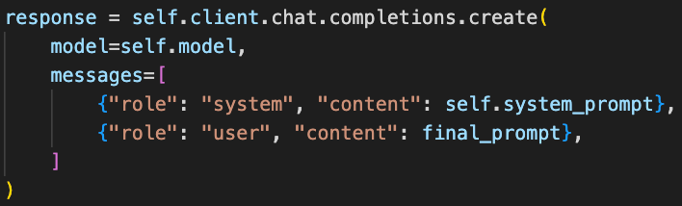
#Functionality-3
Review Summary
Summarizes multiple movie reviews into a concise, objective summary in Traditional Chinese.
Uses Gemini API for text generation
Custom prompt to ensure objectivity and clarity
Highlights sentiment and main discussion points
6
22

Slide 23
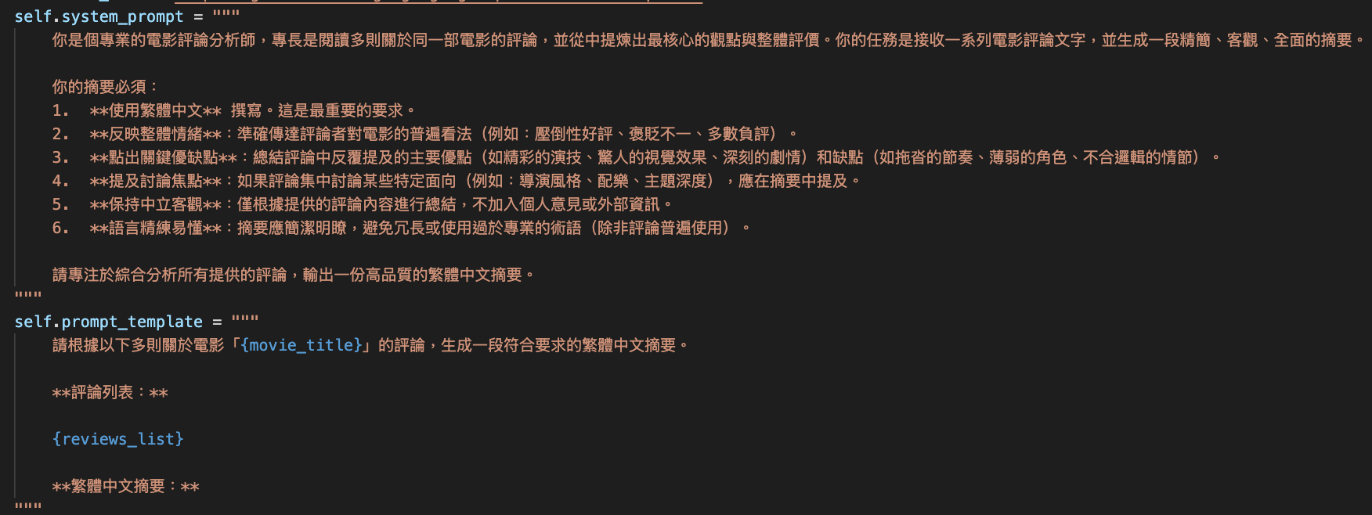
#Functionality-3
Review Summary
Summarizes movie reviews in Traditional Chinese.
Use Gemini API for text generation.
Custom prompt to ensure objectivity and clarity.
Highlights sentiment and main discussion points.
6
22

Slide 24
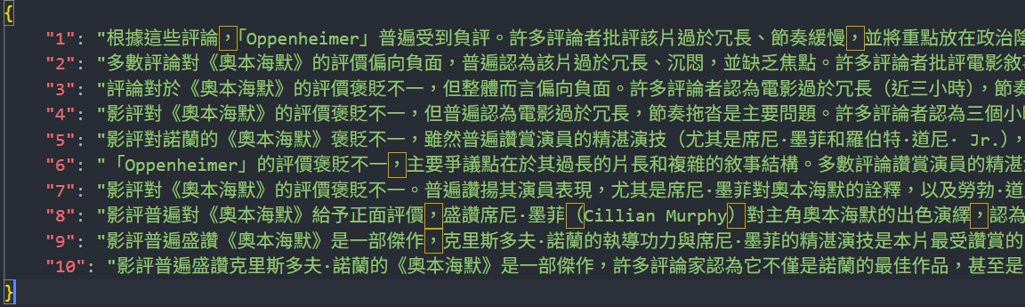
#Functionality-3
Review Summary
Summarization Result
Movie: Oppenheimer
Source: 4,306 Reviews
Number of Clusters: 5
6
23

Slide 25
Work Distribution
李宇捷 01057108 contribution 33 %
Implement Function #3, Finding Useful Tools, Presentation File, Helping Others
沈奎勳 01057115 contribution 33 %
Implement Function #2, Web Crawling, Presentation File, Helping Others
陳柏瑋 01057138 contribution 1 %
Living Well
洪旻昌 01057158 contribution 33 %
Implement Function #1, Finding Useful Tools, Presentation File, Helping Others
24

Slide 26
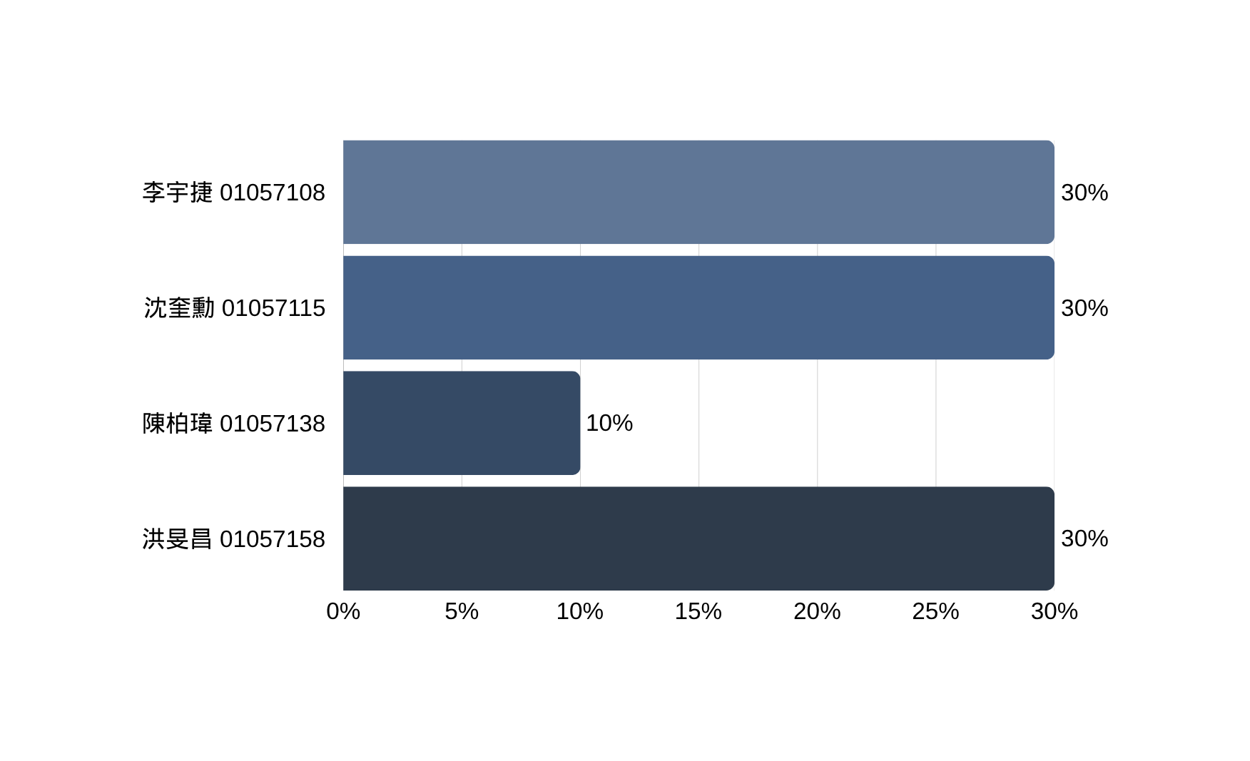
Work Contribution
Function #3, Data Processing, Presentation
Function #2, Web Crawling, Presentation
Provide Idea
Function #1, Data Processing, Presentation
24

Slide 27
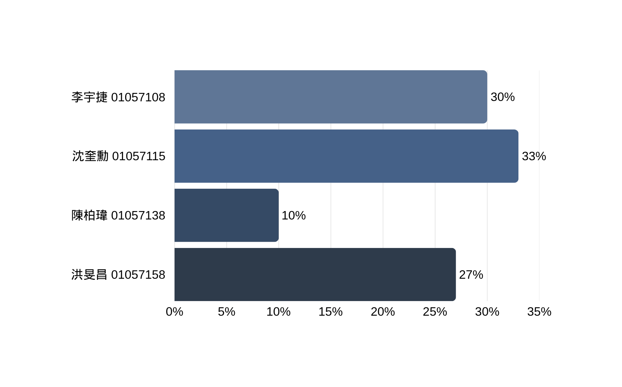
Work Contribution
Function #3, Data Processing, Presentation
Function #2, Web Crawling, Data Processing, Presentation
Provide Idea
Function #1, Data Processing, Presentation
24

Slide 28
Thank you
https://github.com/shenks0628/Information-Retrieval-IMDb-project
END

