Slide 1
How do we build TiDB
A Distributed, Consistent, Scalable, SQL Database

Slide 2
About me
LiuQi (刘奇)
JD / WandouLabs / PingCAP
Co-founder / CEO of PingCAP
Open-source hacker / Infrastructure software engineer
Codis / TiDB / TiKV
Twitter: @ngaut1
Weibo: @goroutine
Email: liuqi@pingcap.com

Slide 3
Topics discussed in the slides...
A brief history of database
Why do we need another database
Google Spanner / F1
TiDB and TiKV
Architecture overview
TiKV Overview
Database based on Raft
Scale-out / Replication / Failover
MVCC
Transaction model
Requests routing
Typical scenario:
MySQL Sharding
Cross-datacenter HA

Slide 4
RDBMS
NoSQL
NewSQL
1970s
2010
2015
Present
MySQL
PostgreSQL
Oracle
DB2
...
Redis
HBase
Cassandra
MongoDB
...
Google Spanner
Google F1
?

Slide 5
Why do we need another database
Applications nowadays...
Workload
The amount of data
Complexity
What do we expect from a database:
Scalability
SQL
ACID Transaction
High Availability / Auto-Failover

Slide 6
Google Spanner / F1
Globally-distributed
Paxos
SQL above NoSQL
ACID Transaction support
TrueTime API
Designed for Google AdWords, originally
became the successors of BigTable

Slide 7
TiDB and TiKV
Building NewSQL outside Google
Of course, it’s open-sourced.
https://github.com/pingcap/tikv
https://github.com/pingcap/tidb
「 You can no longer win with a closed-source platform. 」

Slide 8
Architecture overview (Software)
Applications
MySQL Clients (e.g. JDBC)
MySQL Protocol
F1
TiDB
RPC
Spanner
TiKV

Slide 9
Architecture overview (Logical)
Highly layered
Separate SQL and Key-Value layers
Using Raft for consistency and scaling
Without a distributed file system
MySQL Protocol Server
TiDB
SQL Layer
Transaction
TiKV
MVCC
Raft
Local KV Storage (RocksDB)

Slide 10
TiKV Overview
Client
RPC
RPC
RPC
RPC
TiKV Node1
TiKV Node2
TiKV Node3
TiKV Node4
Store1
Store2
Store3
Store4
Raft groups
Region 1
Region 1
Region 2
Region 1
Placement
Driver
Region 3
Region 2
Region 3
Region 2
Region 3
...
...
...
...

Slide 11
Database based on Raft
Data is organized in Regions
The replicas of one region is a Raft group
Multi-Raft
Workload is distributed among multiple regions
There could be millions of regions in one big cluster
Once a region is too large, it will be splitted into two smaller regions
Just like cell division

Slide 12
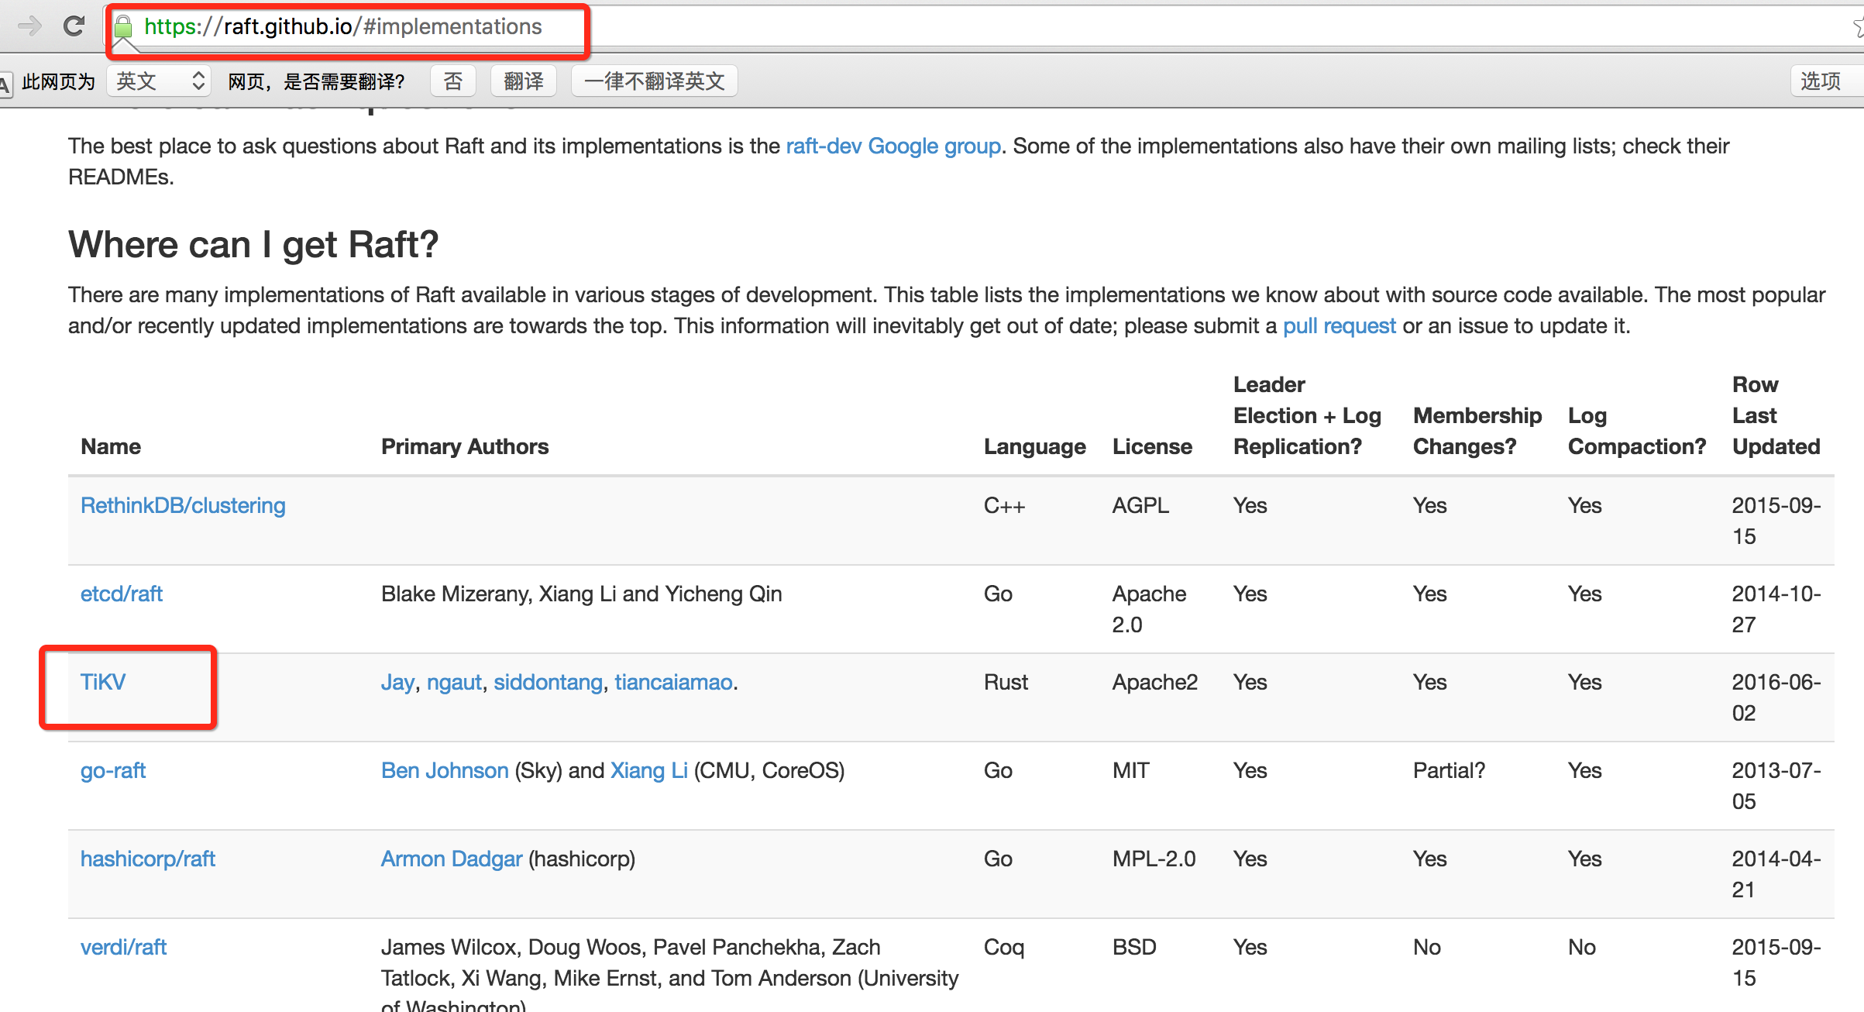
Implementations of Raft

Slide 13
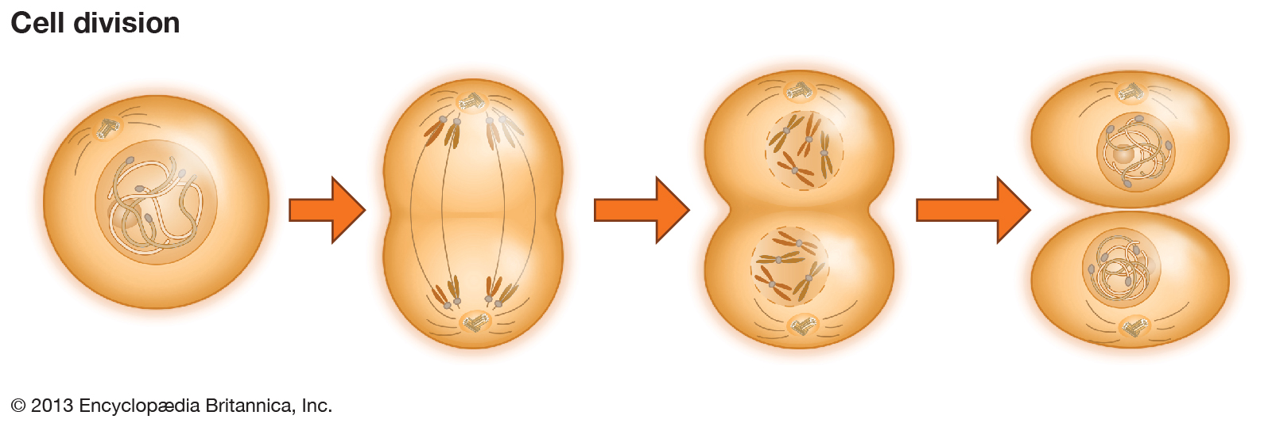

Slide 14
Scale-out
Region 1
Region 2
Region 1
Region 3
Region 3
Region 1
Region 2
Region 2
Region 3
Raft group for region 1
Raft group for region 2
Raft group for region 3

Slide 15
Scale-out
DEMO

Slide 16
Replication / Failover
3 Replicas, by default.
Raft consensus algorithm will ensure:
When the existing leader is down, the remaining servers will run an election to elect a new leader
The new leader always contains the newest committed logs
Replicas are distributed across datacenters

Slide 17
Replication / Failover
NEVER LOSE ANY DATA
The whole failover process is AUTOMATIC
Just remember:

Slide 18
MVCC
Multi-Version Concurrency Control
Lock-free snapshot read
Isolation of transaction
GC Problem

Slide 19
Keys
Values
meta key ->
keyA
Metadata of A
data key ->
keyA
version3
Value @ version3
keyA
version2
Value @ version2
keyA
version1
Value @ version1
keyB
Metadata of B
keyB
version2
Value @ version2
keyB
version1
Value @ version1
keyC
Metadata of C
keyC
version2
Value @ version2
keyC
version1
Value @ version1
...
...
in RocksDB

Slide 20
Transaction model
Based on Google Percolator
with some practical optimizations
2PL / 2PC

Slide 21
Requests routing
TiClient
Placement Driver

Slide 22
Typical scenario: MySQL Sharding
Trait:
High throughput
Huge amounts of concurrent small transactions
Always have a sharding key
No complex query
Pain:
Scaling and DDL
Lack of cross-shard transactions

Slide 23
Typical scenario: MySQL Sharding
What TiDB can do:
Online DDL
Elastic scalability and workload auto-balancing
Distributed ACID transaction support

Slide 24
Typical scenario: Cross-datacenter HA
Trait:
Data is extremely critical
Zero downtime, even when one of the datacenters is down
Multi-master architecture
Pain:
No database nowadays provides these features!
Master-slave model is slow and not so reliable
Manual recovery is error-prone

Slide 25
Typical scenario: Cross-datacenter HA
What TiDB can do:
Data is safely replicated by Raft across datacenters
The latency depends on the communication latency of the majority datacenters.
e.g. There are 3 replicas, 2 of them in Beijing, the other one in Hong Kong. When a write request is replicated by the 2 nodes in Beijing, it’s committed safely.
Even if less than N/2 nodes fail, the system is still alive.

Slide 26
How to contribute?
BETA
github.com/pingcap/tidb
github.com/pingcap/tikv
github.com/pingcap/pd

Slide 27
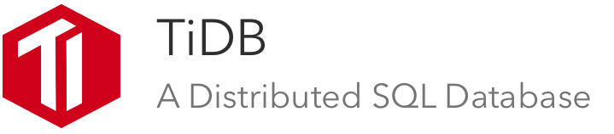

Thanks
https://github.com/pingcap/tidb

