Slide 1
Tersoff training script explanation
Shenli Zhang

Slide 2
General description
Use main.py to run optimization for two body terms, it involves the following scripts: annealing_test_2.py, AQalpha_least_square_2.py, Bbeta_least_square.py, bond_order_calculation.py, REBO.py and REBO2_whole.py
After obtain the optimized two body parameters, change the corresponding parameters in REBO.py
Use post_process.py and main_calculatebij.py to plot bond energy and force constant change with bond distance, and output the bond order bij values for the given two body parameters
Use scripts in bond_order_training folder to train the parameters in bij term.

Slide 3
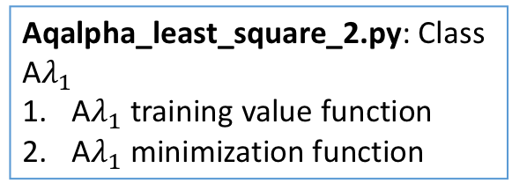
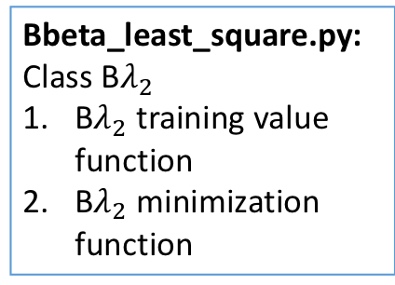

Script description and relations
Wrapped up as a whole class in REBO2_whole.py
Annealing_test_2.py: Class Annealing
Local minimization function
(Class B$λ_{2}$, Class bond order, Class A $λ_{1}$)
$A,λ_{1}$parameter adjust function
Error value calculation function F (energy and force constant weight can be changed in line 64)
Acceptance function
Output error function value after random selection (line 125), after B$λ_{2}$ minimization (line 79) and after acceptance (line 163)
Please change the output file directory
REBO.py: Class REBO
Parameters (initial values can be changed here)
Training sets
Energy, force and force constant functions
Parameter communication
Parameter communication
Note: scripts on this page usually don’t need to be changed, unless mentioned in the box.
Local minimization
Bbeta_least_square.py: Class B$λ_{2}$
B$λ_{2}$ training value function
B$λ_{2}$ minimization function
Bond_order_calculation.py: Class bond order
1. Calculate bond order bij
Aqalpha_least_square_2.py: Class A$λ_{1}$
A$λ_{1}$ training value function
A$λ_{1}$ minimization function

Slide 4
Script description
Main.py is the running script for optimization of two-body terms, it describes the following optimization flow:

Slide 5
Script description and running command
In main.py, it defines the Ge-Cl training parameters used (bond length r1, bond energy E1 and force constant k1)
User should define random change percentage in line 34, currently it’s 0.05 (5%)
User also defines annealing parameters from line 63-65, their definition can be found in slide 3.
To run the script, simply type
python main.py
The error function value will be shown in the command window and the final value is the lowest value during this run. The corresponding trained parameters will also be shown.
Usually you should run the main script more than 10 times to find the most likely global minimum value.
Note: Tersoff and REBO have common two body parameters parts, so this set of scripts can be used for both training, only need to verify/modify the number of parameters defined in the script

Slide 6
results analysis script
main_calculatebij.py: calculate and output bond order value for the parameter set defined in REBO.py script, it also includes Ge-Cl training data. To run this, type
python main_calculatedbij.py
post_process.py: check and plot data using optimized parameters. It includes Ge-Cl training data, and also uses REBO parameters defined in REBO.py to plot bond length with molecules, bond energy with bond length and force constant with bond length. Some plotting functions are currently disabled and can be enabled by deleting ’’’ symbols.
To run this, type
python post_process.py
Please change the figure output directory either in line 93, line 111 or line 119, depending on the plotting function used.

Slide 7
Bond_order_trainings
All the following scripts are run by
python scriptname.py
Correction_terms.py: get H correction terms in modified Tersoff and do a cubic spline.
training.py: describe bij with c, d, h parameters as in original Tersoff equation and optimize these parameters.
training_polynomial.py: describe bij with 3th order polynomials and optimize these parameters.
Calculatebij_withP.py: calculate bond order with known bij parameters, bij is described by 6th order polynomials.
Transfer_tersoff_to_REBO.py: transfer bij parameters in Tersoff equation to the bij parameters in REBO form.

