Slide 1
2 Dimensional Arrays

Slide 2
A 2D array is really just a 1 dimensional array of arrays
int matrix[][];
Here is what gets created in memory
matrix: [null] // ref var allocated with a null in it
The reference variable indicates it’s a ref var for a 2D array by having a double set of brackets [][] in its declaration.
Note that the above declaration of a ref var does not create any array yet.
matrix = new int[5][3];
Now we have actually created a 5 row by 3 col array of int.
The address of where that array lives gets assigned into the ref var.

Slide 3
Here is what memory looks like now:
0 1 2
matrix: [ ] 0[ ] [0][0][0]
1[ ] [0][0][0]
2[ ] [0][0][0]
3[ ] [0][0][0]
4[ ] [0][0][0]
We usually visualize the array as just the grid part but in fact a 2D array is an array of arrays. Each row of the array is itself a 1D array. You could also say a 2D array is an array of references to 1D arrays

Slide 4
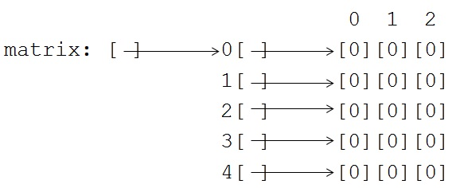
2D Arrays
The expression matrix refers to this part of memory
fffff

Slide 5
2D Arrays
matrix.length is 5
matrix[0] is the ref to the first array.
matrix[0].length is 3
To find out how many rows in the entire matrix use matrix.length
To find the length of a specific row use matrix[row].length

Slide 6
2D Arrays
To access individual elements of the matrix use this syntax:
matrix[3][2] = 7
[0][0][0]
[0][0][0]
puts a 7 [0][0][0]
[0][0][7]
[0][0][0]

Slide 7
2D Arrays
Rather than plinking individual values into a matrix with hardcoded indices in solitary assignment statements, arrays and matrices are generally initialized using loops.
Use matrix.length to produce the number of rows. Use matrix[row].length to produce the number of columns in that row.

Slide 8
2D Arrays
int[][] matrix = new int[5][3];
for (int row=0 ; row < matrix.length ; row++ )
for (int col = 0 ; col < matrix[row].length ; col++)
matrix[row][col] = row+col;
matrix [] [] [0][1][2]
[] [1][2][3]
[] [2][3][4]
[] [3][4][5]
[] [4][5][6]

