Slide 1
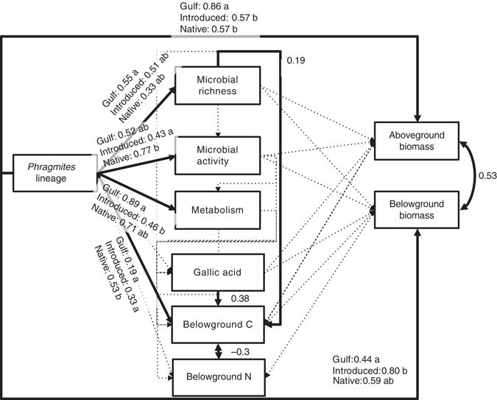
Bowen, J. L., Kearns, P. J., Byrnes, J. E. K., Wigginton, S., Allen, W. J., Greenwood, M., et al. (2017). Lineage overwhelms environmental conditions in determining rhizosphere bacterial community structure in a cosmopolitan invasive plant. Nat Commun 8, 1–8. doi:10.1038/s41467-017-00626-0.
使用该篇文章的数据拟合他们完整路径图的简化版本，只关注地上生物量。从而达到学习结构方程模型的拟合和结果解读的目的。

Slide 2
目的：不同的盐沼植物芦苇的微生物群落是如何驱动生态系统功能，并最终促进地上生物量的产生的？
微生物活性
RNA.DNA
芦苇来源
微生物丰度
地上生物量
status
observed_otus
abovebiomass_g
地下C:N比
belowCN
lme(observed_otus ~ status, random = ~1|Genotype, data = bowen, method = "ML")
lme(RNA.DNA ~ status + observed_otus, random = ~1|Genotype, data = bowen, method = "ML")
lme(belowCN ~ observed_otus + status, random = ~1|Genotype, data = bowen, method = "ML")
lme(abovebiomass_g ~ RNA.DNA + observed_otus + belowCN + status, random = ~1|Genotype, data = bowen, method = "ML")

