Slide 1
Web_project Presentation
Trains project

Slide 2
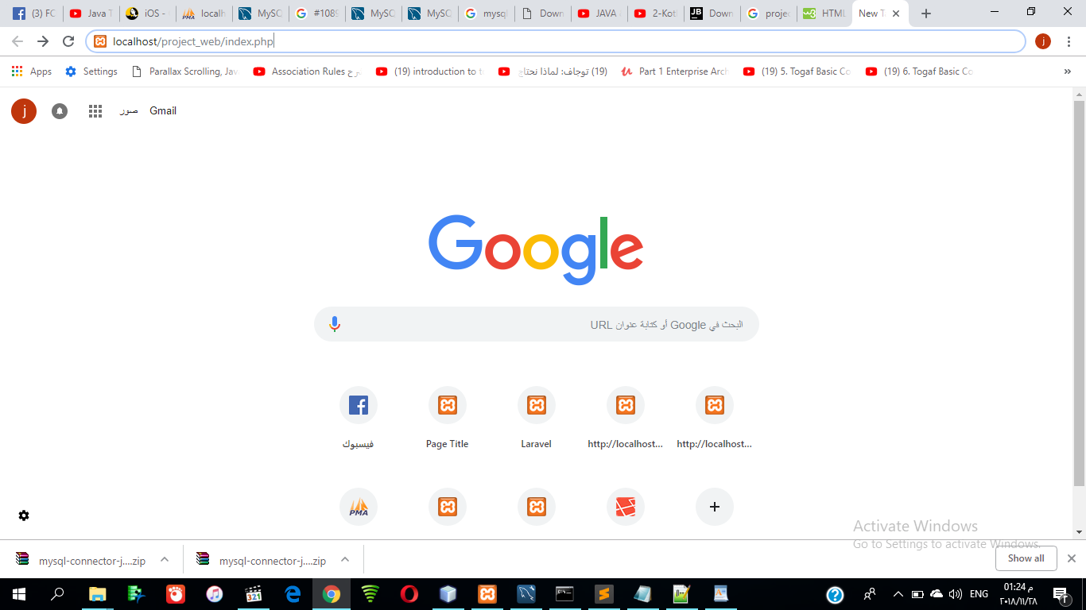
App Test Step1:page of index.php

Slide 3
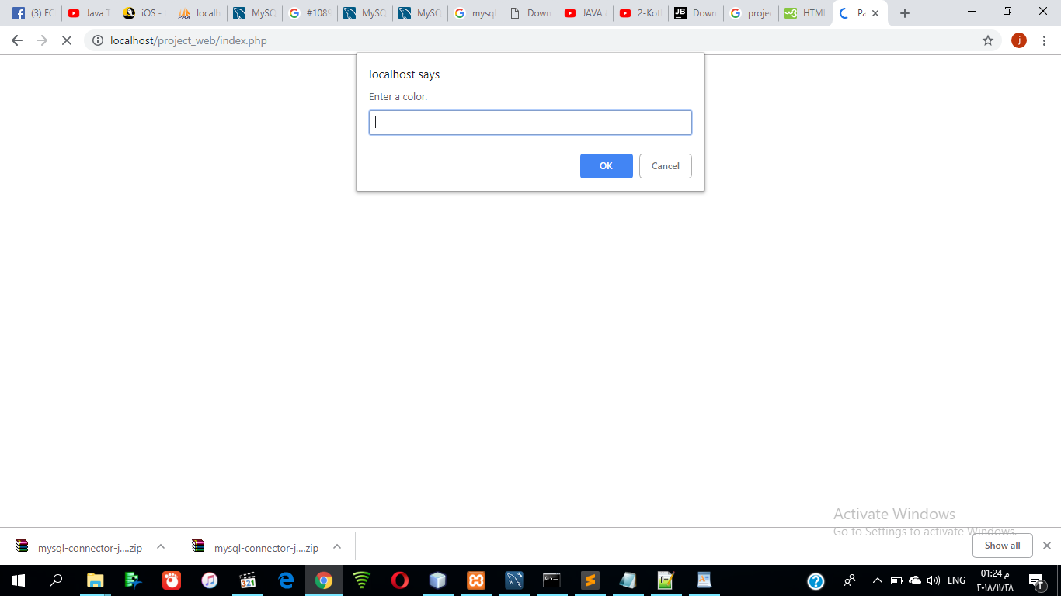
Step2:After open of the page of index.php java script:Ask from user to Enter acolor

Slide 4

Ex we write acolor black color instead of default

Slide 5
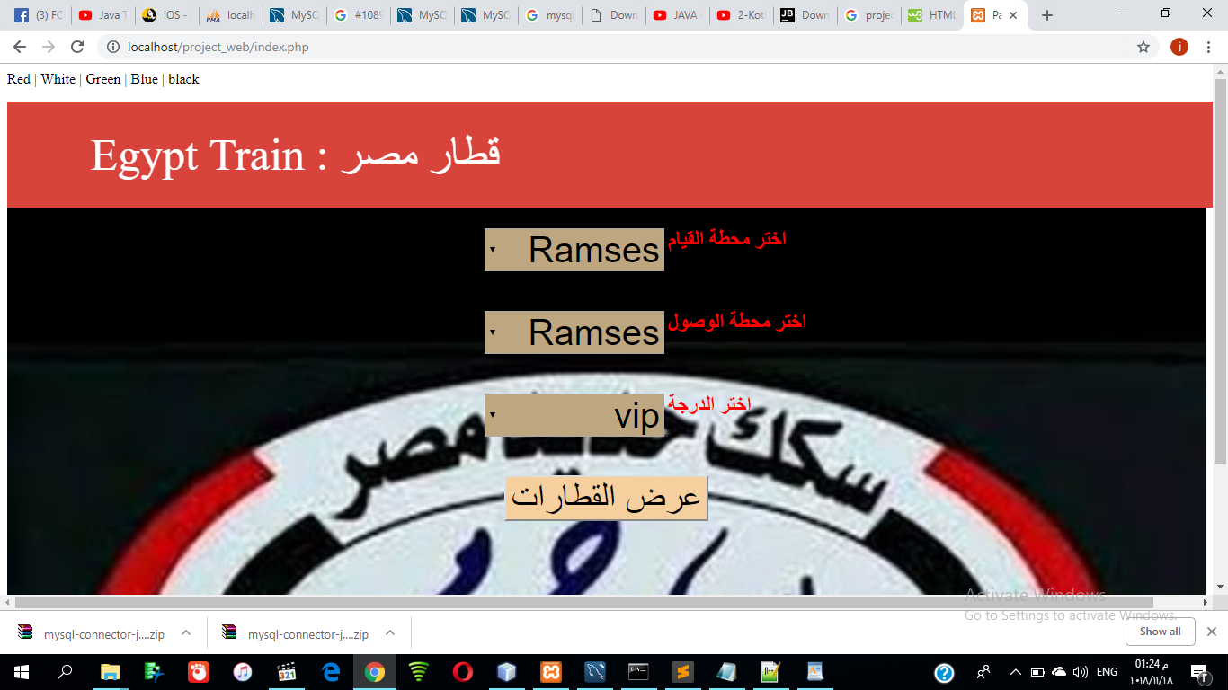
The app interface after Enter aclor is black

Slide 6
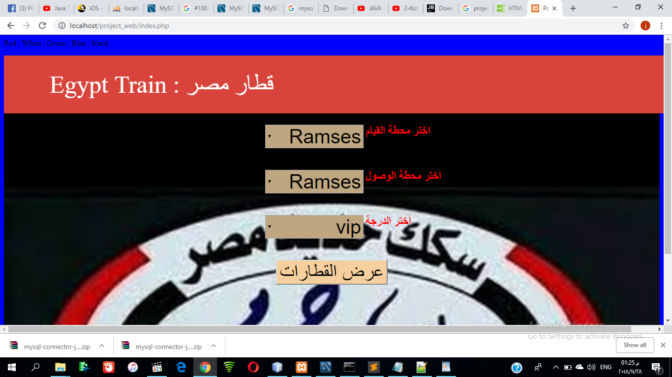
When click on ablue the background is changed into blue

Slide 7
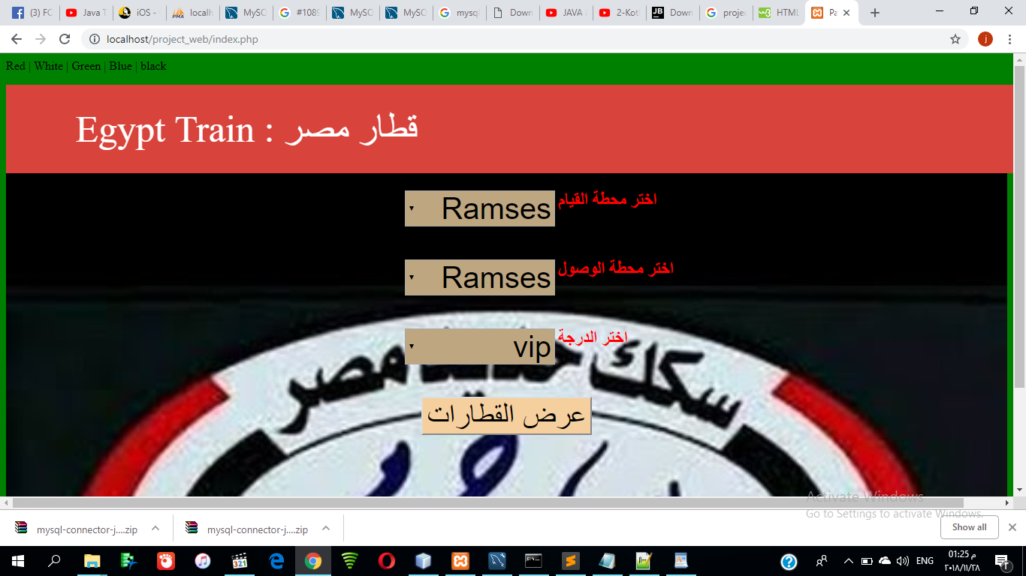
Also When click on acolor is green

Slide 8

There are two menus of names of stations and another menu of degree and button to )submitعرض القطارات)

Slide 9
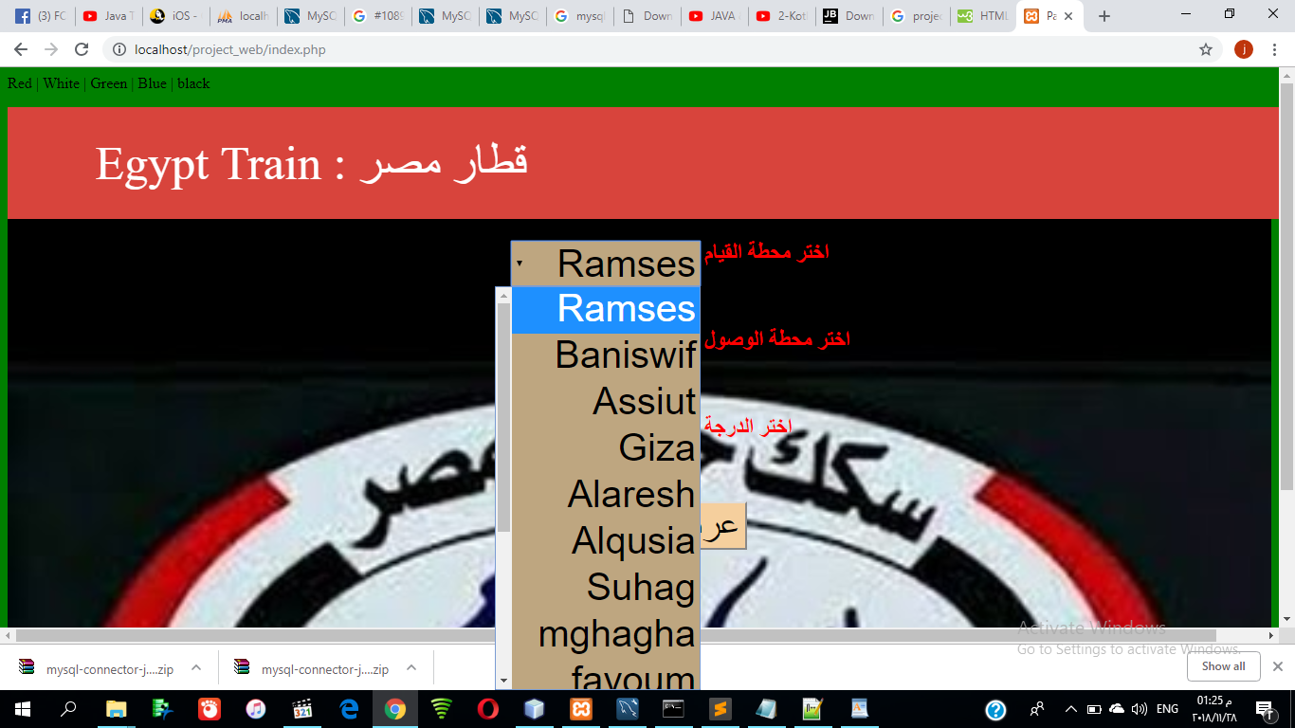
User can select the station as station that start

Slide 10
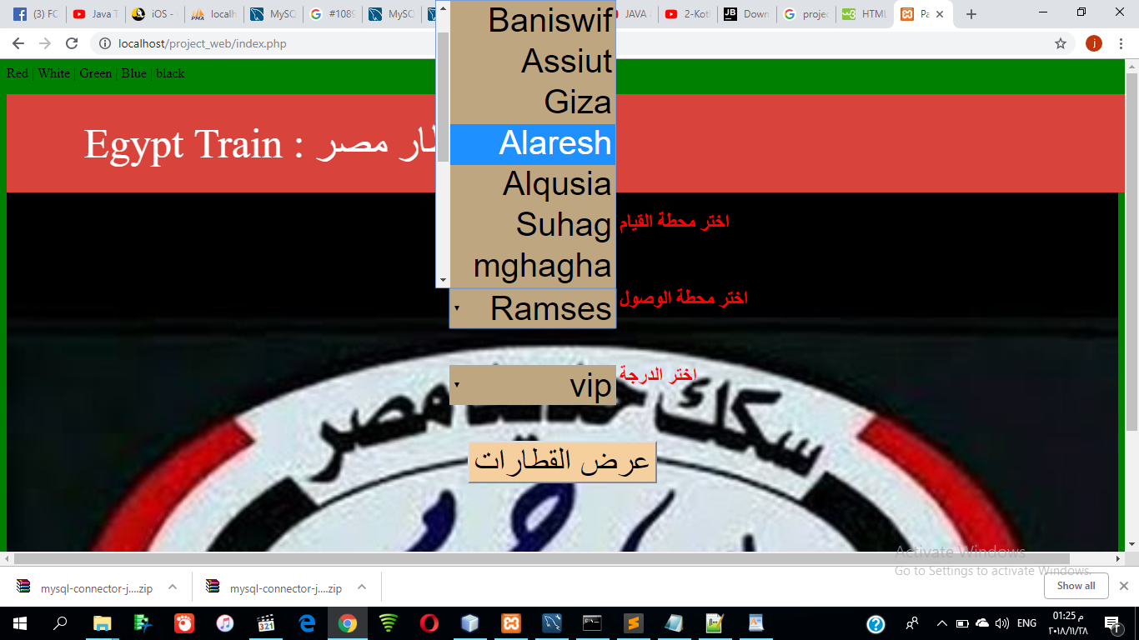
Suppose that user select Assiut

Slide 11
Select the destination station suppose that is Alaresh

Slide 12
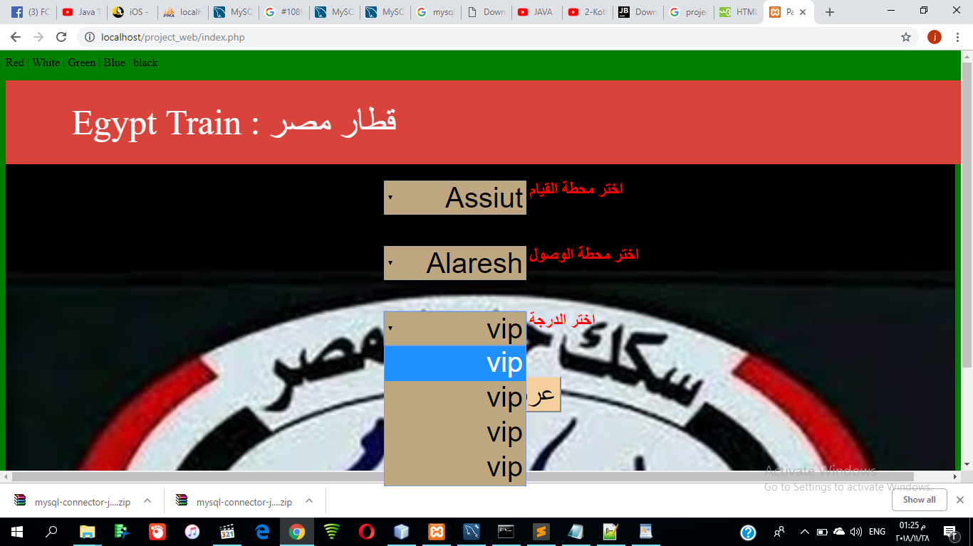
Then select the degree of Train, suppose that we select the degree is the Vip

Slide 13

The click on (عرض القطارات)

Slide 14
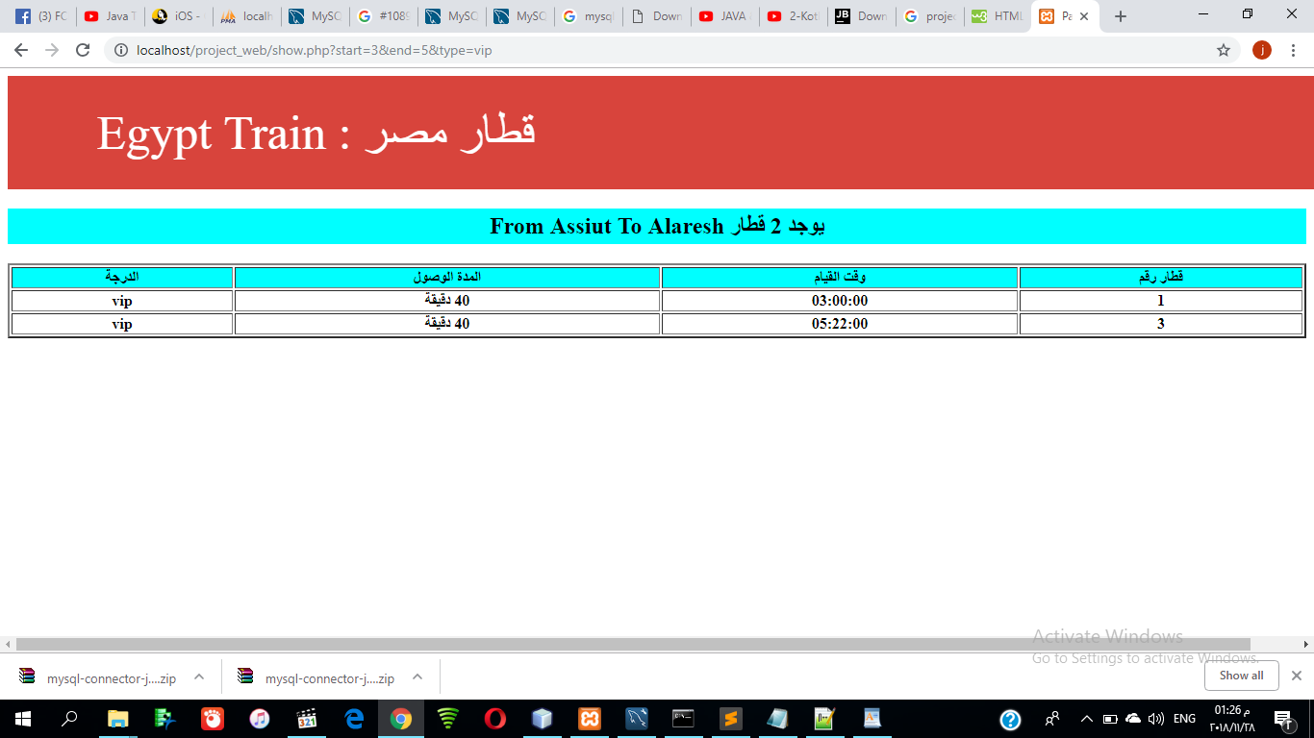
The result is

Slide 15
Describtion of the project doing
The app show the number of available Train
And the numbers of trains and the strart time of The Train and the time that the train will take to arrive to the destination and the degree of the available Trains

Slide 16
The End
Thanks
Name:Shenouda karam shehata gerges
Section number :3
Department: Is

