Slide 1
Guest Lecture
File Systems on Unix/Linux

Slide 2
Topics
Linux File System Architecture
Types of File Systems
File Systems Overview
  Solid, stable: ext2, ext3
  Small is beautiful: ReiserFS
  The network is the storage: NFS
  COW to the rescue: WAFL
  The new kid on the block: BtrFS
  More power to the user: FUSE

Slide 3
Linux Virtual File System
Multiple file systems need to coexist
But file systems share a core of common concepts and high-level operations
Create a filesystem abstraction
Applications interact with this VFS
Kernel translates abstract-to-actual

Slide 4
Linux VFS Architecture
Task 1
Task 2
…
Task n
user space
kernel space
VIRTUAL FILE SYSTEM
btrfs
ext3
xfs
proc
Buffer Cache
device driver
for hard disk
device driver
for floppy disk
Linux Kernel
software
hardware
Hard Disk
Floppy Disk

Slide 5
Unix File System Concepts
Files are represented by inodes
Directories are files, too (with dentries)
Devices accessed by I/O on ‘special’ files
UNIX filesystems can implement ‘links’

Slide 6
Directories
These are structured in a tree hierarchy
Each can contain both files and directories
A directory is just a particular type of file
Special user-functions for directory access
Each dentry contains filename + inode-no
Kernel searches the directory tree, and translates a pathname to an inode-number

Slide 7
File System Design Issues
How are disks divided up into file systems?
How does the file system allocate blocks to files?
How does the file system manage free space?
How are directories handled?
How can the file system improve…
  Performance?
  Reliability?

Slide 8
Carve up the disk
Entire disk
Partition table
Master
boot record
Partition 1
Partition 2
Partition 3
Partition 4
Boot
block
Super
block
Free space
management
Index
nodes
Files & directories

Slide 9
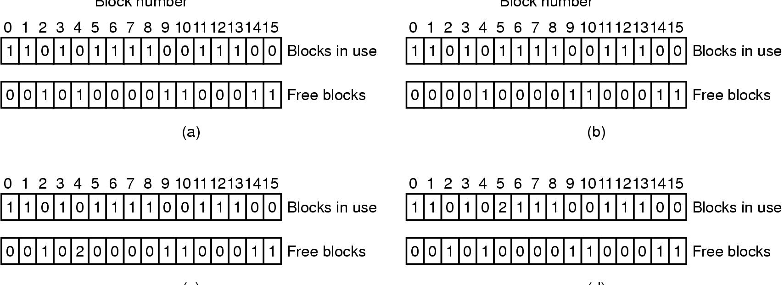
Check file system for consistency
Consistent
Missing (“lost”) block
Duplicate block in free list
Duplicate block in two files

Slide 10
Journaling and JFS
Atomically updated
Old and new versions of data held on disk until the update commits
Undo logging:
  Copy old data to the log
  Write new data to disk
  If you crash during update, copy old data from log
Redo logging:
  Write new data to the log
  Old data remains on disk
  If you crash, copy new data from the log

Slide 11
Why JFS?
Speed recovery time after a crash
  fsck on a large disk can be very slow
  ‘to eliminate enormously long filesystem recovery times after a crash’
With JFS you just reread the journal after a crash, from the last checkpoint

Slide 12
Journal
Contains three types of data blocks
  Metadata: entire contents of a single block of filesystem metadata as updated by the transaction
  Descriptor: describe other journal metadata blocks (where they really live on disk)
  Header: contain head and tail of the journal, sequence number, the journal is a circular structure

Slide 13
Log Structured File System
A log structured file system ONLY contains a log, everything is written to the end of this log
LSFS dictates how the data is stored on disk
JFS does not dictate how the data is stored on disk

Slide 14
Snapshots
Used for data recovery
Recovery Point Objective with Recovery Time Objective
File system or device mapper levels

Slide 15
Types of File Systems
Disk File Systems
  Most common, assumes disk access is random-access and slower than memory access
Special device file systems
  Tape file systems, CDFS, Flash memory file systems
Pseudo file systems
  Procfs, sysfs
Networked/Clustered file systems
  NFS, GFS, OCFS2

Slide 16
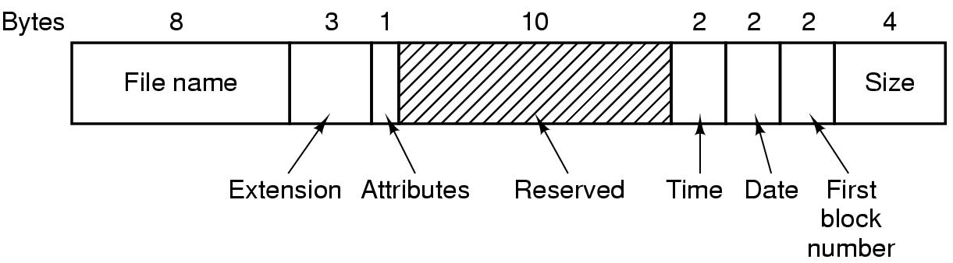
Simple file system: FAT

Slide 17
Solid and Stable
Ext2, Ext3

Slide 18
ext2/ext3 – macro structure
Boot
block
Block group 0
Block group 1
Block group n
Super
block
Group
descriptors
Data block
bitmap
Inode
bitmap
Inode
table
Data blocks
Disk broken into block groups
Each block group is a (mostly) self-contained unit
  Files can span block groups, but doesn’t happen often
  Most information is local to the block group
Bitmaps must fit into a single file system block, limiting the number of data blocks
Copies of the superblock and group descriptors are stored in every block group for reliability
1
x
1
1
m
n

Slide 19
Inode structure in ext2/ext3
Protection mode
data
Owner & group
data
Block count
.
.
.
Size
data
Timestamps
•
data
Link count
•
.
.
.
•
Direct pointers
.
.
.
data
•
•
•
data
•
.
.
.
•
•
single indirect
•
•
data
double indirect
•
•
data
•
•
•
•
.
.
.
triple indirect
•
•
•
inode
•
•
•
data

Slide 20
ext3 and JFS
Two separate layers
  /fs/ext3 – just the filesystem with transactions
  /fs/jdb – just the journaling stuff (JFS)
ext3 calls JFS as needed
  Start/stop transaction
  Ask for a journal recovery after unclean reboot
Actually do compound transactions
  Transactions with multiple updates

Slide 21
Ext2 vs ext3 vs ext4
Properties | ext2 | ext3 | ext4
Max file size | 16GB to 2TB | 16 GB to 2TB | 16GB to 16 TB
Max FS size | 2TB to 32 TB | 2 TB to 32 TB | 1 EB = 1K PB
Subdirs | 32000 | 32000 | 64000
Journaling | none | Journal, writeback, ordered | Journal + journal checksum
Other |  |  | Multiblock, delayed alloc
Other |  |  | Fast fsck
What is the default file system on Ubuntu?

Slide 22
Small is beautiful
ReiserFS

Slide 23
ReiserFS - Overview
Author
  Hans Reiser
Features
  Fast journaling
  Based on balanced trees
  More space efficient
Necessary evil
  Increased code complexity (ext2fs 6K LOC vs reiserFS 30K LOC)

Slide 24
ReiserFS and B-trees
The tree is in the disk blocks
In Reiserfs, keys are used in place of inode #’s
  Lookup(Key) = internal node location

Slide 25
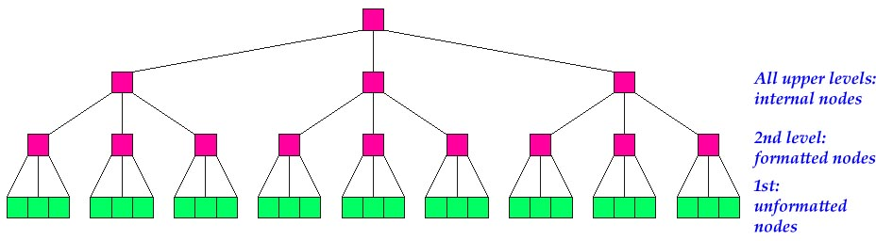
ReiserFS – using B-Trees

Slide 26
What are internal nodes?
Exist to determine which formatted node contains the item corresponding to a key
Used to drive the search through the tree

Slide 27
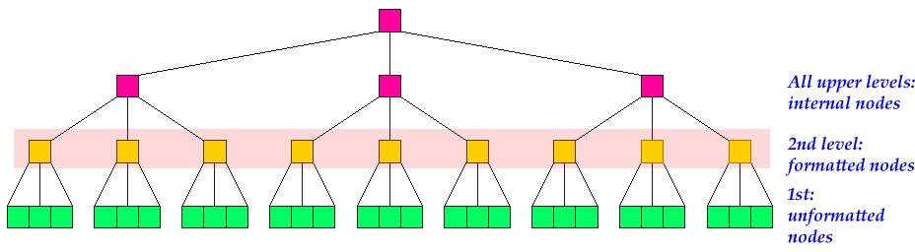
Formatted Nodes - Visual

Slide 28
What are formatted nodes?
Contains items, with every item having a unique key
Types of items:
  Direct – contain the tails of files
  Indirect – pointers to unformatted nodes
  Directory – contain the key of the first directory entry in the item, followed by a number of directory entries
  Stat data – optional analysis metric data

Slide 29
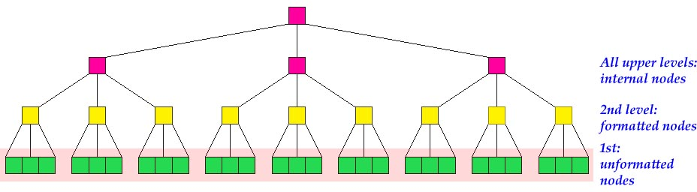
Unformatted Nodes

Slide 30
What are unformatted nodes?
Size = FS_block_size
Do not contain keys
Do contain the body of big files
  How big is “big”?
  Anything over X bytes, where X=block size – 112 bytes. For example, using blocks of size 4KB (4096 bytes), this is 3984 bytes

Slide 31
How are files handled?
We know that files do not exist in internal nodes, and unformatted nodes do not contain keys…
  So files must “exist” in the formatted nodes.
    “exist” indicates logical organization, as opposed to physical representation of bits
    Recall that formatted nodes contain items
    Tails are the last part of the file (last file_size % FS_block_size)

Slide 32
How are files handled? (cont.)
Example:
  Let’s say we have a 27K file, FS_block_size=4K
    Tail = 27648 % 4096 = 3072 bytes
    Non-tail = 24576 bytes = 24 KB
Formatted Nodes/indirect items contain pointers to unformatted nodes.
  6 indirect items (24 KB / 4 KB)
  1 direct item (Direct length = 4096 -112 = 3984). This is stored directly in the formatted node.
Why tail of files and not head of files?
  Allows for odd sized data to go into odd sized space left in the formatted nodes – leaves rest of the file contents aligned in disk and memory similarly
  Allows tail packing – packing tail of multiple files into 1 block

Slide 33
The Network is the Computer®
NFS

Slide 34
Network File System (NFS)
Interconnected hosts viewed as a set of independent machines with independent file systems which allows sharing among these file systems
  A remote directory is mounted over a local file system directory
  Potentially any file system (or directory within a file system), can be mounted remotely on top of any local directory

Slide 35
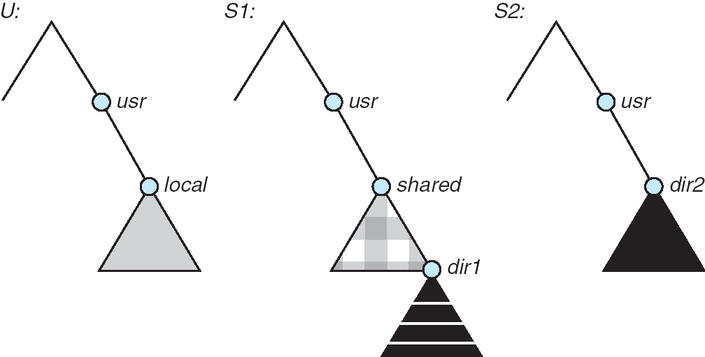
Network File System (NFS)

Slide 36
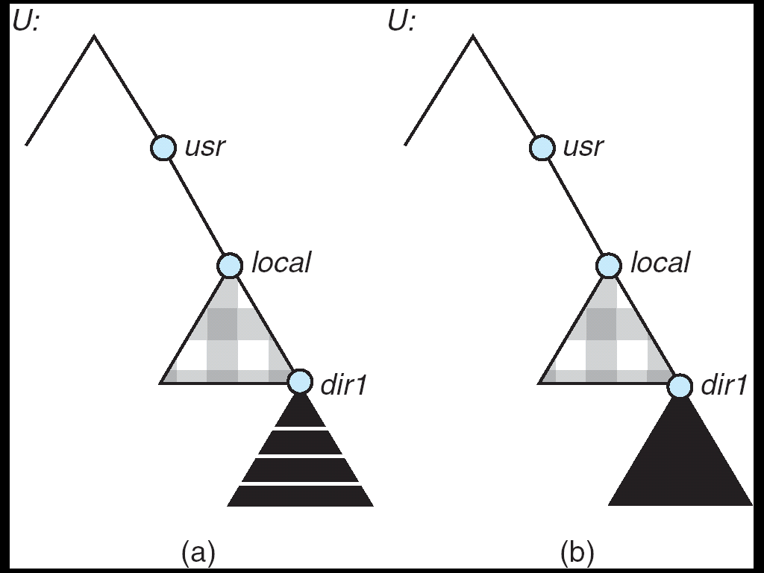
NFS Mounts

Slide 37
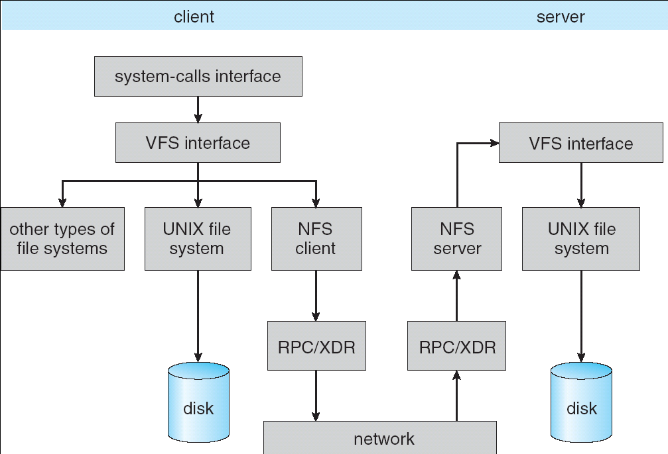
NFS Schematic Architecture

Slide 38
COW to the rescue
WAFL

Slide 39
WAFL
Write-Anywhere File Layout
NetApp – part of the ONTAP operating system
Main features
  Point-in-time snapshots
  Checkpointing
  Metadata ordering for quick recovery
  Deferred writes

Slide 40
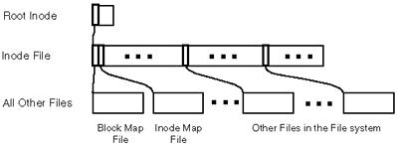
WAFL - overview
The whole on-disk file system layout is a tree of blocks.
Fixed location
Everything else: write anywhere.
User data
Allocation maps

Slide 41
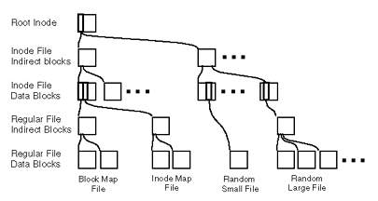
WAFL – Closer View

Slide 42
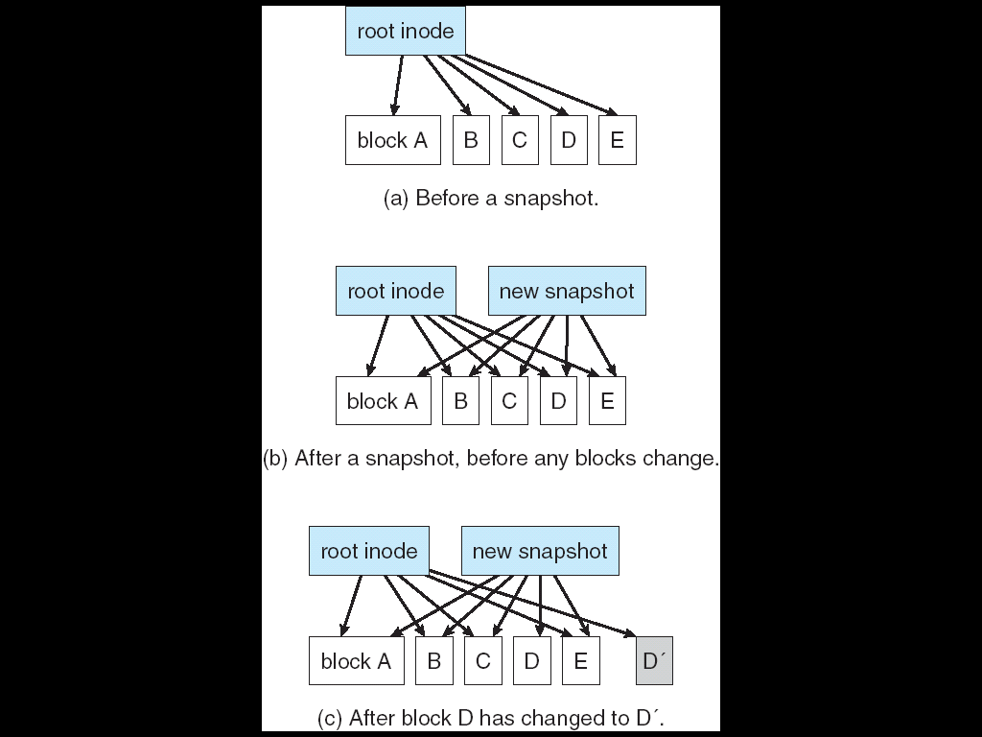
WAFL - Snapshots

Slide 43
The new kid on the block
btrFS

Slide 44
btrfs
“ButterFS”, “BetterFS”, “ButterFuss”
A brand new next gen file system
  Chris Mason. Oracle
Based on modified B-Trees
  No tied leaf nodes like normal file systems
Automatic Snapshots

Slide 45
Btrfs - Capabilities
Extent based file storage (2^64 max file size): 18 million TB
Space efficient packing of small files
Space efficient indexed directories
Dynamic inode allocation - no running out of inodes
Writable snapshots for backups, duplication
Efficient incremental backup and FS mirroring

Slide 46
Btrfs – capabilities – contd.
Subvolumes, FSCK on small chunks, in parallel
Fast Online filesystem check
Object level mirroring and striping
Checksums on data and metadata
Strong integration with device mapper for multiple device support

Slide 47
BtrFS Design
Everything in the file system - inodes, file data, directory entries, bitmaps, the works - is an item in a copy-on-write (COW) B+-tree
B+tree: variation of btree, an efficient n-ary search data structure, invented by Richard Bayer at Boeing in 1971 (B is for 'bushy' or Boeing or Bayer)
COW: a lazy way to keep track of rapidly changing data, by delaying reading/writing until the last minute

Slide 48
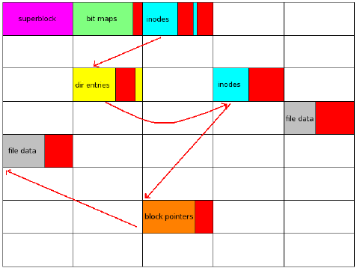
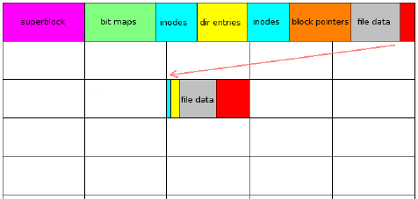
Btrfs vs other FS – disk layout
Traditional
BTRFS
Compare the number of seeks!!!

Slide 49
Power to the user (space)
FUSE

Slide 50
FUSE – User Space
For the future File System heroes
  You!
FUSE – File system in user space
Makes it easy to write new file systems
  Without understanding how the kernel works
  without breaking unrelated things
  more quickly/easily
Con: performance

Slide 51
FUSE Usage
# gcc fuse_example.c –o fuse_example -D_FILE_OFFSET_BITS=64
–lfuse
# ./fuse_example /mnt/mount_point

Slide 52
FUSE Architecture
User AP
User-level program
4
1
Kernel
FAT32
VFS
Ext2/3
5
3
2
FUSE
mount as /mnt/user_level_fs

Slide 53
Q&A
4
Thank You!

