Slide 1
An Algorithm for enumerating All Spanning Trees of a Directed Graph
- S. Kapoor and H. Ramesh
Speakers: 李孟韓¹, 林蔚茵², 莊秋芸³, 黃稚穎⁴

Slide 2
Reference
H. N. Gabow and E. W. Myers: Finding all spanning trees of directed and undirected graphs, SIAM J. Comput., Vol. 7, No. 3, 1978.
S. Kapoor, V. Kumar, and H. Ramesh: An algorithm for generating all spanning trees of directed graphs, Proceedings of the Workshop on Algorithms and Data Structures, LNCS, Vol. 955, Springer-Verlag, Berlin, pp. 428–439, 1995.
S. Kapoor and H. Ramesh: Algorithms for generating all spanning trees of undirected and weighted graphs, SIAM J. Comput., Vol. 24, No. 2, 1995.
W. Mayeda: Graph Theory, Wiley, New York, 1972.
S. Shinoda: Finding all possible directed trees of a directed graph, Electron Comm. Japan, Vol. 51-A, pp. 45–47, 1968.

Slide 3
Outline
Introduction and Algorithm outline
李孟韓
Main Algorithm
林蔚茵
Correctness
莊秋芸
Time analysis and conclusion
黃稚穎

Slide 4
Definition
An exchange for a spanning tree T of G rooted at v is a pair of edges (e, f) , where e ∈ T , f ∈ E – T , and T – {e}∪{f} is a spanning tree rooted at v.
A edge p∈ E - T is back edge if its tail is an ancestor of its head in T.
A edge p’∈ E - T is forward edge if its tail is a descendant of its head in T.
T
G
x = Tail(f)
V = head(f)
v
v
forward edge
back edge
u
f
u
cross edge
z
x

Slide 5
Property 1
Every nonback nontree edge, f , relative to a spanning tree T , may replace exactly one tree edge, e, in the spanning tree, namely, the edge having the same tail, to result in a new spanning tree rooted at the same vertex as T.
v
f
u
e
x
z

Slide 6
Property 2
A back edge cannot be exchanged for any edge in the spanning tree to get a new spanning tree.
v
e
u
x
g
z

Slide 7
Computation Tree
let CD(G,v) be the computation tree which generates all spanning trees of the directed graph G with root v.
SD_{a}
CD(G,v)
v
u
a
f
g
b₁
b₂
x
e
z

Slide 8
Computation Tree
SD_{b1} is obtained from SD_{a} by exchanging f with e, where f is a nontree nonback edge and e is the unique tree edge with the same tail as f .
SD_{b1}
CD(G,v)
v
u
a
pick f
f
g
b₁
b₂
x
e
z

Slide 9
Computation Tree
SD_{b2} is the same as SD_{a}. The significance of b₂ is that the subtree rooted at b₂ will not include f in any spanning tree.
SD_{b2}
CD(G,v)
v
u
a
delete f
b₁
b₂
g
x
e
z

Slide 10
Computation Tree
SD_{b1}
CD(G,v)
v
u
a
pick f
f
b₁
b₂
x
e
z

Slide 11
Computation Tree
SD_{b2}
CD(G,v)
v
u
a
delete f
b₁
b₂
g
x
e
z

Slide 12
Lemma
CD(G,v) has at its nodes all directed spanning trees of G rooted at vertex v.

Slide 13
An Algorithm for enumerating All Spanning Trees of a Directed Graph
--- S. Kapoor and H. Ramesh
Speaker: 林蔚茵²

Slide 14
Algorithm Description
DFS tree of G (rooted at r)
The root of the computation tree CD(G,r)
For each node a of the computation tree
NB: a set of those nontree edges which are nonback w.r.t. the directed spanning tree and which are not included in
Maintained as a list of nonempty lists
Each nonempty list containg edges incident upon a particular vertex
Arranged in postorder number
B: a set of those back edges w.r.t. which are not included in

Slide 15
Property 3
Let spanning tree T’ be obtained from spanning tree T by applying the exchange (e,f). If x is a nontree edge which is back w.r.t. T and nonback w.r.t. T’, then head(x) lies in the subtree of T rooted at tail(f), and tail(x) is a vertex which is a proper ancestor of tail(f) and a proper descendant of lca(head(f), tail(f)) in T
lca(head(f),tail(f))
a
tail(x)
u
e
f
v
tail(f)
x
head(x)

Slide 16
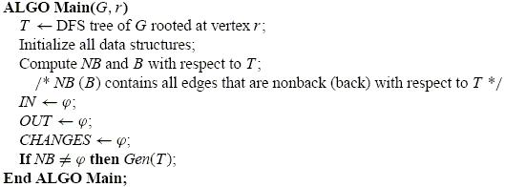
ALGO Main(G,r)
The first edge in the first list of NB is the one having tail node with the least postorder number.
CHANGES is used to store the differences from the last spanning tree generated

Slide 17
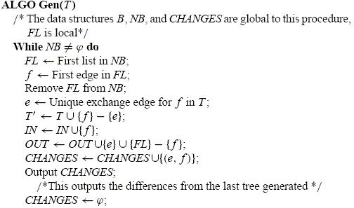
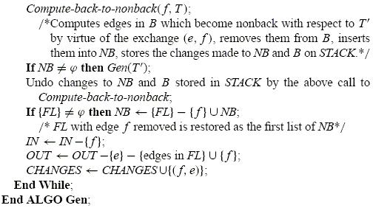
ALGO Gen(T)
b₁
b₂

Slide 18
ALGO Compute-back-to-nonback(f,T)
The sets NB and B are updated at every exchange
transferring edges from B to NB
Removal of edges from B and NB
Data structure for B
For each node v of G
B[v]: a list of nontree back edges in B having head vertex v
A[v][p]: each element points to the first edge in its list which is incident upon a proper ancestor of node p
BASE[v]: initialized to be v

Slide 19
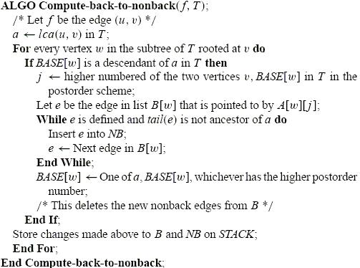
ALGO Compute-back-to-nonback(f,T) (cont’d)

Slide 20
An Algorithm for enumerating All Spanning Trees of a Directed Graph
--- S. Kapoor and H. Ramesh
Speaker: 莊秋芸³

Slide 21
PROPERTY 4
If f =(u, v) is an edge in NB and b=lca (u,v) in SD_{a},
then no edge in NB has its head in the subtree of SD_{a} rooted at v and its tail on the path from b to u
(b excluded).
b
lca(u,v)
u
f
v

Slide 22
PROPERTY 4 (some observations)
DFS
The order of the selection of the exchange edge from NB.
All “exchangeable edges” must connect a vertex with higher postorder number to a vertex with lower postorder number.
b
lca(u,v)
u
f
v

Slide 23
PROPERTY 4 (proof)
By induction on the level of x, where x is a node on the computation tree.
Base case: root node.
Induction hypothesis: assume this is true for any node x of the computation tree.
Consider the left and right sons b₁, b₂ of x. 1) It’s trivially true for the right son b₂.
5
3
4
1
2
A DFS tree with postorder number on each node.

Slide 24
PROPERTY 4 (proof)
2) For the left son b_{1.}
9
9
7
8
7
8
Exchange
e and f
5
5
e
f
1
5.3
f
1
4
6
4
6
5.1
2
5.2
2
3
3

Slide 25
PROPERTY 4 (conclusion)
Since no such edges exist, there’s no nonback edges will become back edges.
b
lca(u,v)
u
f
v

Slide 26
LEMMA 4.1
During the construction of the computation tree the following changes to NB and B suffice after an exchange at a node a in the computation tree:
changes from B to NB by Property 3.
deletions from NB according to IN and OUT definitions.
removal of RB_{a} from B.

Slide 27
PROPERTY 5
If an exchange (e, f), f=(u,v) is made at a node x of the computation tree, then the subtree of SD_{x} rooted at v is preserved as such in each of the trees generated at descendant nodes of x in the computation tree. So at node x, any edge in B incident upon a vertex in that subtree, is redundant for future computations at descendant nodes of x and may be removed from B.

Slide 28
PROPERTY 5
SD_{x}
computation tree
e
v
f
u
x
All have the same subtree rooted at v
A redundant back edge

Slide 29
An Algorithm for enumerating All Spanning Trees of a Directed Graph
--- S. Kapoor and H. Ramesh
Speaker: 黃稚穎⁴

Slide 30
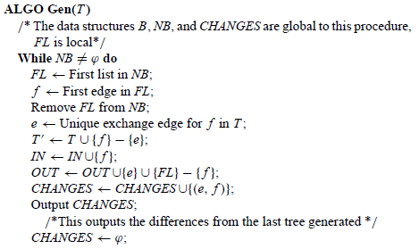
LEMMA 4.4
ALGO Main outputs the changes corresponding to the compressed computation tree CD'(G,r) in O(N(r)V+V²) operations.
The time for manipulating the data structures NB, B, and STACK is O(V*(NBC_{x}+1))
Computing B and NB initially require O(V²) time.
Total requires O(N(r)V+V²+V+E+N(r))
= O(N(r)V+V²) time.
The total time required by ALGO
Gen minus the output operations
equals O(Σ(V*NBC_{x}))
DFS requires O(V+E)time.
At any node x in the compressed
computation tree, the above summation gives an O(N(r)V)
time bound.
Total output operations are O(N(r)).

Slide 31
LEMMA 4.5
ALGO Main requires O(V²) space.
Follows from the size of the data structures involved.
B requires O(V²)-space.
NB requires O(V+E)-space.
Changes stored on STACK is O(V+NBC_{x})-space.
The total stack space required is O(V²+ΣNBC_{x})
= O(V²)

Slide 32
Complexity
From LEMMA 4.4 and LEMMA 4.5 the following result follows if the above procedure is repeated with each vertex in turn as root.
THEOREM 4.6. All rooted directed spanning trees can be output in O(NV+V³) operations and O(V²) space.

Slide 33
Thank U

