Slide 1
Recitation: Week 14
EE4033 Algorithms, Fall 2019
Instructor: Yao Wen Chang, James Chien Mo Li, and Iris Hui Ru Jiang
Presenter: Yi-Ting Lin, Yu-Sheng Lu

Slide 2
HW4
Deadline: 12/17(Tue.) 9:00 AM
Submit your solution 10 minutes before the class begins
Collaboration policy
Please specify all of your collaborators (name and student id) for each problem. If you solve some problems by yourself, please also specify “no collaborators”. Problems without collaborator specification will not be graded.

Slide 3
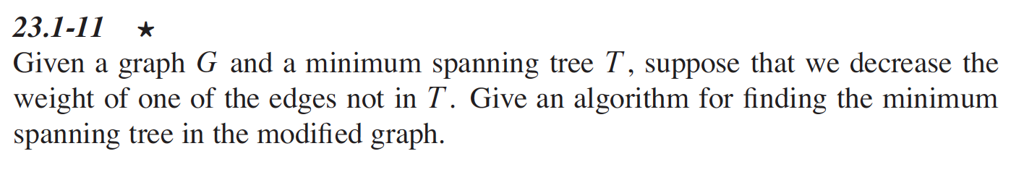
Problem 1 (Exercise 23.1-11)
Give an algorithm. Briefly justify the correctness.
Do not directly find the MST in the modified graph.

Slide 4
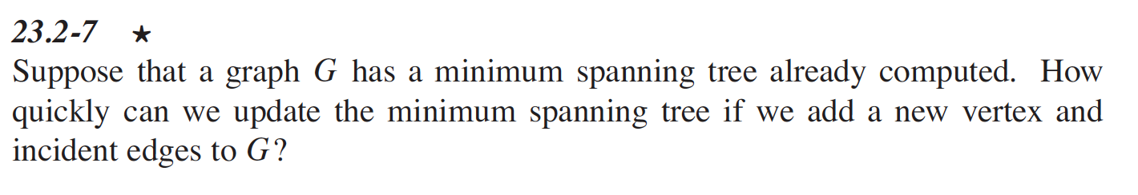
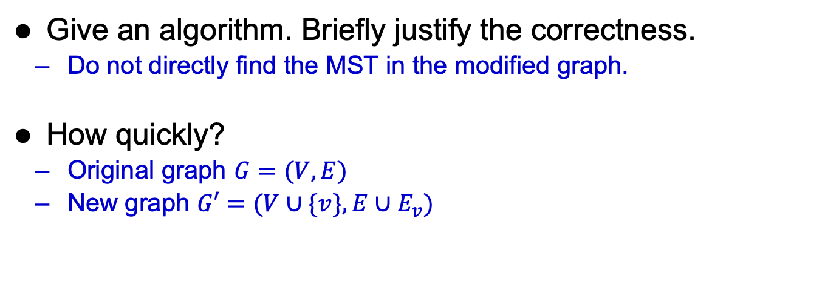
Problem 2 (Exercise 23.2-7)
Give an algorithm. Briefly justify the correctness.
Do not directly find the MST in the modified graph.
How quickly?
Original graph $G=(V,E)$
New graph $G′=(V∪\{v\},E∪E_{v})$

Slide 5
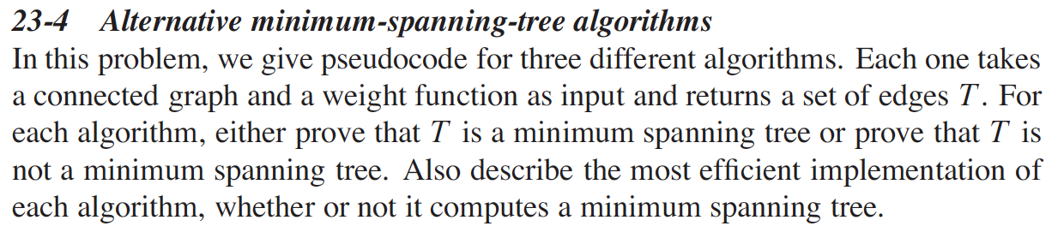
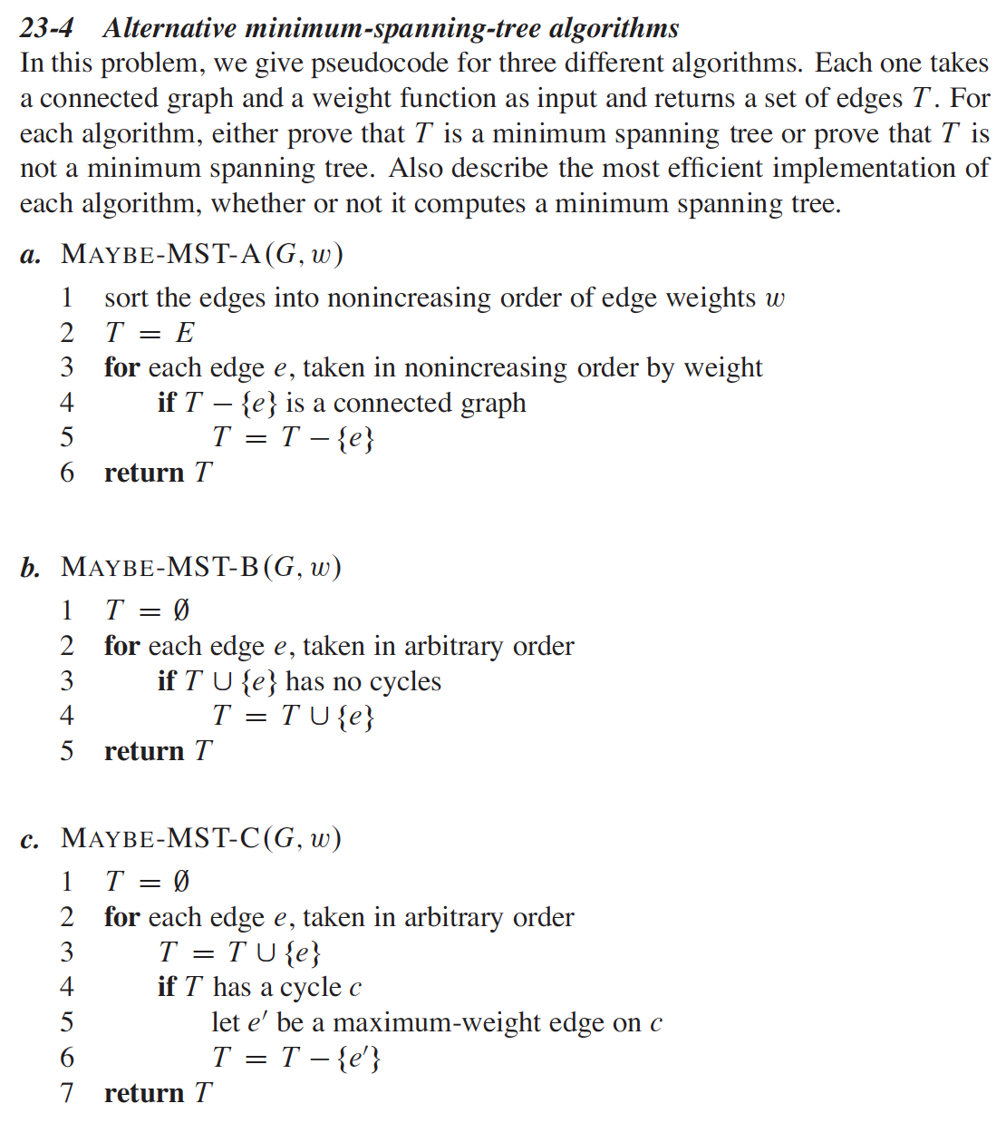
Problem 3 (Exercise 23.4)
For each algorithm,
Prove T is a MST or not
Describe the most efficient implementation

Slide 6
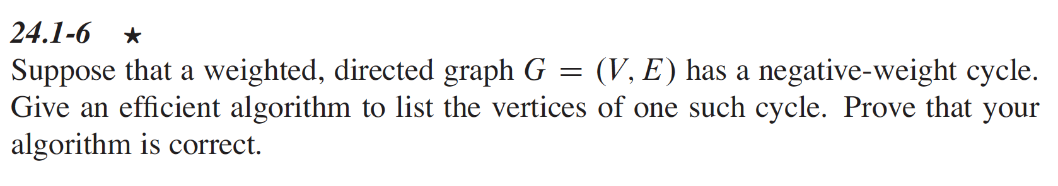
Problem 4 (Exercise 24.1-6)
Give an efficient algorithm.
Prove that your algorithm is correct.

Slide 7
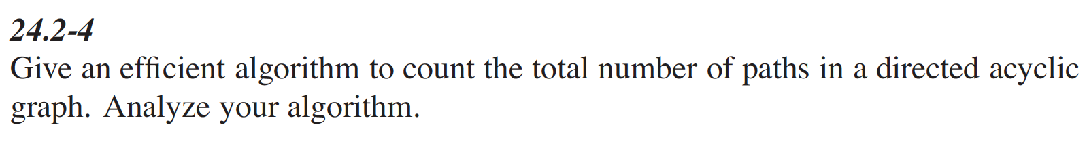
Problem 5 (Exercise 24.2-4)
Give an efficient algorithm. Briefly justify the correctness.
Analyze your algorithm.

Slide 8
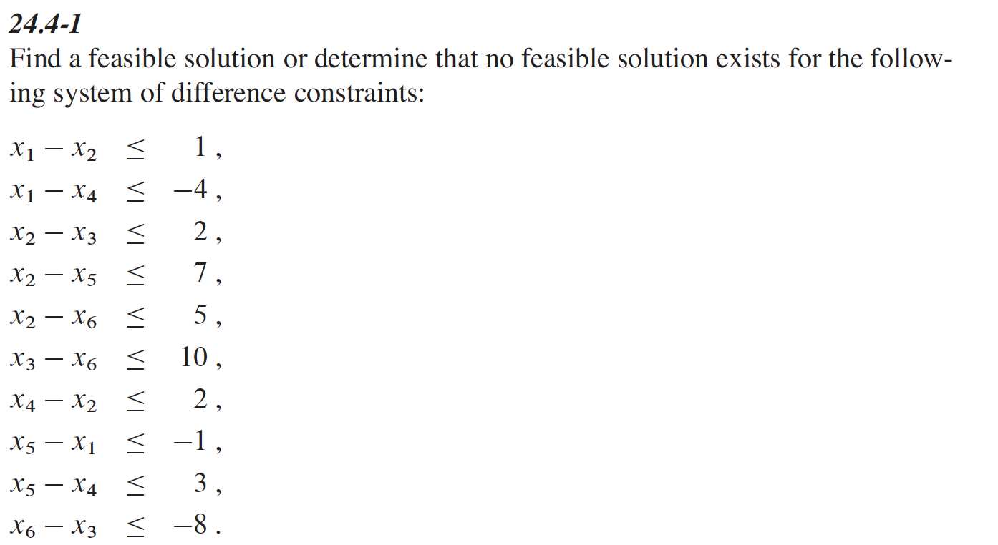
Problem 6 (Exercise 24.4-1)
Please show your steps.

Slide 9
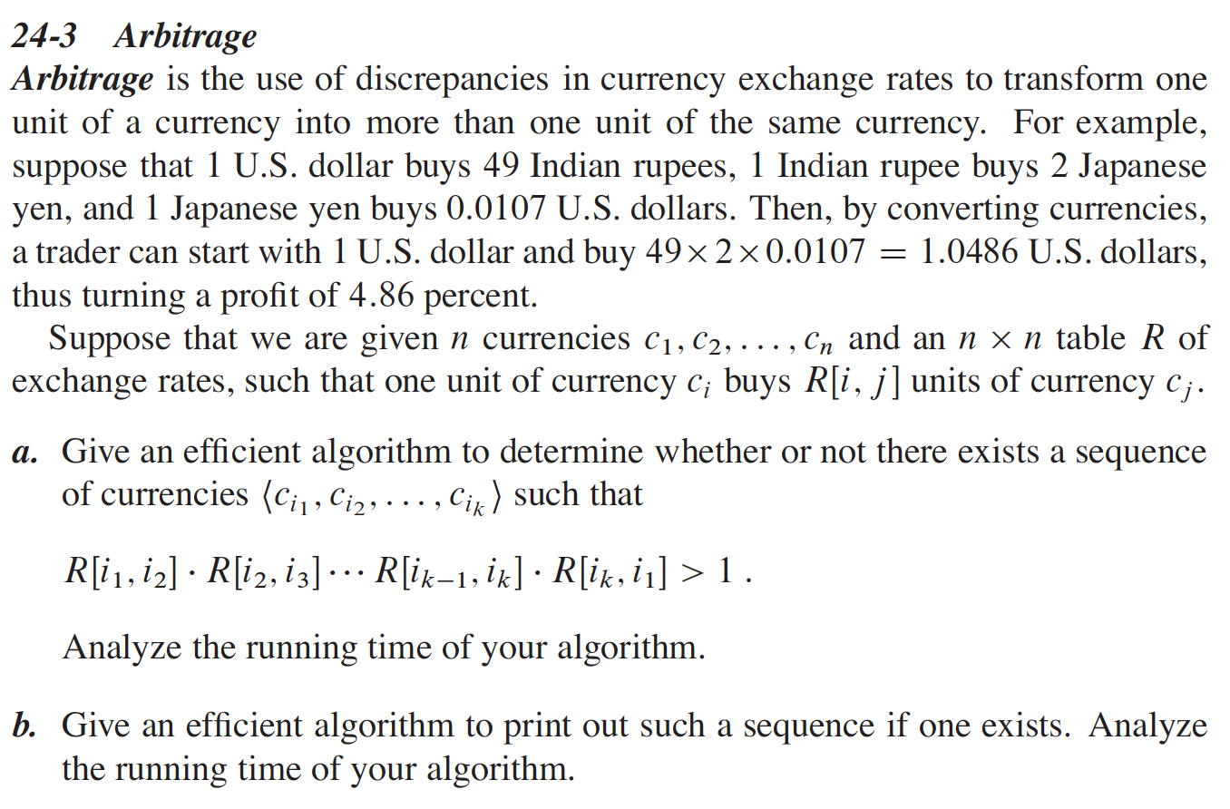
Problem 7 (Problem 24-3)

Slide 10
Problem 7 (Problem 24-3) conti.
Give an efficient algorithm. Briefly justify the correctness.
Analyze your algorithm.

Slide 11
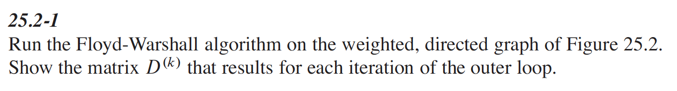
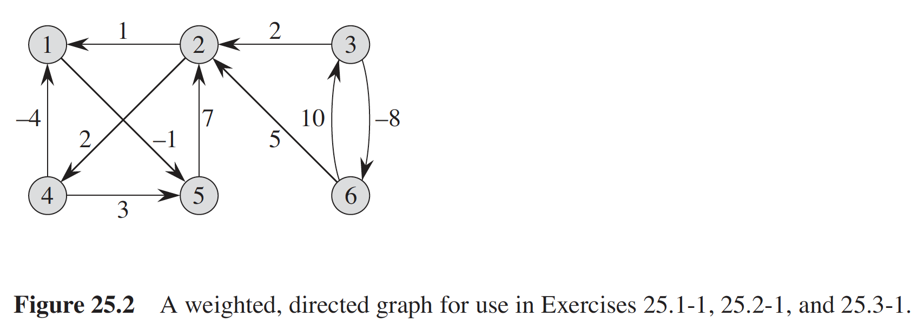
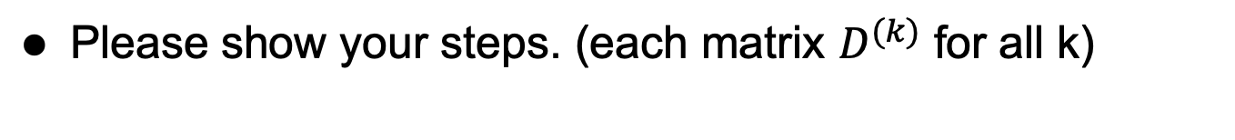
Problem 8 (Exercise 25.2-1)
Please show your steps. (each matrix $D^{(k)}$ for all k)

Slide 12
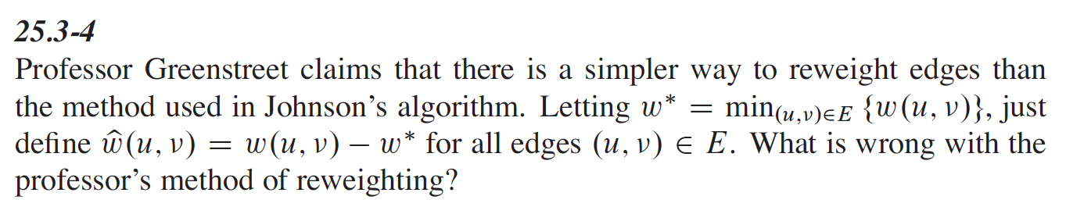
Problem 9 (Exercise 25.3-4)
What is wrong?
Demonstrate on a counterexample

