Slide 1
CS 4476 Project 1
Shaohua Shen
sshen76@gatech.edu
sshen76
903344685

Slide 2
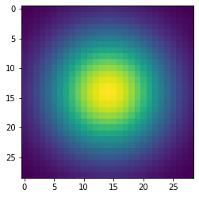
Part 1: Image filtering
First get the stats of the image and calculate the padding size. Then use np.pad() to pad the image. Finally use iteration to apply the filter to the image.

Slide 3
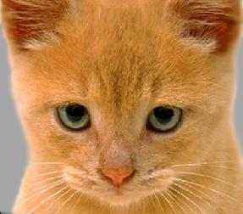
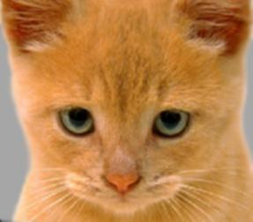
Part 1: Image filtering
Identity filter
<insert the results from proj1_test_filtering.ipynb using 1b_cat.bmp with the identity filter here>
Small blur with a box filter
<insert the results from proj1_test_filtering.ipynb using 1b_cat.bmp with the box filter here>

Slide 4
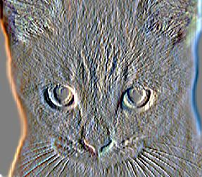
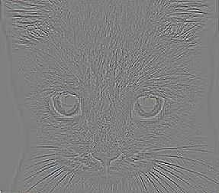
Part 1: Image filtering
Sobel filter
<insert the results from proj1_test_filtering.ipynb using 1b_cat.bmp with the Sobel filter here>
Discrete Laplacian filter
<insert the results from proj1_test_filtering.ipynb using 1b_cat.bmp with the discrete Laplacian filter here>

Slide 5
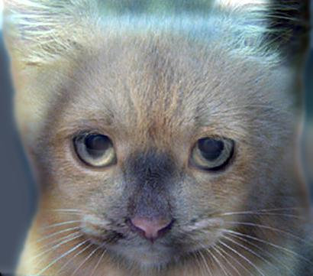
Part 1: Hybrid images
Get high frequency part by applying filter to image2 and then subtracting the filtered content from the original image.
Get low frequency part by applying filter to image1.
The hybrid image is made from adding the low frequency part to the high frequency part and clip the pixels.
Cat + Dog
<insert your hybrid image here>
Cutoff frequency: 7

Slide 6
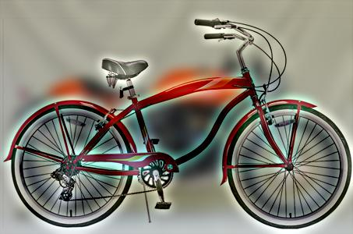
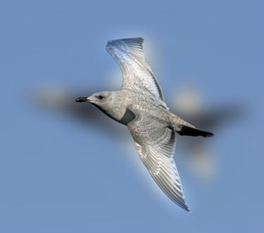
Part 1: Hybrid images
Motorcycle + Bicycle
<insert your hybrid image here>
Cutoff frequency: 7
Plane + Bird
<insert your hybrid image here>
Cutoff frequency: 12

Slide 7
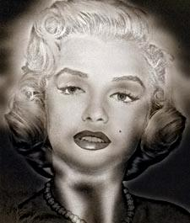
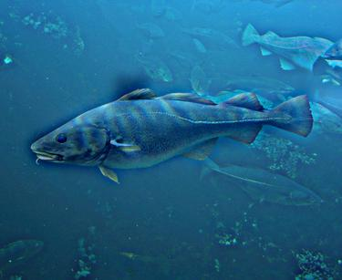
Part 1: Hybrid images
Einstein + Marilyn
Cutoff frequency: 4
Submarine + Fish
<insert your hybrid image here>
Cutoff frequency: 5

Slide 8
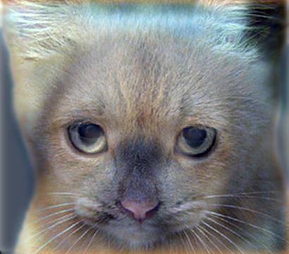
Part 2: Hybrid images with PyTorch
Cat + Dog
<insert your hybrid image here>
Motorcycle + Bicycle
<insert your hybrid image here>

Slide 9

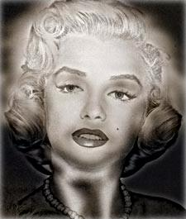
Part 2: Hybrid images with PyTorch
Plane + Bird
<insert your hybrid image here>
Einstein + Marilyn
<insert your hybrid image here>

Slide 10
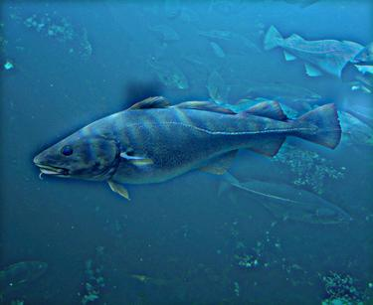
Part 2: Hybrid images with PyTorch
Submarine + Fish
<insert your hybrid image here>
Part 1 vs. Part 2
The runtime for Part 1 is 8.00 seconds and that for Part 2 is 2.23 seconds. Using pytorch to do the work is much more efficient.

Slide 11
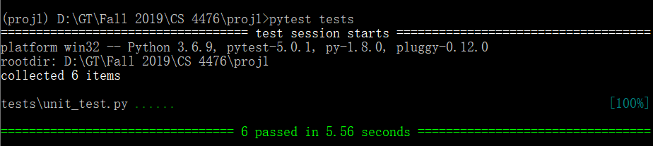
Tests
<Provide a screenshot of the results when you run `pytest tests` on your final code implementation (note: we will re-run these tests).>

Slide 12
Conclusions
The cutoff frequency influences that how clear the low frequency image is in the hybrid image. A good cutoff frequency depends on the extent of difference in the colors of the images in one pair and the image order chosen to do low/high frequency operations.
Also, by swapping the images in each pair, I found that the pairs with low cutoff frequencies for original hybrid images should take in high cutoff frequencies to get a good hybrid image after swapping images in the pair.
Furthermore, using Pytorch to do the work is much faster since Pytorch provides faster access to the array elements.

