Slide 1
CSCI 2400 Computer Systems
Data Lab Recitation
TA: Si Shen

Slide 2
Recitations, Office Hours, Email
Recitations
Friday 9:15-10:35 am, ECCR 105
get prepared for the lab assignments, exam etc.
If you have questions, please ask
Office hours
Thursday 4:00pm - 4:45 pm, ECES 116
Friday 11:00am - 11:45 am, ECES 116
Email
Si.Shen@colorado.edu
for short questions

Slide 3
Data Lab: Prerequisite
Prepare your working environment:
Virtual Machine with the “college version” Linux installed:
download links/instructions in https://foundation.cs.colorado.edu/vm/
Download and install a VM hypervisor
either VMware (follow https://foundation.cs.colorado.edu/vm/)
or VirtualBox (from https://www.virtualbox.org/ ) – a free software
Download “CU CS” version VM Linux image
Load the Linux image in the hypervisor
for VMware, follow the https://foundation.cs.colorado.edu/vm/
for VirtualBox, “file”-> “import appliance”, select the “ovf” file from the unzipped image.
Notes:
How many of you have already set up the Virtual Machine ?

Slide 4
Data Lab: Prerequisite
Tips about VM/Linux
set display resolution here: -> settings -> display
if “error” in VirtualBox, try VirtualBox: view -> “Scaled mode” first, then set display resolution. (Use right “CTRL”+C to return normal windowed mode)
open terminal by: -> terminal emulator
set terminal font size by: edit -> preferences -> appearance -> Font
Linux basics:
home directory (~): /home/user/ (“user” is your account name)
basic commands (used in terminal):
cp <src> <dest> (copy file <src> to <dest>); mv <src> <dest> (move/rename file <src> to <dest>)
cd <dir> (change directory to <dir> # cd .. (is “cd” to parent directory)
man <command>, or, <command> --help (show help/manual for <command>, e.g. man cp)
Google for more commands
Notes:
any question about virtual machine or linux?

Slide 5
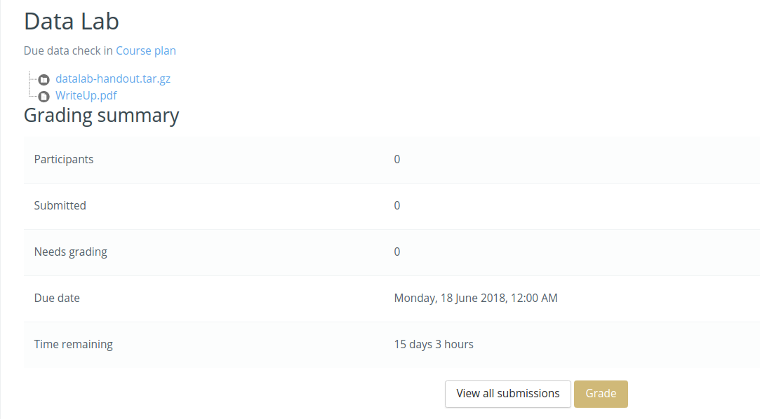
Data Lab
the directory where you write your code
We give 10 days because the lab is really hard.
Suggestions:
attend recitation
start early
description of the lab assignment, read first
Notes:
You can get .. from moodle. the datalab-handout file is a compressed file, in which you can find the file to write your code. And WRiteUp is a description file. You need to read it first. Note you have about 10 days to finish this lab. But

Slide 6
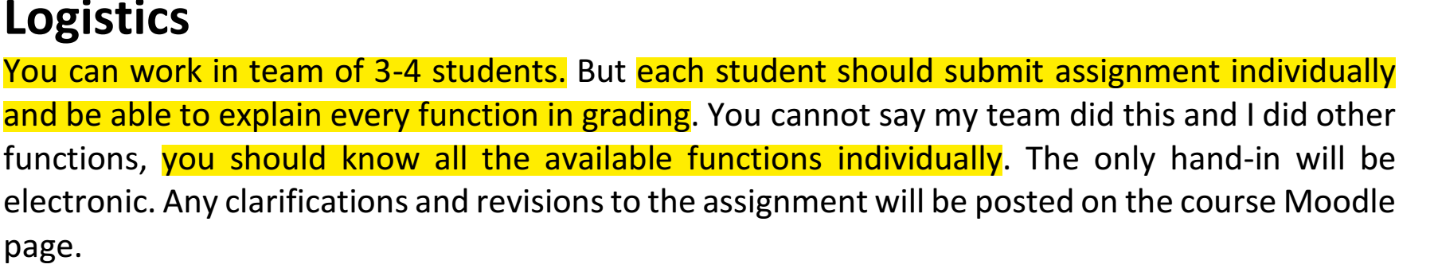
Data Lab: WriteUp.pdf
We will have individual interview grading.
Notes:
I will give you some highlights of the WriteUp.pdf here
just read – grading. We will have individual interview grading. So you can work in group, but you need to know all the functions individually.

Slide 7
Data Lab: WriteUp.pdf
Handout instructions:
copy “datalab-handout.tar.gz” to some directory and unpack it:
tar -xvf datalab-handout.tar.gz
inside “datalab-handout” directory:
bits.c: file to write your code, total 15 functions to implement
btest.c/btest: to test the correctness of your code
dlc: to test your code for compliance with “coding rules”
“rules” are documented in bits.c
read the “rules” in bits.c before start coding
demo
Notes:
after the slide, show demo of this directory , bits.c (no dlc, no coding here)

Slide 8
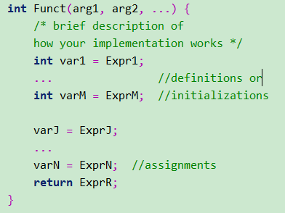
Data Lab: WriteUp.pdf
Coding rules highlights:
use only straightline code. No loops (while, for, goto … ), no conditions (if, else, switch,…).
no macros. (Macros are #include, #ifdef, …)
no additional functions
no function calls
no any form of casting (e.g. (unsigned) x)
no any data type other than int. (no unsigned, no float, no char, no array, no struct …)
no global variable
integer constants 0-255(0xFF). (no large/negative integer constants)
Follow “legal ops, max ops” requirements of every function.
Assumption: Uses 2s complement, 32-bit representations of integers.
Assumption: Performs right shifts >> arithmetically
write variable definitions / initializations before any assignment statements,
otherwise “dlc” test may fail
Notes:
after 1. This is a template. So typically, your function code may have variable definition statement, initialization statement, and assignment statement. Sometime DLC may be very strict, you must write assignment statements after the initialization/definition statements. If you write…

Slide 9
Data Lab: WriteUp.pdf
What you need to do:
read the instructions (ignore floating point part) in bits.c and implement 15 functions
run: ./dlc bits.c. (to test your code compliance with the rules)
- succeed if just 1 warning of “no includable file <command-line> …. /usr/include/stdc-predef.h”
- fix bugs otherwise
run: make btest (to compile the btest)
fix bugs if compilation failed
run: ./btest (to test code correctness)
show how many tests you passed/failed. Fix bugs.
submit bits.c to moodle
make sure write your full name in the beginning of bits.c
Note. if compilation error: “fatal error: sys/cdefs.h: No such file or directory”, try run:
sudo apt-get install libc6-dev-i386
demo

Slide 10
Data Lab: WriteUp.pdf
This lab is worth 100 points.
50% comes from your correctness running of code
must pass dlc, for btest:
full credit for a puzzle if it passes all tests
half credit if it fails one test
no credit otherwise
50% comes from your ability to explain the assignment
individual interview grading
you will be asked 5-6 of the puzzles, including puzzles from rank 1,2,3,4
Notes:
any question so far?

Slide 11
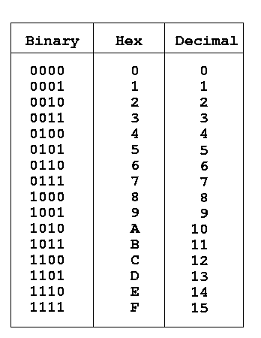
Data Lab: tips
Be careful of operator precedence
what’s the execution order of “~a+1+b*c<<3*2”?
I don’t know. I prefer use parentheses: (~a)+1+(b*(c<<3)*2)
some online tools
bitwise calculator: http://bitwisecmd.com/
hex/binary table
Notes:
any question?

Slide 12
Data Lab
I will give you guidance/hints for each of the questions
but not the solutions
you can also try on your own, some question may have multiple solutions
use dlc, btest to check your answer

Slide 13
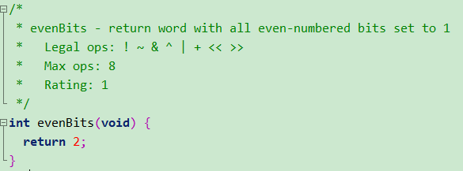
Data Lab: 1. EvenBits
Questions:
What is the integer that has all even-numbered bits set to 1?
But, we can’t use large integer constant…
How can we represent this larger integer with constants in [0,0xff] and bit operations ?

Slide 14
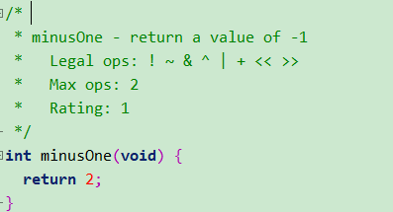
Data Lab: 2. MinusOne
Questions:
Note. We can’t use “return -1” because using negative constant is not allowed.
What’s the bit representation of -1 ?
How can we get that bit representation? (Note, max ops: 2)
* return/ assignment(=) are not accounted as “operator” (for “max ops”)

Slide 15
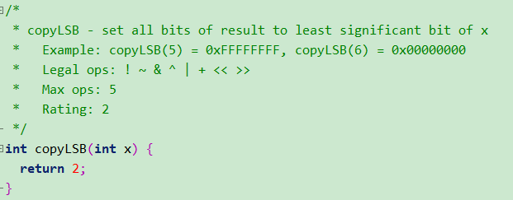
Data Lab: 3. CopyLSB
Questions:
What is Least Significant Bit? -- try example copyLSB(5), copyLSB(6)
hint: shift

Slide 16
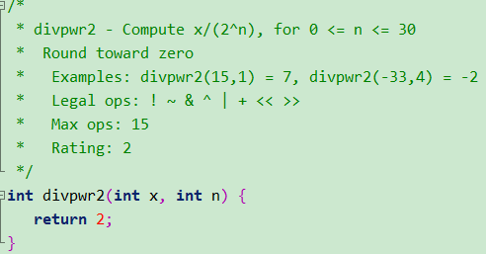
Data Lab: 4. Divpwr2
Hints:
x>>n gives x/(2^n), but round to –inf
solution: if x>=0, return x>>n; else return (x+2^n -1)>>n,
i.e. add a biasing item (2^n-1) if x<0, before right shift
Questions:
How to implement “if / else” by bit-operators?
hints: x>>31; 11111…1111₂ & a= a; 00000.0000₂ & a= 0 (for arbitrary a)
2. How to represent 2^n – 1 by bit-operations & non-negative integer?
Notes:
after 111 &a , 0000 &a,
try (x>>31) & (2^n-1)

Slide 17
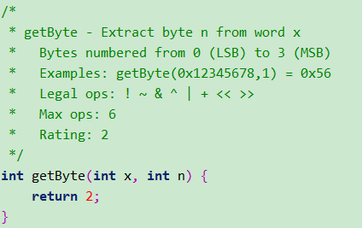
Data Lab: 5. GetByte
Hints:
One byte is 8 bits, or 2 hex digits
try example, (n=0, n=1, n=2, n=3)
Notes:
any idea, about write down 2 hints

Slide 18
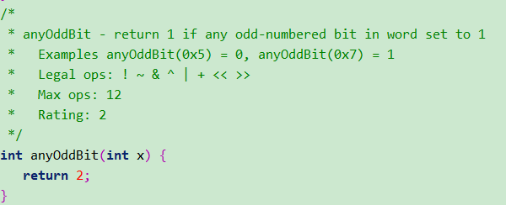
Data Lab: 6. AnyOddBit
Questions:
How to check if some specific bits are 1s?
How to convert non-zero to 1 and 0 to 0? (think of “!”)

Slide 19
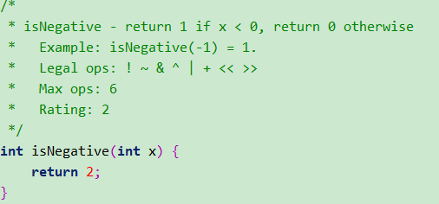
Data Lab: 7. isNegative
Hints:
1. return 1 if the signbit (31st bit) is 1. similar to question 6.

Slide 20
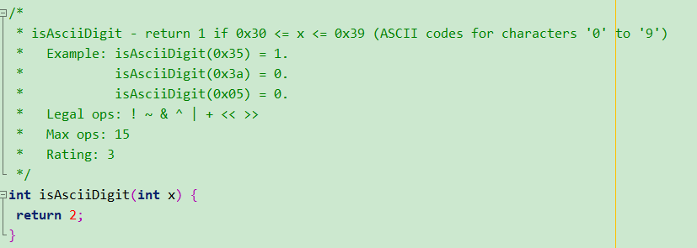
Data Lab: 8. isAsciiDigit
Hints:
“x is Ascii Digit” is same with “x-0x30>=0” & “x-0x40<0”
i.e. a=x-0x30, b=x-0x40, return 1 if a’s SignBit == 0 and b’s SignBit == 1,
or in other words, (SignBit of a^b) == 1
how to represent -0x30, -0x40:
remember we have: -x = ~x + 1 (if x > 0)
Notes:
in this case you need to test if x is in some range

Slide 21
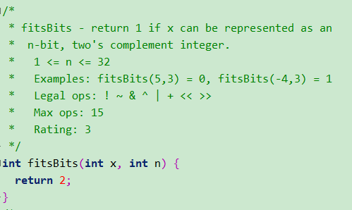
Data Lab: 9. fitsBits
Hints:
For example, what x can be represent by 3 bits (n==3)? –- x in range [-4, 3]
From observation of the example, we can conclude:
if x>=0, can be represented by 3 bits, its left 30 bits should all be 0
if x<0, can be represented by 3 bits, its left 30 bits should all be 1
in order words, x’s left 30 bits should all have same bit value with x’s Sign Bit
3. when testing for equality/difference, think about ^(xor).
Notes:
Note hint 1, explain it in detail, what number can be represent by 3bits, from 0 ->3, then -1 -> -4, then extend to 32 bits—because we actually use 32 bits to represent them here. positive extended by 0, negative extended by 1, right? Here we can observe, all the positive numbers (0-3), have their left 30 bits are 0s, right?, all negative numbers have their left 30 bits all 1s, right?
Let’s see other example, out of the range, 4. 5, -5, -6, we can see their left 30 bits are all 0s or all 1s any more.
So we can do this way here, we test he left

Slide 22
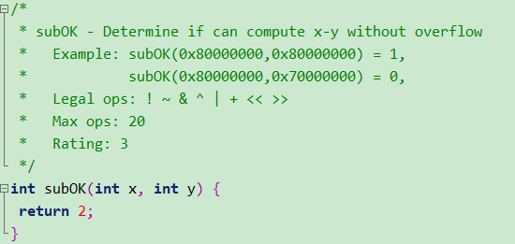
Data Lab: 10. subOK
Hints:
example of “minus operation overflow”.
– try 4bits int, 0111₂-1000₂
correct result (7 - -8=15) , but the result we get is 1111₂ (-1).
Overflow happens because the correct result need more than 4 bits to represent.

Slide 23
Data Lab: 10. subOK
Hints:
2. when x-y overflow may happen?
a. if x>=0, y>=0,
b. if x>=0, y<0,
c. if x<0, y>=0
d. if x<0, y<0,
if (x-y) <0, then overflow
if (x-y) >= 0, then overflow
Conclusion:
x-y overflow happens when 2 conditions hold:
1. x has a different sign bit with y
2. x-y has a different sign bit with x
Hints:
when testing for equality/difference, think about ^(xor)
when only testing some bit, think about &

Slide 24
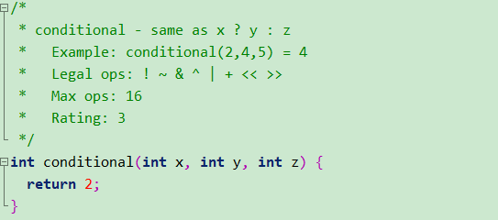
Data Lab: 11. conditional
Hints:
x?y:z, means, if (x /= 0), then return y, else, return z
how to test if x is non-zero (true) ?
how to implement the if/else here?
- hints: 1111…1111₂ & x = x, 000…00000₂& x = 0 , x | 0 = x , for arbitrary x

Slide 25
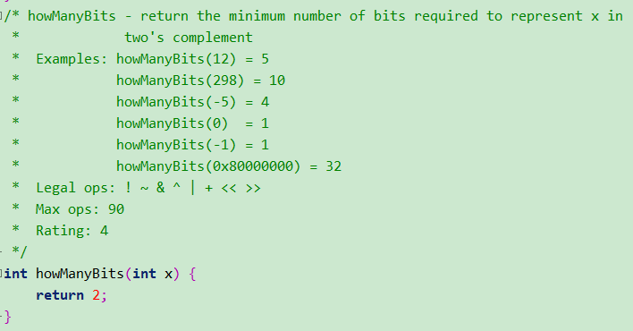
Data Lab: 12. HowManyBits
Hints: this question has relation with question 9 “fitBits”, but a more difficult one.
try example howManyBits(12), 4 bits for 12, 1 bit for sign, 32-4=28 leading bits are 0s
try example howManyBits(-5), 4 bits, 32-3 = 29 leading bits are 1s
flip (~) negative integers (~(-5)=4), you will get a zero or positive number, with same number of bits to represent
In summary, flip x if x is negative, then count the leading 0s, then add 1 (for sign bit)
* flip x is x is negative: y = x<0 ? ~x: x. (refer to the “conditional” question to implement it)
Notes:
12:1100, -5: 1011
after 1, what we can do here, we can count the number of leading 0s, here we have 28, then we use 32-28=4, 4+1(sign bit) =5, that is the number of bits we need to represent 12
similarly, we can see a negative value, -5

Slide 26
Data Lab: 12. HowManyBits
Hints:
4. How to count: binary search
--- find a position bar, so that its left are all 0s, and its right bit is 1. the result position is what we need
8bits integer example
n_bits=0 #the result bits number
function binsearch(left=7, right=0)
if(left == right) return left;
pos = (left+right)/2
if ([pos+1, left] ) ==0:
res=binsearch(pos, right)
else:
res=binsearch(left, pos+1)
return res
nbits = res+1
(note. x flipped if x<0)
0000 0101
pos = (!!( x>> 4 ))<<2; (here, pos = 0)
pos += (!! (x>> pos+2) ) << 1; (here, pos=2)
pos += (!! (x>> pos+1) ) << 0; (here, pos = 2)
pos += 1; (here, pos = 3)
nbits = pos + 1 (add sign bit, so nbits=4)
0000 0101
0000 0101
nbits = 3 +1=4
Note for corner case:
if x==0, nbits = 2, but only 1 bit is needed,
i.e. add biasing item = -1 if x==0
Summary: 3 steps (flip, binary search, corner case biasing)
Note. You need to implement your binary search for 32bits integer.
Notes:
after all of them, a summary. fir

Slide 27
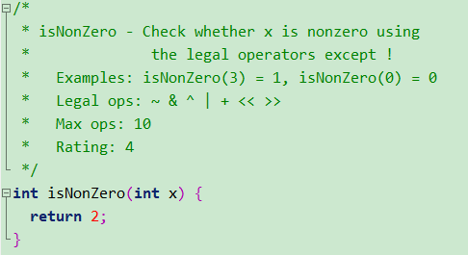
Data Lab: 13. isNoneZero
Hints:
note, we can’t use “!”
trick:
x is 0 if sign bits of x and –x are both 0
-x= ~x+1
think about why it is true (other cases, x>0, x<0, x==Tmin)
Notes:
It seems very easy. It just return 1 if x is non-zero, return 0 if x is 0
But the key part here, is we can’t use “!” (logical not)

Slide 28
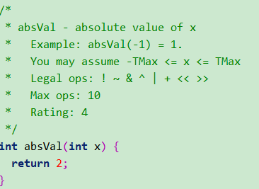
Data Lab: 14. absVal
hint:
absVal: x<0? –x : x. Refer to the “conditional” question.

Slide 29
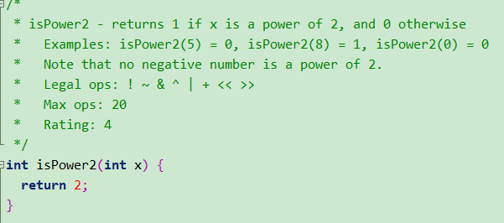
Data Lab: 15. isPower2
Hints:
try example, see their bit representations
x is a power of 2, if x has one 1 in its 0th – 30th bits, others are all 0.
try examples with x&(x-1)
Note. x >0

Slide 30
Some final tips
if you get stuck:
read the hints I give you
try some examples
try some operators if you don’t know which one to use
discuss with your teammates.
office hour:
Thursday 4:00pm - 4:45 pm, ECES 116
Friday 11:00am - 11:45 am, ECES 116
submit on or before due date!
I will release individual interview grading time slots on Moodle.
Get my slides: https://github.com/shensimeteor/CSCI2400_recitations

