Slide 1
SZMB hydro postproc+webpage
technique report
si shen
2017.11.14

Slide 2
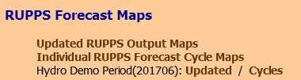
webpage:
http://10.153.105.129:8080/images/ens/GWRUPPS/
1 & 2 lines: Real-time;
3rd line: A Hydro case for demonstration
Notes:
As I showed last week, the webpage has 4 links, the first two lines are for real-time plots, and last line is quick link to the demonstration period.
As Gregory hasn’t come last week, so I will review the webpage very briefly.
Variable (hydro static, through hydro 2d, hydro timeseries), 4 domains, add new atmospheric plots, which are also requirements of the project

Slide 3
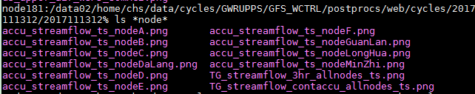
webpage, plots storage:
directories of plots: -- same place with atmos.
/data02/home/chs/data/cycles/GWRUPPS/GFS_WCTRL/postprocs/web/:
- cycles/<cycle_yyyymmddhh>/<valid_yyyymmddhh>/: individual cycles
- gifs/<valid_yyyymmddhh>/: updated figures
names of plots:
2dplots: name convention as <Dom>_<Var>.png
<Dom>: d4, d5, TG, GL
<Var>: RainRate, Evapor, Streamflow, SFCHEADSUBRT,
SOILM1, SoilMTotal(not shown on webpage)
Time Series:

Slide 4
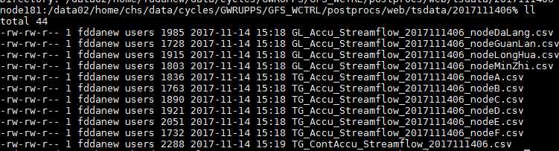
webpage, time-series data:
/data02/home/chs/data/cycles/GWRUPPS/GFS_WCTRL/postprocs/web/tsdata/<cycle_YYYYMMDDHH>/:

Slide 5
webpage, scripts
/data01/home/fdda/apache
For real-time:
/cgi-bin/model/ugui_png_mean_addHydroAtmos &
/cgi-bin/model/ugui_png_mean_cycview_addHydroAtmos
/htdocs/images/ens/GWRUPPS/GFS_WCTRL/js_file.addHydroAtmos
For demonstration case:
/cgi-bin/model/ugui_png_mean_addHydro &
/cgi-bin/model/ugui_png_mean_cycview_addHydro
/htdocs/images/ens/GWRUPPS/GFS_WCTRL/js_file.addHydro
For real-time cycles without hydro plots:
/cgi-bin/model/ugui_png_mean3_rupps
/htdocs/images/ens/GWRUPPS/GFS_WCTRL/js_file_qpe
Notes:
Here is the webpage scripts related with the Hydro part

Slide 6
Postprocessing
crontab: fddanew@node181 (Beijing Time Zone)
10 5,11,17,23 * * * setenv LANG en_US.UTF-8 && /data02/home/fddanew/data/GMODJOBS/GWRUPPS/hydro_postproc/rtfdda_hydro_postproc.pl -id GWRUPPS -m GFS_WCTRL -o 9 >& /data02/home/fddanew/data/GMODJOBS/GWRUPPS/hydro_postproc/log.run
( -o 9 change be substituted by –c <cycle, YYYYMMDDHH>)
Running time:
- 3:10 UTC (18Z cycle); 9:10 UTC (00Z)
- 15:10 UTC (06Z); 21:10 UTC (12Z)
Running nodes: most on node181, small on node30 (reason)
- node181: ~7 parallel tasks ( 20 minutes per cycle )
Notes:
Now we change to the postprocessing part.
Here is the crontab. The main script is rt*pl, and passing parameters is gmod id, member, hour offset

Slide 7
Postprocessing
HYDRO_ROOT: GMODJOBS/GWRUPPS/hydro_postproc/
cons/: constant files (channel node lonlat, google earth pngs)
data/: data file needed (Fulldom_hires_netcdf_file.nc, SZDistrictSurface.nc, geo_em.nc, 201710260500.CHRTOUT_DOMAIN1 )
ncl/: ncl files (used in real-time, compatible with NCL v5.2.1 )
ncl/non_realtime/: (not used in real-time, may not be compatible with NCL v5.2.1) e.g. static plots, streamflow w/o G.E., other TS plots
script/: shell script used in postprocessing, e.g.
run_plot_precp_SZMB_alldom.sh (every plot has a submitting script)
link_6hr_atmos_png_forcycle.sh (add 6 hour analysis dir for web)
convert_ps_to_png_vianode30.sh (do convert in node30)
etc.
rtfdda_hydro_postproc.pl: main script, will:
a. wait for WRF-hydro running finish
b. copy for hydro out files to /dev/shm
c. make plots by submitting script/run_plot*.sh parallelly
d. monitor all sub-scripts finish, then make a flag (so web/cycles add “H”)

Slide 8
Postprocessing
2d-plot | script | ncl | notes | input
RainRate | run_plot_precp_SZMB_alldom.sh | plot_precprate_Customize.ncl | Plot All doms (d4/d5/ TG/GL); convert, copy to WEB_DIR directly in NCL | Forcing/LDASIN
Evapor | run_plot_evapor_SZMB_alldom.sh | plot_evapor_Customize.ncl | Same with above | LDASOUT
SFCHEADSUBRT, SoilMTotal, SOILM1 | run_plot_tiles_SZMB_alldom.sh | run_plot_tiles_SZMB_alldom.sh | Same with above | RTOUT
Streamflow | plot_streamflow_Customize_forTrans_noLegend2.ncl | run_plot_streamflow_SZMB_{D4,SZ,TG,GL}.sh | Plot 4 doms separately. NCL generates ps. Convert to png, overlaying with Google Earth, copying to WEB_DIR are done afterwards. | CHRTOUT_DOMAIn1
Notes:
Streamflow: the NCL is a liitle different, because it will generate ps not png (because it’s very slow to directly generate png on SZMB machine)

Slide 9
Postprocessing
TS-plot | script | ncl | Notes | 数据
accu_streamflow_ts_node<XX>.png | run_plot_TimeSeries_SZMB.sh | plot_nodes_accu_streamflow_ts.ncl | Plot hours accumulated streamflow Time-Series on specified channel nodes (<XX>). (for TG, 6 nodes; for GL, 4 nodes) | CHRTOUT_DOMAIn1
TG_streamflow_3hr_allnodes_ts.png | run_plot_TimeSeries_SZMB.sh | plot_TGfixed_streamflow_accu.ncl | For TG. Plot 3hr accumulated streamflow Time-Series of 6 nodes and a SumIn in one plot. | CHRTOUT_DOMAIn1
TG_streamflow_contaccu_allnodes_ts.png | run_plot_TimeSeries_SZMB.sh | plot_TGfixed_streamflow_contaccu.ncl | Similar with above, but plot the continuous accumulated streamflow (accumulation start with 0) | CHRTOUT_DOMAIn1

Slide 10
How to add new domain (2d-plot)? -- using example of creating TG domain based on GL domain
Step1
Modify script/run_plot*.sh to add/modify a domain segment (not for streamflow plots)
e.g. (in script/run_plot_precp_SZMB_alldom.sh)
cmd="ncl 'srcfilename=\"*.LDASIN_DOMAIN1\"' 'dom_name=\"TG\"' 'lonlat_list=\"113.843,113.936,22.595,22.7\"' 'add_chan_border=\"TGchan\"' 'copydir_list=\"$webdir/cycles/$cycle,$webdir/gifs\"' plot_precprate_Customize.ncl >& log.plot"
- dom_name=<dom_name> ; Lonlat_list=“lon1,lon2,lat1,lat2”
- will generate RainRate_<dom_name>_valid_at_<YYYYMMDDHH>.png
and copied to WEB_DIR as <YYYYMMDDHH>/<dom_name>_RainRate.png
- After Step1, you get a plot in the specified domain, but with no channel node markers.
Notes:
Now I will show you how to add a new domain or modify a domain.
Here we take the example for creating TG domain based on GL domain. Assume we have GL domain, but not TG domain

Slide 11
How to add new domain (2d-plot)? -- using example of creating TG domain based on GL domain
Step2: if you want add channel node markers
-- not for streamflow plots
Prepare the channel node lonlats (refer to cons/GL_channode_lonlat.txt for format), e.g., create:
cons/TG_channode_lonlat.txt
in NCL/plot*ncl, modify codes related with the variable: "add_chan_border“ i.e. add a if statement, and add a function similar with add_node_marker_GL(wks, plot)
In script script/run_plot*sh, modify the “add_chan_border” parameter for NCL, and link the cons/TG_channode_lonlat.txt
After Step2, you have finished all 2d-plots except streamflow
Notes:
If you want add the channel node markers, you need to do step2. Also, this is not for streamflow plots
First, you need to prepare the channel nodes lon-lat data, so that NCL can read the file. You can refer to .., and create this */TG_channode_lonlat.txt
Then, you need to modify the ncl file. The parameter “add_chan_border” is related with the channel nodes plotting, so you than modify that. It includes a if statement, and a function named as add_node_marker_GL
After that, you need to goto the script file, and modify the pass value of “add_chan_border”

Slide 12
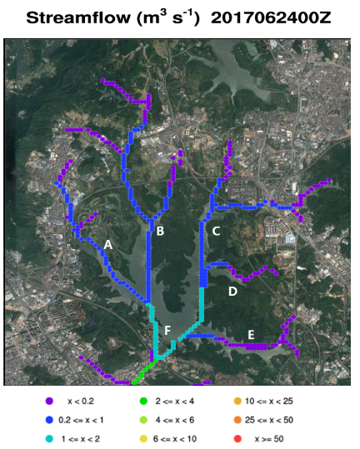
How to add new domain (2d-plot)? -- using example of creating TG domain based on GL domain
Step3: for streamflow plots -- overview
A. Generate NCL plots, and make its background transparent
B. Get Google Earth background, & cut/resize it to same domain area
C. Get pixel coordinates of NCL plot – so that we know where to cut & match G.E. background
D. append a white space on G.E. background in head (for NCL plot title)
E. prepare the legends
F. After A-E are done, modify the script.
The script process works as:
Run NCL to generate plots, convert ps->png
Cut/resize plots (with title) & Overlay with G.E. background (with white space in head)
Append the legends in bottom

Slide 13
How to add new domain (2d-plot)? -- using example of creating TG domain based on GL domain
Step3: for streamflow plots – step(a)
run ncl to generate streamflow plot with transparent background
Run plot_streamflow_Customize_forTrans_noLegend2.ncl (refer to script/run_plot_streamflow_SZMB_GL.sh, but with domain definition for the new domain TG) for an arbitrary CHRTOUT_DOMAIN1 file to generate the bare streamflow plot (rename it as fig.ps), and convert/make it transparent by command:
/data02/home/fddanew/data/GMODJOBS/GWRUPPS/hydro_postproc/script/convert_ps_to_png_vianode30.sh fig.ps #convert to fig.png
convert +repage -transparent "rgb(255,255,255)“ fig.png trans.png

Slide 14
How to add new domain (2d-plot)?
Step3: for streamflow plots (b)
get the Google Earth map and cut/resize it to match the domain
Screenshot Google Earth Background with a bit larger domain (ge.png). Compare it with trans.png and do the cut/resize for ge.png so that they have exactly same domain, save it for new_ge.png.
I usually do it in PPT, and use the KML channel file for reference
for large domain, use Google Map instead of Google Earth because Google Map projection matches NCL plots better

Slide 15
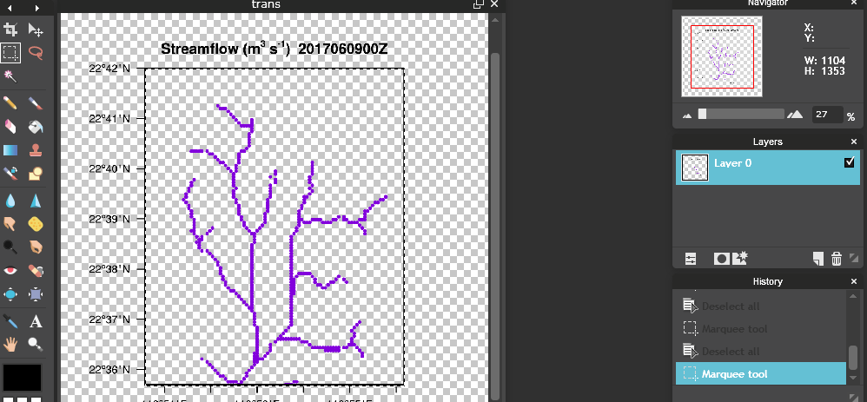
How to add new domain (2d-plot)?
Step3: for streamflow plots (c)
get the pixel coordinates of the box in NCL plots
Upload trans.png to: http://www.onlinephotoshopfree.net/
get the X,Y of the left-top corner of “box”, and the W,H of the “box”, e.g. for TG area, X=570,Y=450,W=1100,H=1350
we also need to measure dH (H for title) = 130, thus the figure with title is X=570, Y=320, W=1100, H=1480

Slide 16

How to add new domain (2d-plot)?
Step3: for streamflow plots (d)
append the new_ge.png with white head (background for title)
In trans.png, the title H=130, while the box H=1350. In new_ge.png, we get has its W=695, H=694 (by run: identify new_ge.png)
Thus, we calculate the height = 130/1350 * 694= 67. So we append the new_ge.png with a 695 x 67 sized white space on head: convert -size 695x67 xc:white white.png
convert –append white.png new_ge.png TGbg_withWhilteHead.png
After that, TGbg_withWhilteHead.png has size of 695x761

Slide 17
How to add new domain (2d-plot)?
Step3: for streamflow plots (e)
prepare the legends
I prepared legend for D4(i.e. d4), SZ(i.e. d5), GL. D4/SZ has maximal value of 100 (m3/s), while GL has maximal value of 50 (m3/s) – different scale.
Select the scale you use, and resize it to match TGbg_withWhilteHead.png .
e.g.
cp /data02/home/fddanew/data/GMODJOBS/GWRUPPS/hydro_postproc/ cons/pngs/GL/legend_max50_GL.png max50_legend_TG.png
convert –resize 695x137 max50_legend.png legend_max50_TG.png
(695 is W of TGbg_withWhiteHead.png, 137 is H you want legend has)
- If existing legends don’t match your requirement, you need to generate it yourself

Slide 18
How to add new domain (2d-plot)?
Step3: for streamflow plots (f)
finally,
- cp TGbg_withWhilteHead.png /data02/home/fddanew/data/GMODJOBS/GWRUPPS/hydro_postproc/cons/pngs/TG/background.png
- cp legend_max50_TG.png /data02/home/fddanew/data/GMODJOBS/GWRUPPS/hydro_postproc/cons/pngs/TG/legend.png
- in data02/home/fddanew/data/GMODJOBS/GWRUPPS/hydro_postproc/script/,
cp run_plot_streamflow_SZMB_GL.sh run_plot_streamflow_SZMB_TG.sh
- modify run_plot_streamflow_SZMB_TG.sh, including:
domain name (GL->TG), NCL parameters, convert * -crop 1100x1480+570+320 –resize 695x761
- Modify rtfdda_hydro_postproc.pl to include run_plot_streamflow_SZMB_TG.sh

Slide 19
How to add time-series plots for new domain?
For accu_streamflow_ts_node<XX>.png.
- cp a new segment in script/run_plot_TimeSeries_SZMB.sh.
- modify NCL parameters:
cmd="ncl plot_nodes_accu_streamflow_ts.ncl 'nodes_idx_list=\"17751,18024,18286,16975,15568,14986\"' 'accu_hour_list=\"1,3,6,12,24\"' 'color_list=\"blue,cyan,green,orange,red\"' 'file_pattern=\"*.CHRTOUT_DOMAIN1\"' 'nodes_name_list=\"A,B,C,D,E,F\"' 'start_date10=\"$date_start\"' 'end_date10=\"$date_end\"' 'copydir_list=\"$webdir/cycles/$cycle,$webdir/gifs\"' 'ymax=1000' 'cycle_date10=\"$cycle\"' $tspara "
nodes_idx_list: channel node index (minus 1) list (refer to KML file)
nodes_name_list: channel node node (<XX>)
ymax: trYMaxF (max Y-axis value)

Slide 20
How to add time-series plots for new domain?
For TG_streamflow_3hr_allnodes_ts.png &
TG_streamflow_contaccu_allnodes_ts.png
Copy & modify the NCL (related with the nodes, line color, png names etc.)

Slide 21
How to add static plot for new domain?
In /data02/home/fddanew/data/GMODJOBS/GWRUPPS/hydro_postproc/ncl/non_realtime/static/,
use plot_hires_terrain_chan.ncl , according to run_ncl.sh
ncl plot_hires_terrain_chan.ncl 'srcfilename="Fulldom_hires_netcdf_file.nc"' 'chanfilename="201705310000.CHRTOUT_DOMAIN1"' 'lonlat_list="113.955,114.113,22.577,22.740"' 'dom_name="GL"' 'nodeidx_file="nodeidx_GuanLan.txt"'
- nodeidx_file: the channel node index (minus 1) file (refer to cons/nodeidx_GuanLan.txt). If not given, any channel node inside the domain will be plotted; else, only plot the channel node specified in file.

Slide 22
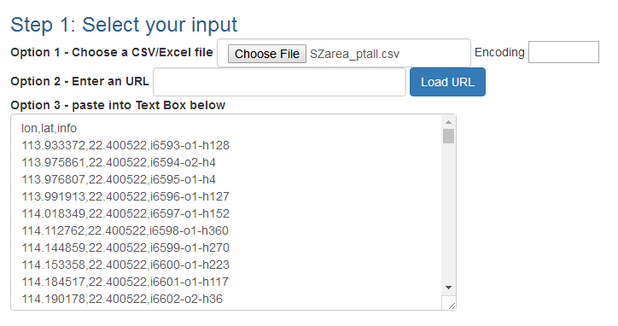
Generating KML file
http://convertcsv.com/csv-to-kml.htm
Prepare the csv file (containing lon,lat,info) in the domain you want
Upload to website

Slide 23
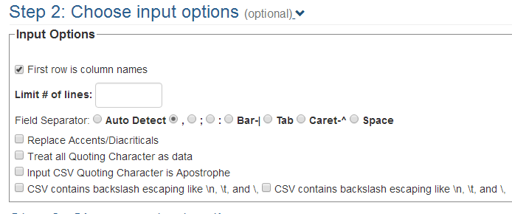
Generating KML file

Slide 24
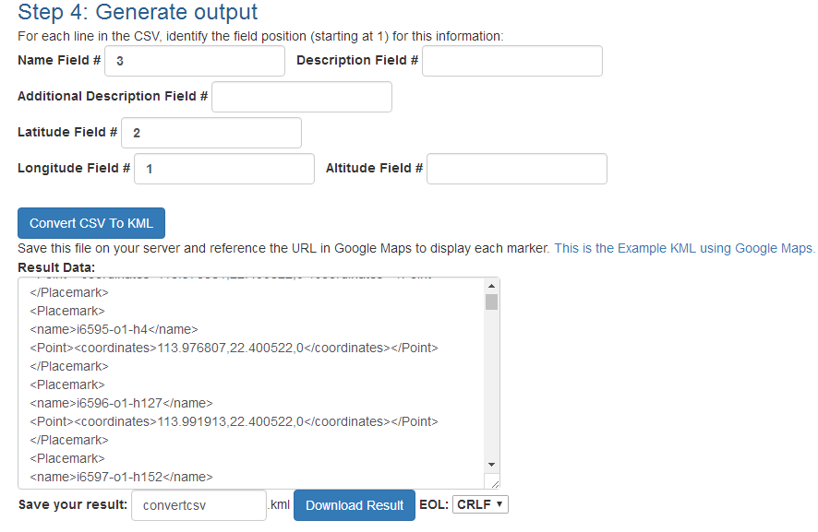
Generating KML file

Slide 25
Appendix

Slide 26
Why run on node181/node30
Running on: node181 / node30 (sharing node)
First run on node81/node86, but NCL will not generate RANGS or Titles/Labels without printing out any error information.
So I change to run it on node181, no problem for node181!
for streamflow:
a. if NCL directly output png format, it is unacceptably slow on SZMB (maybe due to old version of Linux/NCL)
b. if NCL output ps format (must faster than png), then but convert (ps->png) fails on most nodes, except node30 (node30 is SUSE 11, while other nodes are SUSE10)
So, recommend to run on node181 + node30
to convert streamflow ps->png, use script/ convert_ps_to_png_vianode30.sh
return

Slide 27
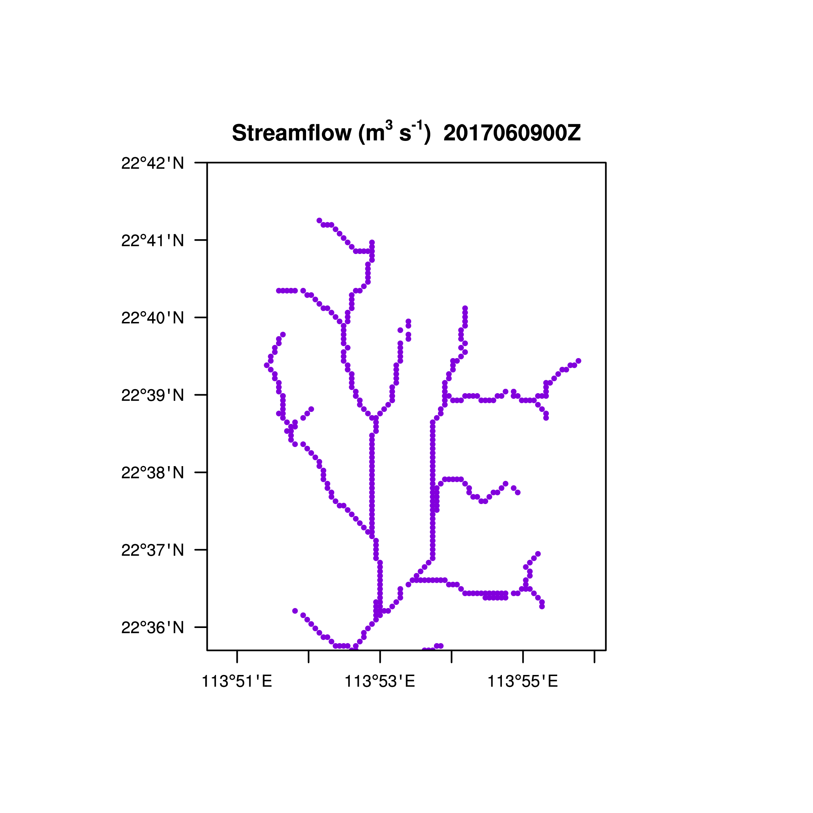
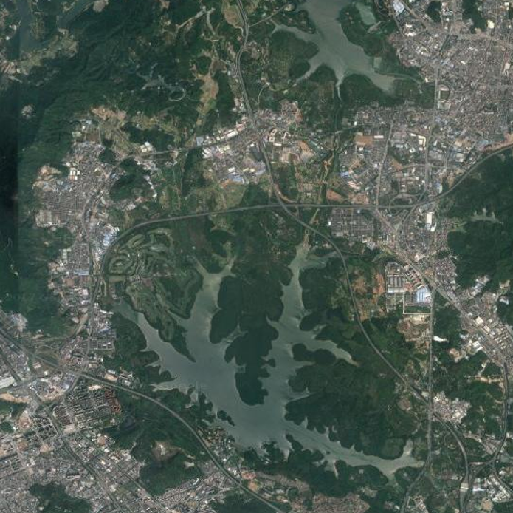
Matching ge.png + trans.png (return)

