Slide 1
Contrastive Learning on the Solubility Classification Task
2021-01-14
Shen Wan Xiang

Slide 2
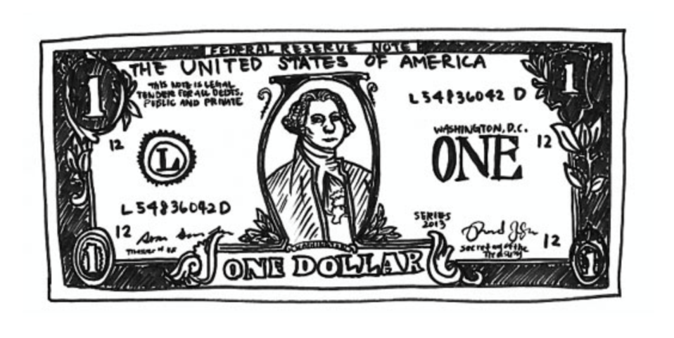
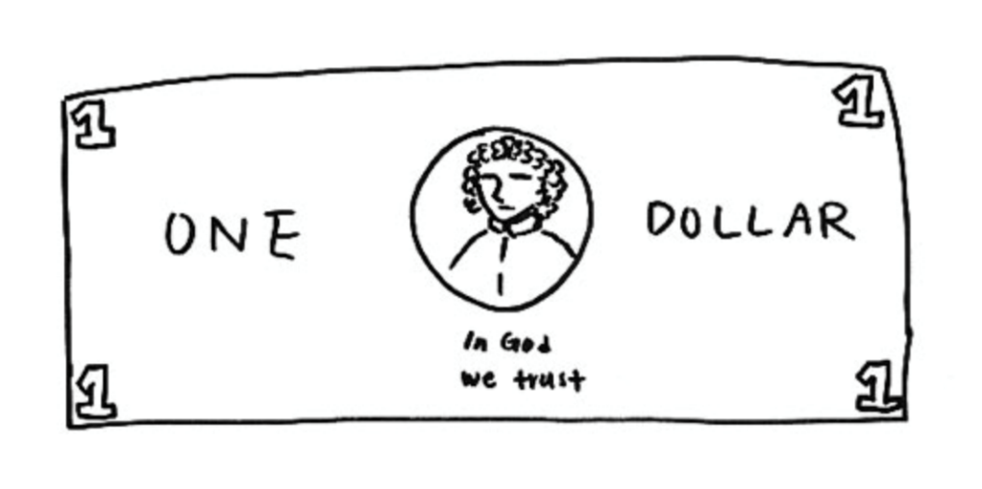
Key features matters
Contrastive learning:
What we look
What we remember
Left: Drawing subsequently made with a dollar bill present. Right: Drawing of a dollar bill from memory. Image source: Epstein, 2016
Our brain can not member every details of a dollar, but we can recognize the dollar

Slide 3
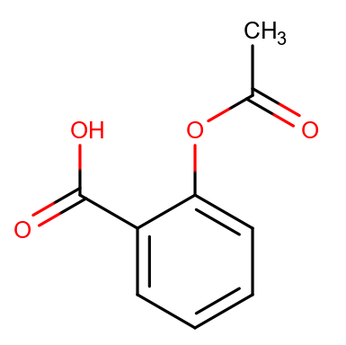
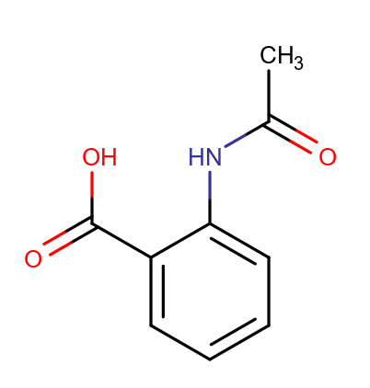
Representation the distance of compounds
Fingerprint: 2048 bits ECFP-liked fingerprint, MAP4, etc, too general
Key-features: pharmacophore fingerprint, core and fragment fingerprint(CFFP), data-specific, manual craft
Key-features : the two are quite different !
Fingerprint: the two are almost same !
Why not learn the distance directly from the compounds?
Using the self-supervised learning directly learn the distance for the given task!

Slide 4
Learning the distance with Contrastive Learning
H2
H3
Triplet-1
…
Triplet-n
M5
H1
H4
H5
L4
H4
activity cliff
H7
H6
L3
L2
M1
H7
H1
anchor
H1
anchor
High solubility, n = 7
L1
M6
M8
H1
H6
H2
H5
L4
positive
positive
Low solubility, n = 4
M7
H5
H5
M2
M3
M3
M9
L3
H3
M2
negative
negative
M1
M4
M5
L2
M1
L2
M6
M7
M8
L1
M9
M4
Moderate solubility, n = 9
1) Input Chemspace:
Similarity Tree Map
2) Contrastive learning model input: triplets
3. Final output: latent space

Slide 5
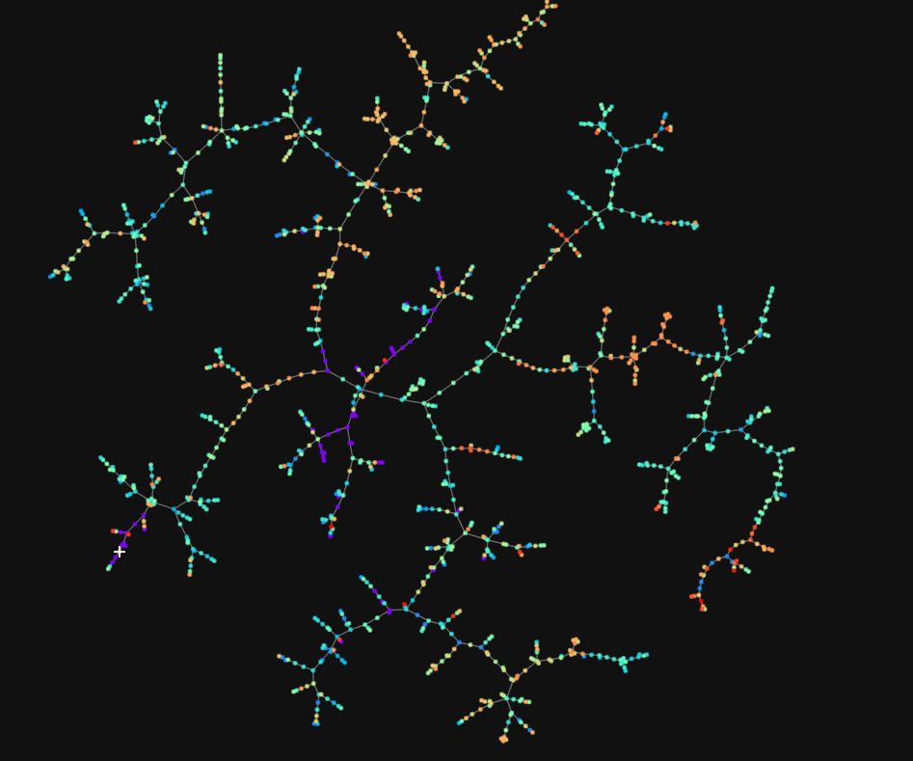
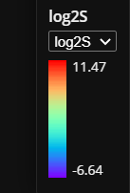
1) Input Chemspace: Similarity Tree Map of ETC compounds
Solubility level

Slide 6
2) Sampling the triplets and training
Hard samples:
Two compounds are very similar to each other, but the solubility values are quite different
Two compounds
Compounds representation:
Input as the general fingerprint: compression learning
Input as a Graph(nodes, bonds feature): end 2 end distance learning

Slide 7
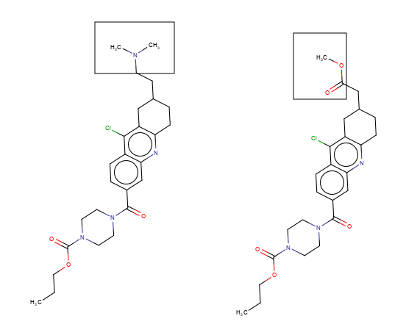
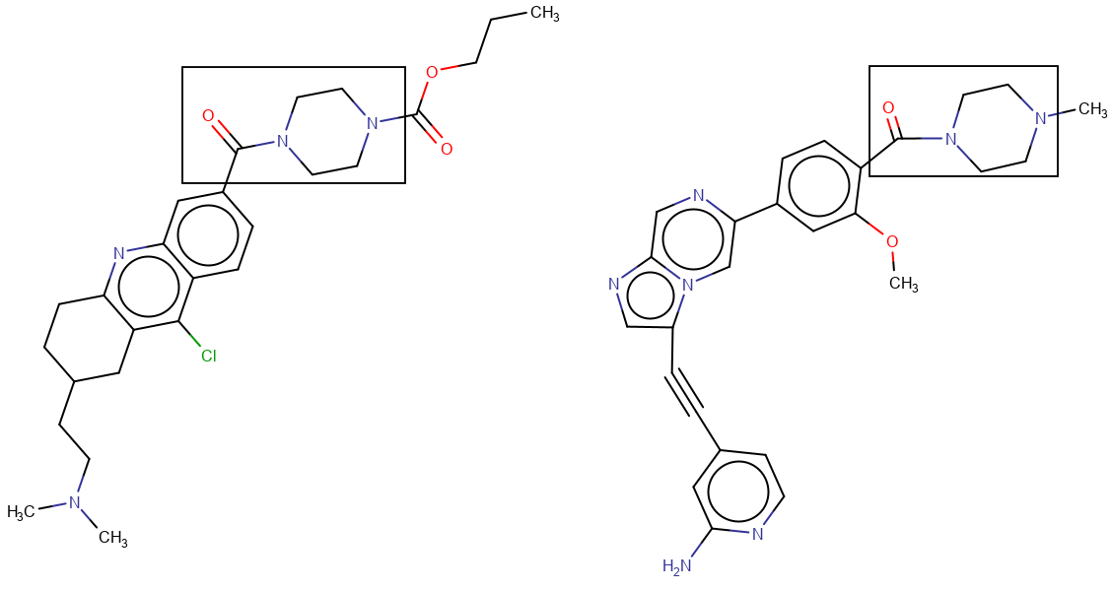
Hard Sample Examples (for high solubility ETC compounds)
Contrastive differences
Contrastive similarities
High soluble
High soluble
High soluble
Low soluble
Hard sample: very similar but solubility is very different
Hard sample: very unsimilar but solubility is very different

Slide 8
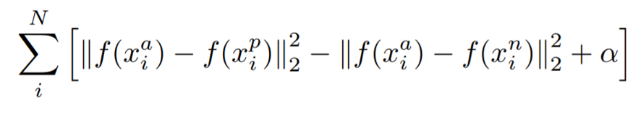
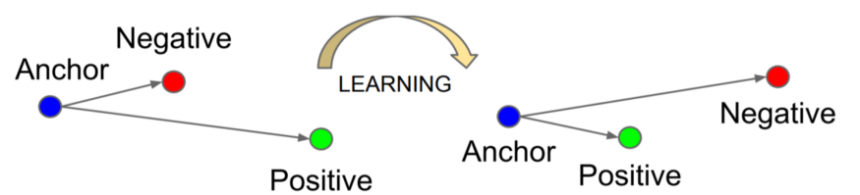
Contrastive learning training
Inputs
Triplet Loss
Triplet
H1
Anchor: high solubility
Maximizing the distance between anchor and negative
Minimizing the distance between anchor and positive
H5
Positive: : high solubility
L2
Negative: : low/moderate solubility

Slide 9
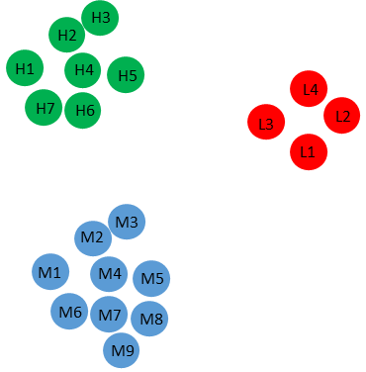
Purposed Contrastive Modelling
Anchor
Distance based on the vectors
Triplet loss
Positive
New Similarity distribution
Negative
Graph Convolutional Net
Latent vectors: 128 or 512 bits
Triplet

Slide 10
3. Final output: latent space
The proposed comparative learning model is equivalent to a feature extractor
Given a test compound, using the model to calculate the 128 or 512 bits latent vectors
Calculate the distance based on the vectors with the low, high and moderate groups, and judge the compound which class should be

