Slide 1
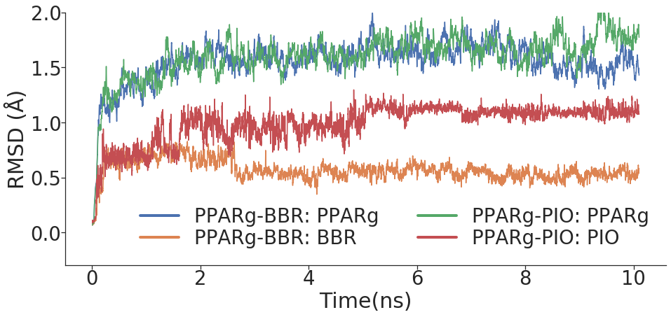
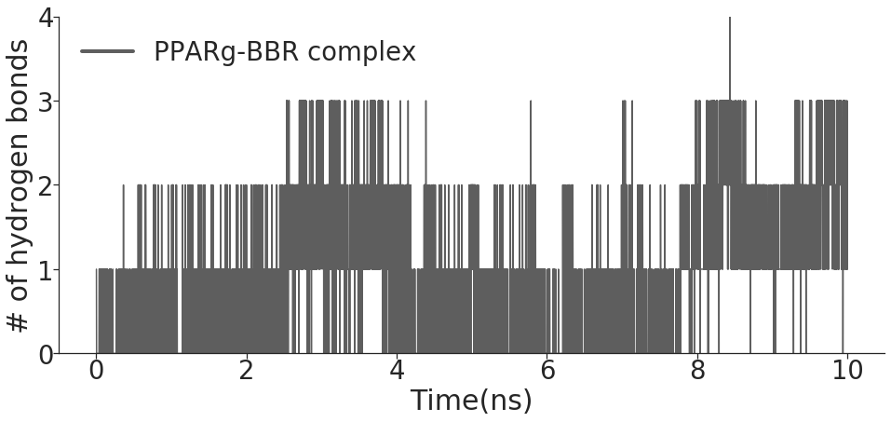
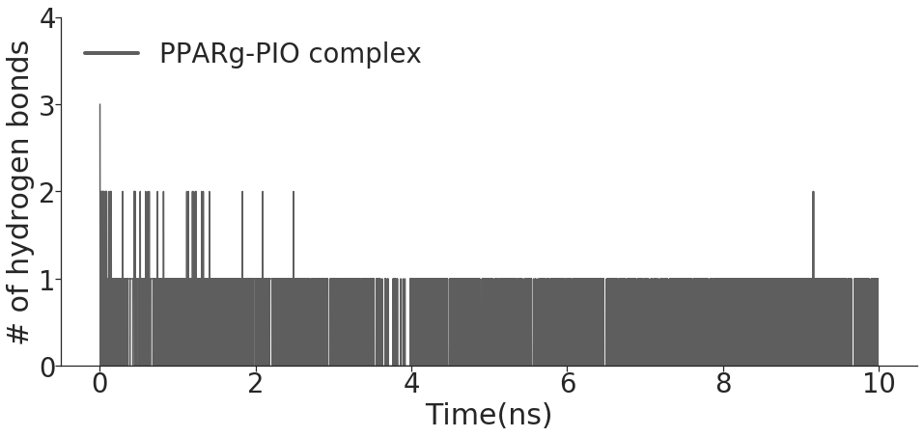
A
D
E
Met329
Glu343
Leu228
Leu228
Pro227
Ala292
Leu333
3.18
Arg288
3.29
Arg288
Leu330
Phe226
Ile341
Ile326
Cys285
B
Cys285
Hie449
3.13
Phe363
Lys367
C

Slide 2
D
E
Met329
Glu343
Leu228
Leu228
Pro227
Ala292
Leu333
3.18
Arg288
3.29
Arg288
Leu330
Phe226
Ile341
Ile326
Cys285
Cys285
Hie449
3.13
Phe363
Lys367

Slide 3
F
G
Val339
Met348
Ile341
Ile341
Cys285
Gly284
Cys285
Gly284
Leu330
Ser289
3.12
Gln286
2.97
3.02
Tyr327
Hie449
Phe363
3.22
Tyr473
Tyr473

Slide 4
Hydrogen Bond Interaction | Frames | Fraction | Avg. Distance (Å)
ARG288-BBR | 5456 | 54.56% | 3.14
LYS367-BBR | 3962 | 39.62% | 3.09
GLU343-BBR | 2255 | 22.55% | 3.2
TYR473-PIO | 4411 | 44.11% | 3.15
SER289-PIO | 69 | 0.069% | 2.93
Gln286-PIO | 34 | 0.034% | 3.2

Slide 5
